Slide 1
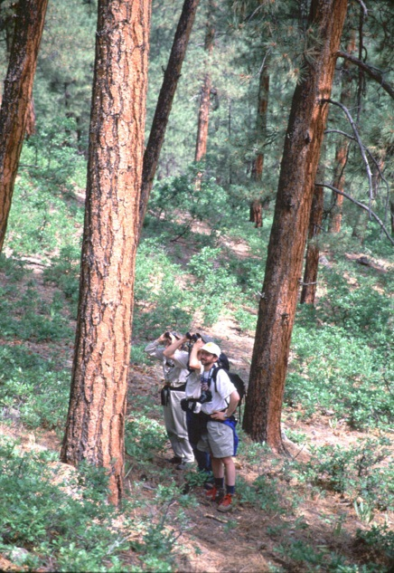
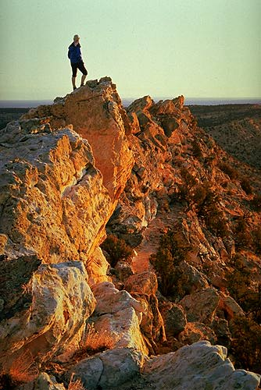
Collaboration: legal context and sideboards
Presented by
Mike Anderson The Wilderness Society

Slide 2
What is collaboration?
Co-labor: Working together
(Webster’s second definition: Assisting the enemy!)
2012 Forest Planning Rule definition:
People with diverse interests
Sharing knowledge, ideas, & resources
Working together toward common purpose
Notes:
Conflict resolution + public participation
Potent advocate for restoration – formula for political and financial support and success

Slide 3
Legal evolution
Secure Rural Schools Act (2000)
Title II - Resource Advisory Committees
Title VI – Community Forest Restoration Program, New Mexico
Healthy Forest Restoration Act (2004)
E.O. on Cooperative Conservation (2004)
Forest Landscape Restoration Act (2009)
Forest Planning Rule (2012)
Farm Bill Forestry Title (2014)

Slide 4
Legal Authorities and MANDATES
Special Funding
Secure Rural Schools Act
Forest Landscape Restoration Act
NEPA Streamlining
Healthy Forest Restoration Act
2014 Farm Bill, Forestry Title
National Forest Planning
E.O. on Cooperative Conservation

Slide 5
SPECIAL Funding - SRS
Resource Advisory Committees (Title II)
FACA chartered
Formal structure with defined interest groups: environmental, industry, government
Community Forest Restoration Program, New Mexico (Title VI)
“include a diverse and balanced group of stakeholders as well as appropriate Federal, Tribal, State, County, and Municipal government representatives in the design, implementation, and monitoring of the project”

Slide 6
Special funding – FLRA/CFLRP
Forest Landscape Restoration Act
“… developed and implemented through a collaborative process…”
Representing diverse interests
Transparent and nonexclusive, or consistent with SRS Title II RACs.

Slide 7
Nepa STREAMLINING - HFRA
Healthy Forest Restoration Act, Hazardous Fuels Reduction
Sec. 104(f) - Public Collaboration “… shall facilitate collaboration among State and local governments and Indian tribes, and participation of interested persons …”

Slide 8
NEPA Streamlining
2014 Agriculture Act, Forestry Title
Sec. 603(b) - Collaborative Restoration Project “… developed and implemented through a collaborative process…”
Representing diverse interests
Transparent and nonexclusive, or consistent with SRS Title II RACs.
(same as FLRA/CFLRP)

Slide 9
Forest PLANNING
2012 Planning Rule
use collaborative processes “where feasible and appropriate.”
Council on Environmental Quality - spectrum of public engagement in NEPA
National Advisory Committee

Slide 10
National Advisory committee

Slide 11
sideboards
All federal laws still apply.
Projects must be consistent with forest plan
Forest Service retains decision-making authority.
diverse, balanced, transparent, non-exclusive
Federal Advisory Committee Act?

Slide 12
Federal Advisory Committee Act
“Established or Utilized”?
Utilize = Manage or Control (e.g. members, agenda, funding, meeting place)
If so, group cannot give collective advice unless chartered
Careful not to seek consensus
If not, group can give advice – no charter needed. Relax!

