Slide 1
North Shore Restoration Project
A Collaborative, Adaptive Effort

Slide 2
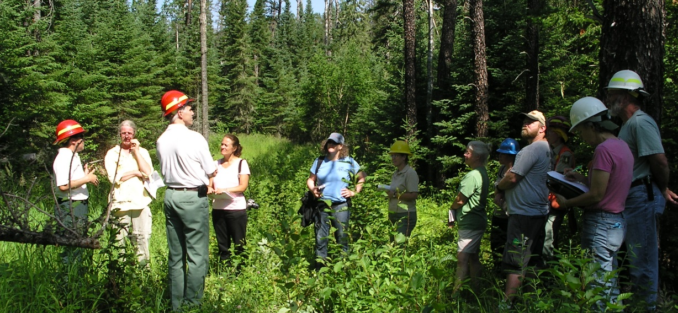
Challenges and Strategies
•Collaboration across Public and Private lands
•Adaptive Management
•Framework for Climate Change Adaptation

Slide 3
Why Here, Why Now?
Desired Condition
Existing Condition

Slide 4
How do we address landscape level problems?
Ownership | Acres | Percentage
Private | 105,588 | 39
USA | 48,175 | 18
State | 48,358 | 18
Tribal | 30,369 | 11
Lake County | 30,294 | 11

Slide 5
How do we increase capacity for restoration?
Adaptive Management Process

Slide 6
How do we incorporate climate change?
Adaptation Framework
1. DEFINE area of interest, management objectives, etc.
5. MONITOR and evaluate effectiveness.
2. ASSESS climate change impacts and vulnerabilities.
4. IDENTIFY and implement adaptation approaches.
3. EVALUATE management objectives given climate impacts.
Swanston and Janowiak 2012; www.nrs.fs.fed.us/pubs/40543

Slide 7
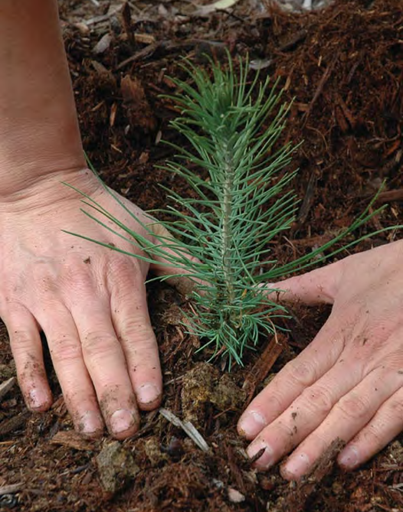
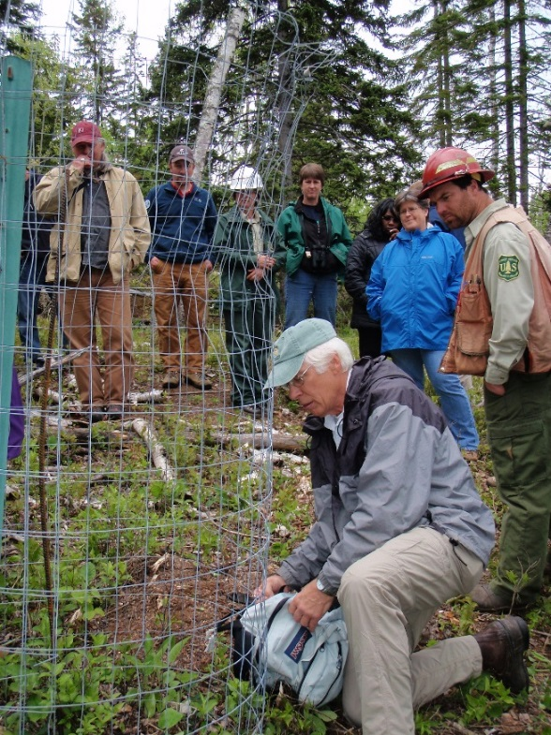
Summary
•

Slide 8
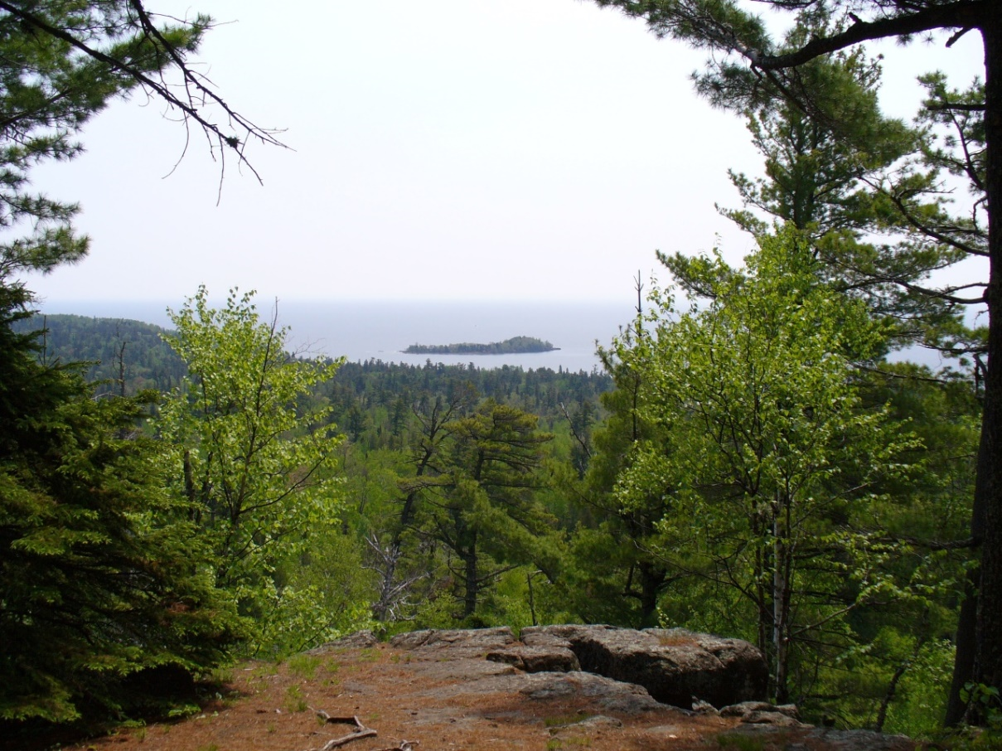
Questions?

