Slide 1
FSVeg Spatial Data Analyzer
Imputation, Climate, and More
Collaborative Restoration Workshop
Denver, CO - April 2016

Slide 2
What is FSVeg Spatial Data Analyzer?
GIS analysis tool: Helps users understand vegetation data through the use of the Forest Vegetation Simulator (FVS) and landscape analysis.
Integrates Analysis: Uses Forest Service corporate data, growth models, other models and GIS mapping functions.
Workflow: Creates a structured environment for efficient workflow.

Slide 3
What does it do?
Extract and store corporate data in a project directory.
Simulate growth with FVS.
Spatially apply FVS addfiles.
Treat, analyze and compare alternatives.
Spatially visualize FVS output.
Utilize climate data in the FVS growth model.
Create a fully populated landscape (yaImpute).

Slide 4
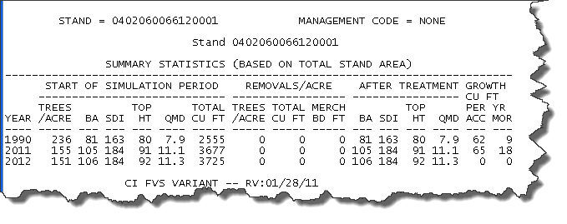
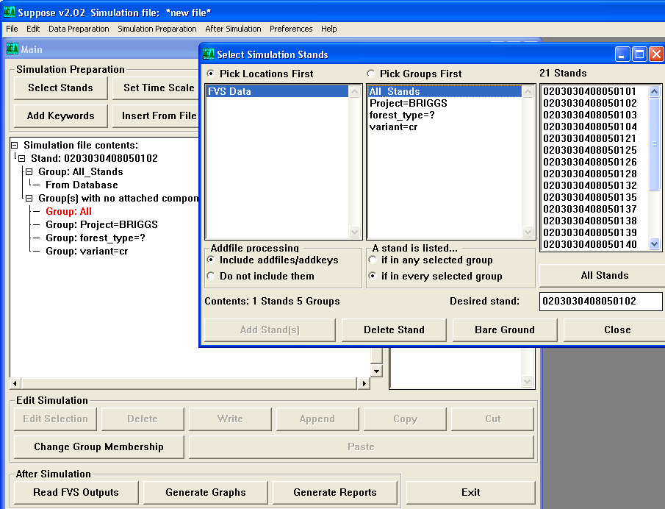
Simulate Growth Uses the Forest Vegetation Simulator (FVS)
Grows data from inventory year to project implementation year and models future growth in 5 or 10 year increments.

Slide 5
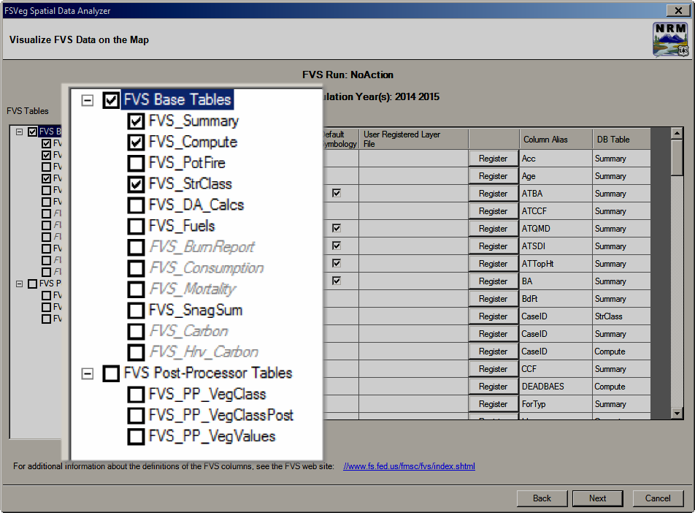
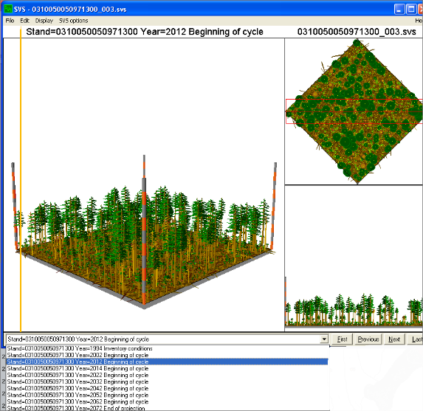
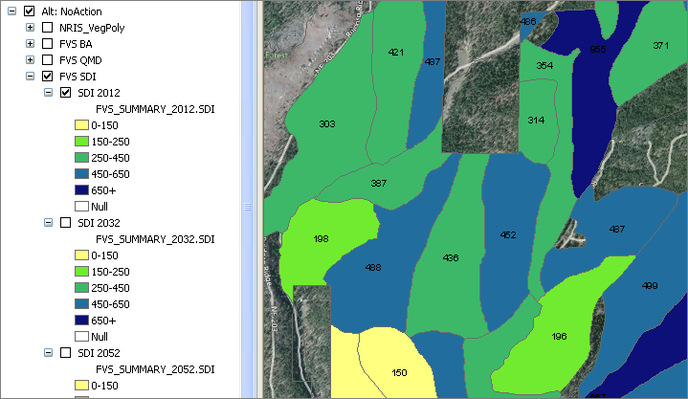
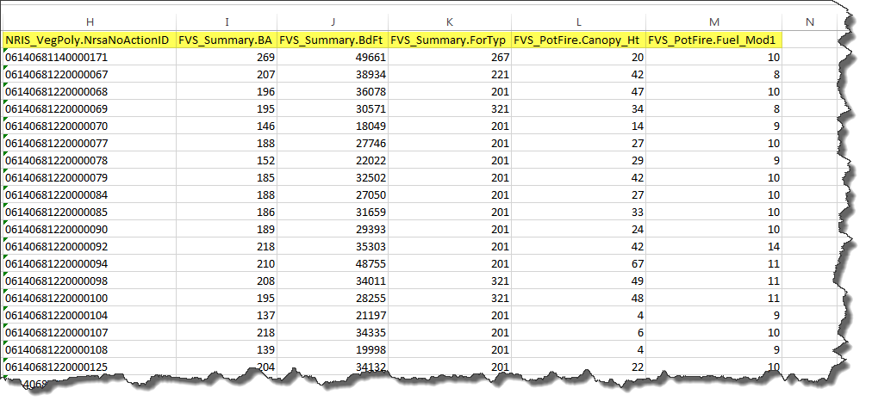
Data Analyzer
Create Project
Analyze Results

Slide 6
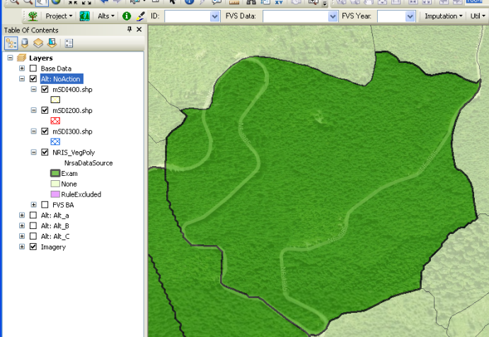
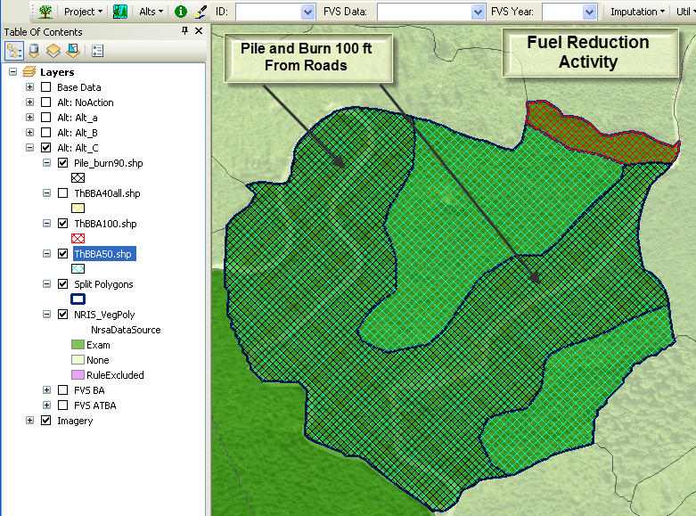
Applying Treatments Whole or Partial Stands
Whole Polygon
Apply to Portions of a Stand

Slide 7
Climate Modeling
GCM: Use any of 17 Global Circulation Models (GCMs) within FVS.
No Action: Model future decades and compare expected outcomes for selected GCMs in FVS vs. no FVS climate inputs.
Proposed Treatment: Model proposed treatment outcomes for selected GCMs in FVS vs. no FVS climate inputs.
Imputation: Utilize climate results on a landscape.

Slide 8
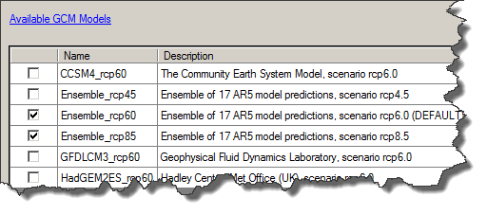
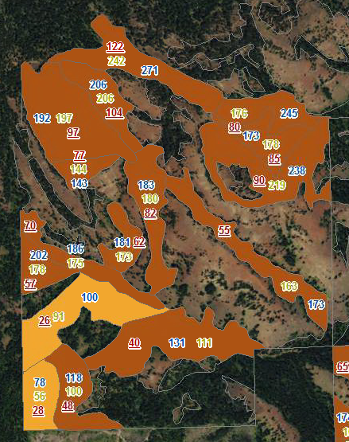
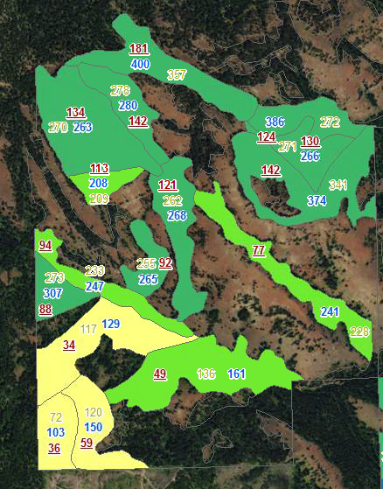
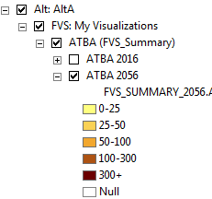
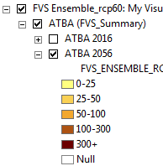
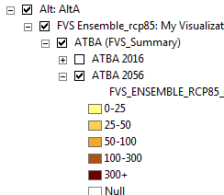
Climate Result Evaluation
Select GCM Models
Basal Area
or
SDI
Select Variable and Model
Base FVS
Ensemble_rcp60
Ensemble_rcp85

Slide 9
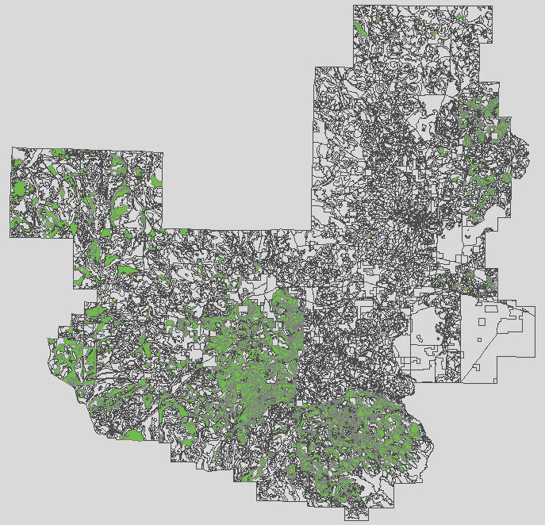
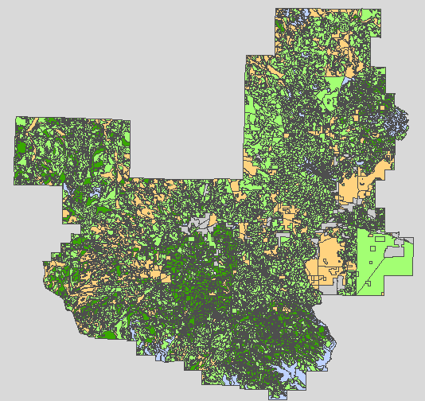
Imputed Dataset Populating un-sampled stands with Nearest Neighbor methods
Sampled Only
Sampled and Imputed

Slide 10
Imputed Data: What can you do?
Build wall-to-wall vegetation data using various nearest neighbor imputations.
Create alternatives and model vegetation treatments (i.e. thinning) for NEPA analysis and impacts evaluation across the landscape.
Run models to evaluate and compare alternatives on a landscape of data.

Slide 11
Data Analyzer Benefits
Project creation wizard provides easy access to corporate data.
Access to FVS ready data.
Spatial application of FVS activities.
Spatial display of FVS results.
Calibrations and Computes carry forward to all alternatives.
Organized, transportable project data.
Ability to incorporate climate data into analysis.
Ability to analyze landscape using Nearest Neighbor imputation.

Slide 12
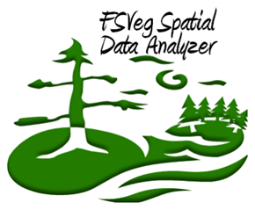
Thank You!
Kathy Sleavin – Project Manager
Brenda Bowen – Account Manager
Lynne Bridgford – Lead Application Architect
Eric Twombly – Resource Specialist – Development and Support
Jonathan Marston – Development and Support
Steve Williams, Margaret Kirkeminde - Support
http://fsweb.nris.fs.fed.us/products/FSVeg_Spatial_Data_Analyzer/index.shtml

