Slide 1
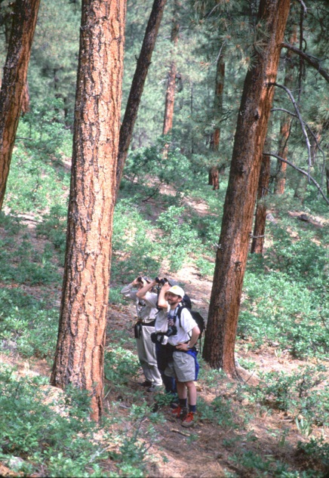
“The people’s forests” Public Participation in National Forest Planning Susan Jane Brown, Staff Attorney Western Environmental Law Center
Notes:
The National Forest Management Act requires the Forest Service to develop forest plans, and to provide an avenue for public involvement in the development of those plans.
A forest plan is similar to a city or county comprehensive plan that helps guide land use and development.
Plans set the overall management direction and guidance for each of our national forests.
Plans do not provide site-specific direction, such as where to put a recreation trail, but instead guide management activities at a forest-wide scale, providing direction for all uses across all lands within the national forests.

Slide 2
2012 Planning Rule overview
Goal: Ecological, economic, and social sustainability
Assessment
Plan Development
Preliminary need for change
Proposed action and NEPA scoping
Planning includes:
Wilderness evaluation
Wildlife conservation strategies
Timberland suitability
Etc.
Draft and final plans and EIS’s
Monitoring
Use Best Available Science
Notes:
The new planning rule sets out a 3-phase approach to planning: 1) assessment, 2) plan development, and 3) monitoring the effectiveness of the plan.
Assessment - the Forest Service will identify and evaluate existing economic, social, and ecological conditions of the national forest or grassland undergoing plan revision.
Plan Development - the information from the assessment - together with input from the public gathered through comments, collaboration, and other consultation – is used to build a forest plan. (Desired conditions, goals, objectives, standards and guidelines are identified)
Plan components: these are standards, guidelines, desired conditions, goals, etc.
Monitoring - of conditions on the ground helps determine whether the plan is actually achieving its intended desired conditions and objectives. Monitoring information helps managers determine whether they need to propose amending or revising the plan.

Slide 3
2012 planning rule: Public engagement
Requires outreach to and inclusion of diverse stakeholders.
Engaging with the public at all phases of the planning process.
Ensuring that the public is involved in the development (and not just the review) of plans.
Notes:
Prior planning rules did not emphasize public engagement, and instead funneled public participation into the NEPA process only
New rule provides for public engagement at all phases of the forest plan revision process: assessment, need for change, plan development, and monitoring, as well as in the traditional NEPA process (scoping and comment)

Slide 4
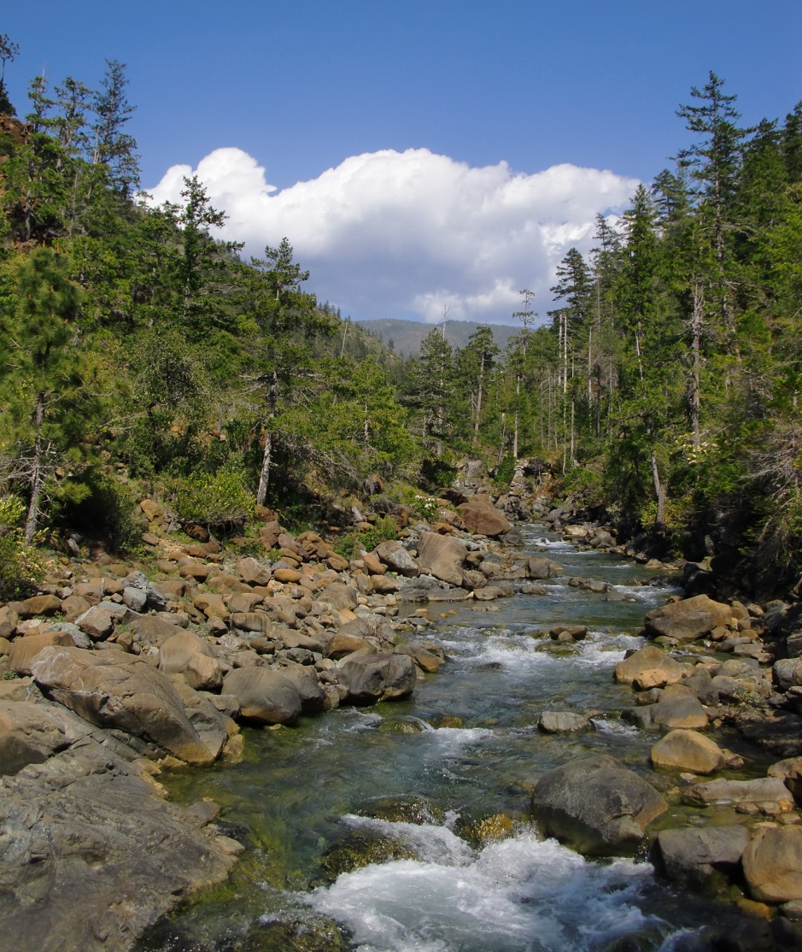
2012 Planning rule: Public engagement
The Forest Service “shall engage the public… early and throughout the planning process”
Assessments
Plan Development
Commenting on the Draft EIS
Objection process
Developing the monitoring program
Use collaboration “where feasible and appropriate”
Notes:
Chapter 40 of USFS Directives provides detailed information about the nuts and bolts of the agency’s public participation strategy
The Forest Service “shall engage the public… early and throughout the planning process.” Public will be involved in the following revision stages:
Assessments
Plan Development
Commenting on the Draft EIS
Objection process
Developing the monitoring program
Spectrum of public engagement, from “collaboration” (most detailed and in-depth, includes FACA committees) to “inform” (fact sheets, mailers, etc.)
Whether collaboration as we have seen it with CFLRPs will translate to forest plan revision is unknown. Based on the FACA cmte’s learning, I would suggest that it would be rare to see either CFLRPs or place-based collaboratives to translate into LRMP collabs
Next slides talk about how the public may be engaged during each phase of the planning process...

Slide 5
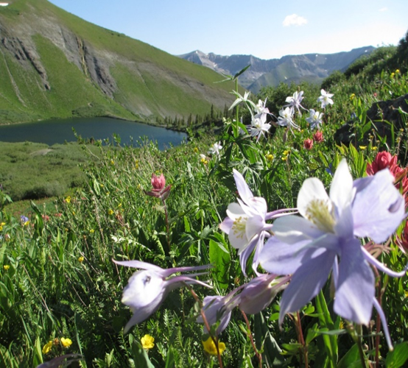
2012 Planning rule: assessment phase
Opportunities for public participation:
Start of the Assessment
During the Assessment
Assessment report will be available for public review and feedback (not a formal comment period)
Opportunity to comment on:
Potential list of Species of
Conservation Concern (SCC)
Area of influence of social and
economic contributions of planning
unit
Wilderness and wild and scenic
river inventories, if those inventories
are initiated during the assessment
Best available science
Notes:
The intent of public participation in the assessment phase is to: 1) provide opportunities for the public to share its knowledge of existing forest conditions; and 2) identify concerns about trends and perceptions of risks to social, economic, and ecological systems.
Notice of Initiation of Assessment to be published in Federal Register, newspaper of record, online.
Assessment is a snapshot of existing conditions: “assesses” existing conditions, and will form the “need for change”
Public may provide information relevant to this inquiry
Best available science: information that is relevant to the issue under analysis; does not have to include peer-reviewed articles, does include TEK

Slide 6
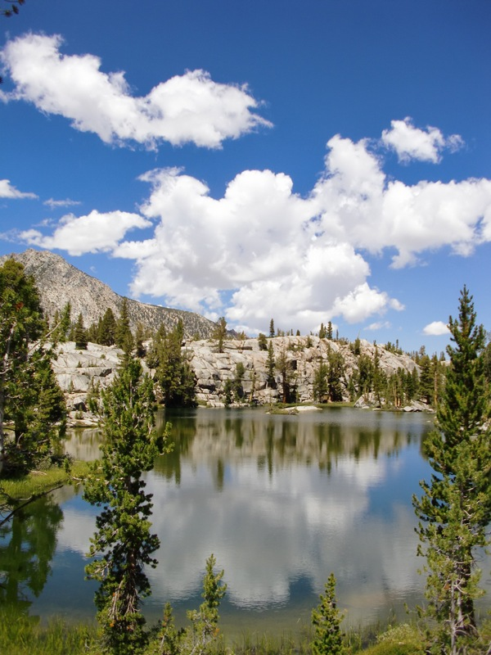
2012 Planning rule: revision phase
Opportunities for public participation:
Identifying the need for change
Developing potential plan components
Ensuring the use of best available scientific information
Providing an opportunity to comment on a proposed plan and accompanying NEPA analysis documents
Opportunity to comment on:
Species of conservation concern
Suitability of land
Environmental consequences
Alternatives
Etc.
Notes:
The revision phase is the meat of the forest planning process
Public may comment on all aspects of the proposed plan
Includes the NEPA process

Slide 7
2012 planning rule: objections
Opportunity for public to seek administrative review of Forest Service draft decision
Predecisional
Object to proposed decision
Objection resolution meetings
Notes:
Public may participate in the predecisional administrative review of proposed USFS plans

Slide 8
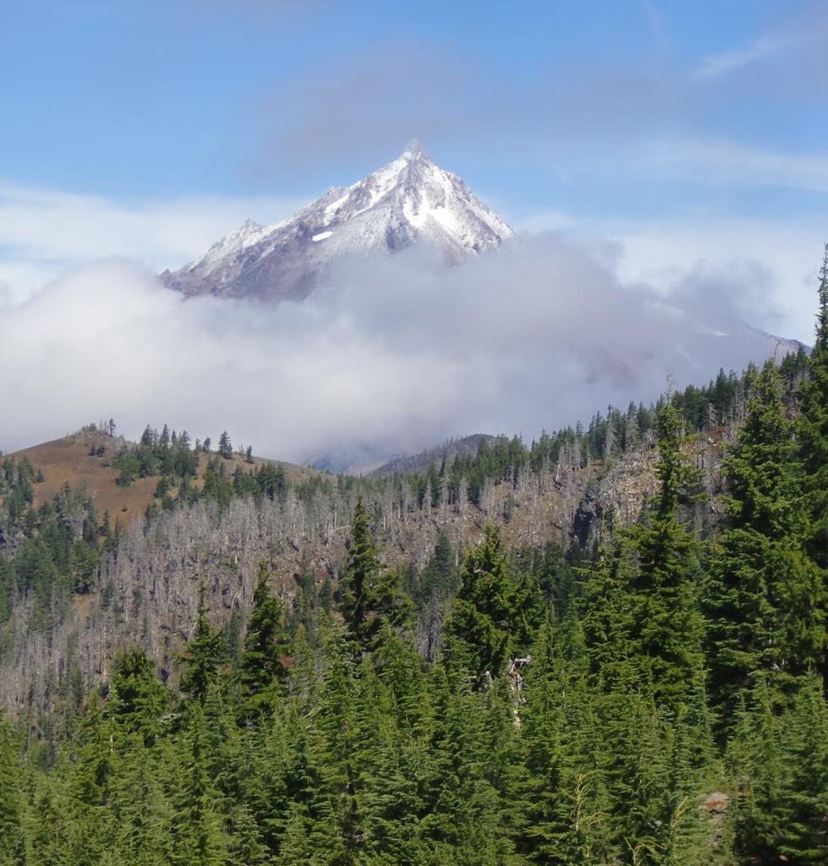
2012 planning rule: monitoring phase
Opportunity for public participation:
Development and implementation of the Plan Monitoring Program
Opportunity to comment on:
Monitoring questions and indicators
Design and implementation of multi-party monitoring
Effectiveness of plan direction
Broad scale monitoring
Notes:
Plan monitoring plans are in development now; currently required for all forests, regardless of when their plan was developed (i.e., 1982-era plans)
Broad scale monitoring takes place at larger scales than just the forest unit level, developed by regional offices. Made available to the public on 5 year intervals.

Slide 9
2012 Planning rule
Questions?

