Slide 1


Salmon Superhighway
Fish, Habitat, and community connections at a landscape scale
Collaborative Restoration Workshop
April 26, 2016
James Capurso, PhD
Regional Fisheries Biologist
Pacific Northwest Region
USDA Forest Service

Slide 2
Presentation Content
The Origin of the Salmon SuperHighway Partnership
Its Unique Approach
Monitoring
Human Dimensions

Slide 3
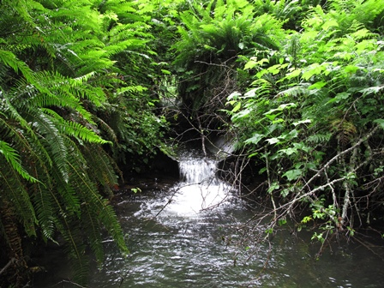
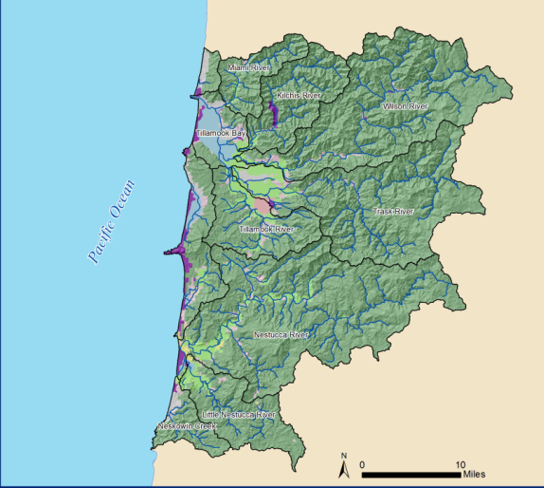
Considering Scale while Planning Passage Projects
Considerations at the:
  Project Site Scale
  Stream Scale
  Watershed Scale
  Basin Scale
Need to be problem-solving at multiple scales.
Need for data exchange at multiple scales to inform decisions

Slide 4


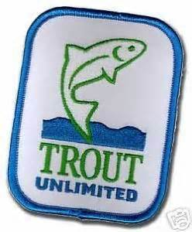

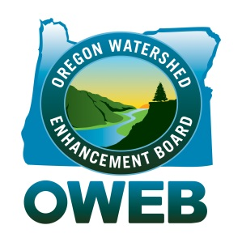
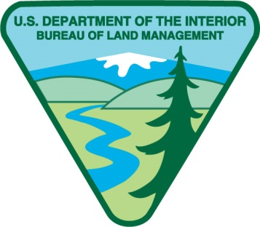


Salmon SuperHighway Partnership Origin
Program Managers from several agencies in Portland and Salem convened to develop a demo project to:
  Prioritize passage at multiple scales
  Concentrate resources
  Develop and use passage barrier database to prioritize and present portfolio of opportunities.

Slide 5
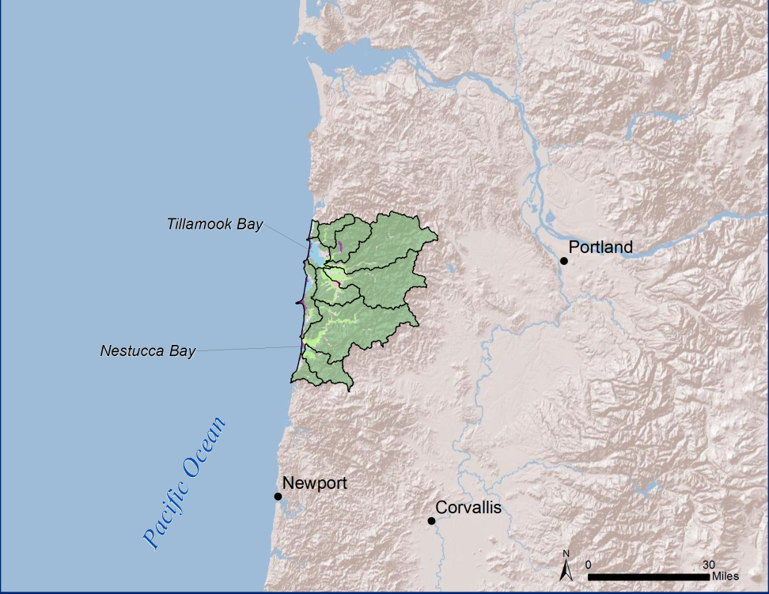
Selection of First Demo Drainage
Partners overlayed their priority areas
Tillamook-Nestucca selected due to:
  High quality habitat
  Fish species diversity
  Land ownership mix between partners
  Active restoration partner community

Slide 6
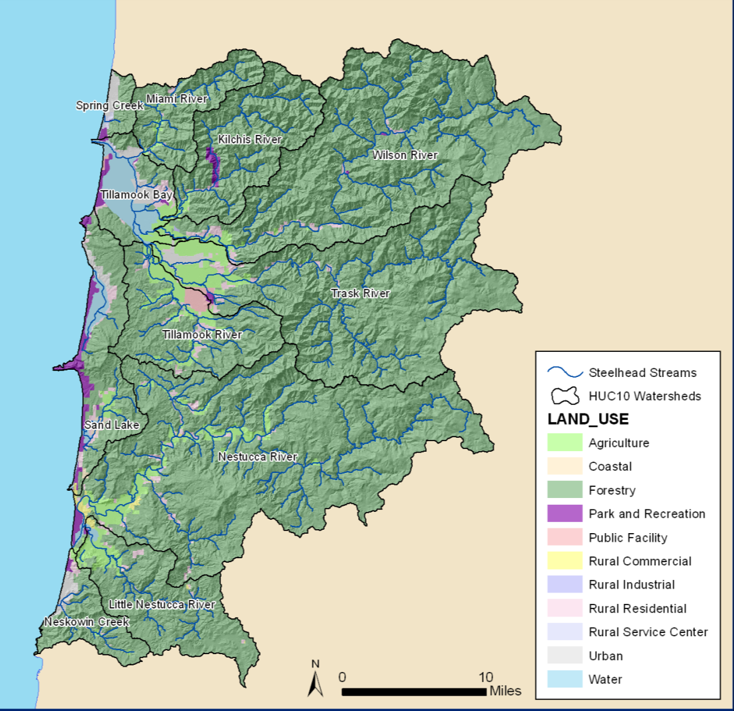
Partnership Goals
Determine where on the landscape fish passage restoration could make the most impact on fish populations.
Optimize habitat gain per funding
Develop a passage portfolio that sets priorities at a landscape scale, tying to measurable biological outcomes at the population level.

Slide 7
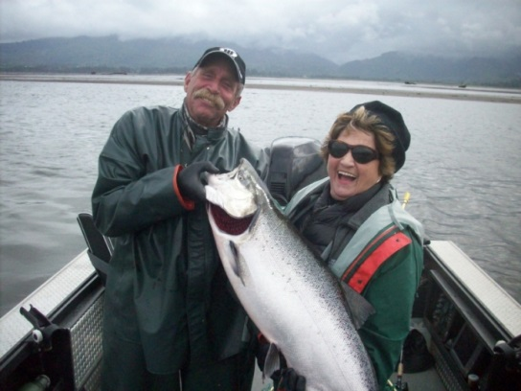
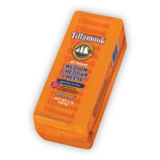
Tillamook and Nestucca Watershed Characteristics
40 miles from Portland
Consists of 2 major bay drainages
Forestry is the dominant land use on state, federal, and private lands.
Lowlands converted from floodplain forests to diked agricultural lands (dairies).
Important commercial and sport fisheries

Slide 8
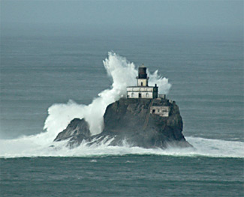
Tillamook and Nestucca Watershed Characteristics
Local partners include:
  Forest Service
  BLM
  Tillamook Estuary Partnership
  Nestucca-Neskowin Watershed Council
  Oregon Department of Forestry
  Oregon Department of Fish and Wildlife
  Natural Resources Conservation Service
  Trout Unlimited
  USFWS
  County Roads Dept.
  City and County Leadership

Slide 9
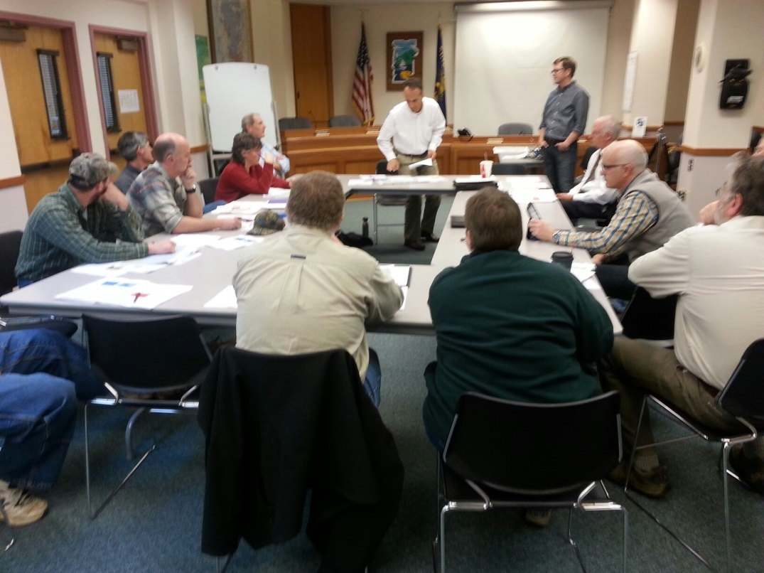
Salmon SuperHighway Partnership Executive Team
Formed to:
  Represent local stakeholder groups
  Outreach to other local and broader interests
  External fund-raising
Consists of agency execs, ag interests, fishing interests, county and city politicians, NGO leaders, etc.

Slide 10
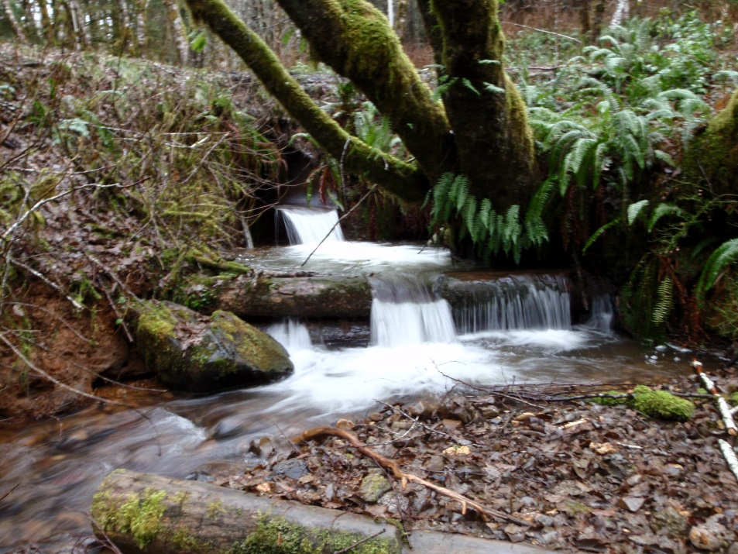
Creating the Database
Compiled local existing data into overall database.
Includes Road Crossings, Dams, and Tide Gates
Includes project cost estimates
Includes key species benefited at each barrier

Slide 11
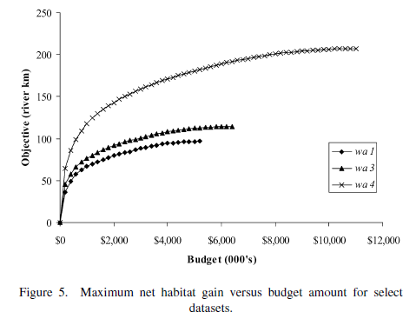
Use of APASS Model
We needed a tool to strategically consider landscape and population-level goals
Utilized O’Hanley prioritization method including use of APASS
  Anadromous Passage Optimization Tool
  O’Hanley and Tomberlin 2005
  O’Hanley 2011
From O’Hanley and Tomberlin 2005

Slide 12
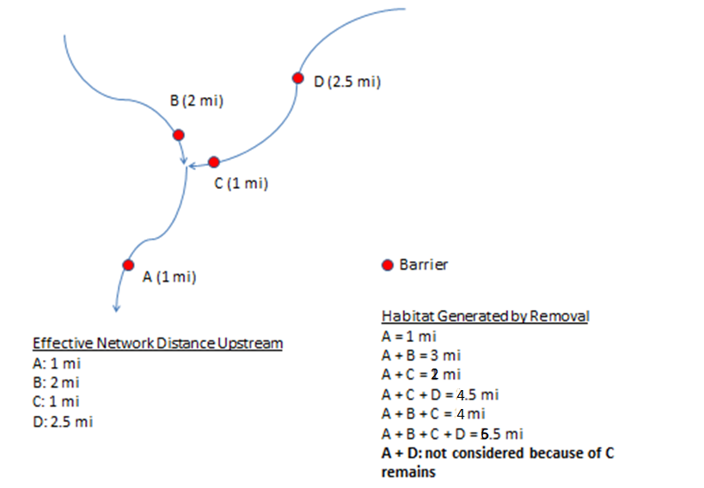
Use of APASS Model

Slide 13
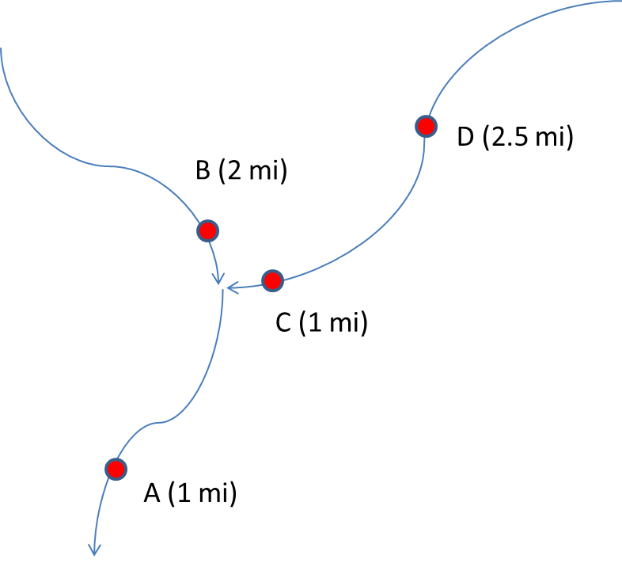
Use of APASS Model
Budget | Barriers | Total Habitat (mi)
$200K | A+B | 3.0
 | A+C | 2.0
 | A+B+C | Can’t afford
 | A+C+D | Can’t afford
A: $100K, B: $50K, C: $75K, D: $100K
$300K | A+B+C | 4.0
 | A+C+D | 4.5
 | A+B+C+D | Can’t afford
$400K | A+B+C+D | 6.5

Slide 14
Use of APASS Model
Provides a rough guide to where and in what order fish passage restoration should take place.
Incorporates priorities set by local partners.
Provides a way to quantify progress at the subbasin scale or individual watersheds.
Allows us to incorporate species-specific, population-level distribution goals.

Slide 15
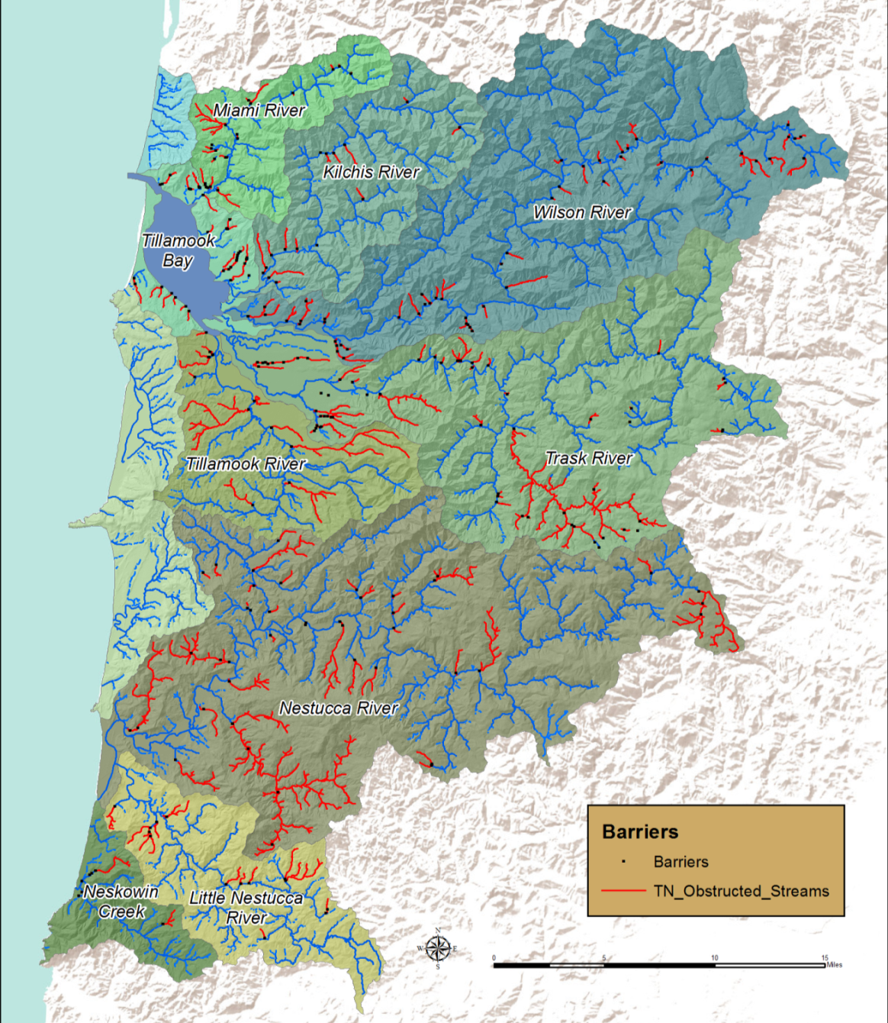
Model Results
270 anthro-pogenic barriers
Blocked stream reaches in red.
Most barriers are on streams, not mainstem rivers.
Fixing 63 barriers would return access to 95% of available fish habitat.

Slide 16
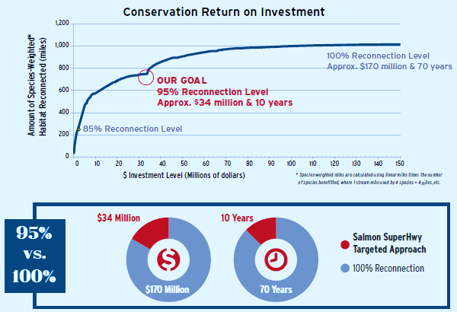

Slide 17
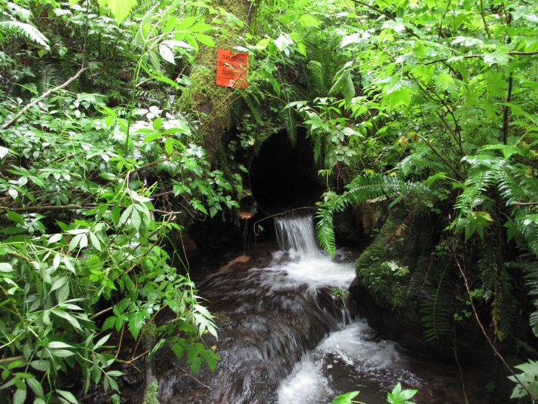
Strong Monitoring Component
Partnership monitoring plan includes Implementation, Effectiveness, and Validation components.
Database used by partners to enter pre- and post-project effectiveness monitoring.
Findings feed back to improve implementation
Informs next demo partnership.

Slide 18
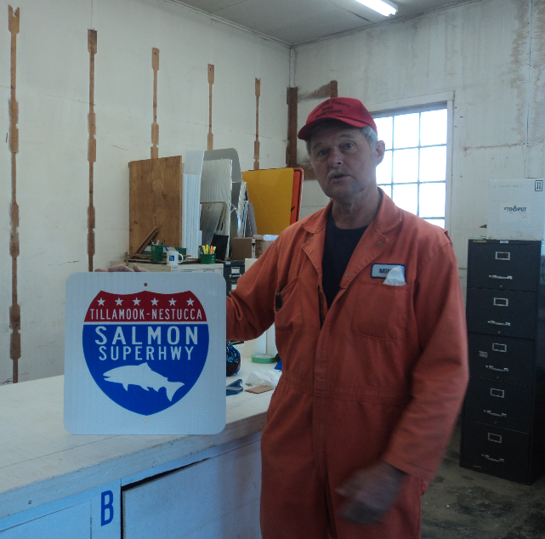
Human Dimension
Additional investment in coordination between all levels of partnership
Ownership from key players in community
Using salmon to rally community to action
Advanced fundraising capabilities
Advanced marketing capabilities

Slide 19
Conclusions
The Salmon SuperHighway Partnership is a unique approach to connecting fisheries resources to their historic habitat and local communities to their landscape.
The approach includes essential components:
  Data
  Prioritization of projects using a portfolio approach.
  Supportive, interested, and capable community
  Concentrated funding stream
  Monitoring to facilitate its application elsewhere
For more information: Salmonsuperhighway.org

