Slide 1
Oregon’s Federal Forest Health Program (FFH)
Chad Davis
Oregon department of forestry

Slide 2
From whence it came
2009 Federal Forest Advisory Committee Report
Called for State action, including state funds
Identified collaboration as a path forward
2012 FFAC Subcommittee scopes out State funding package
Co-funded Forest Restoration Economic Analysis
Initial package prioritized in Gov Kitzhaber’s 13-15 budget
FFWG continues: supports collaboratives & informs implementation of the FFH program

Slide 3
Version 1.0
2013-2015 biennium - $2.88 million
“Dry forests” of eastern & SW Oregon
USFS only
Focus in Blue Mountains
Staffed with existing positions at ODF; ie. no overhead
Relied on lead partner at USFS (Bill Aney)
Driving assumption:
Significant uptick needed on social license & NEPA shelf stock
USFS “match”: $10 million

Slide 4
Scaling up collaboration
USFS Records of Decision were signed on 137,487 acres of collaborative projects within the Blue Mtns region from 2012–2014
Blue Mtns Collaboratives worked on planning an additional 465,356 acres.
Contracts for collaborative projects on the Malheur National Forest yielded approximately 156.8 mmbf in volume.
Full report: http://ewp.uoregon.edu/sites/ewp2.uoregon.edu/files/WP_57.pdf

Slide 5
+136 jobs
Full report: http://ewp.uoregon.edu/sites/ewp2.uoregon.edu/files/WP_57.pdf

Slide 6
Doubling down
$5 million approved for 2015-2017
Key differences:
Statewide scope
More legislative direction on funding for components
Collaborative Support = $1.3 million
State-Federal Implementation Partnership = $3.4 million
ODF Position authority: total 7.64 FTE
Includes “District Coordinators” in each EOA District
Combination of LD and seasonal positions

Slide 7
Version 2.0
Two primary program components
Collaborative Support (Scale & Quality)
Collaborative Grants
Technical Assistance and Science Support
Implementation Partnership (Pace & Quality)
Planning and pre-sale activities
ODF Seasonal employees, State contracts, Reimburse USFS contractors
Call for Projects yielded 70 submissions totaling $13.2 million
Notes:
SFIP Project Submissions
$8.2 million (63%) from west side
$7.2 million for “treatments”: largely PCT, piling and burning

Slide 8
Total: $3.4 million
Notes:
~$200K presale work completed in Fall 15

Slide 9
FFH Implementation Partnership – Selected Projects
Forest | Project Descriptions | Funds | Mechanism
FreWin | Unit layout and timber marking on Black Hills, Bluejay, Deuce, Mudhoney. | $300,000 | ODF Seasonal Crew
 | Stand exams on Thomas Creek & Blue Jay II.
Ochoco | Property boundary surveying on Gap and Edge timber sales. Establishes line between public and private land. | $90,000 | IDIQ Contractor
Malheur | LiDAR acquisition & stand exams to support collaborative/research on Canyon Creek Complex. | $178,200 | IGA w/ DOGAMI; ODF Contract
Willamette | Road surveys for upcoming timber sales. ODF will gather data to inform USFS contracting to access NEPA-ready timber sales. | $75,000 | ODF Seasonal Crew
Siuslaw | Marbeled murrelet surveys. Intent to extend operating season on existing sale areas. | $115,000 | ODF Contract
RogueRS | Heritage resource surveys: Agnes project. Protocol shift to survey treatment units only. | $35,000 | IDIQ Contractor
Notes:
By geography:
66% East-side NFs
34% West-side NFs

Slide 10
A new ODF program
Core business statement:
Accelerate the pace, scale and quality of forest restoration to increase the resilience of Oregon’s federal forests, in a manner that leverages collaborative efforts and contributes to the long-term vitality of regional economies and rural communities.
Program principles:
Partnership-oriented
Transparent decision making
Flexible and adaptable
Increase system capacity
Measurable metrics
Notes:
Program includes BOTH FFH as we know it to date, state funds) and GNA projects.
Are scoping out an POP for 2017-2019 session. Desire would be to make it “permanent”.

Slide 11
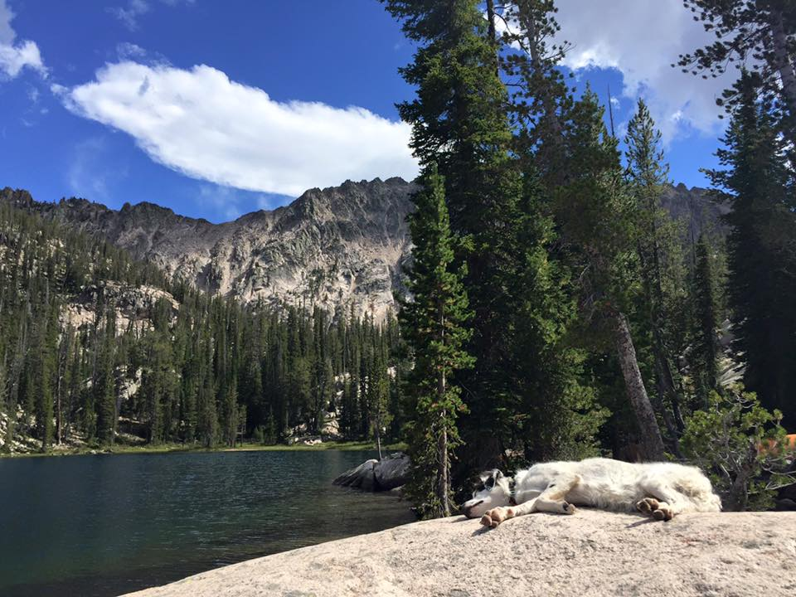
Your turn!
Chad Davis | chad.davis@oregon.gov | 503-602-2130

Slide 12
Full report: http://ewp.uoregon.edu/sites/ewp2.uoregon.edu/files/WP_57.pdf

