Slide 1
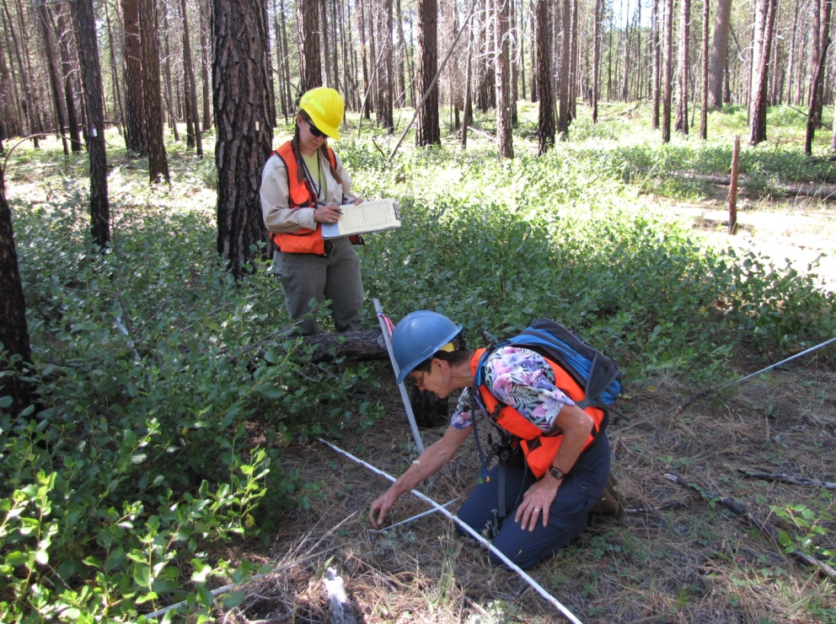
Towards More Effective Monitoring: The Process Used in the Collaborative Forest Landscape Restoration Projects (CFLRPs) in the Pacific Northwest
Thomas E. DeMeo, Amy Markus,
Bernard Bormann, and Jodi Leingang
USDA Forest Service, Pacific Northwest Region

Slide 2
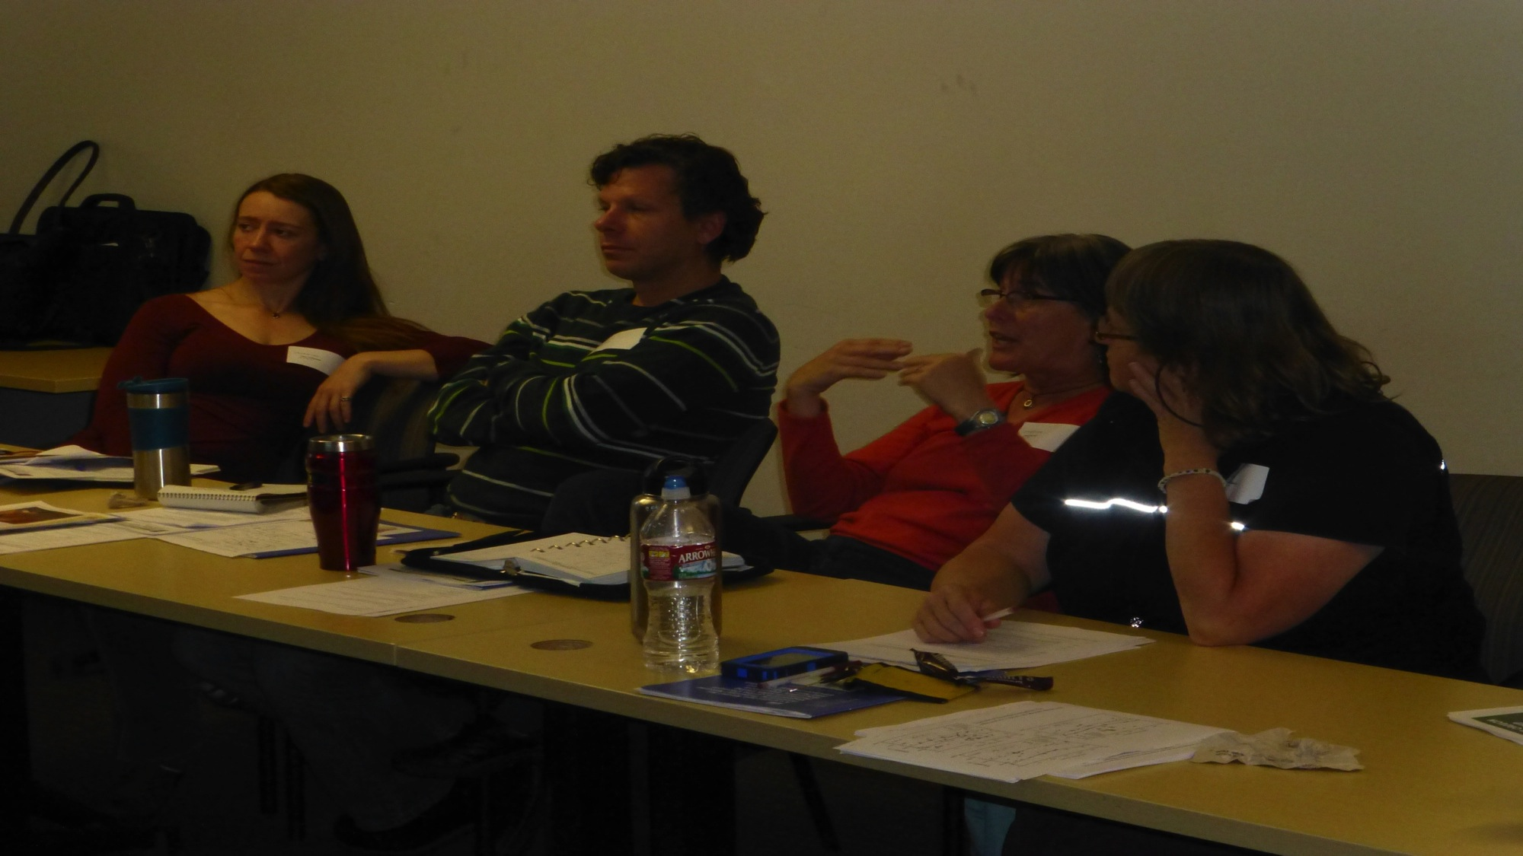
Adaptive management
We evaluate our management policy and actions based on monitoring, and adjust them based on what we find.
Therefore management is seen as a learning process we work on together. Monitoring emphasizes this mutual learning process.

Slide 3
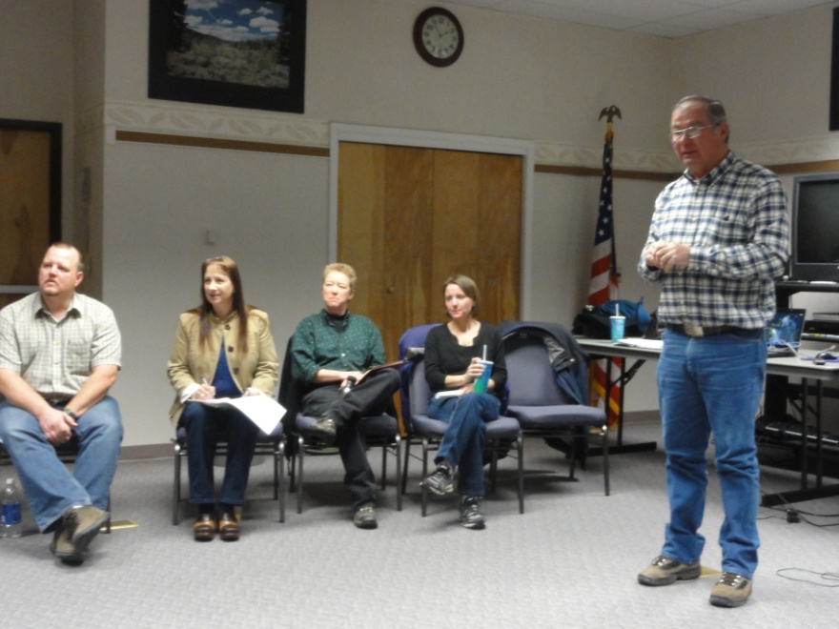
Monitoring and adaptive management process
1. Clearly understand and convey your goals and objectives.

Slide 4
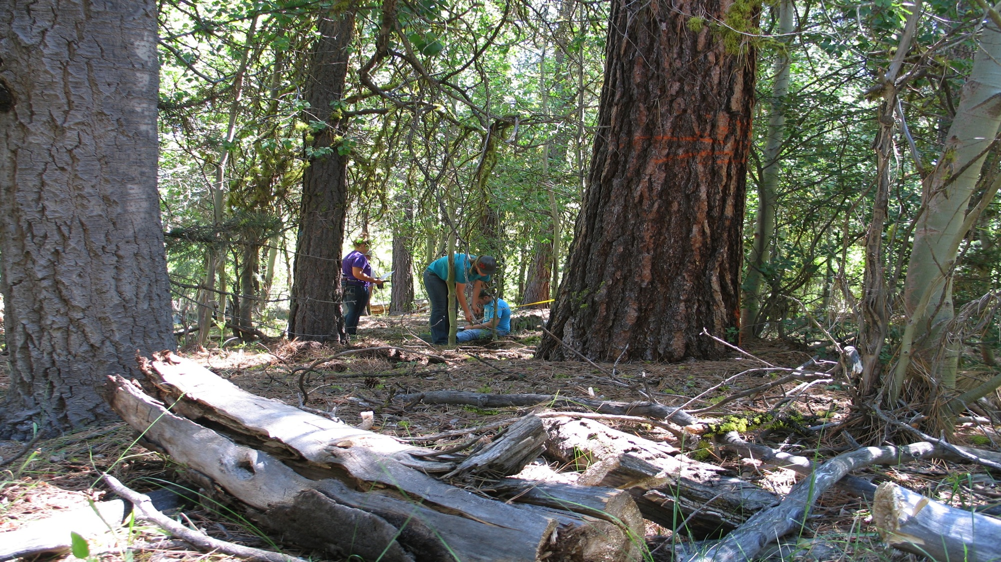
Monitoring and adaptive management process
Organize your monitoring as a set of questions.
Example: The key question usually is: Are our activities making our landscapes more resilient or sustainable?

Slide 5
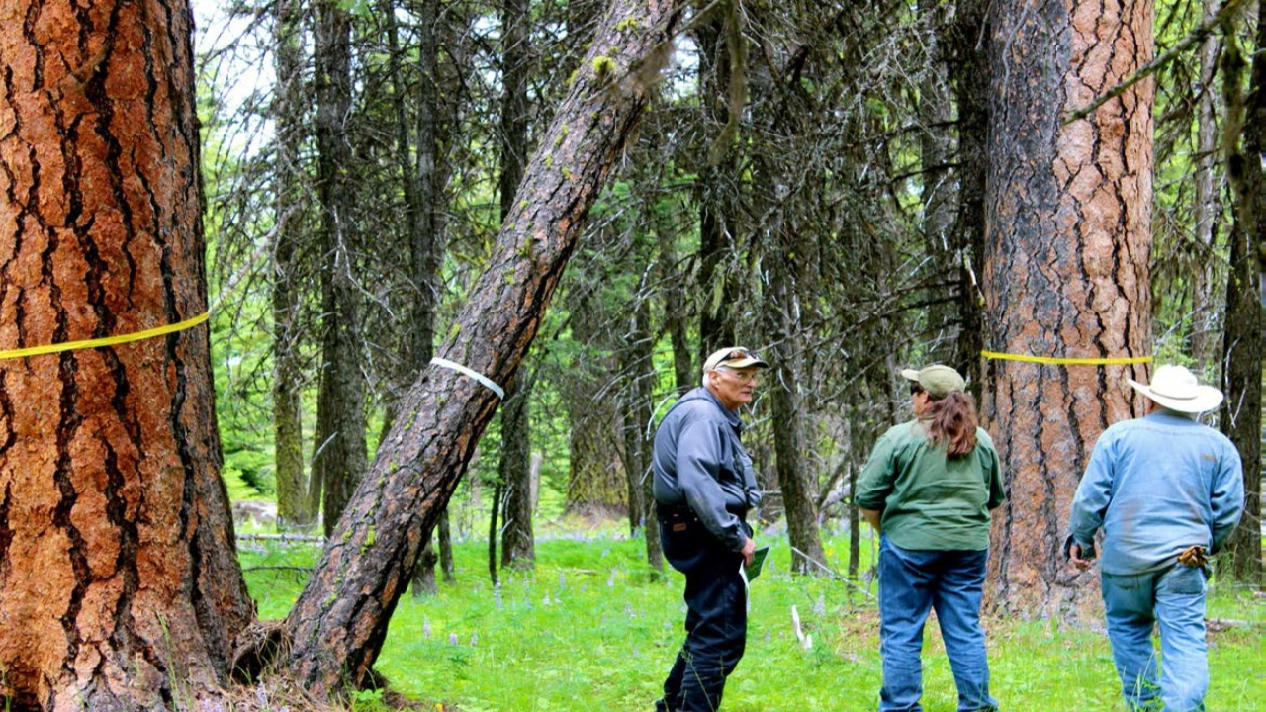
Monitoring and adaptive management process
Involve your stakeholders in developing the monitoring questions.

Slide 6
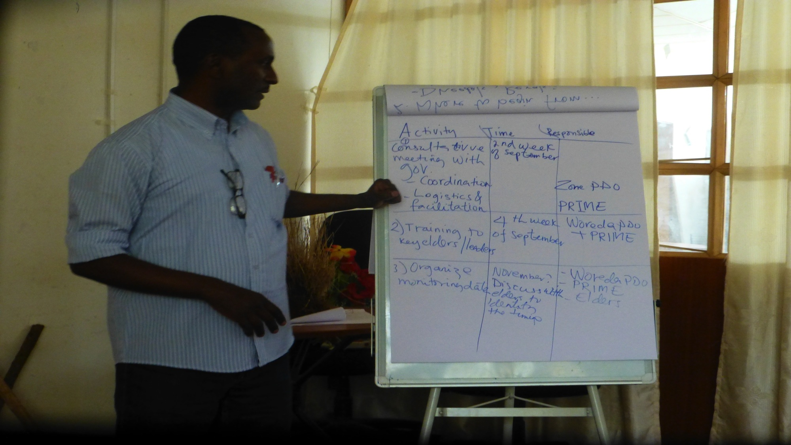
Monitoring and adaptive management process
Keep it simple and commit to your monitoring plan.
When we fail in monitoring, it is usually because we do not answer simple questions well and consistently, not because we are not complicated enough.

Slide 7
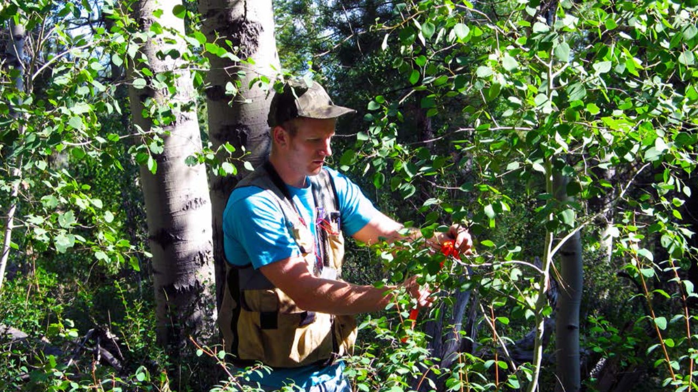
Monitoring and adaptive management process
5. Match your monitoring questions to the resources available. Do not make long lists of questions you will never answer.

Slide 8
Monitoring and adaptive management process
Understand the continuum of evidence of increasing complexity and rigor:
  Expert panel
  Photomonitoring
  Landscape assessment (mapping methods)
  Quantitative ground data
Limited resources often mean a reliance on the first three above.

Slide 9
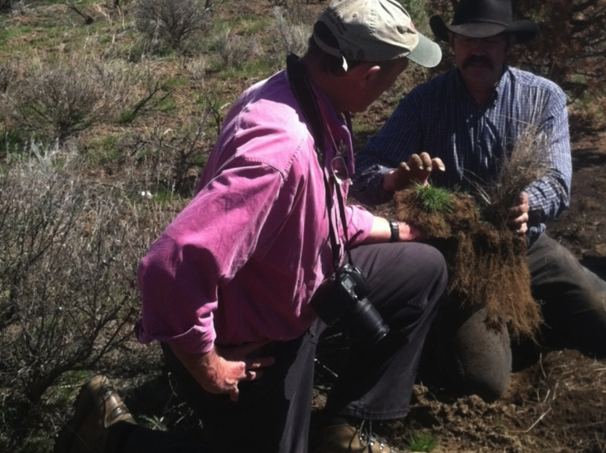
Monitoring and adaptive management process
Often a triage concept works well, using less intensive methods in general, and reserving data intensive methods for areas of high interest or controversy.
Example: This works well for riparian range monitoring, with rapid assessment everywhere and intensive sampling in areas of high controversy.

Slide 10
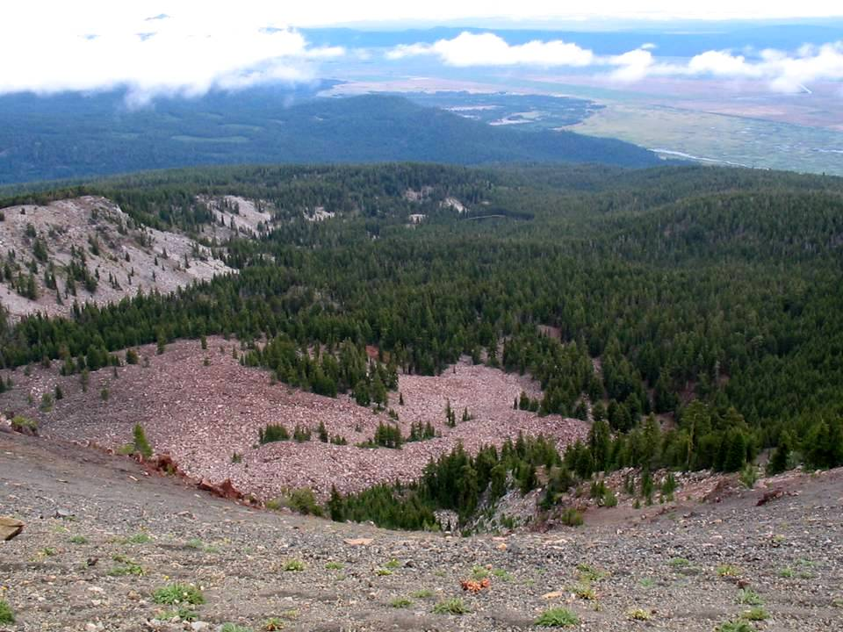
Monitoring and adaptive management process
Understand the right scale for your question.
For example, questions on fire regimes normally are assessed at landscape scale.

Slide 11
Monitoring and adaptive management process
Involve leadership in developing the monitoring plan.

Slide 12
Monitoring and adaptive management process
Only after the questions are precisely decided on do you clarify methods, who will do the work, and the responsibilities of those involved.

Slide 13
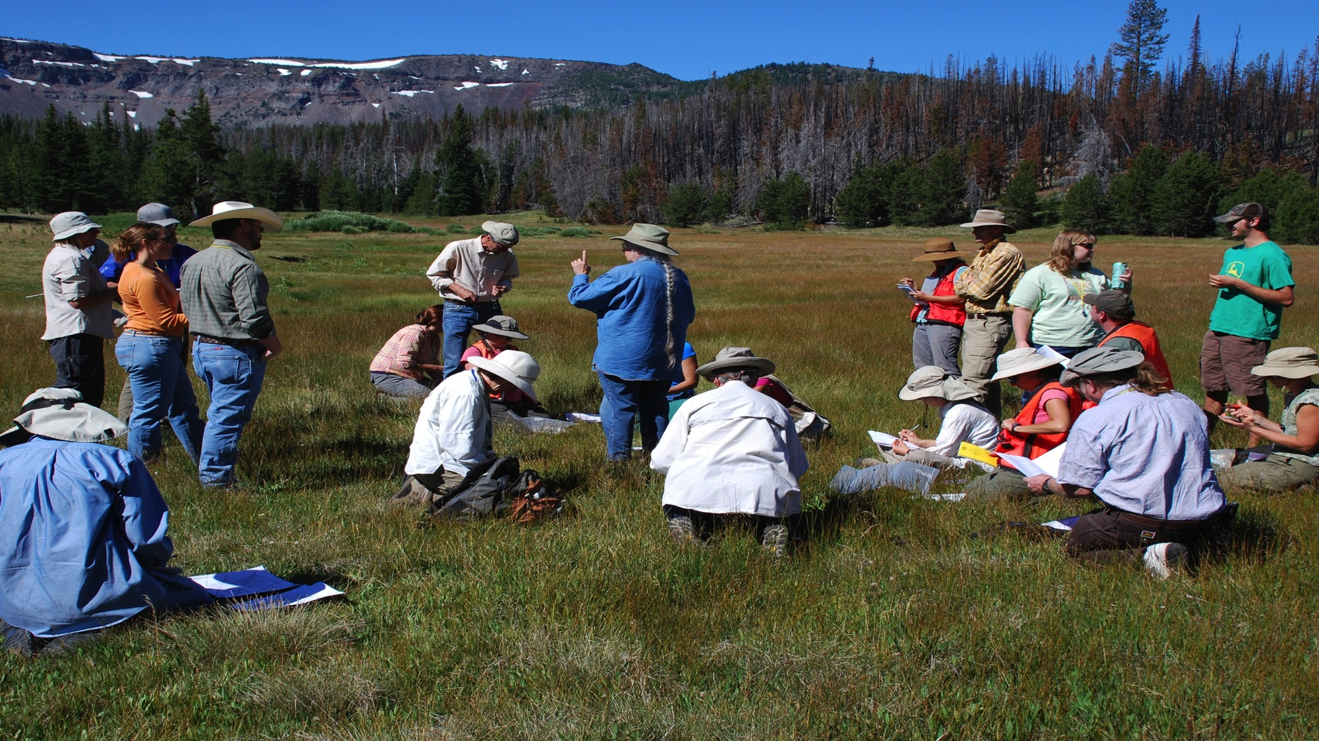
Lessons Learned
Getting to a small list of precise questions is very difficult… but worth it.
To reduce tensions and build trust, emphasize a learning process we do together.

Slide 14
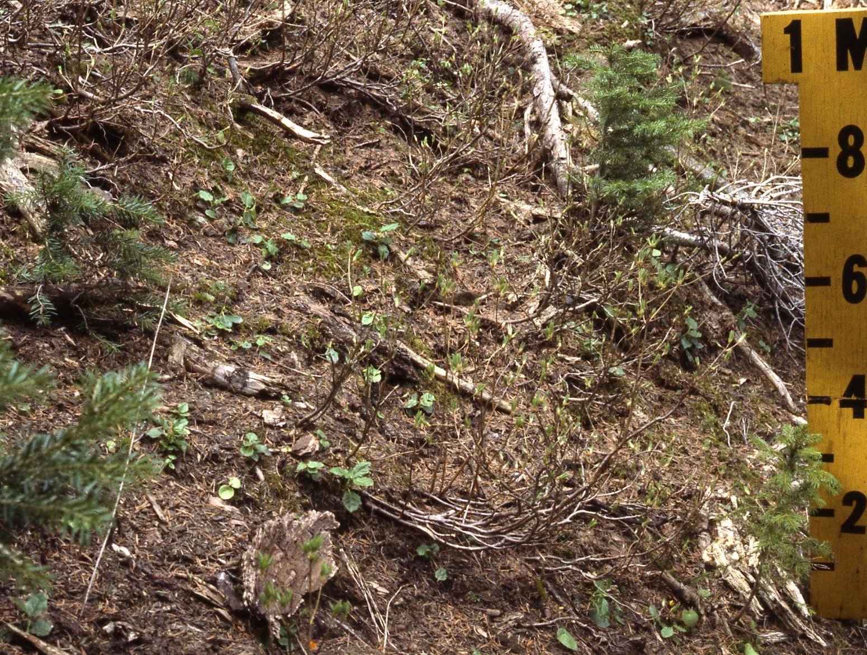
Lessons Learned
3. We continue to struggle with the amount of rigor and resources to be dedicated to a question.
4. Time matters. Frequent (at least yearly) reporting is essential to maintain momentum and credibility.

Slide 15
It’s OK to make mistakes….
….but make new ones.

