Slide 1
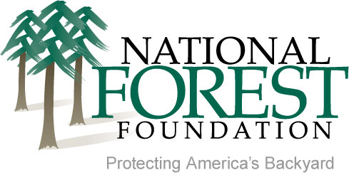
Collaboration under the 2012 Planning Rule
Karen DiBari
Collaborative Restoration Workshop, April 26, 2016

Slide 2
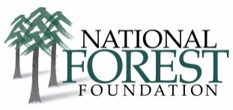
Spectrum of Public Participation and Related Tools for Public Engagement
Level | Examples of Agency Activities and Tools
Collaborate | Directly engage the public to exchange information with each other and work together on one or more issues during the planning process. Identify where there is agreement and disagreement. Potential tools: Facilitated or mediated discussion among public participants, Federal Advisory Committee Act (FACA) groups, and partnerships.
Involve | Work closely with interested members of the public to clarify concerns and seek feedback on how to meet challenges presented by the planning process. Potential tools: workshops, partnerships, and public meetings.
Consult | Provide information to the public and seek suggestions as well as feedback on potential issues and concerns. Potential tools: open house, public meeting, notice and comment, news release, and website.
Inform | Provide sufficient objective information to the public to convey an understanding of intended actions, processes, and preliminary issues. Potential tools: fact sheet, newsletter, mailing, news release, and website.
FSH 1909.12 – Land Management Planning Handbook
Chapter 40 – public participation
Protecting America’s Backyard

Slide 3
National Forest Foundation
Angeles NF Plan Amendment – San Gabriel Mountains Community Collaborative
Nantahala & Pisgah NFs Plan Revision – Stakeholders Forum
Rio Grande NF – public engagement in assessment phase
Protecting America’s Backyard

Slide 4
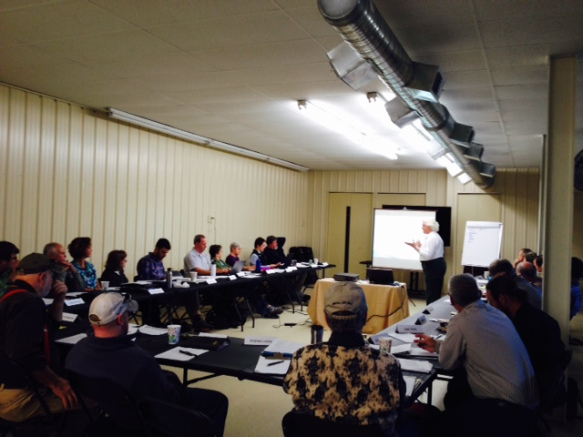
Take the Long View
Forest planning a process with a deliverable, however it is also…
A vehicle to focus discussion
An opportunity to build understanding around areas of conflict and amongst stakeholders
Protecting America’s Backyard

Slide 5
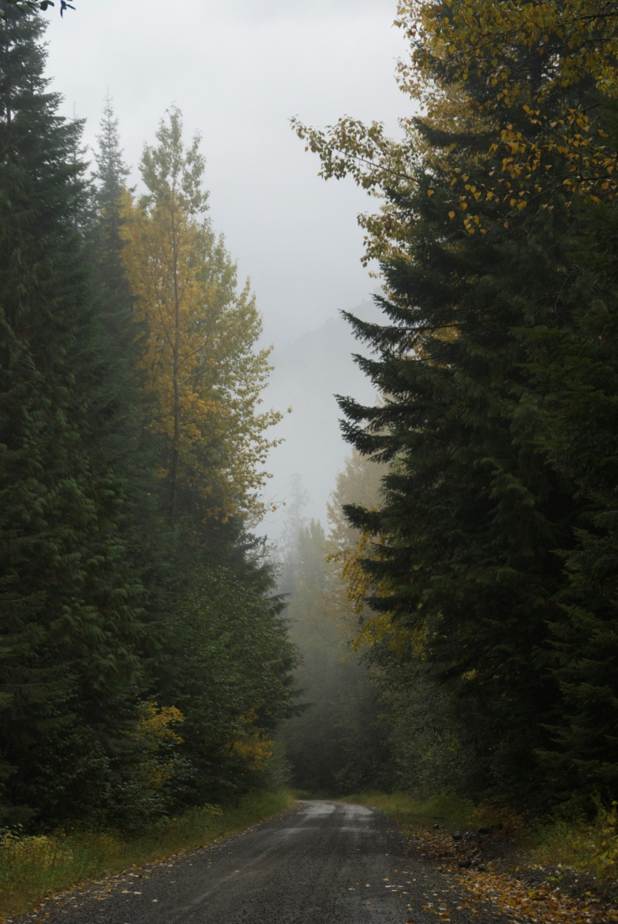
Complex and Circuitous
Process education important
Integrate collaborative touchpoints with public involvement
Easier for collaboratives and public to respond to material vs. developing recommendations out of whole cloth
What to collaborate on?
Protecting America’s Backyard

Slide 6
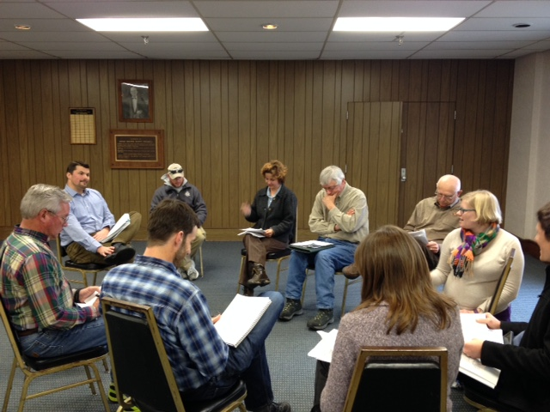
High Stakes
Pressure situation
Involves stakeholders inexperienced in collaboration
Proposed wilderness vs. active management
Protecting America’s Backyard
Notes:
People feel the plan will determine the future/direction of the forest FOREVER
Any unhappiness w/prior plan and management is channeled into plan discussions
Plans are political and people are used to playing by the “old rules”
More permanent nature and even de facto management of proposed wilderness areas make timber and active management interests feel at a disadvantage

Slide 7
Benefits of Collaborative Plan Development
Improve robustness of Public Information Plan
Deeper dialogue
Same table
Focused and rich discussion
Corrections along the way
Relationships, relationships, relationships
Protecting America’s Backyard
Notes:
Improve robustness of Public Information Plan
Deeper dialogue
Everyone at the same table
Focused and rich discussion- great opportunity for public and interdisciplinary team to engage in structured way

Slide 8
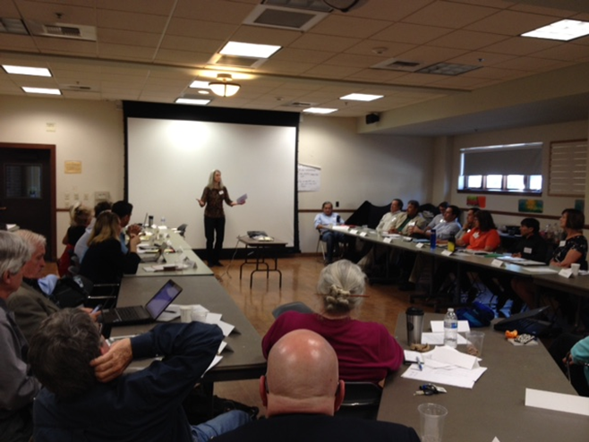
Advice for National Forests
Discuss openly what NF hopes to gain
Continually communicate sideboards
Help set table
Narrow focus
Be transparent
Perception is reality
Share and ask for reactions
Recognize comment deadlines can be flashpoints
Protecting America’s Backyard
Notes:
Recognize the investment – huge time/brainpower

Slide 9
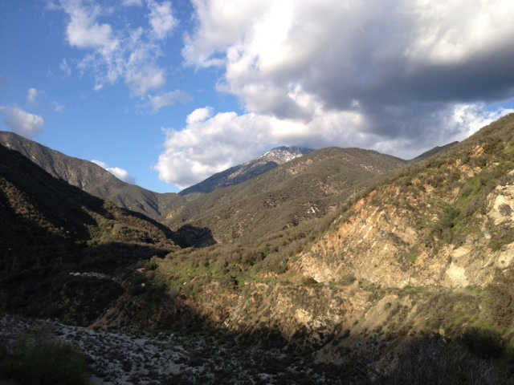
Advice for Stakeholders
It is not all or nothing
Is everyone at the table?
Perception is reality
Steep learning curve
Be strategic about where to engage
Protecting America’s Backyard
Notes:
Be strategic about where to engage

