Slide 1
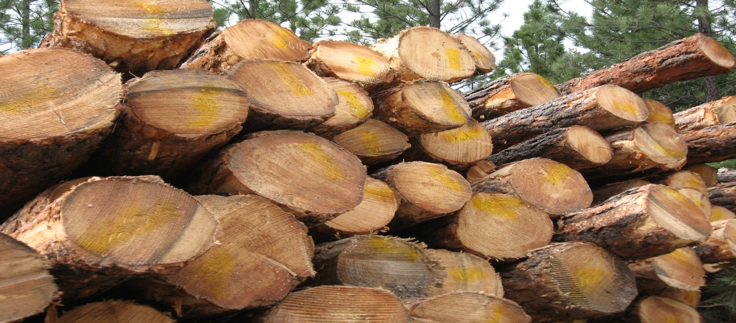
Tribal Forest Protection Act McGinnis/Cabin Stewardship Project
Jim Durglo, Forestry Department Head
Confederated Salish and Kootenai Tribes, Montana

Slide 2
TRIBAL FOREST PROTECTION ACT (Public Law 108-278)
The Tribal Forest Protection Act was passed in 2004 in response to the wildfires that crossed from federal land to Tribal lands the prior summer.
It provides a tool for Tribes to propose work and enter into contracts and agreements with FS and BLM to reduce threats from federal lands to Indian trust lands and Indian communities.

Slide 3
Policy
FS policy to implement is now included in FSH 2409.19, Chapter 60. Draft policy was sent to Regional Foresters for a formal tribal consultation and comment period that ended in June of 2005.

Slide 4
Key Points of the Policy
Proposal must focus on FS lands that:
Border or are adjacent to tribal lands
Pose a fire, disease, or other threat to Indian lands or communities
Are not subject to another conflicting contract or agreement
And, involve a feature or circumstance unique to proposing tribe.

Slide 5
To Qualify
Indian land must:
Border or be adjacent to FS lands
Be in trust or restricted status
Be forested or have vegetative cover or, if burnt over, be capable of regenerating vegetative cover.

Slide 6
Project Initiation
Tribal government submits request to Forest Supervisor or DR or Regional Forester
Within 120 days the RF may issue a Public notice of either:
Initiation of environmental review
Potential of entering into a contract or agreement with the tribe, or
Notice of denial to the tribe

Slide 7
Contracts and Agreements
FS may utilize their complete array of appropriate instruments to enter into contracts and agreements with tribes to further the TFPA and will emphasize the use of stewardship contracting.

Slide 8
Agencies may use best value basis
Giving special consideration to tribal related factors such as:
Historical and cultural affiliation with the land
Treaty rights
Agency/tribal working relationships
& landscape features.

Slide 9
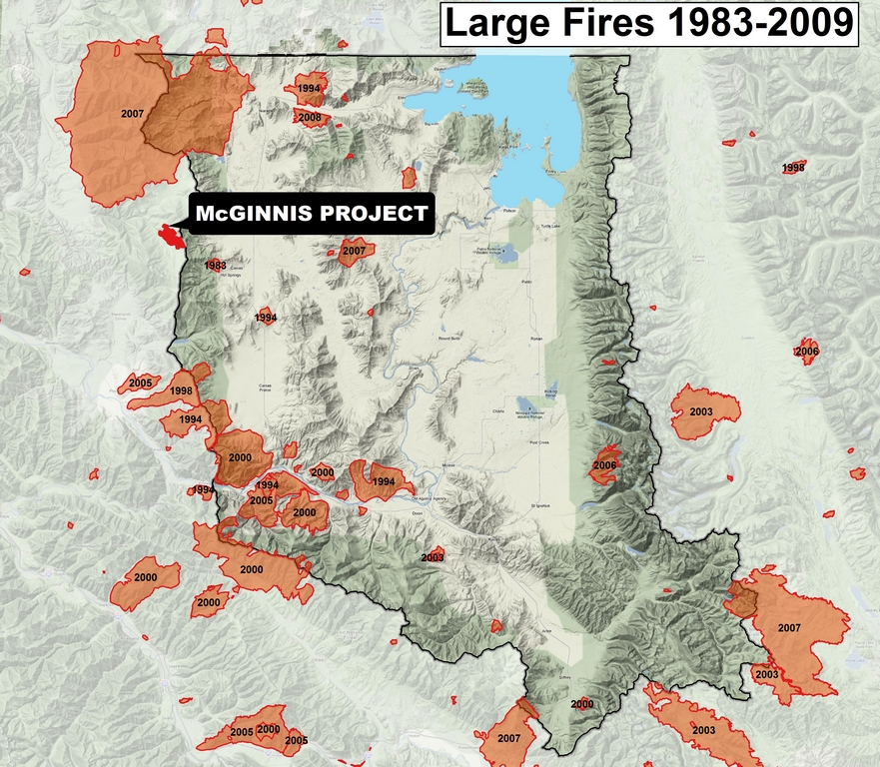

Slide 10
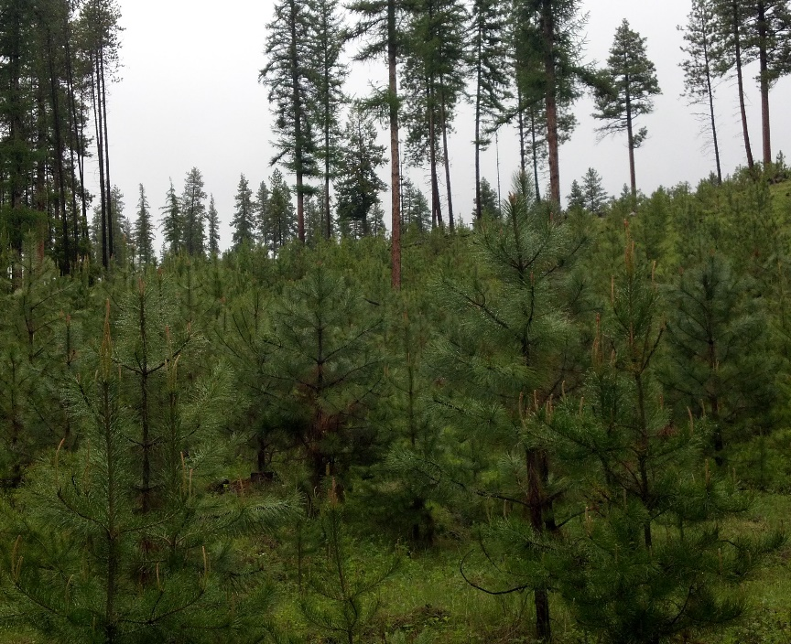
Chronology
Letter of intent sent to Forest Supervisor in November 2007
Integrated Resource Service Contract signed in June 2009
Smurfit-Stone pulp mill closes January 2010
Contract suspended in August 2011 at request from CSKT
By July of 2013 a new market for pulp logs had developed
Complete harvest of sawlog and thinning in 2014
Slash piles burned in winter of 2015
Contract scheduled to expire December of 2016

Slide 11
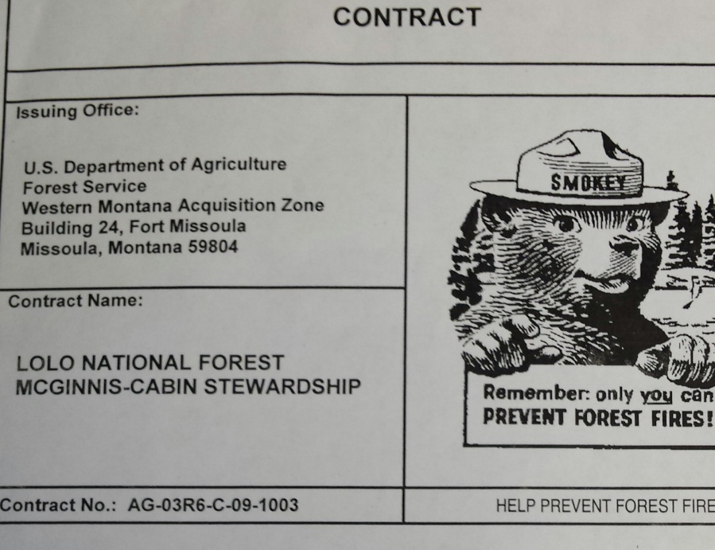
CSKT/Lolo National Forest Plains/Thompson Falls Ranger District
Integrated Resource Service Contract
(IRSC)
Bid Items:
Saw logs
Logging Cost for non-saw material (acre)
Contractor treatment of non-saw material at landing (burning landings) (piles)
Contractor treatment of non-saw material at landing (chipping & hauling) (piles)
Contractor Rehab of landing piles (landing)
Contractor marking of saw timber (acre)
Contractor purchase of non-tracer paint (cost)
Road Maintenance
Road Construction & Reconstruction

Slide 12
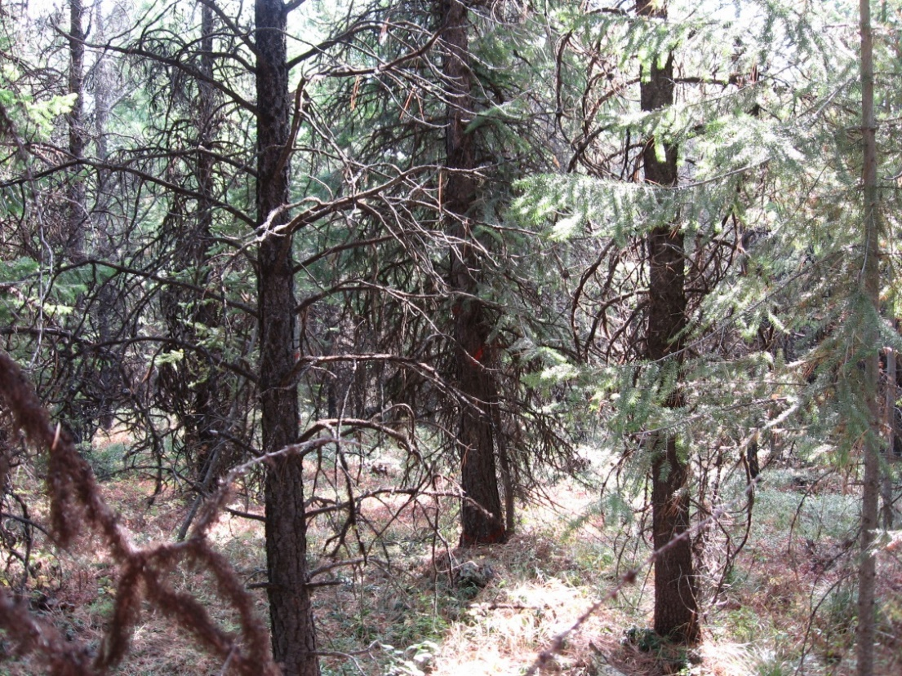
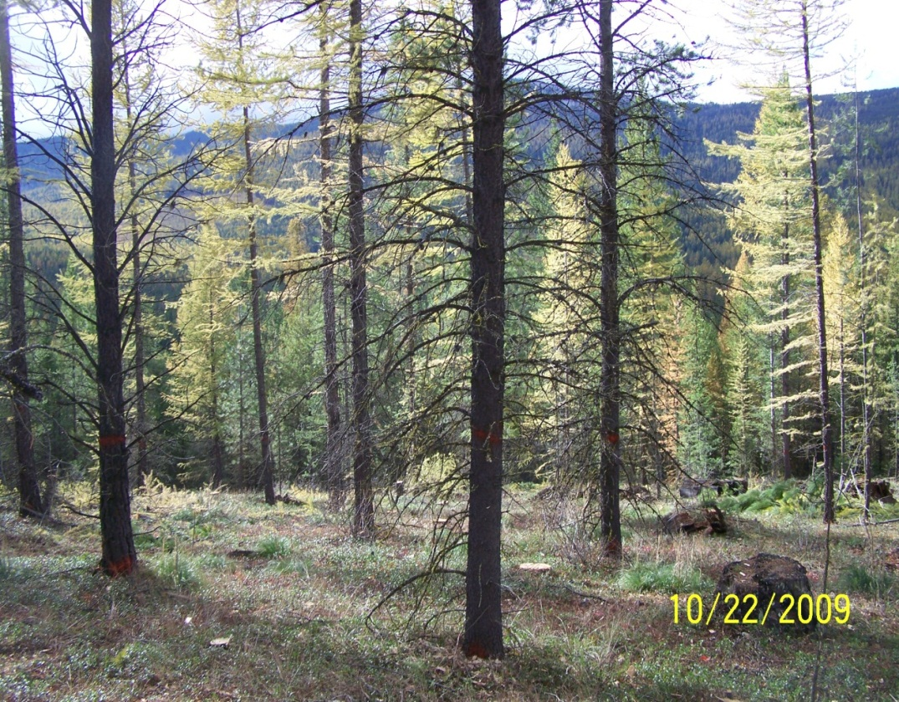
My Perspective
No magic solution; no silver bullet
Just a lot of hard work, commitment, dedication and a little delusion.
Before
After

Slide 13
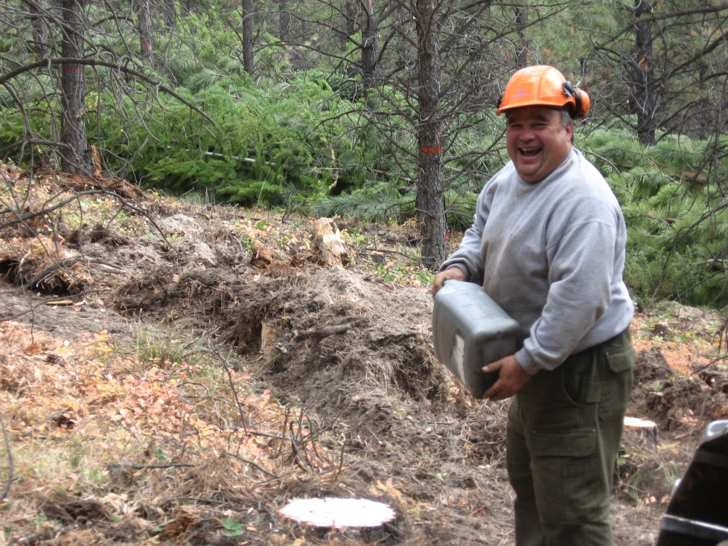
Working Relationships
Historic Working Arrangements
Fire Crews, Aviation, Road Use Agreements, Cultural Preservation, Planting or Thinning contracts. Annual leadership visits, Research, Social Interaction, Sports, and
Collaborative meetings

Slide 14
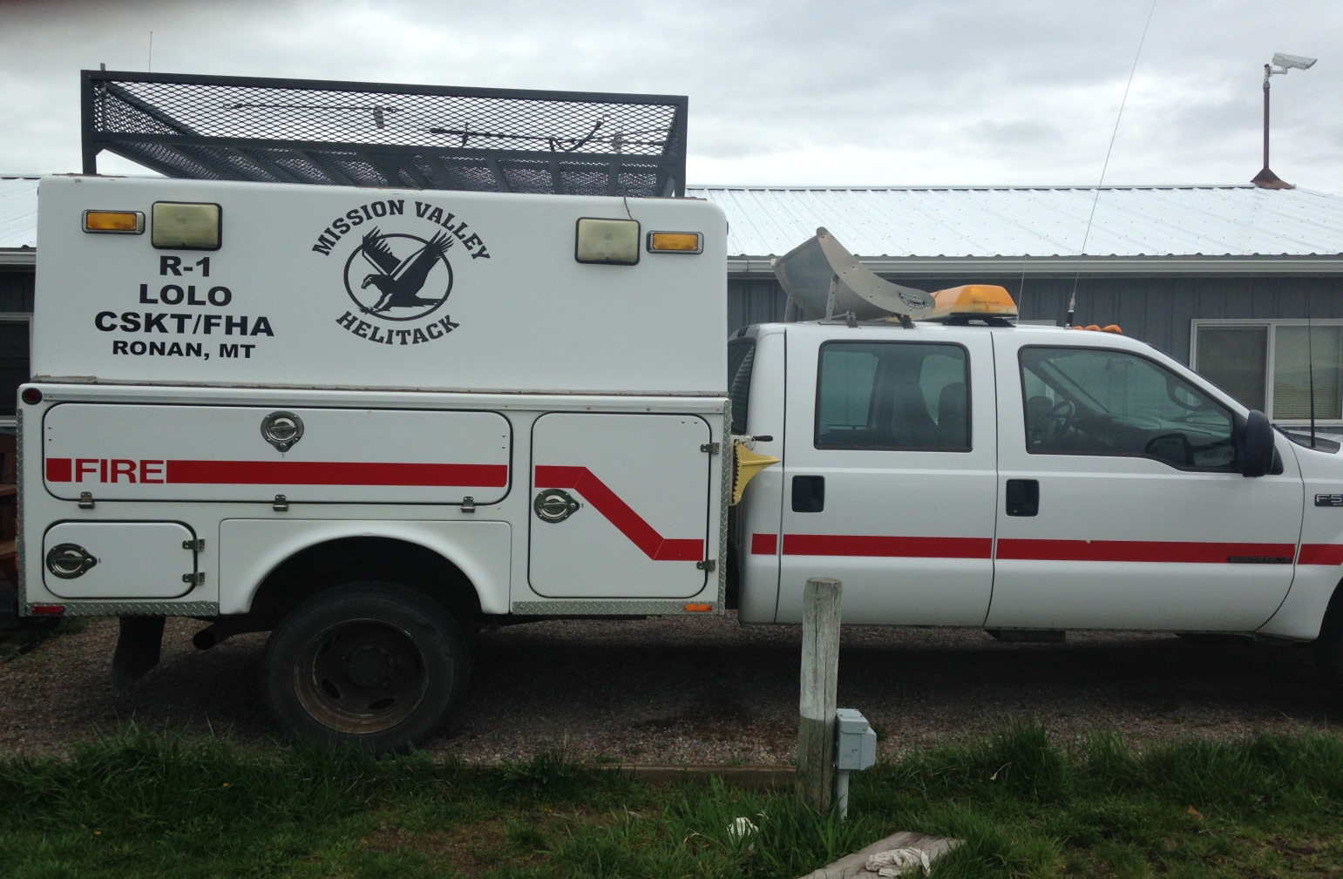
Mission Valley Helitack (MVH)

Slide 15
MVH-History of Program
Started Joint contract in 1996
CSKT fully staffed Helicopter crew (1996-1999)
In 2000 USFS funded 2 personnel for crew, while CSKT funded 6 personnel.
1996-2009 USFS contract
2010-present BIA contract
Present BIA personnel-8 (Mgr., Asst., Sqd ldr, Sr FF, 4 Aid/Tech positions)
Present USFS personnel-5 (Asst., 2-Sqd ldr, 2 Sr FF)

Slide 16
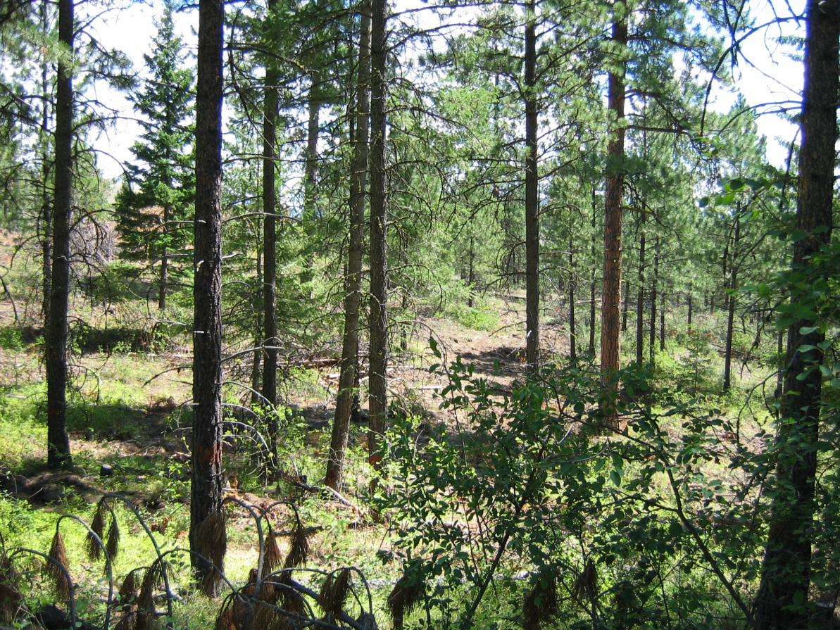
Finding Champions
It is critical to have Champions within both agencies--that keep the ball moving when challenges occur.

Slide 17
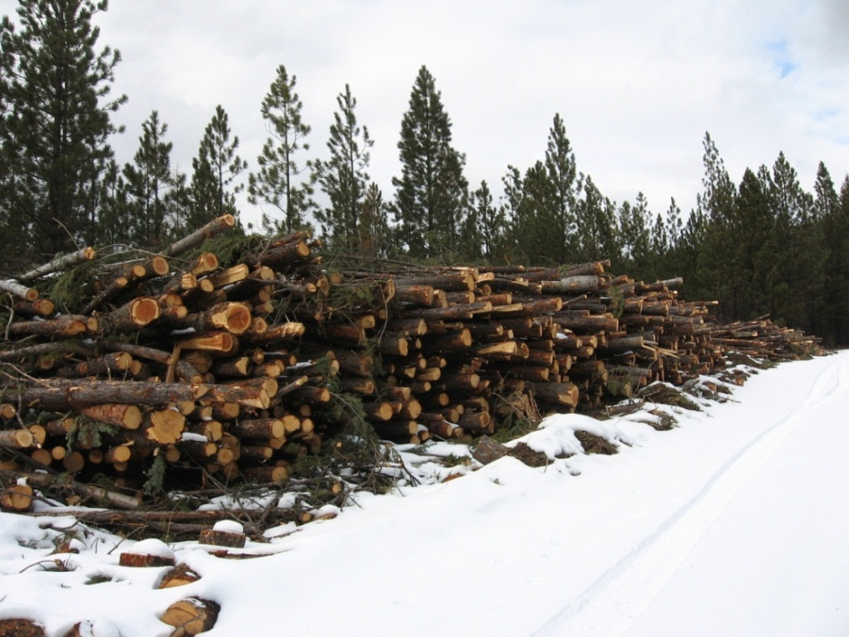
Details
NEPA
Contract Relationship
Bidding
Posting Bonds or Letter of Credit
Financial Accounting and Paying Sub-contractors
Bidding
Market Uncertainty and Fiscal Risk
Billing
Scrutiny
Tribal Capacity
Commitment

Slide 18
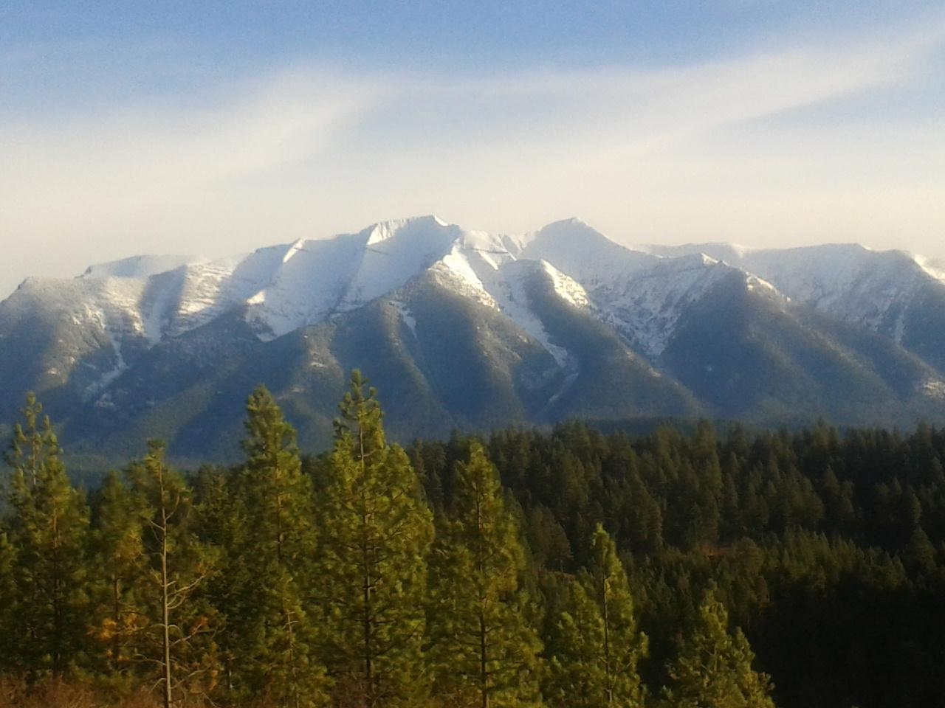
The Path Forward
Contractor Partner

Slide 19
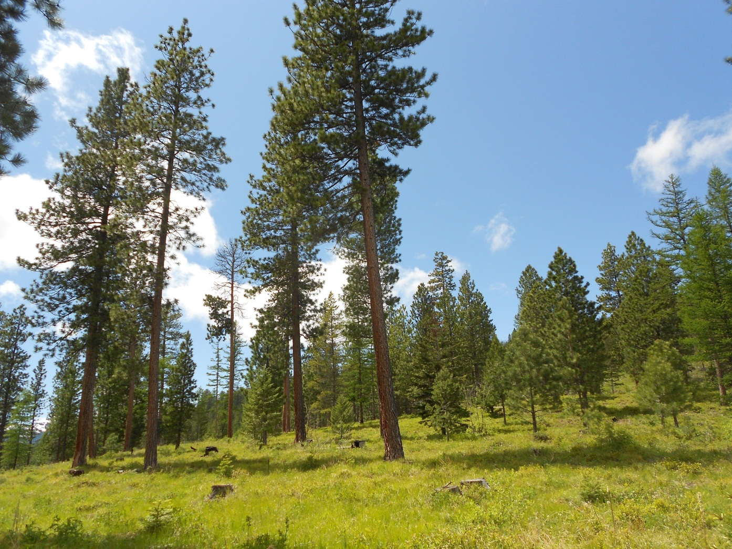
Questions?

