Slide 1
What’s Your Healthy Forest Worth?
Valuing Ecosystem Services for Conservation
Presented by Sherry Hazelhurst, R5 Director State & Private Forestry

Slide 2
Why Do we Care?
To sustain natural resources for people’s wellbeing

Slide 3
Valuing Ecosystem Services
Provisioning Services
Food
Fresh Water
Wood & Fiber
Fuel
Regulating Services
Climate Regulation
Flood Regulation
Water & Air Purification
Pollination
Cultural Services
Recreation
Education
Cultural Heritage
Aesthetics
Supporting Services
Nutrient Cycling
Soil Formation
Primary Production
Built
Capital
Social
Capital
Inter-
action
People’s
Wellbeing
Human
Capital
Ecosystem Services
Natural Capital
VALUES
$ ☺  , etc.
Sources:
Costanza, R., R. de Groot, P. Sutton, S. van der Ploeg, S. J. Anderson, I. Kubiszewski, S. Farber, R. K. Turner. 2014. Changes in the Global Value of Ecosystem Services; Global Environmental Change, V. 26: 152-158. http://dx.doi.org/10.1016/j.gloenvcha.2014.04.002
Millennium Ecosystem Assessment, 2005. Ecosystems and Human Well-being: Synthesis. Island Press, Washington, DC.

Slide 4
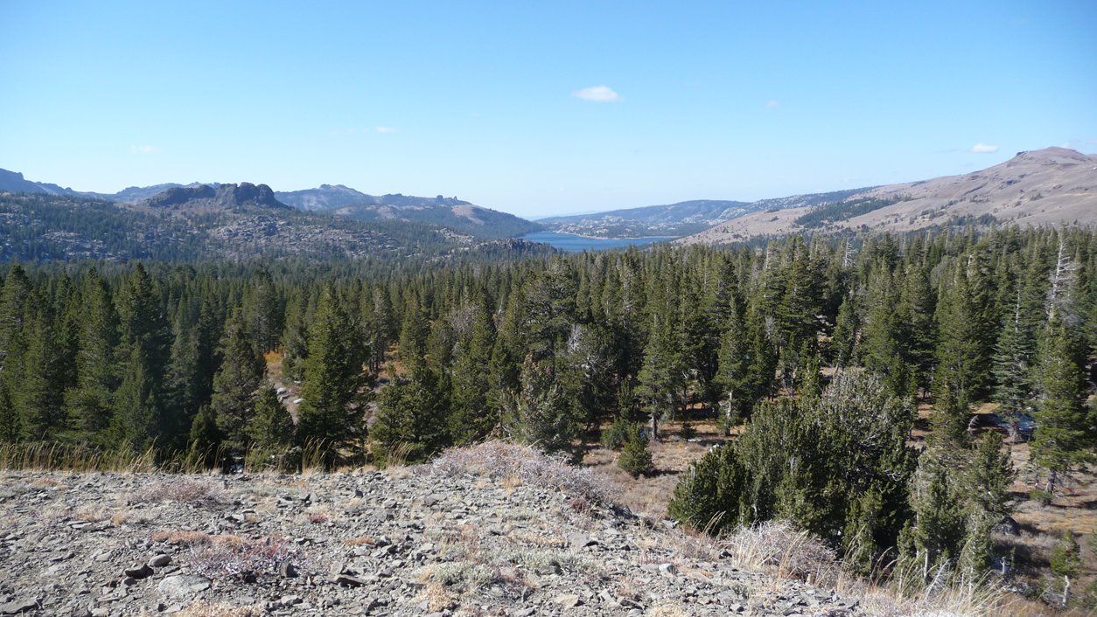
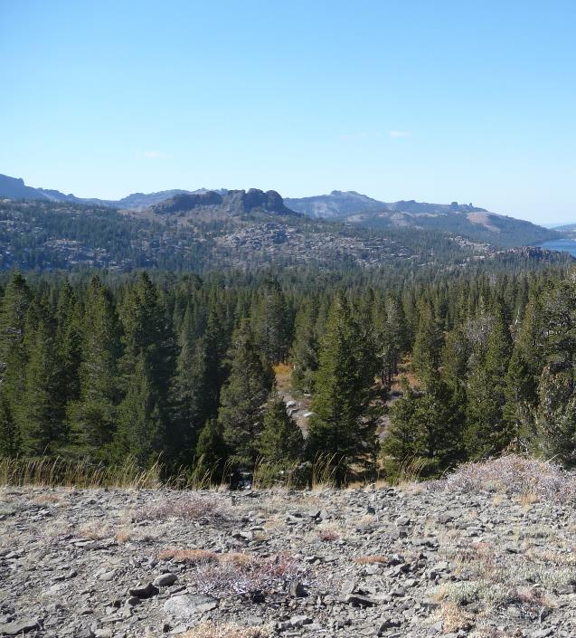
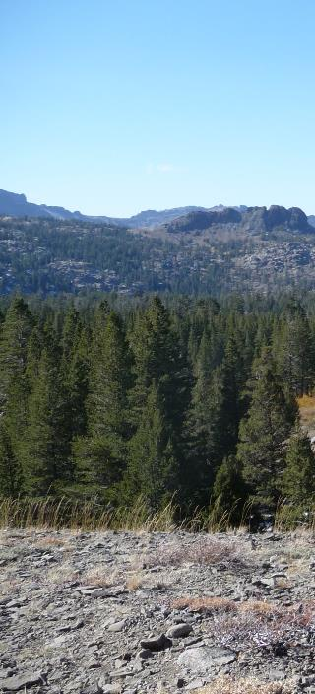
Telling the Story –
3 Tales of One Forest

Slide 5
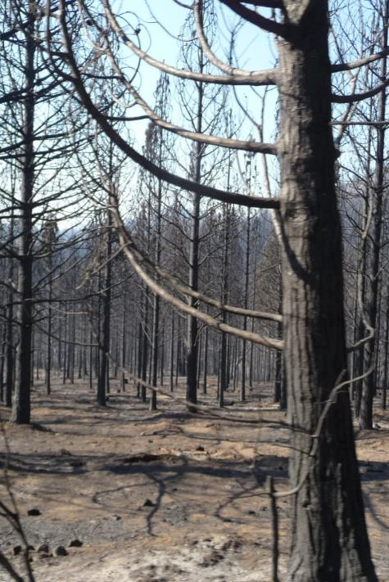
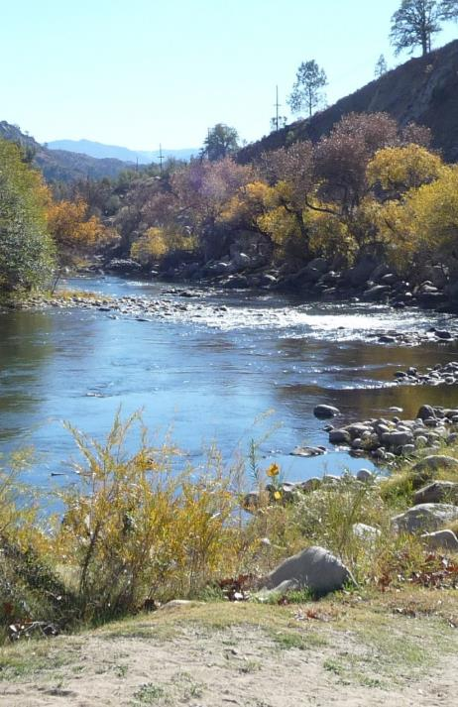
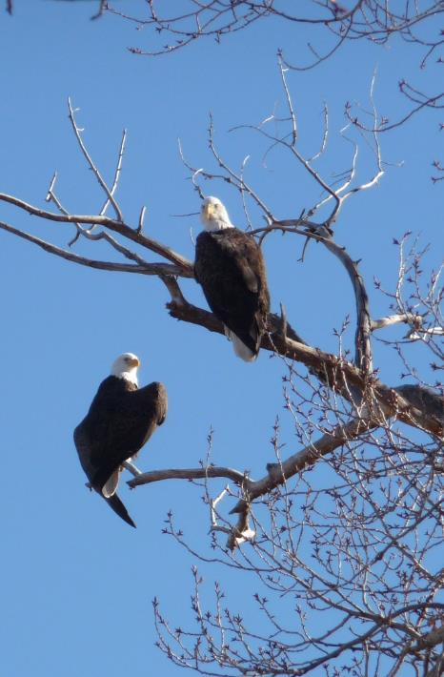
Forest 1 – Ecologic Story

Slide 6
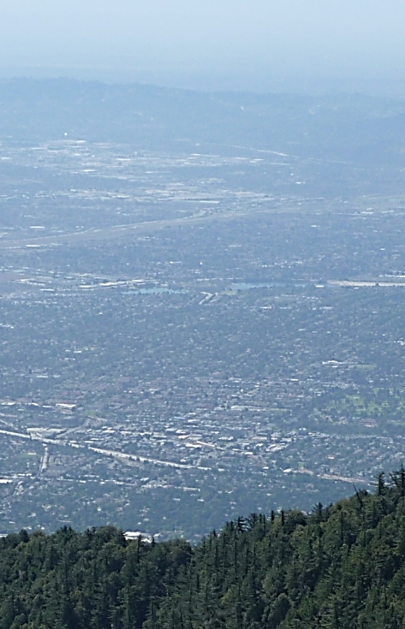
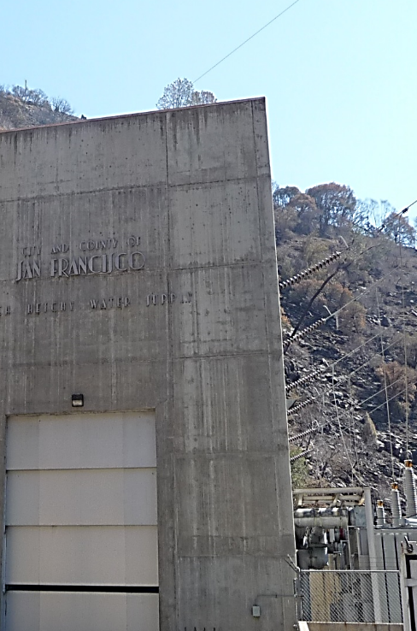
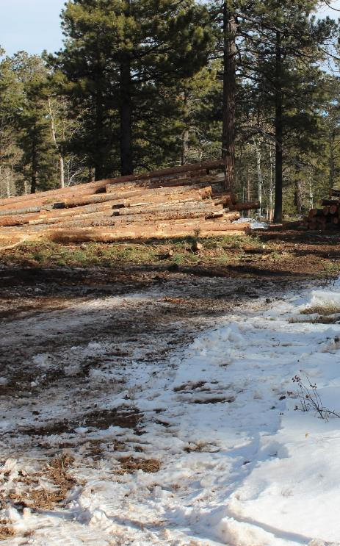
Forest 2 – Economic Story

Slide 7
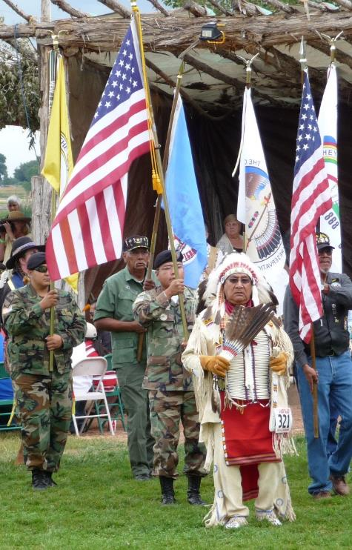
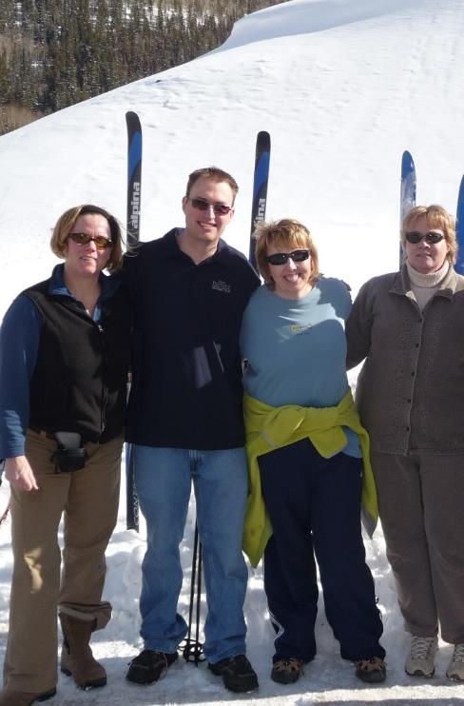
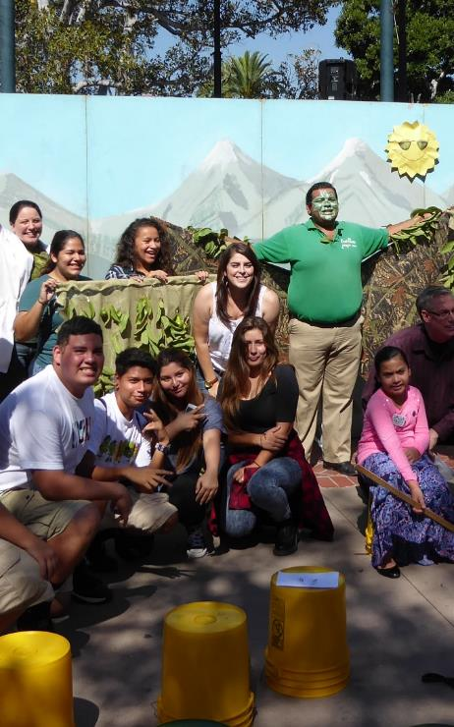
Forest 3 – Social/Cultural
Story

Slide 8
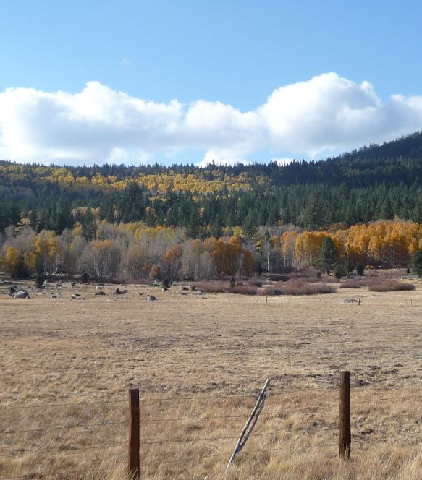
Blending Stories for Action
Identify audiences
Convey urgency
Engage others

Slide 9
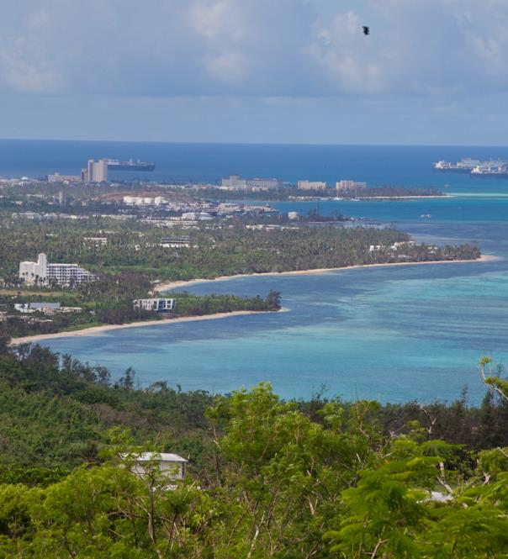
Where might we go Next?
Urban communities
New markets
New investment mechanisms

