Slide 1
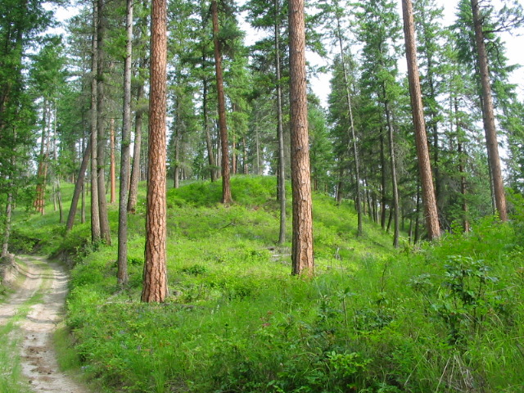
LiDAR and the Northeast Washington Forest Vision 2020
Karen Honeycutt, CFLR Coordinator,
Natural Resource Program Manager

Slide 2
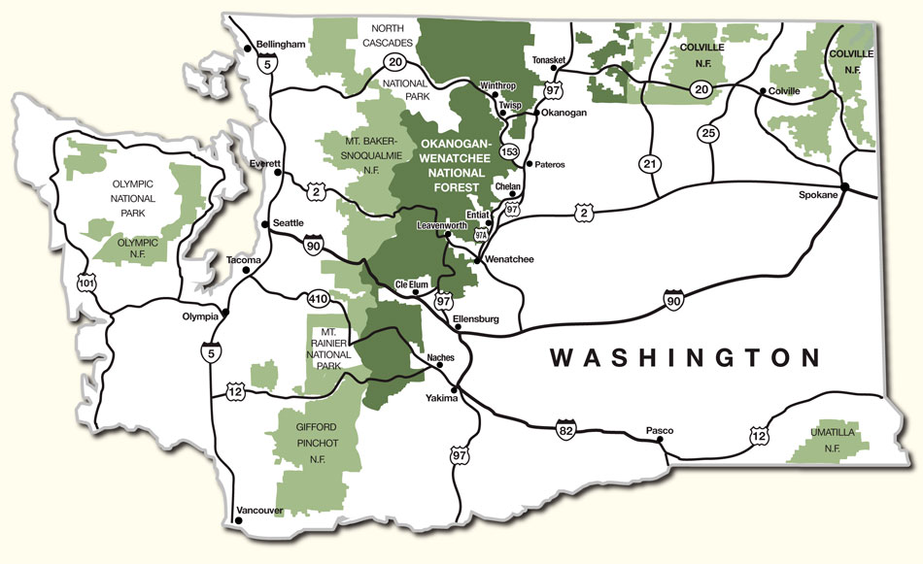
Colville National Forest
Notes:
1.1 million acres
Kettle River Range
Selkirk Mountain Range
Upper reaches of Columbia River
Wide range of forest types ranging from dry Doug fir and ponderosa pine to moist cedar/hemlock

Slide 3
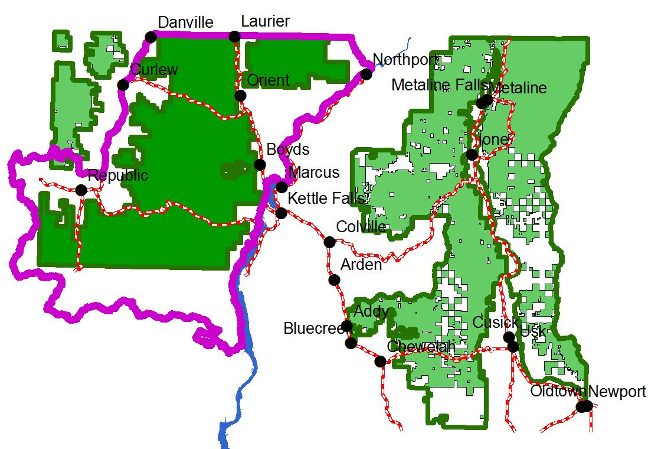
Northeast Washington Forest Vision 2020

Slide 4
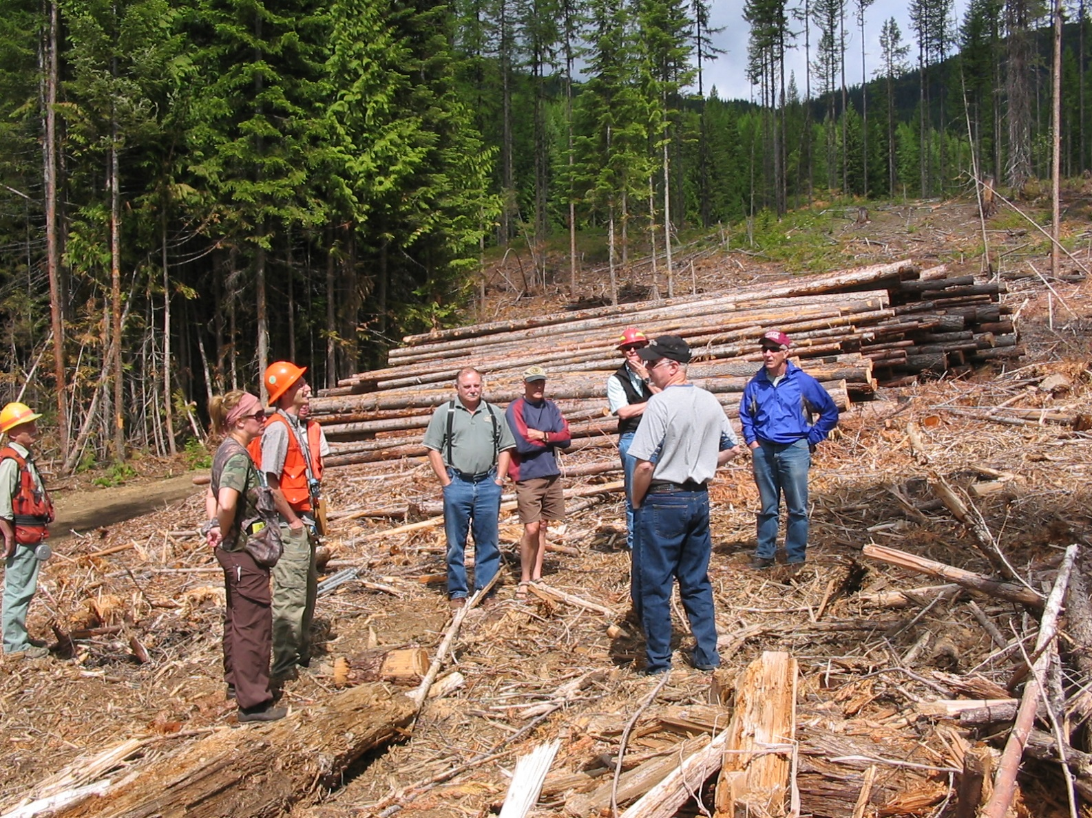
Collaboration

Slide 5







Project Goals
Restore most of the landscape to Condition Class 1
Rebalance structural stages toward HRV
  Particularly increasing amounts of Old Growth Structure
Balance our road system needs with hydrologic and fisheries concerns

Slide 6
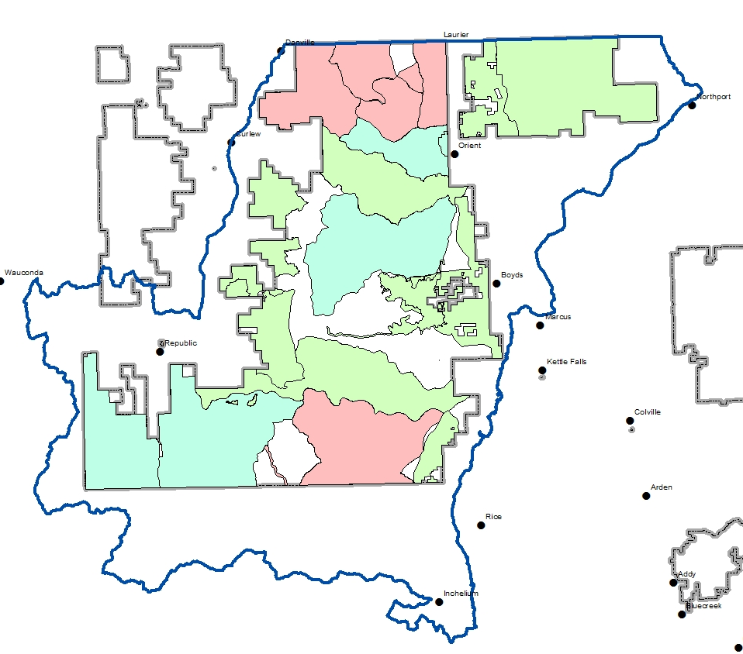
Project Areas in NEW Forest Vision 2020

Slide 7
Big picture, multi-scale question:
Did we shift the pattern, structure, and composition of vegetation at the stand, watershed, and CFLRP scale towards desired targets?

Slide 8
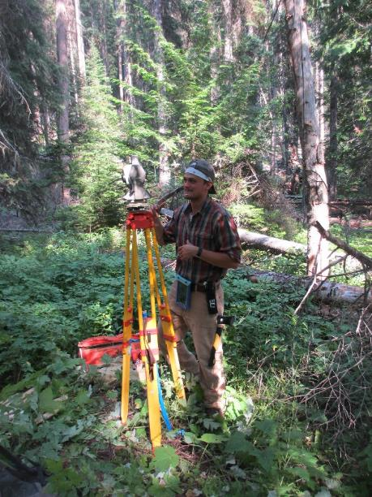
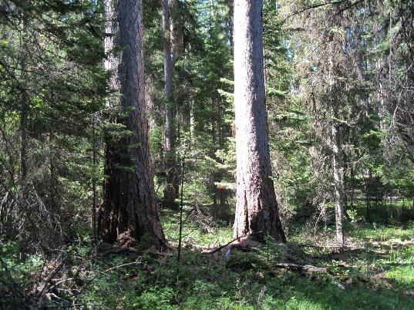
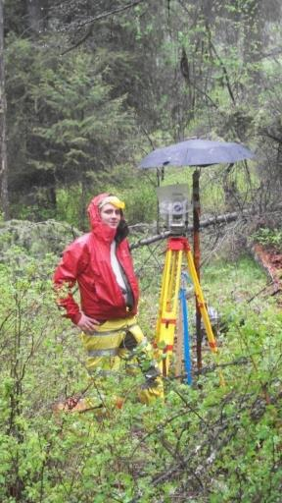
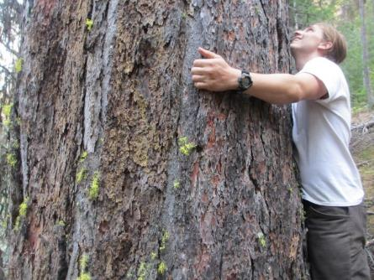
Baseline Reference Conditions Study
7-12 acre Stem maps
Reconstructed to pre-settlement year: 1890
100+ cores per plot to reconstruct diameter
Pre-1890 snags and downed logs included

Slide 9
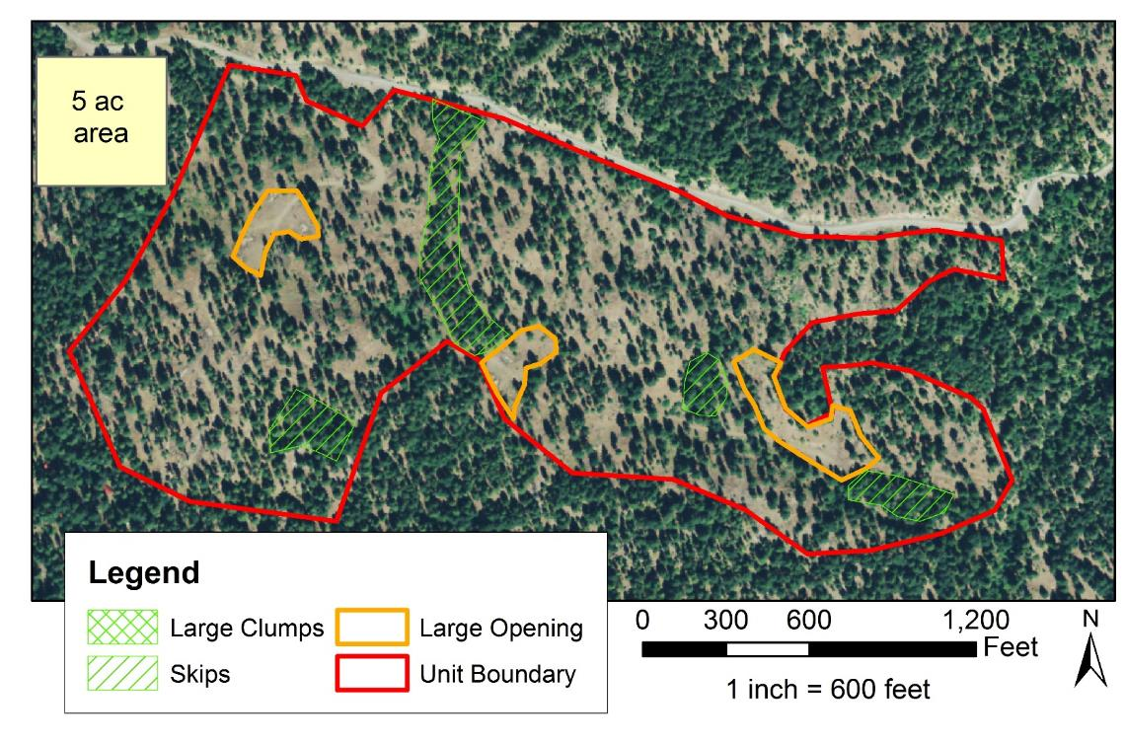
How Much Variability?

Slide 10
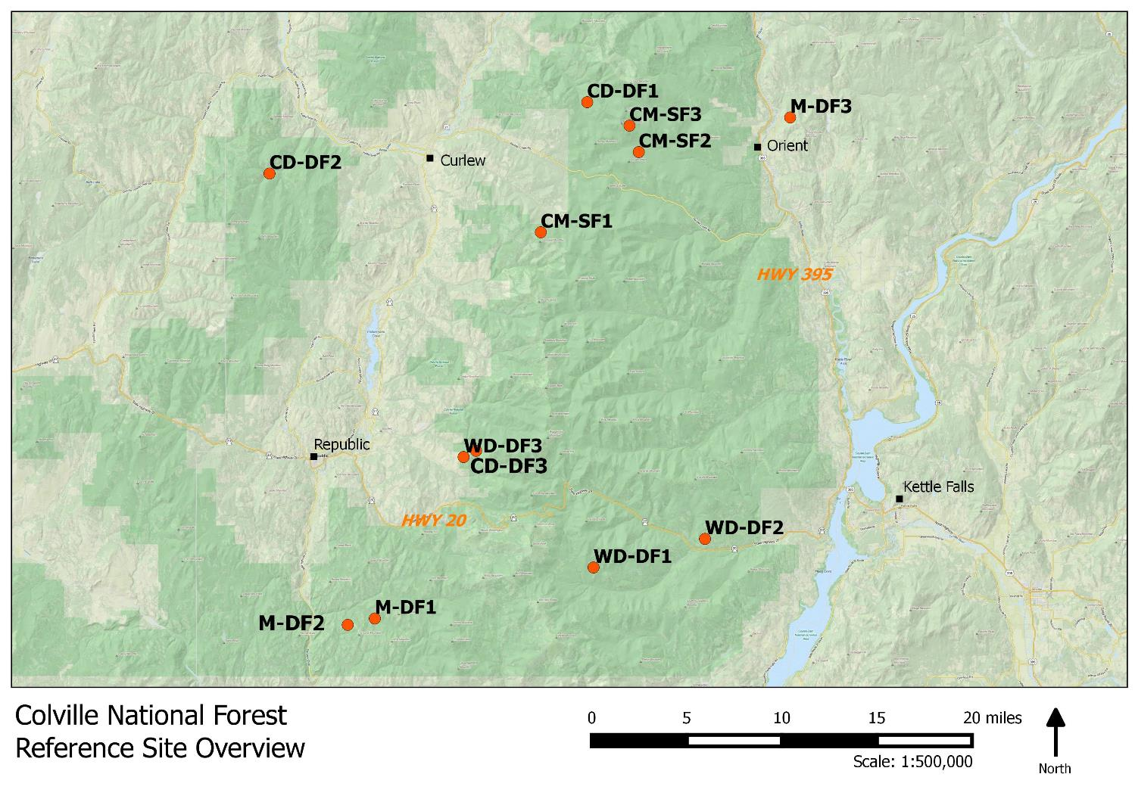

Slide 11
Reference Sites
Type | Count
Cold Mesic Subalpine Fir | 3
Mesic Douglas-fir | 3
Cool/Dry Douglas-fir | 3
Warm/Dry Douglas-fir | 3
Total | 12

Slide 12
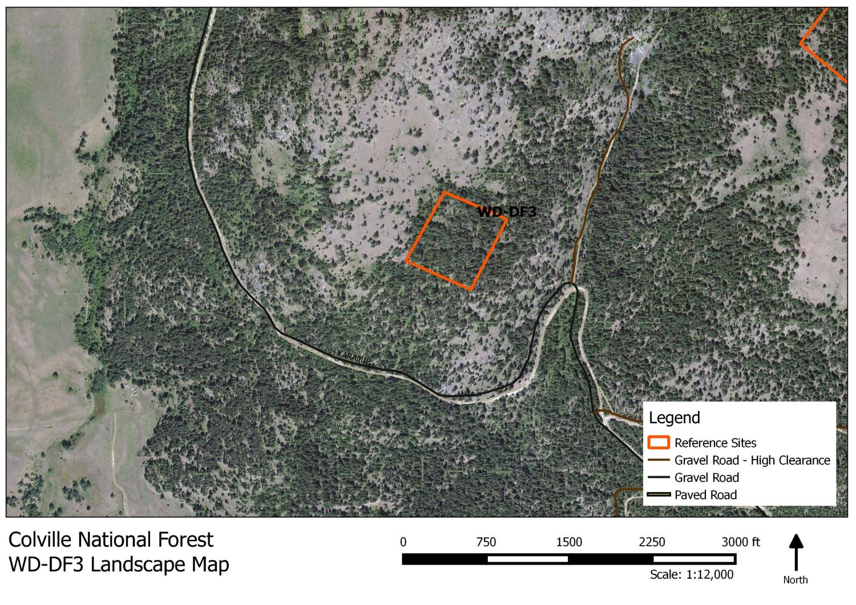

Slide 13
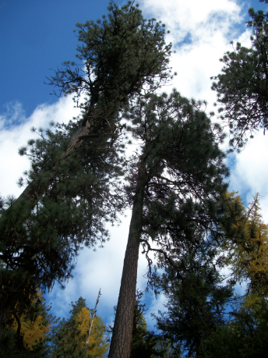
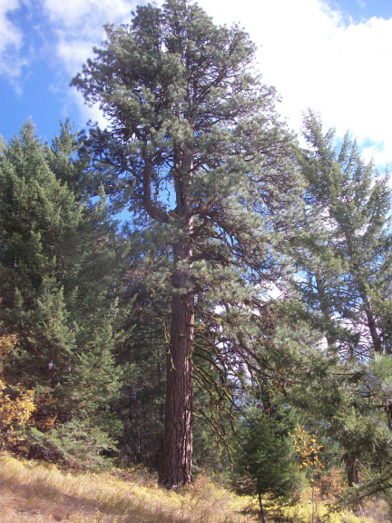
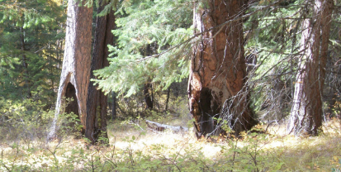
Warm Dry Douglas-fir 1

Slide 14
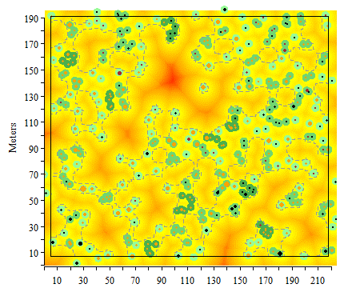
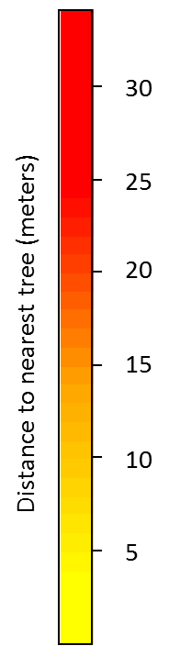
Warm Dry PSME 1

Slide 15
Warm Dry PSME 1
Clump Size | Proportion of Trees
1 | 0.37
2-4 | 0.46
5-9 | 0.17
10-15 | 0.00
15-30 | 0.00
30+ | 0.00

Slide 16
Warm Dry PSME 1
Clump Size | Proportion of Trees
1 | 0.37
2-4 | 0.46
5-9 | 0.17
10-15 | 0.00
15-30 | 0.00
30+ | 0.00

Slide 17
Multi-Scale Monitoring & Data Framework
Did we shift the pattern, structure, and composition of vegetation at the stand, watershed, and CFLRP scale towards desired targets?
Level | Source of Targets, Departure Assessment | Data Analysis & Types
CFLRP Area | Landfire FRCC LiDAR | - Run Landfire FRCC departure assessment - LiDAR pre and post treatment analysis
HUC 6/12 Watershed; NEPA Analysis Area | HRV – FRV: Hessburg data or CNF plan Functional: Forest structure effects on fire, water yield, GRAIP, habitat. | - Pre and post treatment comparison with HRV-FRV data - LiDAR, BACI plots
Stand & Within-stand | Reference stem maps: ICO methods Functional: Fire, habitat needs, snow retention, tree vigor, timber growth. | - Reference stem maps - BACI plots, monitoring stem maps - LiDAR

Slide 18
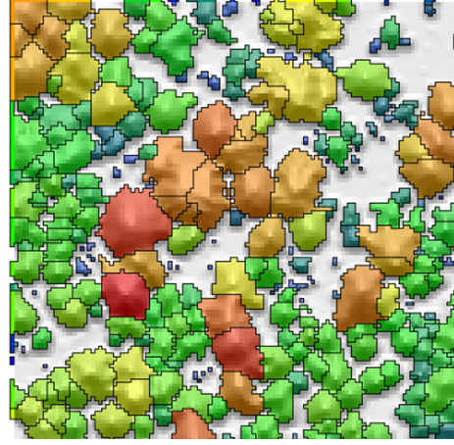
CFLRP LiDAR Data
All CFRLP area flown
Baseline monitoring data
Researched use of pre & post acquisitions for monitoring
Full suite of LiDAR data ready for use
- Canopy cover
- Tree heights
- Fine scale pattern
- Volume, BA, QMD, SDI
- & more

Slide 19
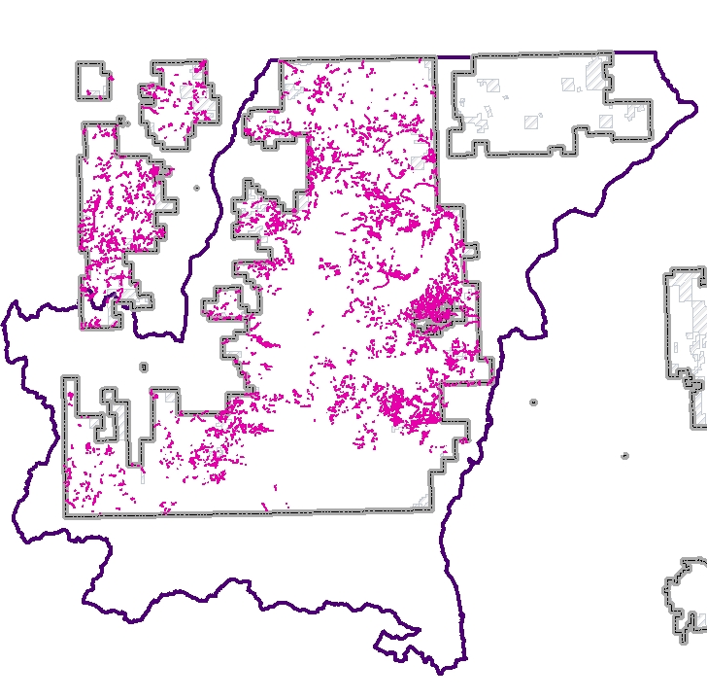
Roads
3190 Unclassified Templates
782 miles of Unclassified templates
1951 miles of Classified roads

Slide 20
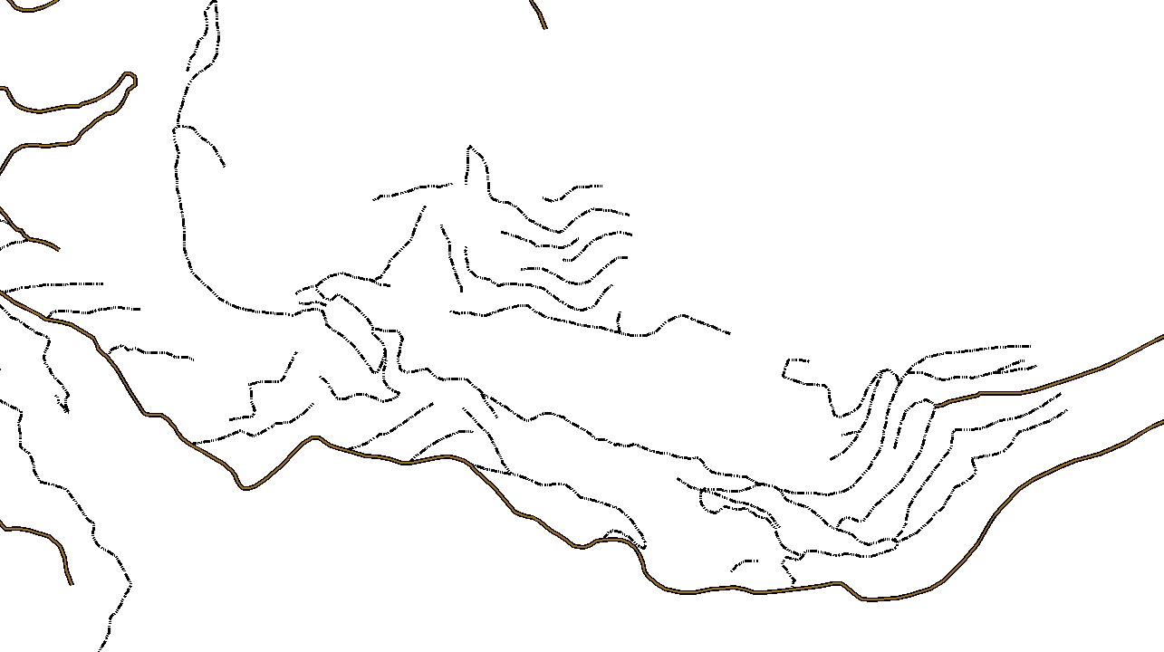
Roads

Slide 21
For More Information
And a Big Thank You to:
Derek Churchill
University of Washington
derekch@uw.edu

