Slide 1
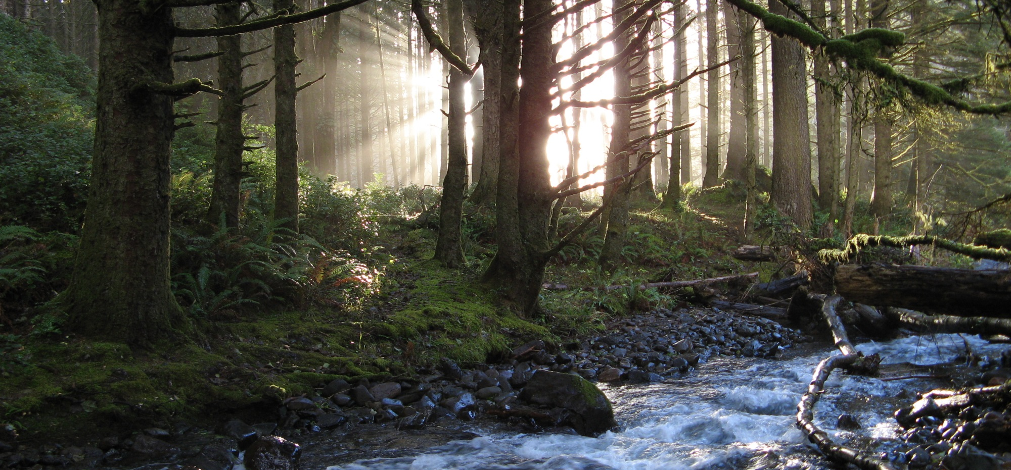
a mature
collaborative
Collabortive
The Siuslaw Story

Slide 2
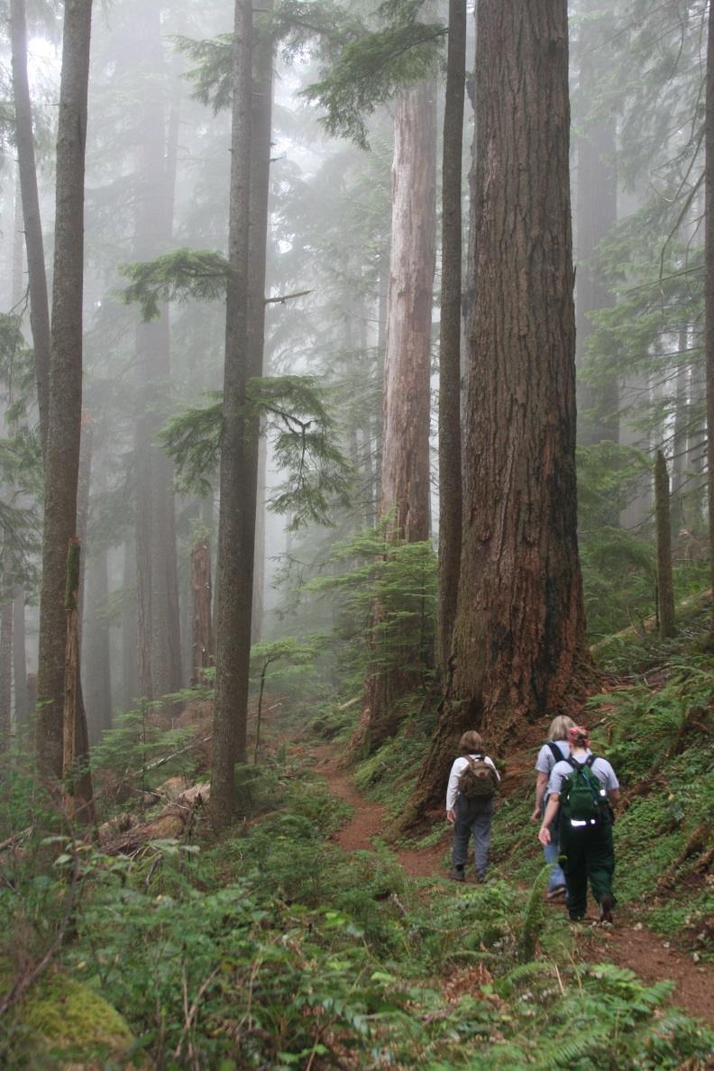
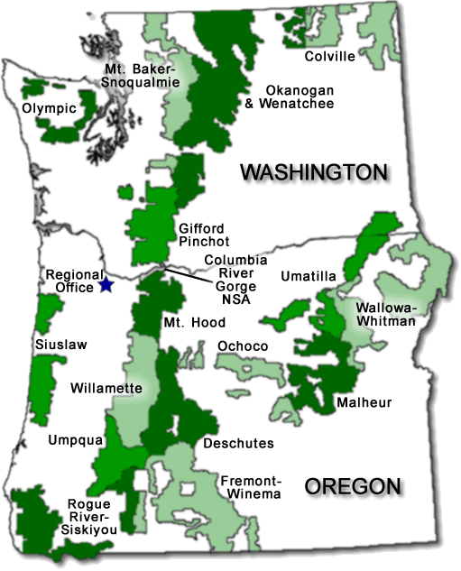
context: place
Oregon Coast Range
630,000 acres
Temperate rainforest
(spruce, Douglas fir, hemlock)
200-300 year fire return interval
Salmon, elk, and endangered species (owl, murrelet, plover, silverspot butterfly)
Notes:
context

Slide 3
context: brief history
1840 – 1868: The forest burns
1907 – 1908: Forest reserves and Siuslaw National Forest
1930s: Civilian Conservation Corps
1950 – 1990: Big timber
1990s: Turning point
1994 – 2016: Restoration, recreation, and partnership
Notes:
context, history

Slide 4
context: crisis in the 1990s
Triggering Events
Mapleton lawsuit – debris flows, uncertainty
Spotted owl, marbled murrelet, coastal coho salmon
Landslides, floods
Herbicides
Northwest Forest Plan
Consequences
Entire Siuslaw reserved (late successional reserves, riparian reserves)
Timber sale reduction: 382 MMBF 4 MMBF in one year
Employee reduction: 440 150
Mill closures, job losses, office closures (especially Mapleton, Alsea)
Crash in county funding
Leadership Challenge – Where To Go From Here?
Notes:
History, timber, Northwest Forest Plan

Slide 5
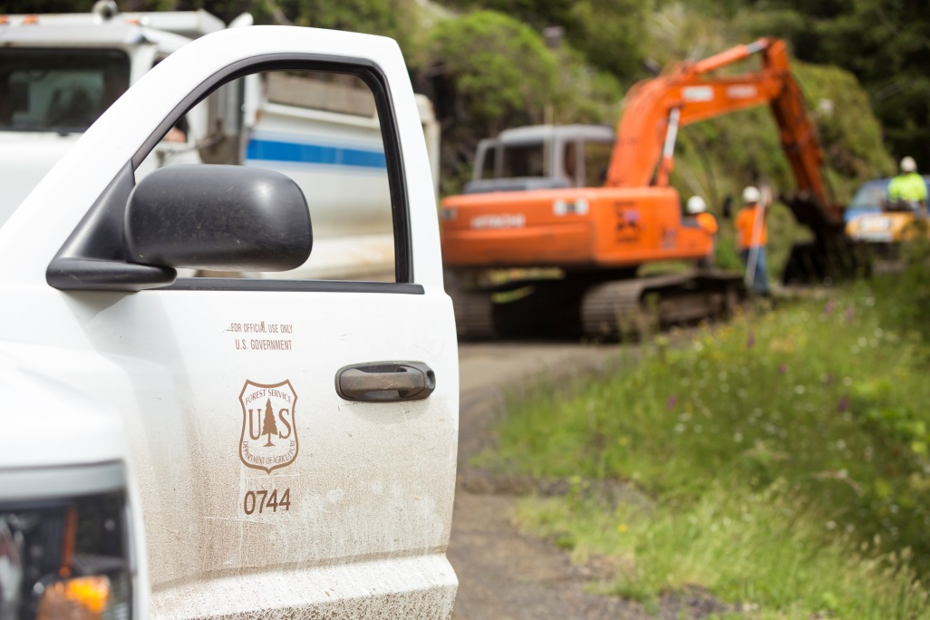
siuslaw today: the siuslaw niche
restoration.
recreation.
partnerships.
Notes:
Siuslaw niche

Slide 6
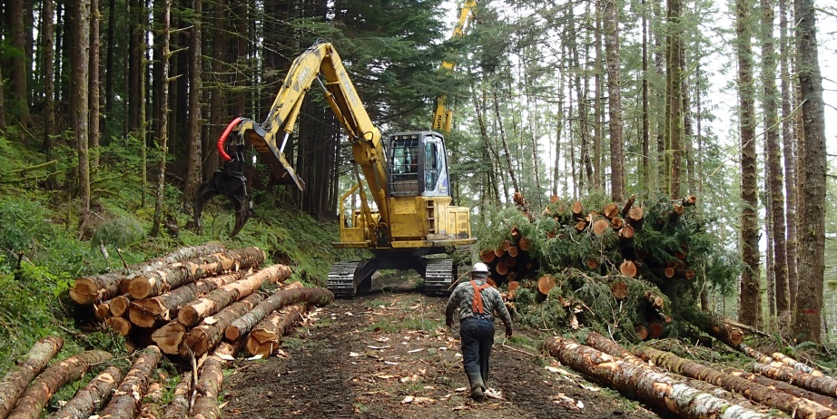
siuslaw today: restoration
Opportunity
Late successional and riparian reserves
206,000 acres uniform, fully stocked Douglas fir plantations
Excellent growth, markets
Commercial thinning to accelerate late-seral conditions
Restoration ecology
Late-seral forests
Streams, whole watersheds
Sustainable road system
Restoration economy
Creating jobs
40 MMBF annual harvest
Collaborative leadership
Retained receipts (> $ 2 million per year)
Working across boundaries
Stewardship groups, watershed councils
Notes:
Restoration strategy

Slide 7
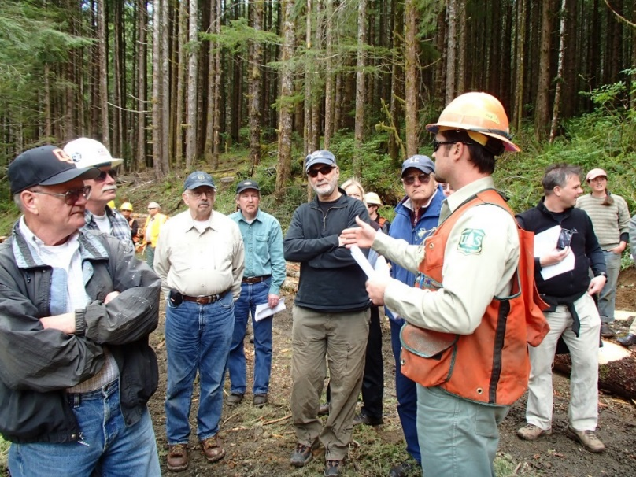
siuslaw today: collaboration
Four stewardship groups (soon to be 5)
Siuslaw
Alsea
Marys Peak
Hebo
(Smith River - Dunes)
Cascade Pacific RC&D
Facilitation, Coordination
Banking, Grantor
Monitoring
50% Stewardship / 50% Timber Sale (100% restoration)
40 MMBF / year
High value (mostly > $ 200/MBF; one recent sale at $ 341/MBF)
Retained Receipts – 60% NFS / 40% Wyden
Notes:
Siuslaw niche - partnerships

Slide 8
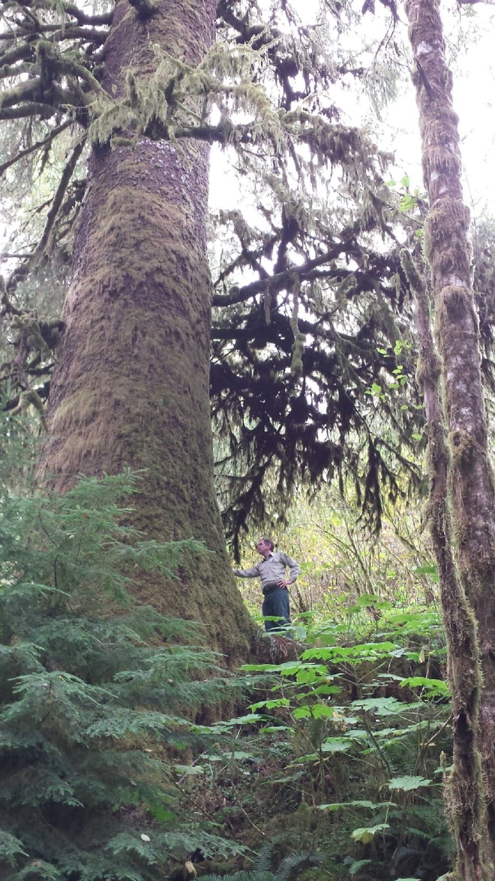
key components of collaboration
Triggering event
Crisis was opportunity for reinvention
Leadership
Early start, before it was cool
Right people at the right time
Leadership in local communities
Facilitation
Role of Cascade Pacific
Funding facilitation
Relationships
High trust
Regular work
Something to do, money to pay for it
High agreement on basic principles, very local, very personal
We don’t need to drive the bus…
Sharing responsibilities, resources, knowledge
Trust and empowerment, internally and externally
Seeking results rather than control
Notes:
Siuslaw niche - partnerships

Slide 9
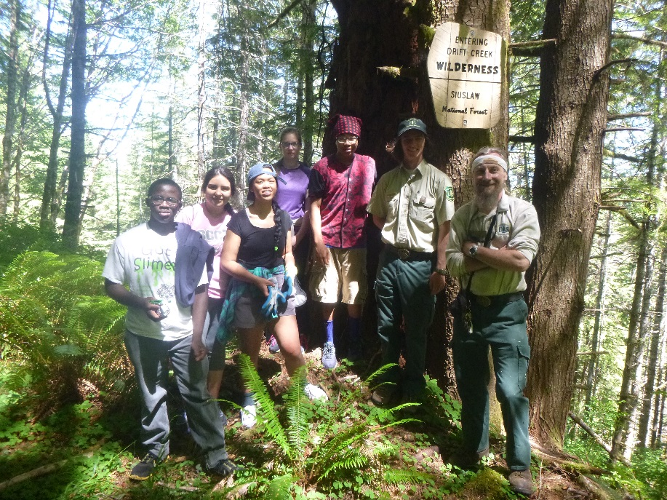
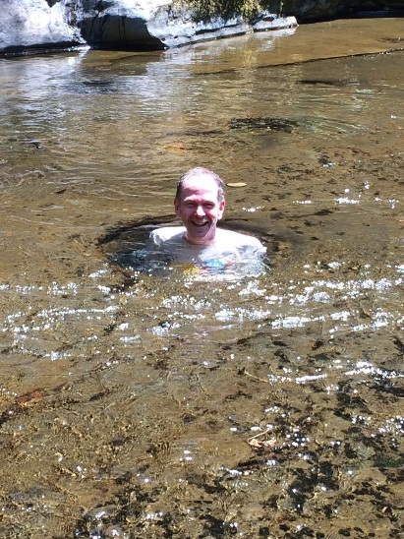
challenges and opportunities
Players change
Forest Service
Partners
Setting Precedent and Staying Unique
What it means to be first
What it means as others catch up
Using, misusing, and sustaining trust
Notes:
Future, restoration questions

Slide 10
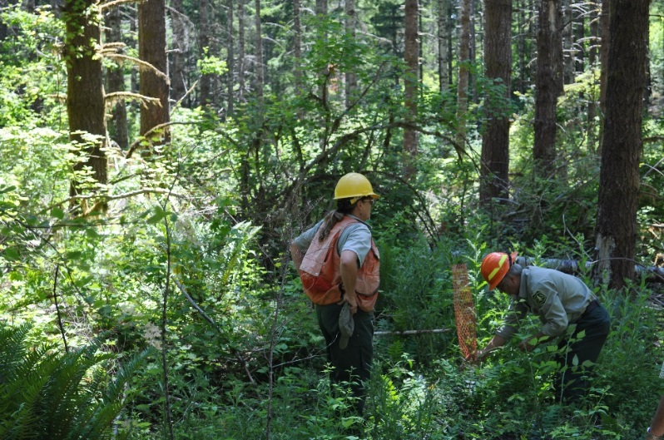
observations on nourishing a mature collaborative
Building Trust v. Sustaining Trust
Sustaining Community Capacity
A Focus on Institutions and on People
Sharing Leadership and Credit
Keeping People Engaged
Something in it for Everyone
Articulating Culture and Vision
Sustaining a Brand
Notes:
Future, restoration questions

Slide 11
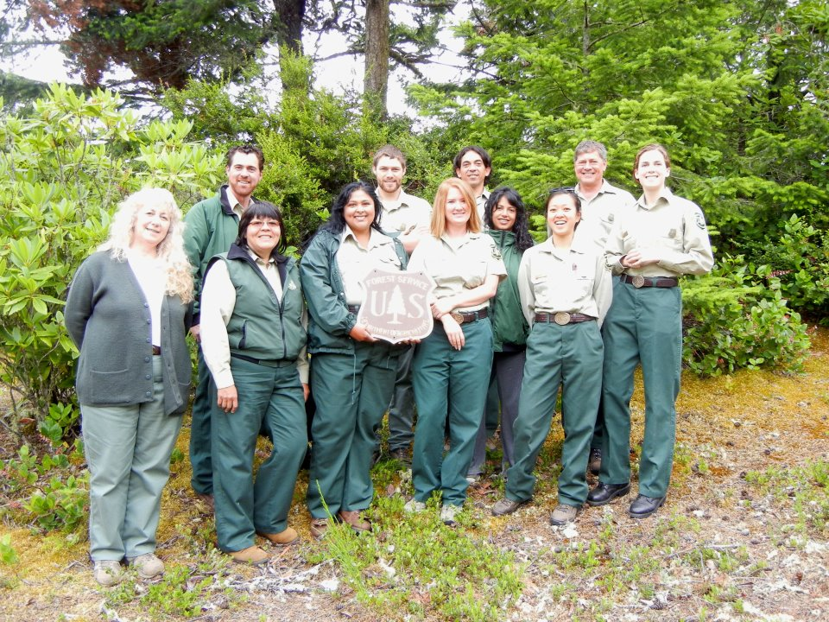
thank you!
“The Siuslaw National Forest is a magical, happy place,
where loggers and environmentalists get along!” Portland Monthly Magazine, February 2013
Notes:
closing

