Slide 1
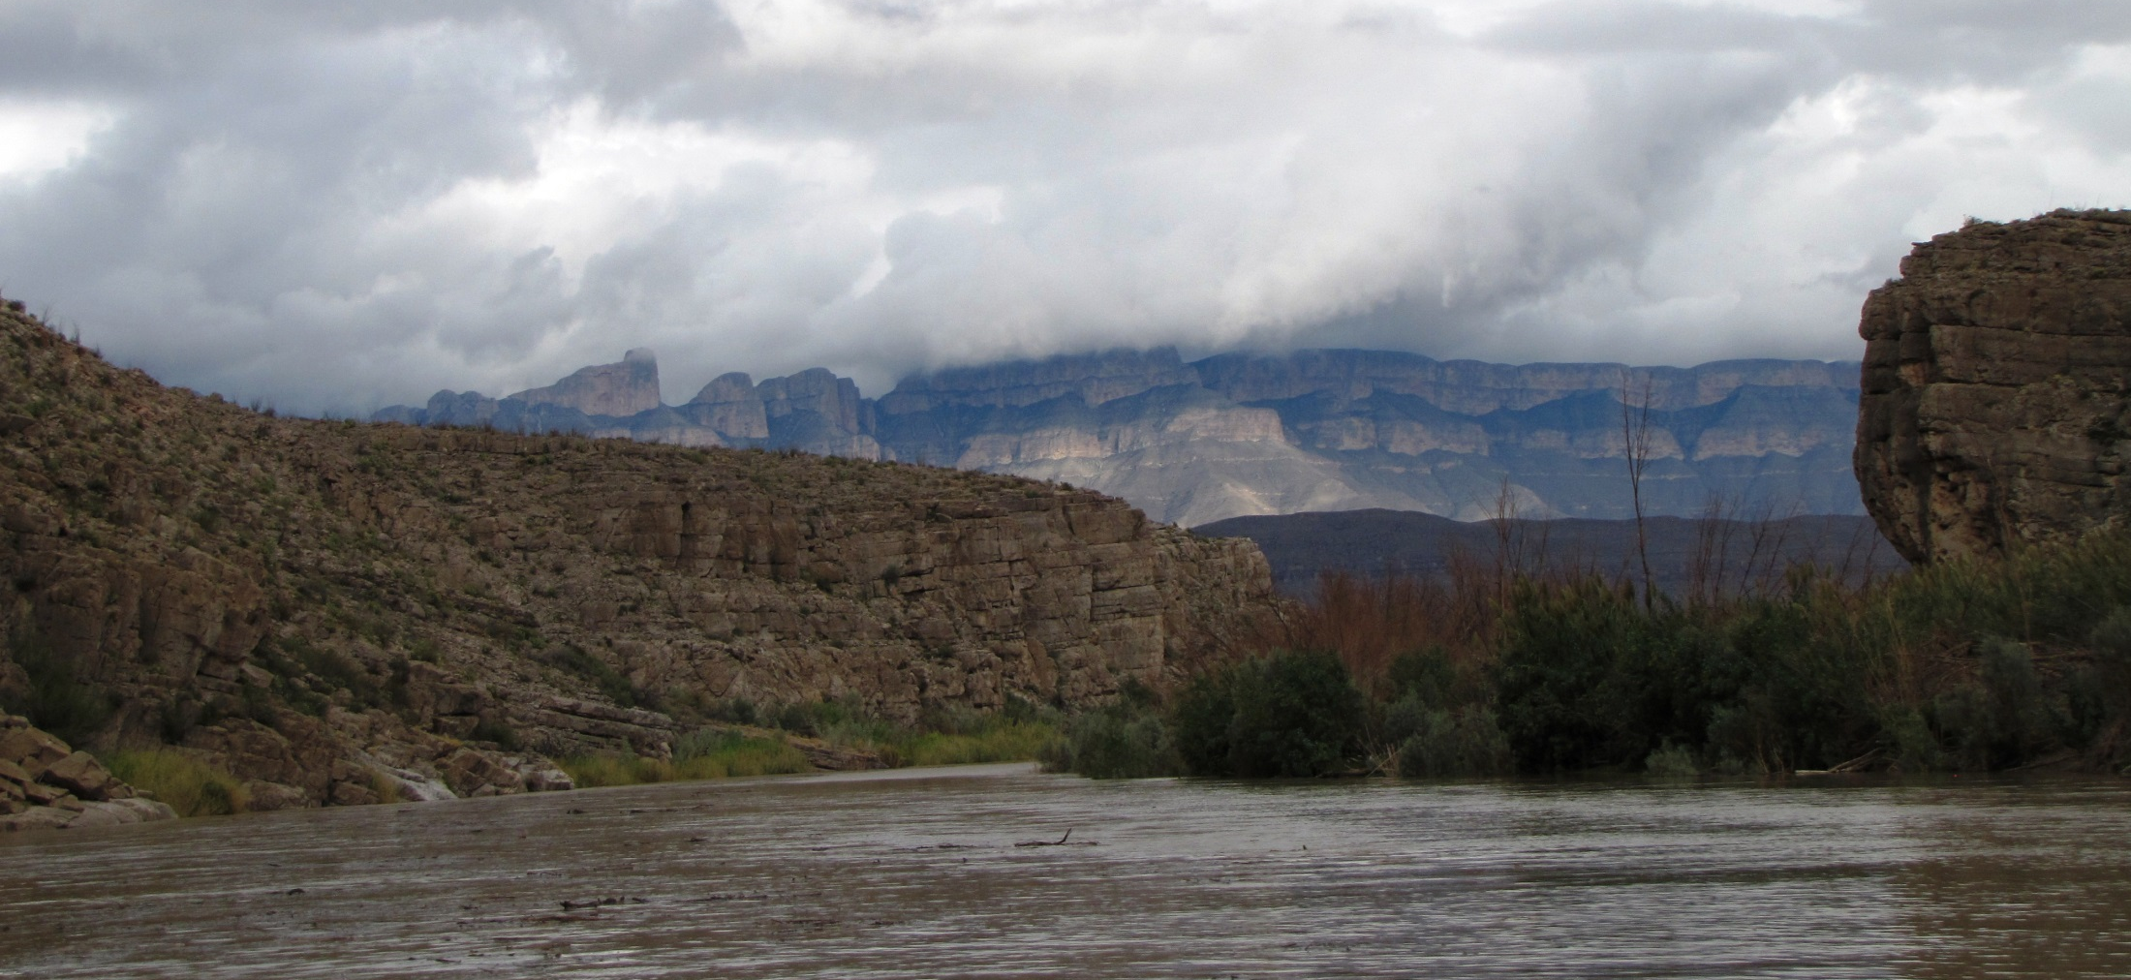
Planning for Restoration at the Landscape Scale:
Desert LCC Case Study
National Forest Foundation Collaborative Restoration Workshop
April 26-27, 2016

Slide 2
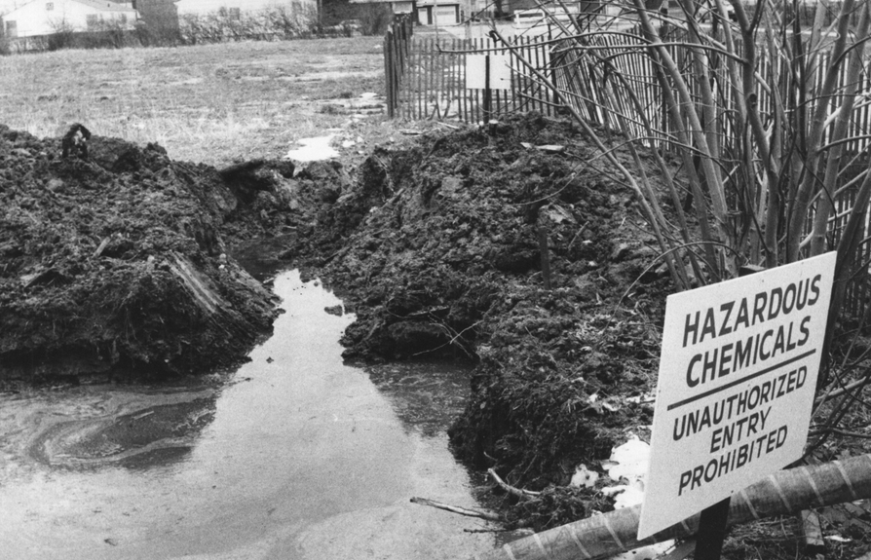
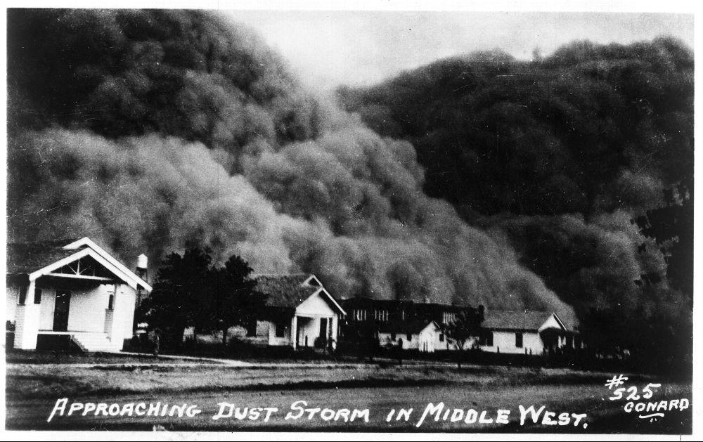
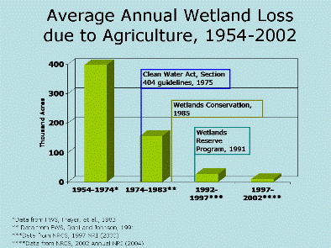
What’s the issue and why do I care?
Resource managers at many levels have successfully responded to major challenges in the past.
http://www.nabci-us.org/fbprograms.html

Slide 3
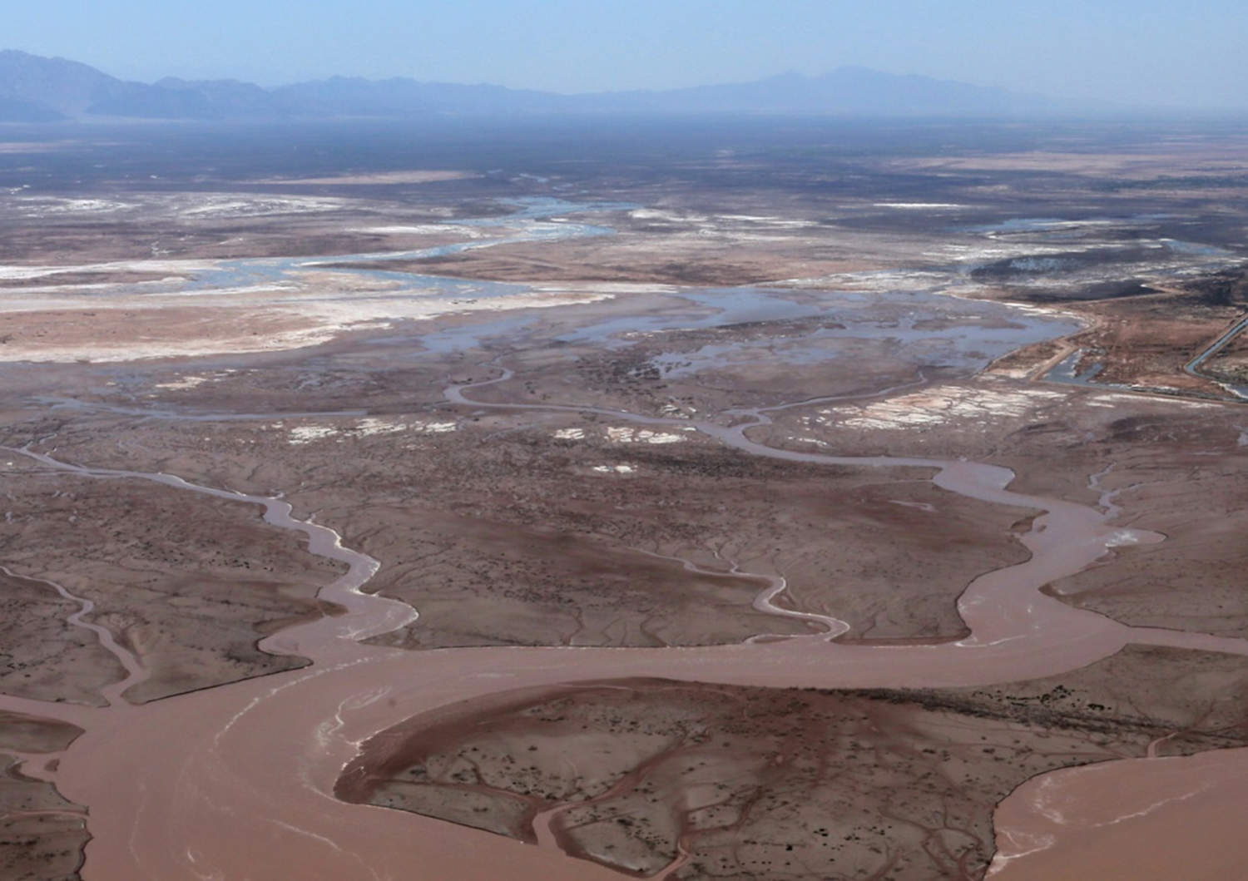
“Despite the legal mandates, massive expenditures, and the burgeoning industry of aquatic and riparian restoration, riverine ecosystems continue to deteriorate as a result of human influences” (Karr & Chu, 1999).
Restoration issues:
lack of a guiding vision or ecological endpoint to guide efforts
over-focus on creating habitat for single species without enough knowledge of the natural systems
lack of routine monitoring and assessment at a timescale that allows for project outcomes to develop
problem of setting goals for an isolated locations without linking entire watersheds or regions
complexity of natural resource management, agencies, laws, regulations, and mandates
Implicit goal of using the best science available

Slide 4
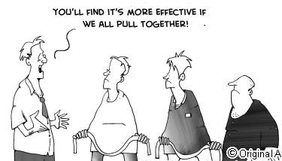
What can we do to build success?
"Organization of people around a common, needed conservation idea is the most important good out of this entire process...because it is a shift of paradigms." (Desert LCC NGO partner in Mexico)
Collective Impact: Changing paradigms

Slide 5
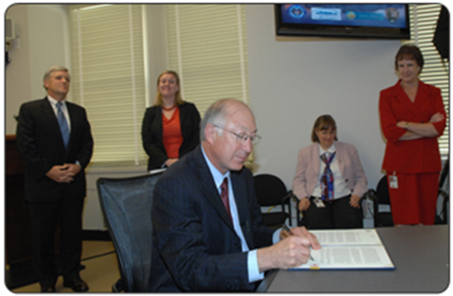
Need dedicated infrastructure
“…Interior bureaus and agencies must work together, and with other federal, state, tribal and local governments, and private landowner partners, to develop landscape-level strategies for understanding and responding to climate change impacts.” (2009: Secretarial Order 3289)
1
DOI Climate Science Centers
Landscape Conservation Cooperatives

Slide 7
Infrastructure
Partnership Community
Entities with resource management interests in the Desert LCC
Communicate interests and needs to the LCC
Contribute resources (staff) for LCC
Use LCC products in decision-making
Share information & resources
Steering Committee
Provides direction
Staff
Coordinator (BOR)
Science Coordinator (FWS)
Provide support & coordination
Management Questions
Working Groups
Science
Local Governments
Data & GIS
Administrative
Information & Products
Tribal
International
5 Critical Management Question Teams

Slide 8
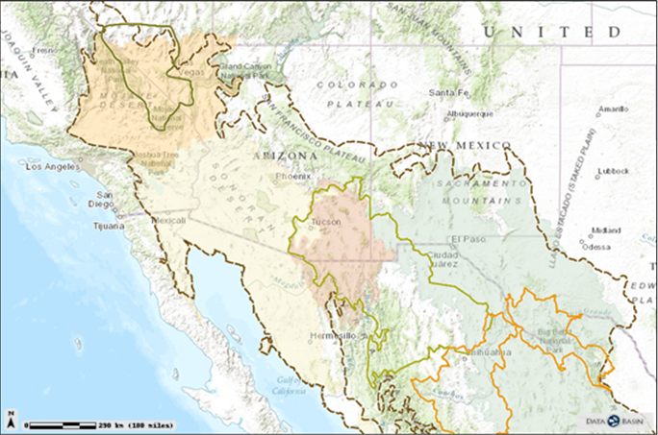
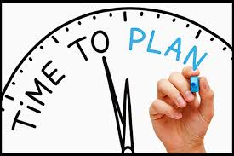
Find a shared focus
I don’t get excited every often, and this is one of the most exciting things I’ve been a part of in a long time. To have the opportunity to share information across boundaries, brainstorm at different scales and across resources, learn from other experts in the room – I’m very grateful that this has finally happened.” (Desert LCC Workshop Participant)
2
Landscape Conservation Planning & Design

Slide 9
Landscape Conservation Planning & Design
Collaborative process to identify common goals and objectives for managing resources across jurisdictional boundaries
Maps & assesses current & projected landscape patterns
Identifies a commonly-held desired future condition
Integrates human and ecological needs
Produces a suite of agreed-upon actions that respond to climatic variability
Maps specific places to develop collaborative actions that are useful and implementable by partners
Provides science to meet management goals

Slide 10
It’s people not institutions that matter
“The Desert LCC can define itself as the interest, enthusiasm, and connection to people that becomes vital in answering hard questions about resource management decisions.” (Desert LCC federal partner)
3

Slide 11
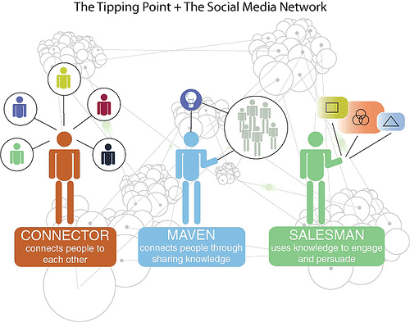
Emphasize communication between groups that develop science, discuss science, and those who use it

Slide 12
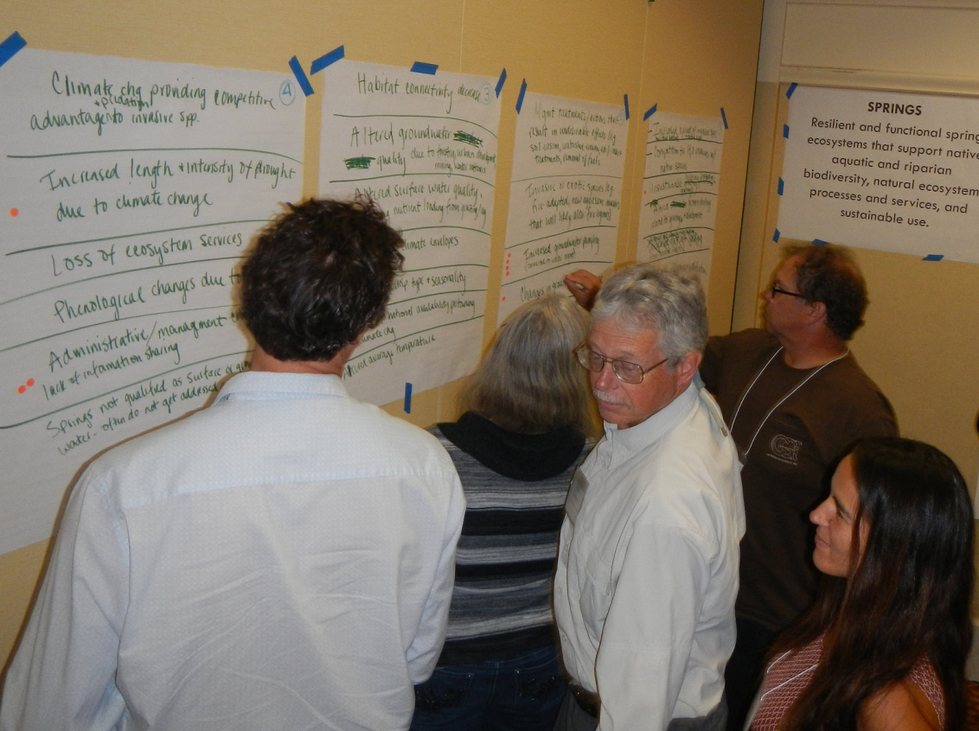
It’s not always the exciting stuff
Developing and applying scientific information, monitoring and evaluating through data collection and disseminating your findings and educating the public, land owners and stewards in a transparent way. Collaboration and good will are the best tools that we have.”
(Desert LCC State partner)
4
“The Fluffy” vs. “The Product”
“Input” vs. “Collaboration”
Define expectations & success
Talk about decision space
Provide a repeatable, meaningful process

Slide 13
Provide the right tools for the job
http://dlcc.databasin.org
5
Map baseline condition assessments or inventories
Map on-going or completed conservation actions: who is doing what where?
Understand where conservation actions are most needed
Understand where the greatest opportunities for collaboration are

Slide 14
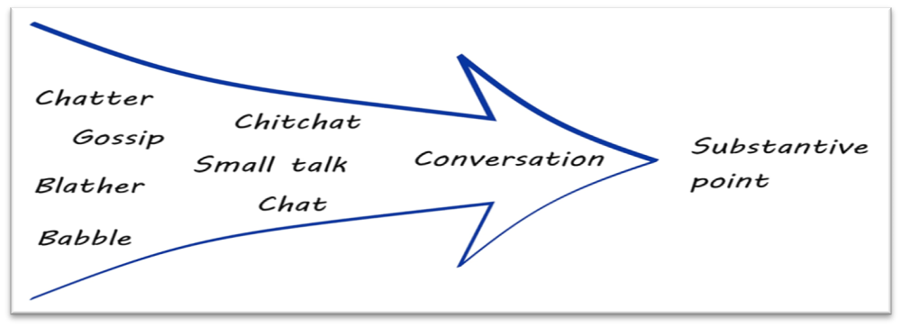
You guessed it…. TIME
I’m going to take all this knowledge back home, and this communication is great but we still need products.” (Desert LCC Workshop Participant)
6
We talk … A LOT

Slide 15
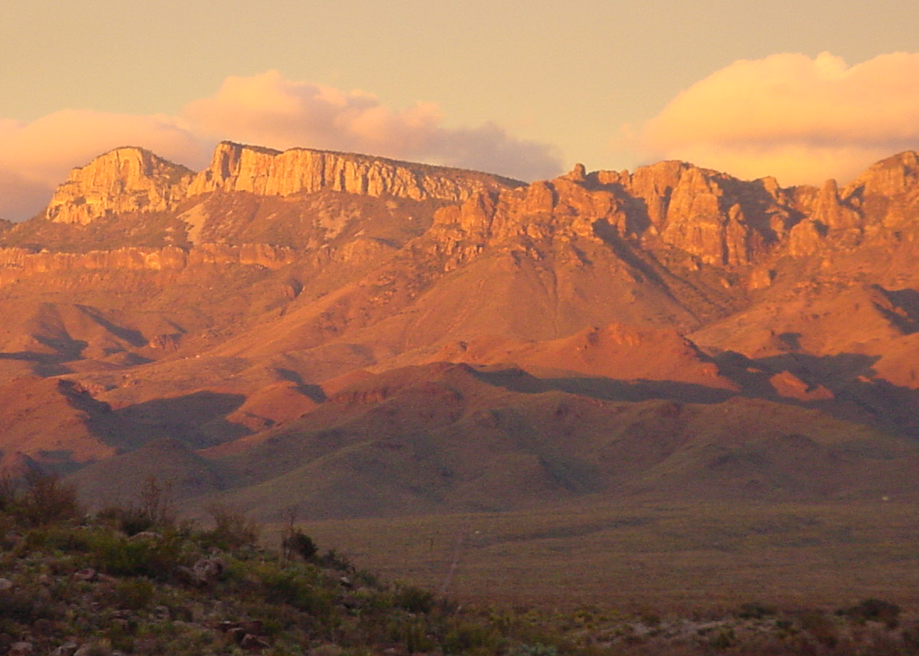
7
Celebrate Success!
"You not only bring people together from agencies and academia, you also bring people together across disciplines and across institutions in ways that would not have happened without your facilitation. When you bring people together, great things can happen. You are also working hard at getting information moving quickly between the researchers and the managers. This takes time to have a measurable impact, but it is happening. The pathways you are building will be very important conduits of information for managers. (e.g. your webinars and efforts to make other web resources accessible and easy for managers to use)." (Desert LCC Academic partner)
Genevieve Johnson, Coordinator
gjohnson@usbr.gov
Aimee Roberson, Science Coordinator
aimee_roberson@fws.gov

