Slide 1

Local Working Groups: Sage-Grouse
David Dahlgren, Lorien Belton, and Terry Messmer
Utah State University
www.utahcbcp.org
If its not good for communities, its not good for wildlife.

Slide 2
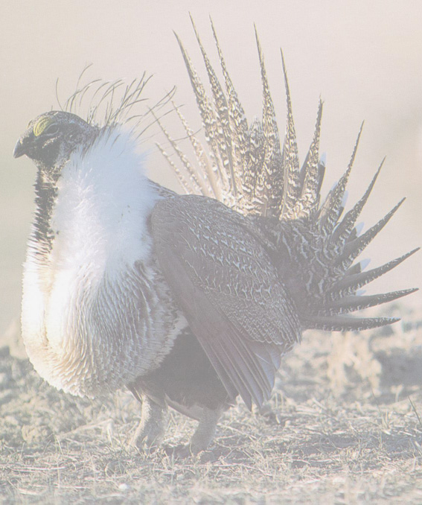
Executive Order 13352 Facilitation of Cooperative Conservation – August 2004
Departments of the Interior, Agriculture, Commerce, and Defense and the Environmental Protection Agency
Implement laws in a manner that promotes cooperative conservation
Emphasis on local participation in federal decisionmaking
In accordance with agency missions, policies and regulations

Slide 3
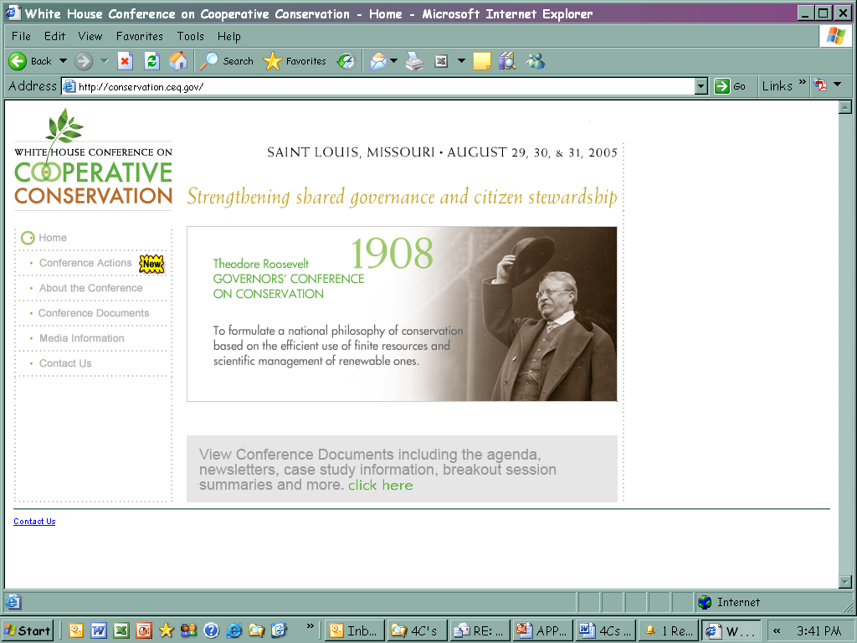
White House Conference on Cooperative Conservation

Slide 4
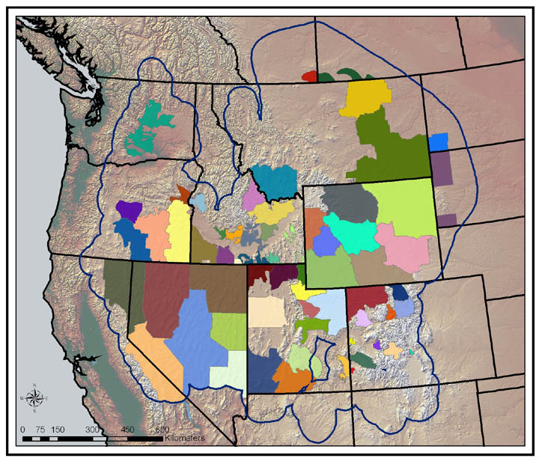
Overview of Groups (L. Belton Survey)
60+ Local Working Groups range-wide
Composition
  52% agency representation
  30% ranchers, farmers, or rural landowners
  Energy, utility, SCD, environmental reps
86% male (rangewide, 82%)
45% Still attend meetings
80% currently attending are paid to attend (rangewide, 64%)
Source: USGS-NBII Sage-Grouse Local Working Group Locator Website

Slide 8
What Do They Need? Information
Utah: % reporting ‘critical need’ for info on:
  70% Protecting landowners in case of ESA listing (61)
  63% Local sage-grouse pops (#s, migration, etc.) (59)
  53% Possible funding sources for projects (47)
  52% Successful examples of habitat improvement (52)
  52% Sage-grouse habitat requirements (51)
  45% Impact of livestock grazing on sage-grouse (49)
  43% Impact of energy development on sage-grouse (45)
Notable in Utah:
  Funding emphasized more than range-wide
  More concern about protection from listing
Key need: continued information flow to groups
Notes:
Note that most of these are remarkably stable for both ranchers, landowners, agency staff, and others.
HOWEVER – two important differences are: (a) ranchers much more interested in ESA protection (84% vs 53%) and (b) ranchers less interested in impacts of livestock grazing and sagebrush restoration techniques (43 vs 53; and 26 vs 41 percent, respectively.

Slide 9
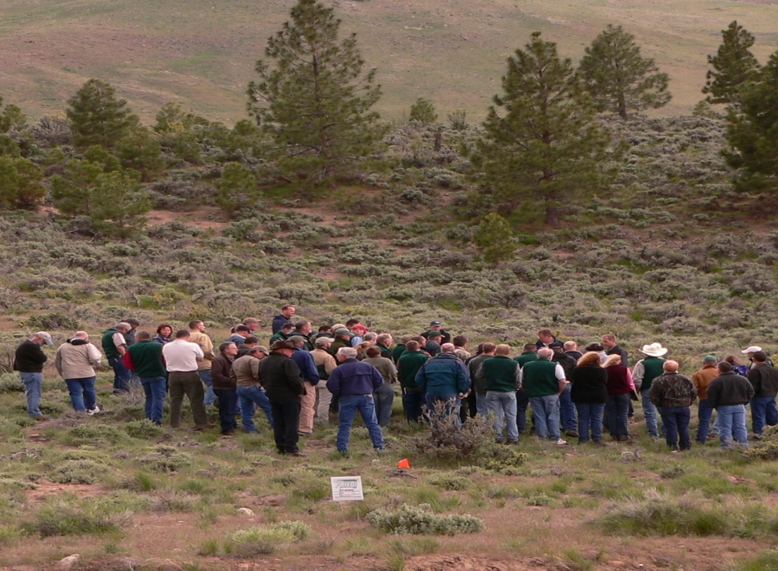
How to Get it to Them?
Most Useful Information Formats
In-Person Learning: very useful
  Expert presentations (58% very useful)
  On-the Ground Training (60% very useful)
Web-Based Learning: not so useful
  Website or online databases (14% very useful)
  Web-based trainings (5% very useful)
Key: web resources may have limited utility for the LWGs
Field Trips (In-Person format) VERY useful
Overall trust: highest 4 are university scientists, state wildlife, Extension, and NRCS.
Notes:
Expert presentation lowest rangewide. Indicate lack of trust in “experts”? Interest in web stuff even lower in Utah than elsewhere

Slide 10
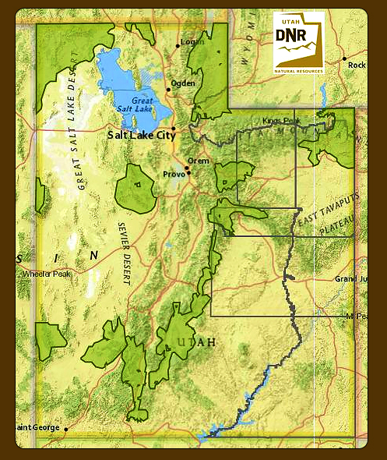
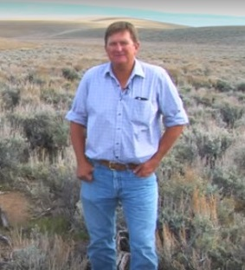
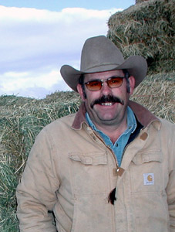
Parker Mountain Adaptive Resource Management Working Group (PARM)

Slide 11
Parker Population
Research Results
Sagebrush Management for Brood Habitat
Wildlife Society Bulletin (2006)
Livestock to Manage Brood Habitat
Dissertation (2010)
Highest Chick Survival in Literature
  Journal of Wildlife Management (2011), PLoS ONE (2013)
Adult Female Survival & Reproduction
Ecosphere (2014)
Stable Population
Ecosphere (2016)
Habitat Management and Livestock Forage
Thesis (2016)

Slide 12
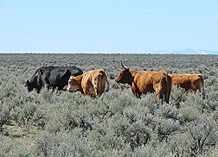
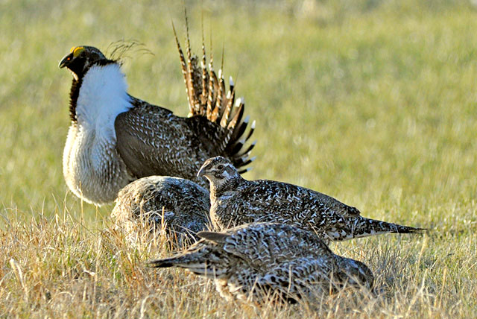
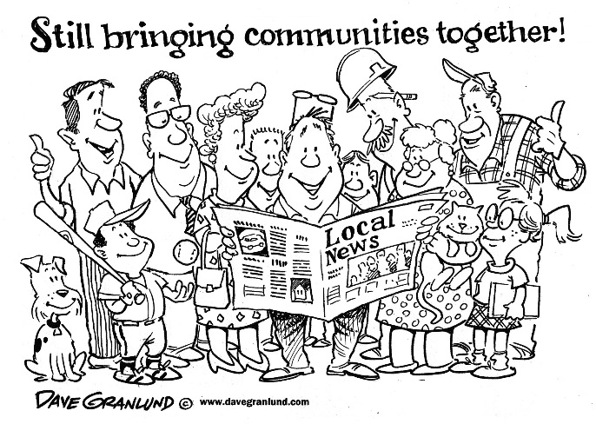
Take-Home Message
Local Leadership (Private Producers)
Psychological Ownership (Share the Pain)
Project Implementation
Research Projects (Active Learning)
In-Person Formats (Human Endeavor – not technology)
Facilitation (Not Directive)
Conflict Resolution
Local Data to Guide Management

