Slide 1
2015 Pocket Guide
Wisdom from the Field:
Principles and Best Practices of
The Fire Learning Network

Slide 2
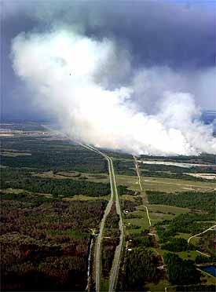
Tip 1
Today’s fire problems are so complex that no single person or party can solve them.

Slide 3
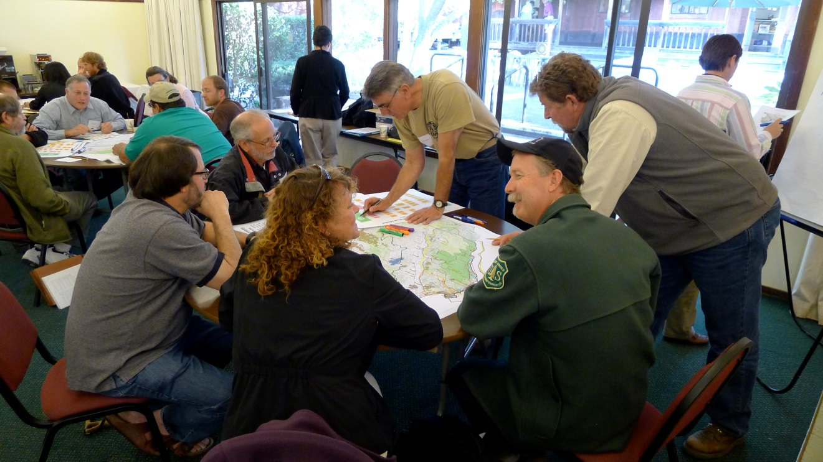
Tip 2
Collaboration is built on the premise that for complex problems, people working together from different perspectives will arrive at better solutions, faster.

Slide 4
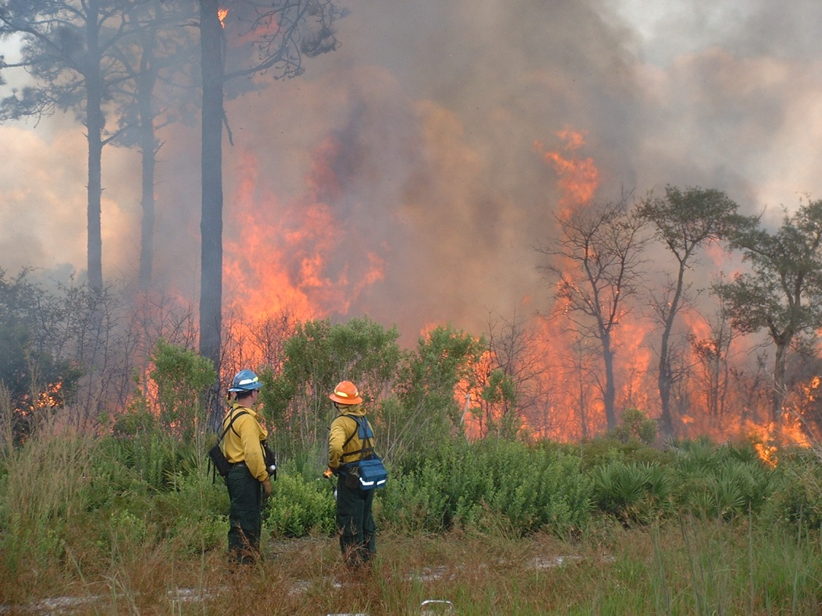
Tip 3
Collaboration is not intuitive. It requires new skills and practices that don’t always come naturally.

Slide 5
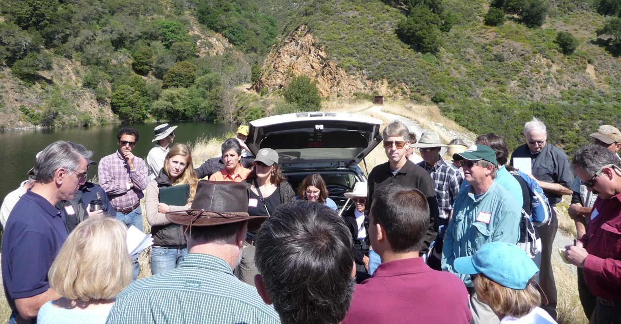
Tip 4
Make a fierce commitment to
openness, transparency, inclusiveness.

Slide 6
Tip 5
Everyone’s ideas are considered equally, regardless of affiliation or job title.
Everyone has something to share,
everyone has something to learn.

Slide 7
Tip 6
Look for nuggets in old, new and novel ideas.

Slide 8
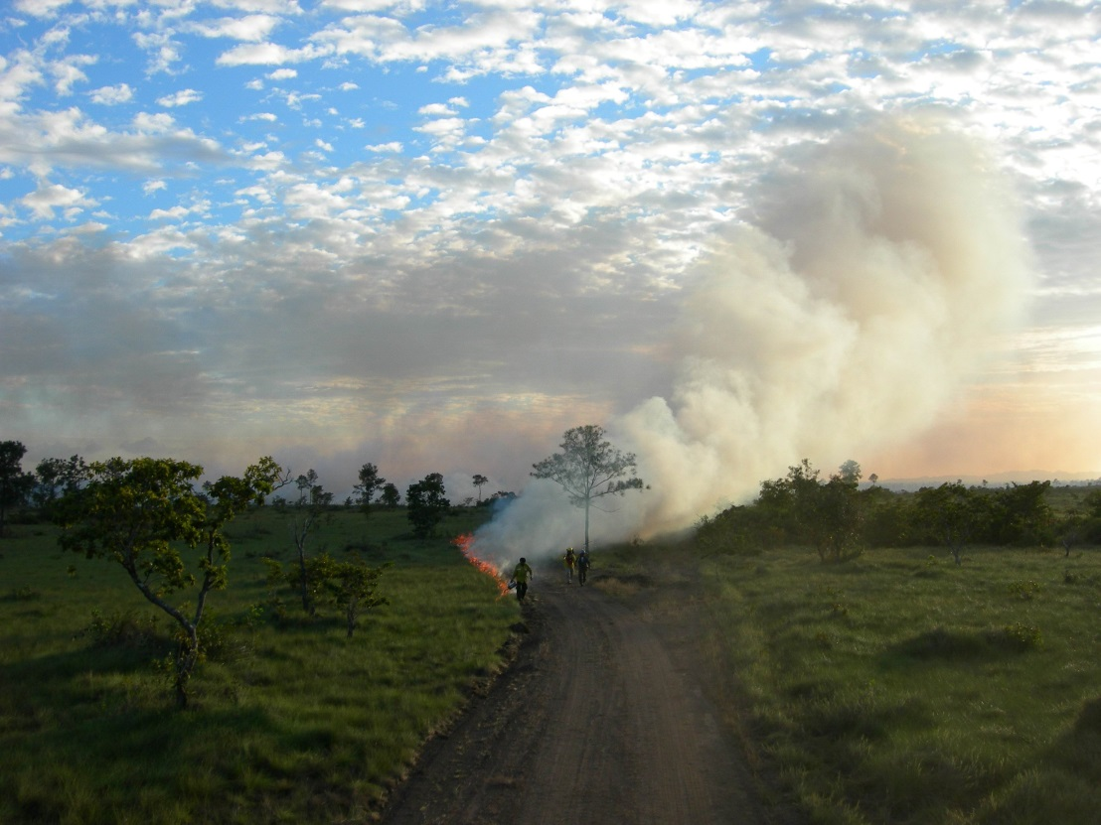
Tip 7
Focus on Zones of Agreement.
There is so much to do. Dig there.

Slide 9
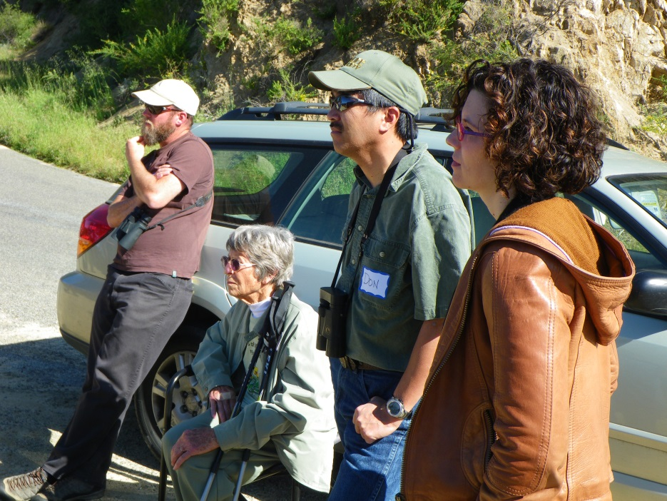
Tip 8
People make choices based on a handful of deeply rooted values. These are personal and unlikely to change.

Slide 10
Tip 9
Three common perspectives in fire problem-solving often lead people to different ideas:
Nature is here to serve people.
Nature should be saved for its own sake.
People have a role in maintaining the physical and spiritual balance of nature.
Assume good intent and know that all three are likely at play.

Slide 11
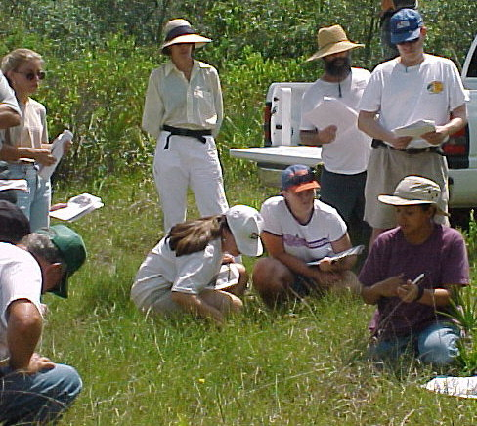
Tip 10
Facts are different from values. Facts change as we learn more. Sharing and questioning facts helps us learn more rapidly.

Slide 12
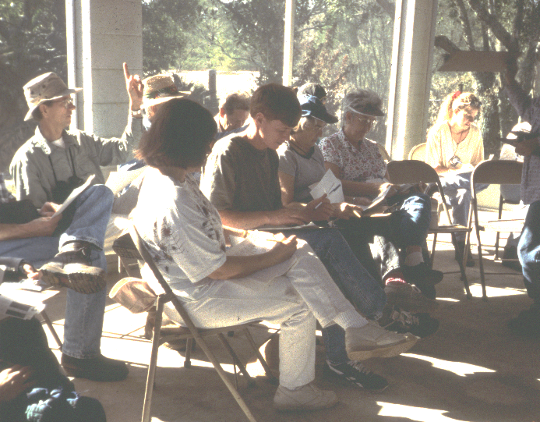
Tip 11
Work in an open forum, then volunteer to contribute what you can, within your home procedures.

Slide 13
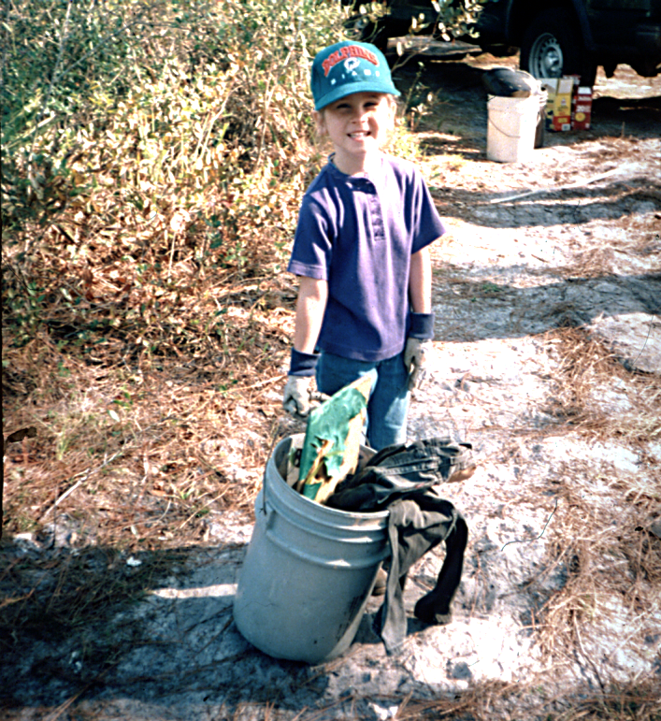
Tip 12
Collaboration is built on trust.
Trust is built upon a clean series
of honorable acts.

Slide 14
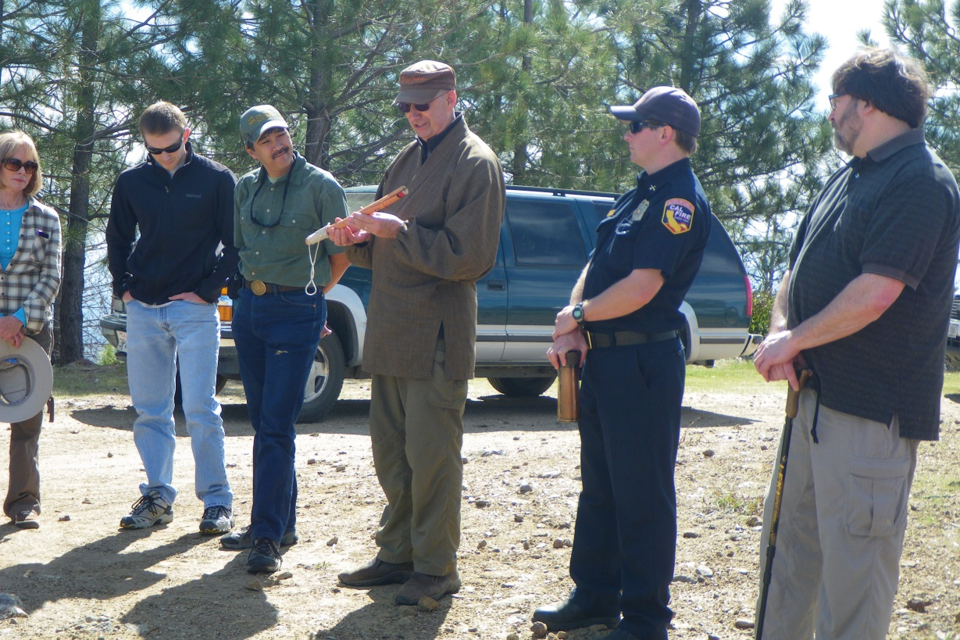
Tip 13
Sometimes you have to go slow to go fast.
Be patient with one another and the collaborative path.

Slide 15
Commonly Used Working Agreements
Maintain an open, transparent, inclusive process
Everyone participates and advocates.
Be an active listener and learner.
Assume people hear you the first time. . . Don’t dominate.
Give honest feedback . . . with a kind delivery.
Create a boss-free atmosphere.
Keep cell phones off, no side conversations.
If more work is needed, a homework team will finalize a proposal and bring it back to the group.
Use good humor to keep things light.

Slide 16
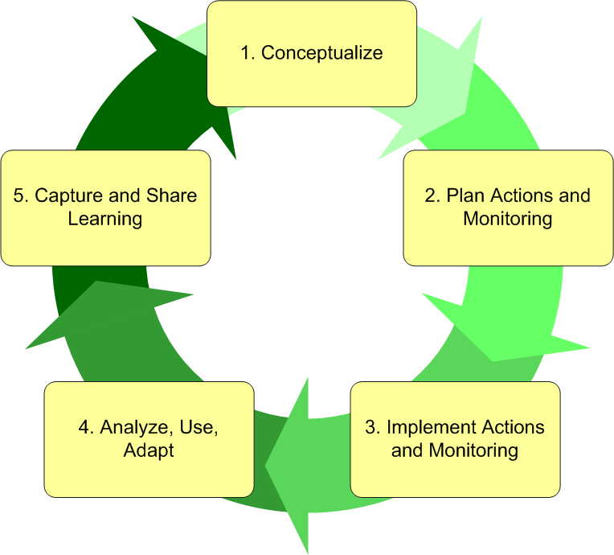
Open Standards for the Practice of Conservation

Slide 19
About Us
The Fire Learning Network (FLN) is a cooperative program of the Forest Service, the Department of the Interior agencies—Bureau of Indian Affairs, Bureau of Land Management, Fish and Wildlife Service and National Park Service—and The Nature Conservancy. The partnership has a 13-year track record of helping to restore our nation’s forests and grasslands and to make human communities safer from wildfire.

Slide 20
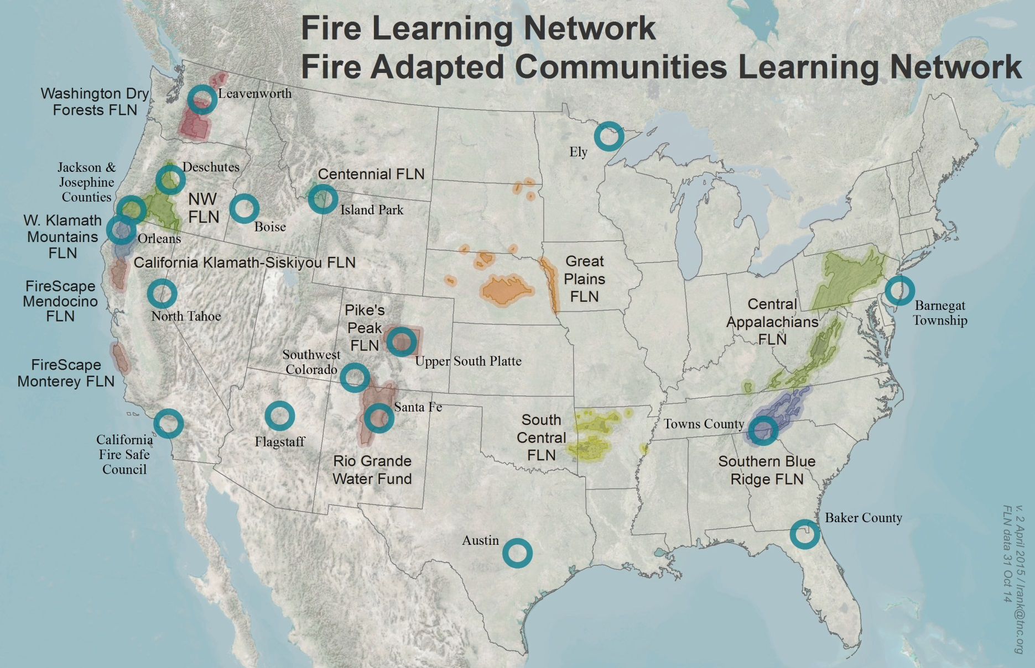
Where We are Working

Slide 21
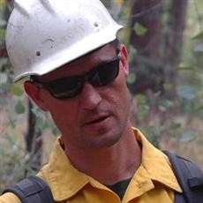
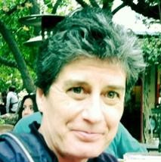
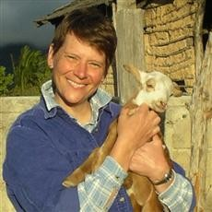
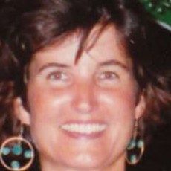
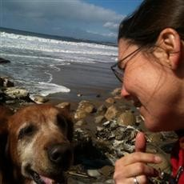
Our Staff
Jeremy Bailey Associate Director
Fire Training
Lynn Decker
Director
Guy Duffner
Conservation Associate, Planning and Training
Wendy Fulks
Associate Director, Fire Adapted Communities
Mary Huffman
Associate Director, Fire Science and Planning
Heather Montanye
Operations Manager
Liz Rank
Conservation Information Manager

Slide 22
The 2015 Pocket Guide, Wisdom from the Field is supported by
Promoting Ecosystem Resiliency and Fire Adapted Communities Together, a cooperative program of the USDA Forest Service, fire agencies of the Department of the Interior and The Nature Conservancy. For more information, contact Lynn Decker at ldecker@tnc.org or (801) 320-0524.
In accordance with Federal law and U.S. Department of Agriculture policy, this institution is prohibited from discriminating on the basis of race, color, national origin, sex, age, or disability. (Not all prohibited bases apply to all programs.)
To file a complaint of discrimination, write USDA, Director, Office of Civil Rights, Room 326-W, Whitten Building, 1400 Independence Avenue SW, Washington, DC 20250-9410 or call (202) 720-5964 (voice and TDD). USDA is an equal opportunity provider and employer.

