Slide 1
“Collaborative” (noun) vs. “Collaborative” (adjective)
Focusing on Collaboration as a Process
col·lab·o·ra·tive
adjective
produced or conducted by two or more parties working together

Slide 2
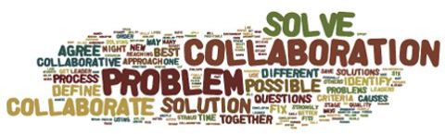
…developed & implemented through a collaborative process that:
Includes multiple interested persons representing diverse interests; and
Is transparent and non-exclusive

Slide 3
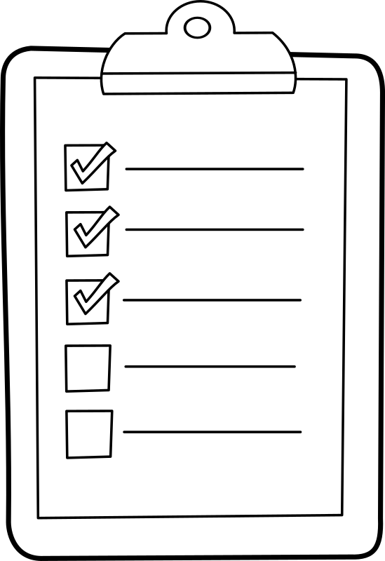
“I can’t use the Farm Bill CE because I don’t have a collaborative group!”
Multiple persons, diverse interests
Transparent
Non-exclusive

Slide 4
“What is the ‘bar’ and how do I meet it?”
Identify and involve relevant stakeholders
Design a strategy to conduct an open, inclusive and transparent process
Plan for implementation and evaluation as part of the collaborative effort
Document the collaborative process

Slide 5
“How do we avoid collaboration burnout?”
Empowerment; line officer and team support
Clarify roles/expectations/timelines and reasons for adjusting
Develop positive working relationships and common purpose and understanding through:
Meaningful education and discussions
Open, continuous communication throughout the process
Engaging at key stages; use facilitator if needed
Reflection
Sincerely listen and use/respond to feedback
Adjust based on what you’re hearing and lessons learned; share your experience

Slide 6
Multiple persons, diverse interests
Transparent
Non-exclusive

Slide 7
Example Timeline & Feedback
“Throughout the process, you and your staff were honest, open and professional… We understand the Forest Service has a job to do, and that forest management is an important function in keeping our forests healthy and usable. We also understand that there is a diverse set of interests in the forests, with Back Country Horsemen representing only a small part of that set. We felt like this ‘collaborative process’ was truly collaborative, and our time participating was well spent.”
Letter to Idaho Panhandle Forest Supervisor
from the Priest River Valley Chapter of
Back Country Horsemen of Idaho

Slide 8
Example Timeline & Feedback
Having attended most of the meetings for this project, I can say that the planning has been done in great detail, and with input from several different user categories. I fully support the decisions made, and look forward to this process being used to improve our forests in the future.
– Email from participant in the collaborative process –

Slide 9
Resources
R1 2014 Farm Bill Webpage (Internal Forest Service only)
- Templates, examples and more
http://fsweb.r1.fs.fed.us/em/nepa_web/FarmBill2014.html
Email: teralittle@fs.fed.us
Phone: (406) 758-5357

