Slide 1
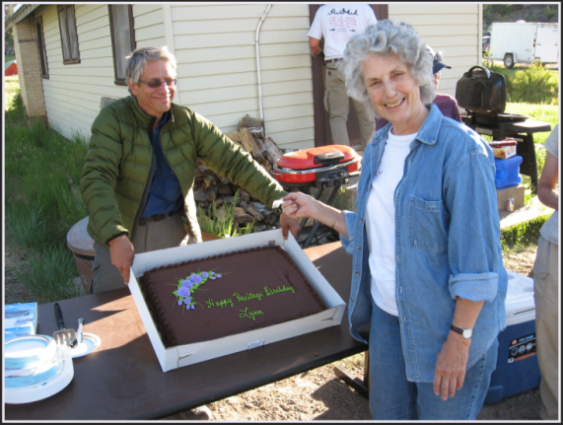
Learning together and working together on the Uncompahgre Plateau
• • • • • • • • •
• • • • • • • • •
Megan Matonis (mmatonis@fs.fed.us)
USDA Forest Service,
Rocky Mountain Research Station
CFLRP Workshop, April 2016

