Slide 1
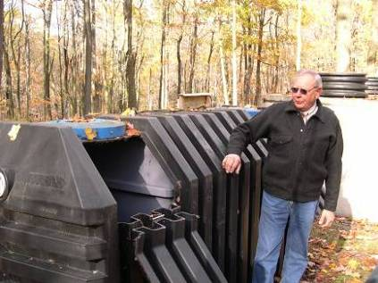
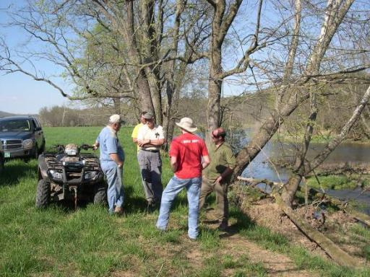
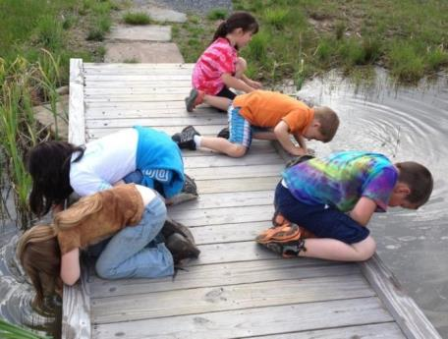
CVI works with local people
on grant-funded and fee-based projects
Treating Wastewater in Small Communities
Restoring Streams
Engaging Students

Slide 2
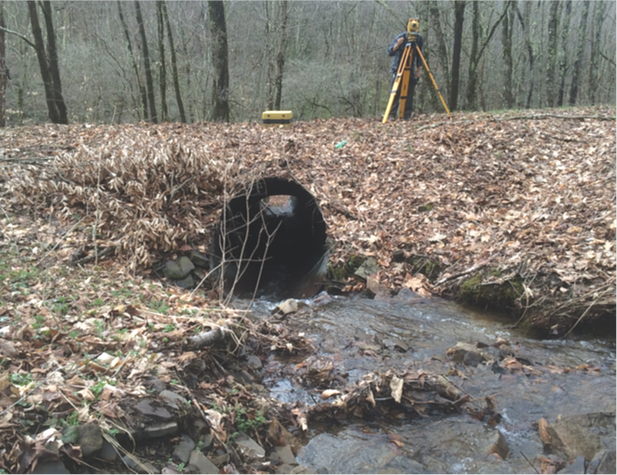
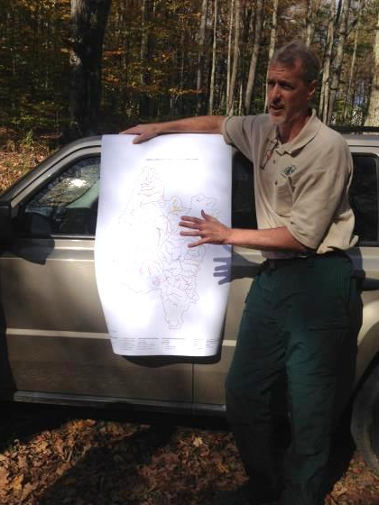
Collaboration with Forest Service
Cooperative Agreements
FS Role: NEPA, guidance, engineering, approval
CVI Role: planning, design, permits, construction

Slide 3
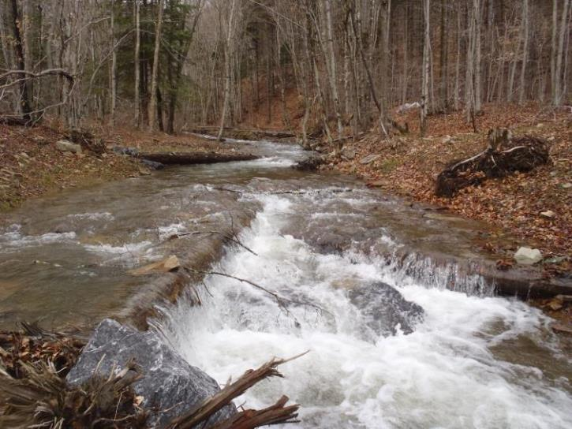
Aquatic Organism Passage
(beginning 2009)

Slide 4
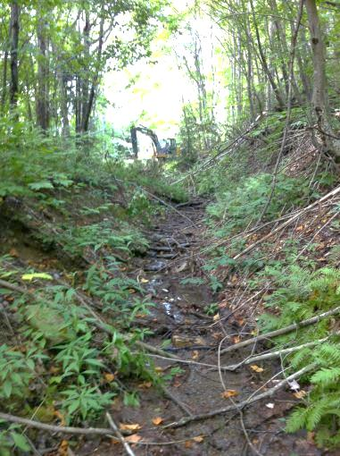
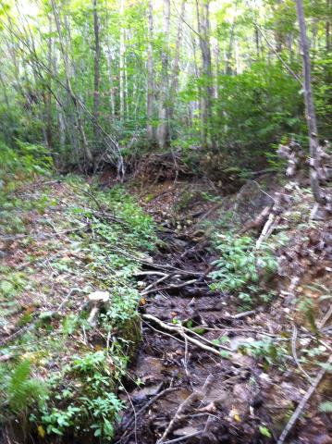
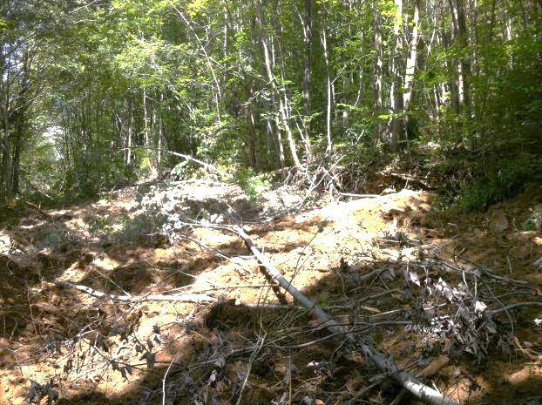
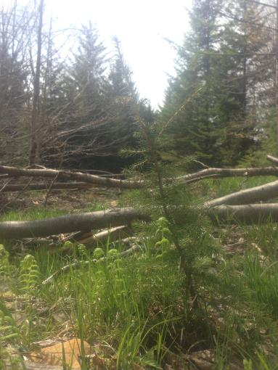
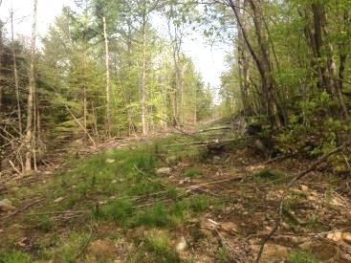
Road Decommissioning
(beginning 2009)

Slide 5
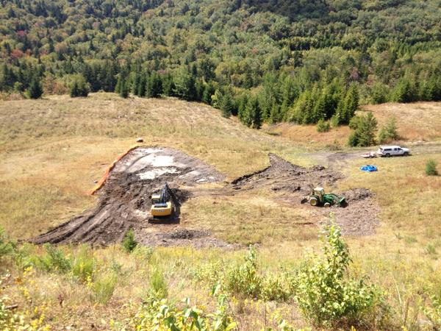
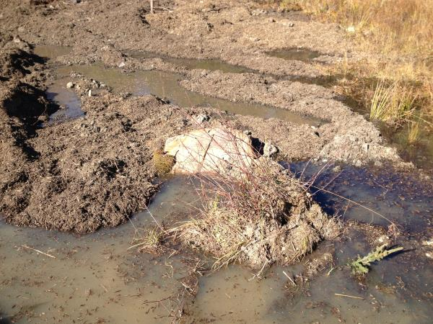
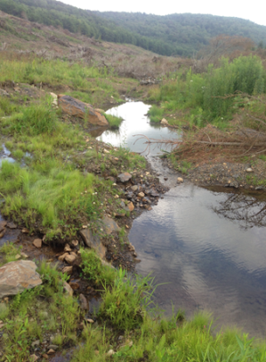
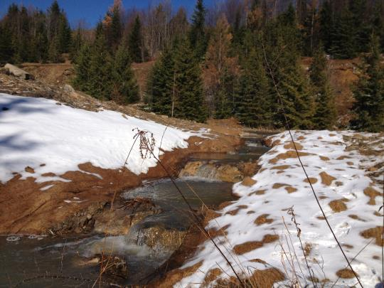
High Elevation Landscape Restoration (beginning 2012)

Slide 6
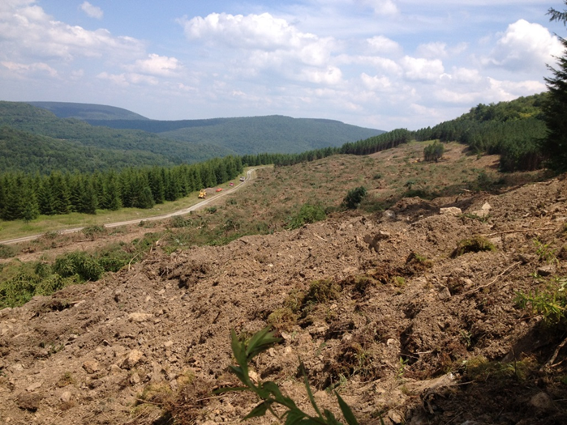
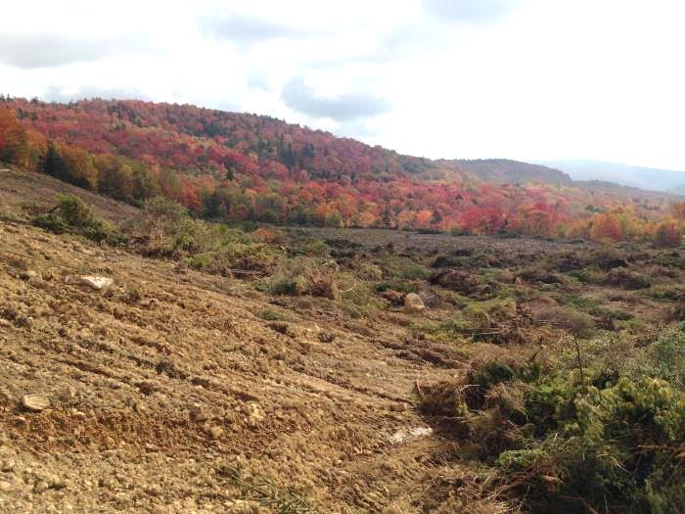
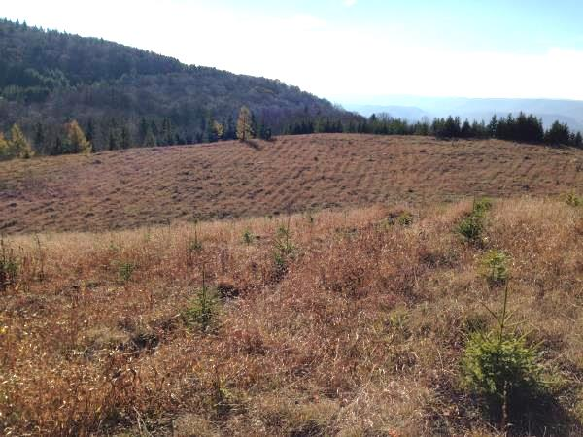
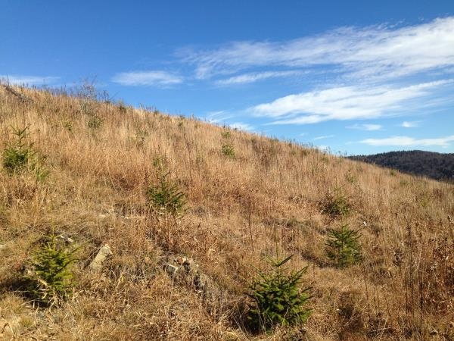

Slide 7
WV Restoration Venture
Added to existing agreement:
Upper Greenbrier North Watershed: Long Run
  2 mi road decommissioning
    Accomplished 4 miles in 2015
  2 stream crossing replacement (AOP) projects
    Designed fall 2015
    Construction planned fall 2016

Slide 8
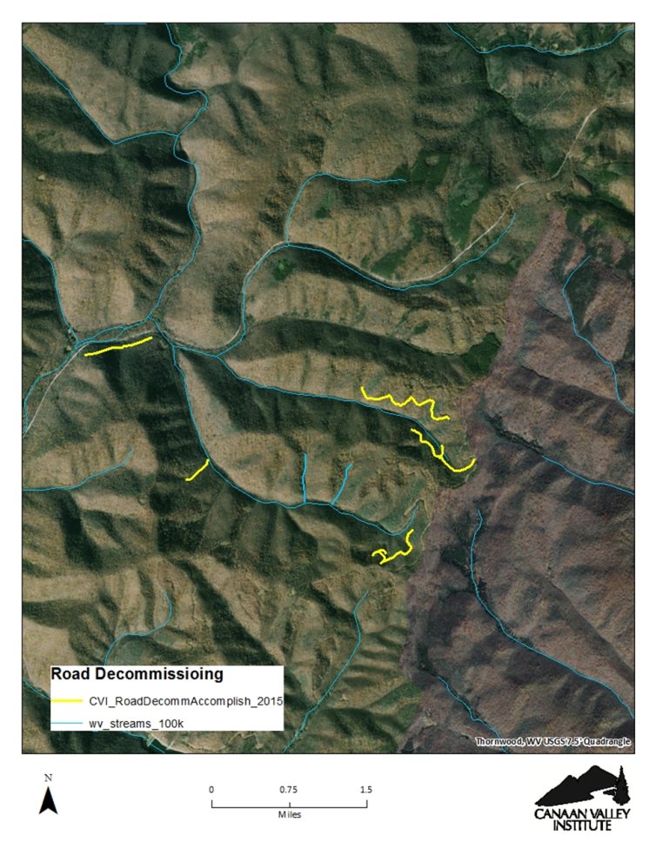
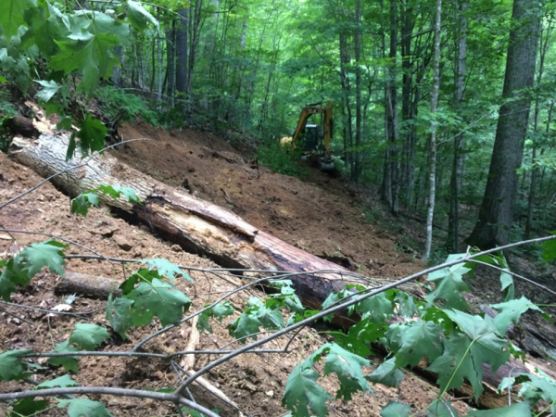
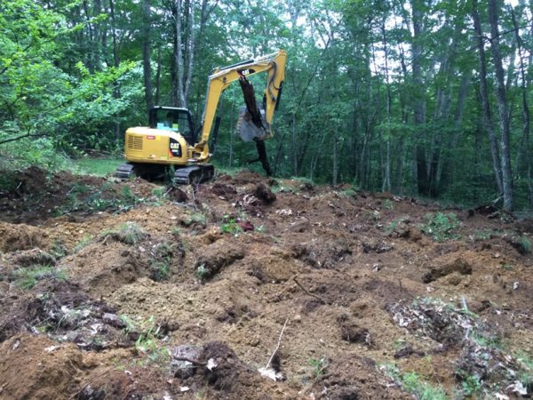
Road Decommissioning in the Long Run Vicinity

Slide 9
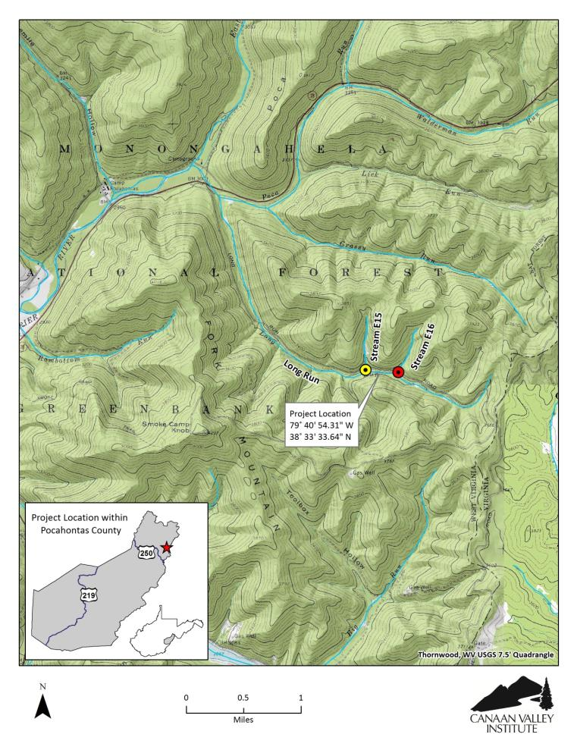
AOP Project Sites on Long Run

Slide 10
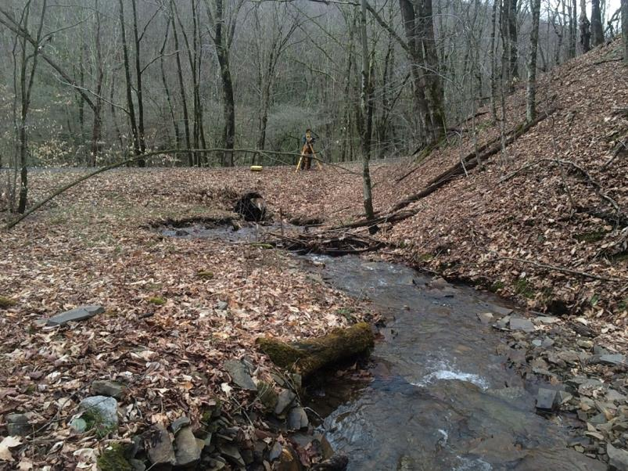
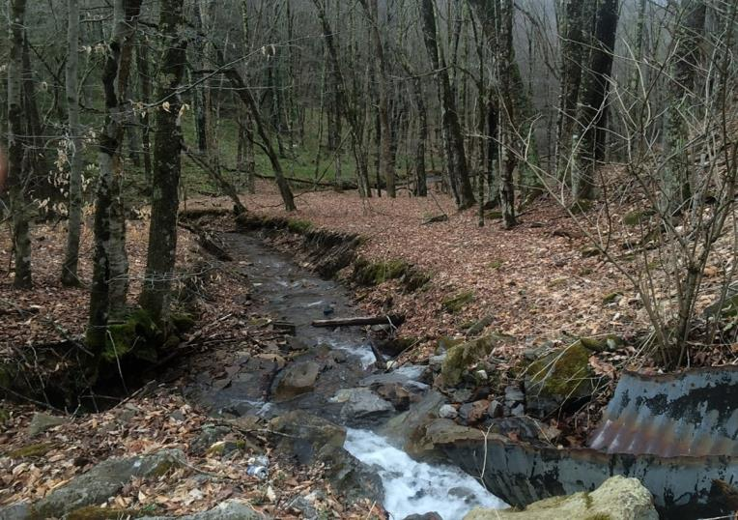
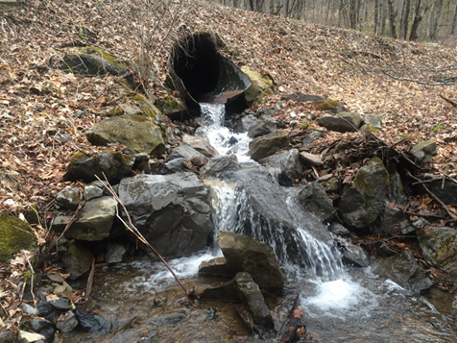
Existing Conditions
Site EF 15

Slide 11
Design

Slide 12
Approval

Slide 13
Take Aways
WVRV started from a successful history of collaboration
  High level of trust
  CVI is an extension of FS team and capabilities
  We have learned from each other
WVRV added to existing agreement
  Agreements easier for FS than contracts; flexibility
  Good opportunity for CVI to do good work and cover our costs
Benefits for CVI
  Work aligned with our mission and capabilities
  We can play a small role in a larger project with bigger outcomes
  We are applying lessons to other projects
Challenges for CVI
  Inventing the Wheel
  Matching funds

Slide 14
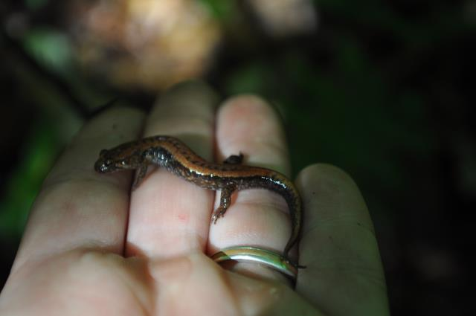
Thank You
Todd Miller
Deputy Director
Canaan Valley Institute
304-259-4739 ext. 293
todd.miller@canaanvi.org

