Slide 1
USFS/Camp Shelby
Stewardship Project

Slide 2
USFS Stewardship Projects
Achieve land management goals for National Forest System (NFS) lands while meeting local and rural community needs.
Focus on restoration and partnerships.

Slide 3
Objectives:
Restore wildlife and fish habitat
Control noxious weed infestations and re-establish native plant species
Promote healthy forest stands
Reduce wildfire hazards, and the risk of catastrophic wildfire
Stabilize erosion sites to protect watershed health
Control nuisance wildlife (e.g. feral hogs and beavers)
Enhance existing military training areas
Offer increased employment within the local community

Slide 4
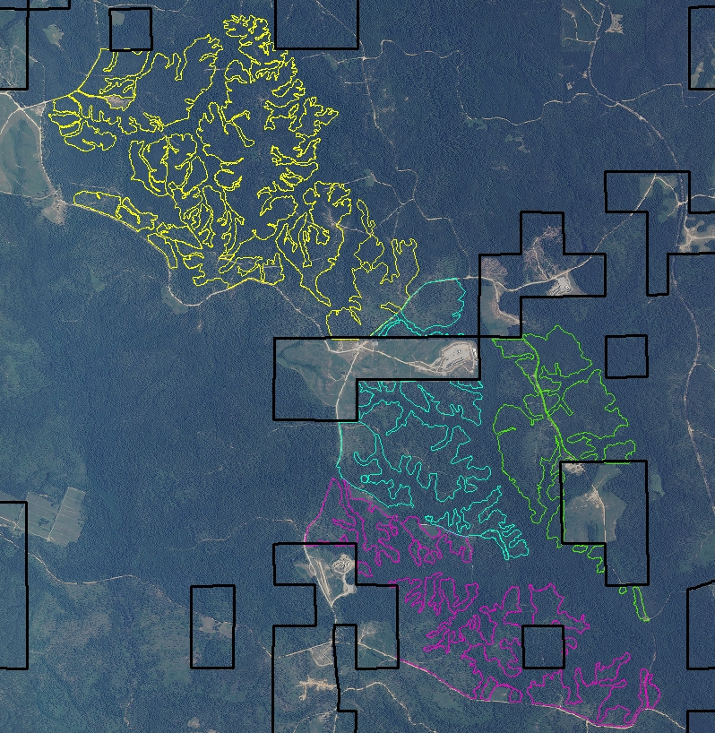
Logging
Forestry Mowing
Erosion Control
Thinning or clearing trees in Military Training Areas 10, 25, 32, and 33 as part of the Combined Arms Area (2094 ac)

Slide 5
Progress
Under Integrated Resource Timber Contract IRTC:
Timber harvested on sale areas 1,2, and 3 (1,108 acres)
Sale area 4, timber harvest in progress (986 acres)
Under Camp Shelby Stewardship Agreement:
Forestry mowed @ 140 acres in sale area 1 and 2
Erosion control in sale area 1

Slide 6
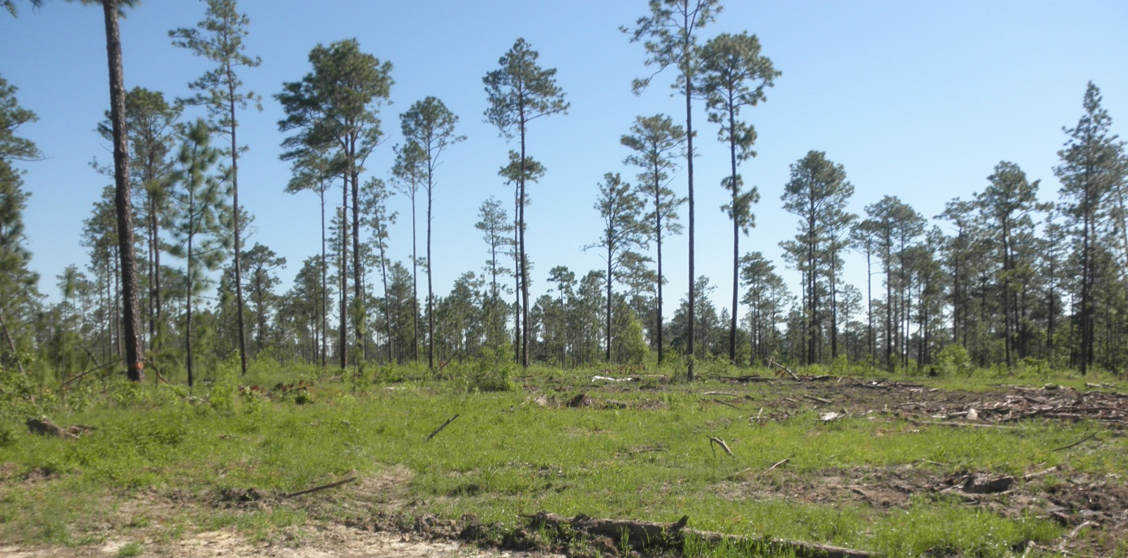
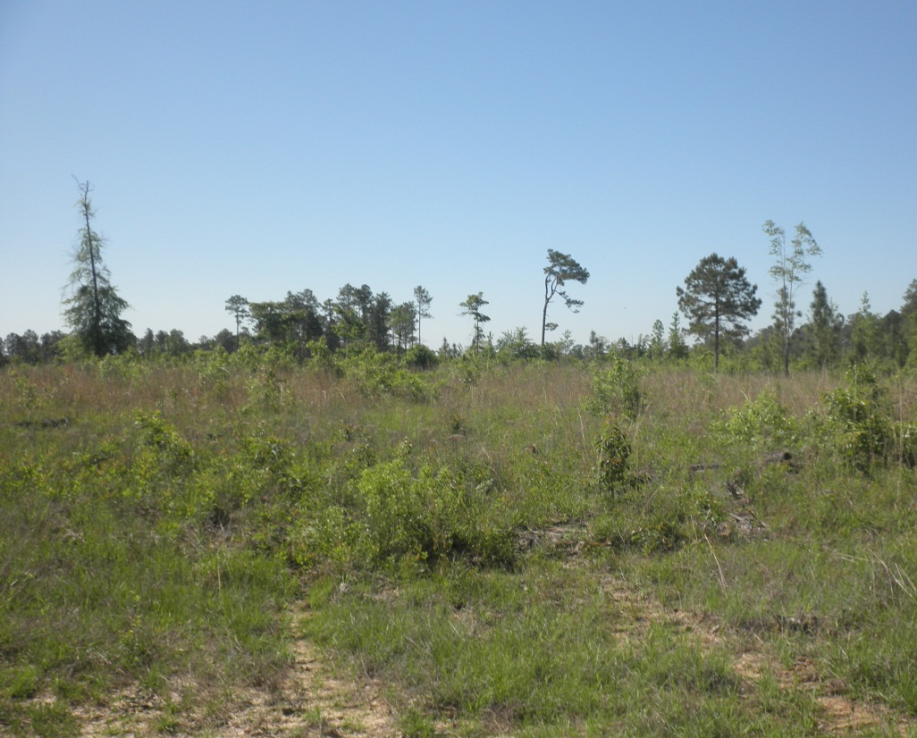
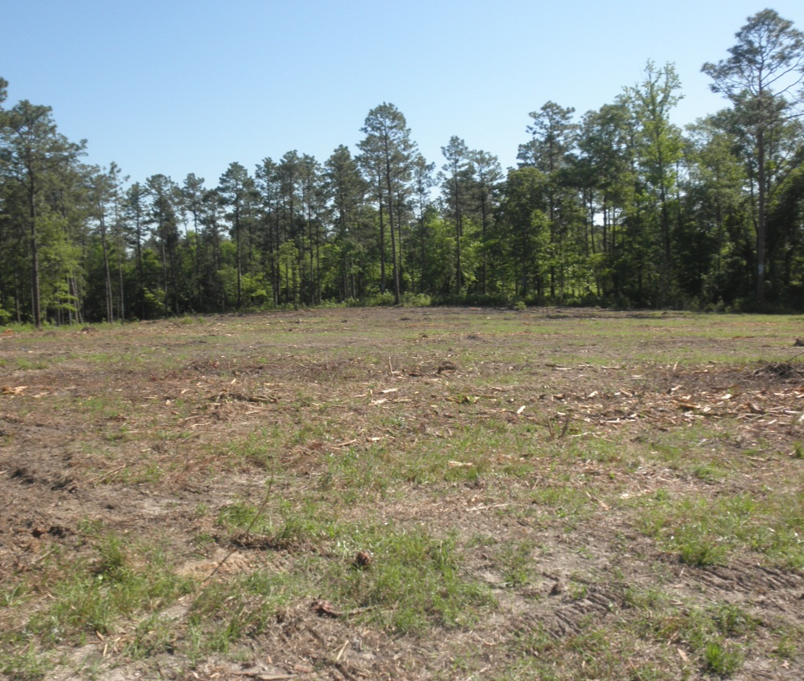
Thinning
Clearing
Forestry Mowing

Slide 7
Service Work Progress
IRTC and Service Contracts.
Completed December 31, 2015
540 Acres of Gopher Tortoise Habitat Enhancement
25 Acres of Native Herbaceous Groundcover in Wildlife Openings on Leaf River Wildlife Mgt. Area
205 acres of Camp Shelby Burrow Crayfish Pitcher Plant Wetland Restoration

Slide 8
Service Work Progress
IRTC and Service Contracts.
Completed December 2015
365 Acres Cogongrass Control
2014 and 2015 Helicopter Contracts (>45,000 acres of prescribed fire)
RCW Translocation 2015 (5 pair per year from Osceola NF to DeSoto)

Slide 9
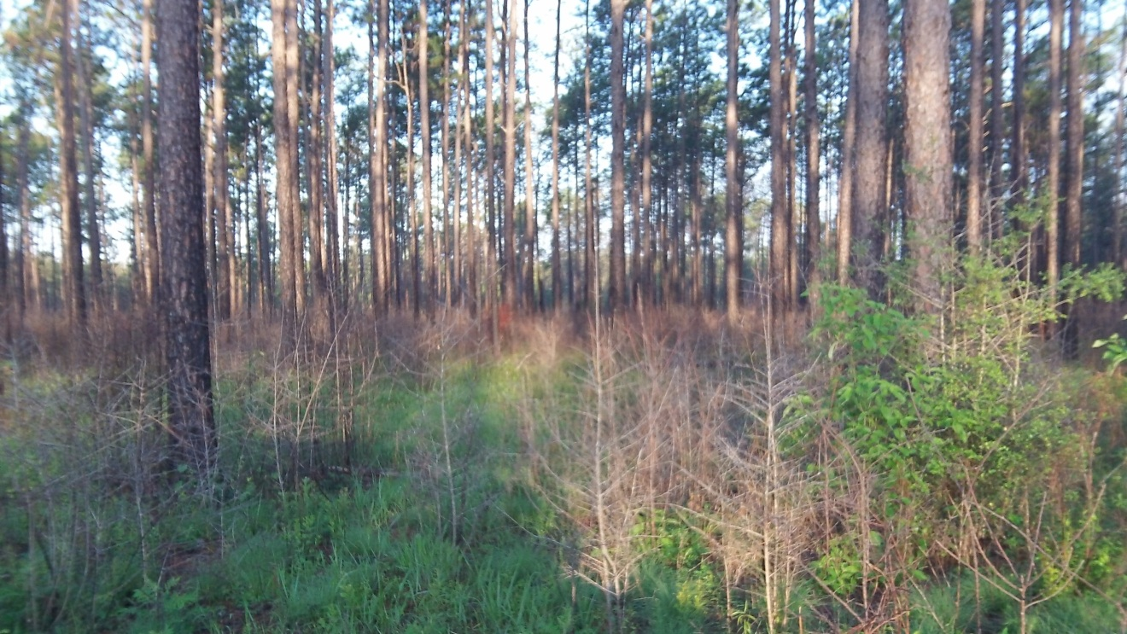
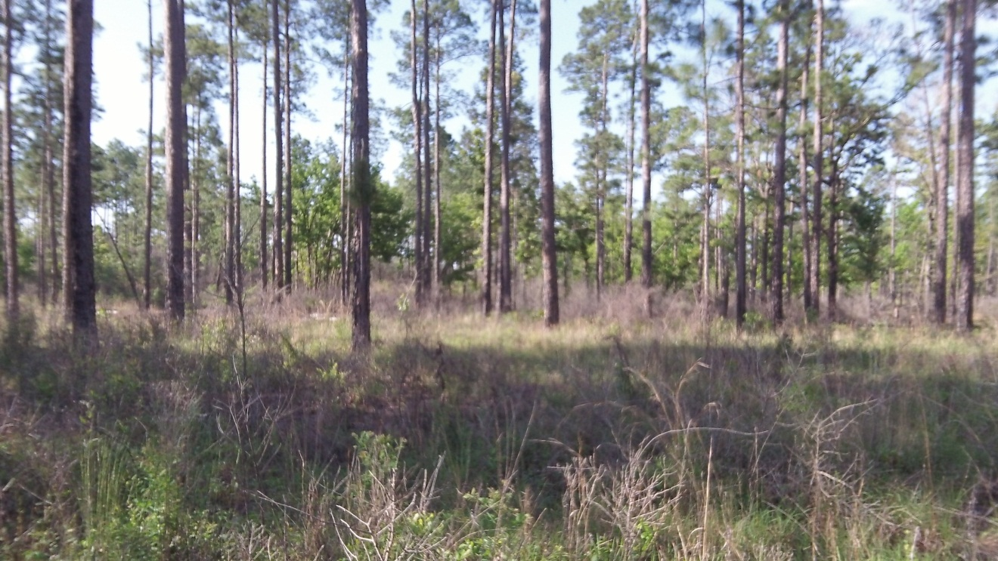
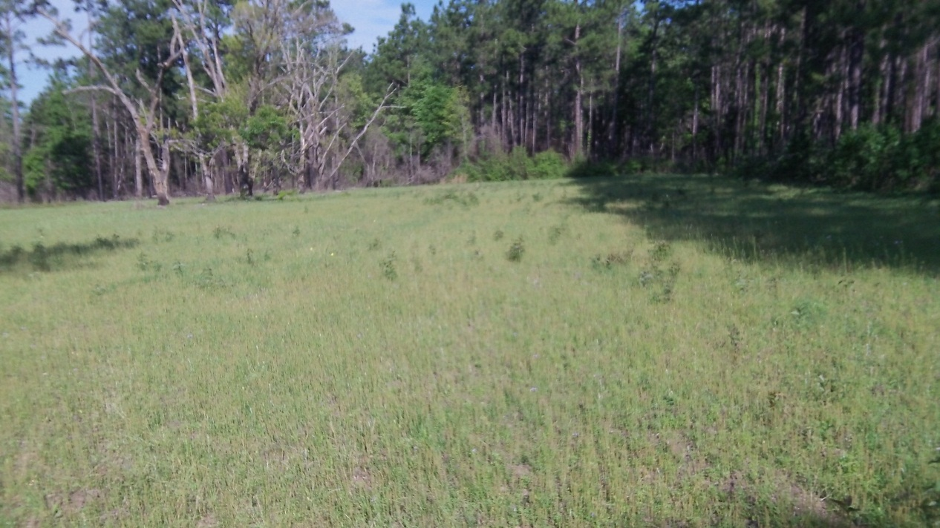
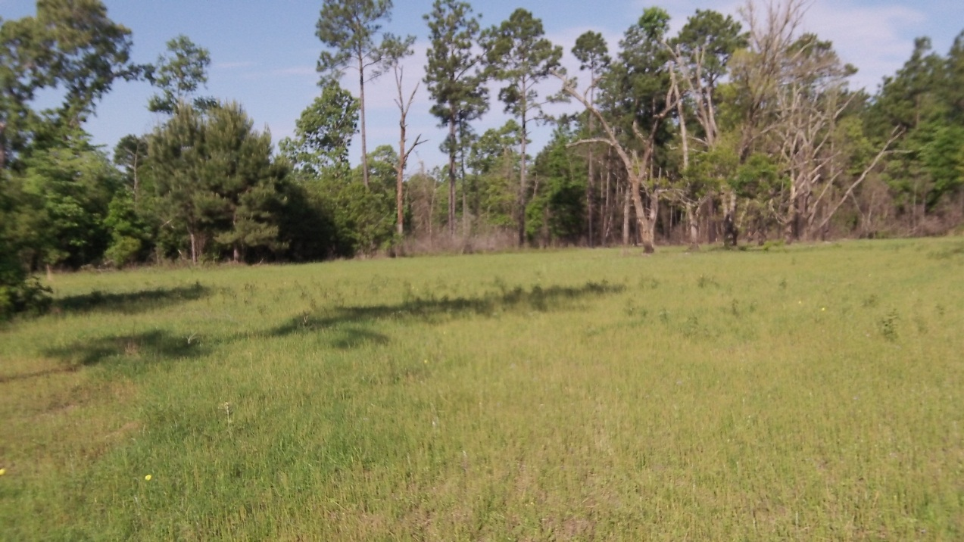
Gopher Tortoise Habitat Enhancement – 540 Acres
Native Plants-Wildlife Openings – 25 Acres

Slide 10
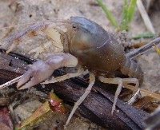
Pitcher Plant Bog Restoration- 205 Acres
Cogongrass Treatment – 365 Acres

Slide 11
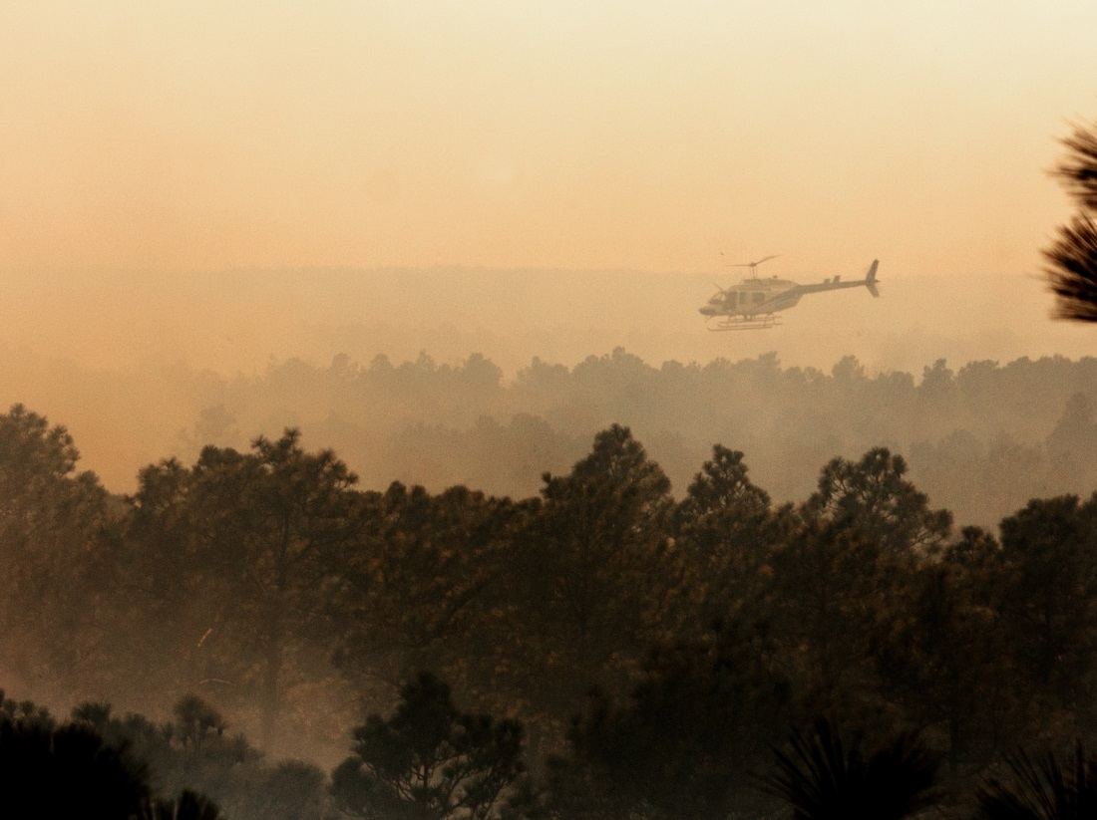
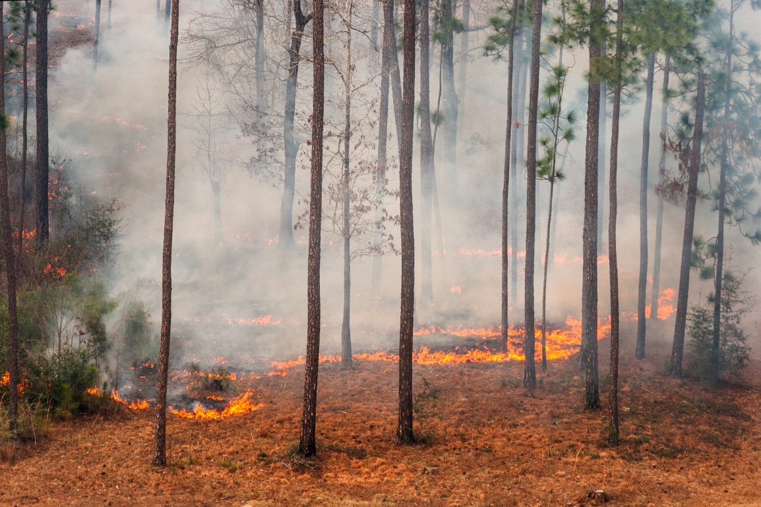
Prescribed Fire- Helicopter Contract – 2014 & 2015

Slide 12
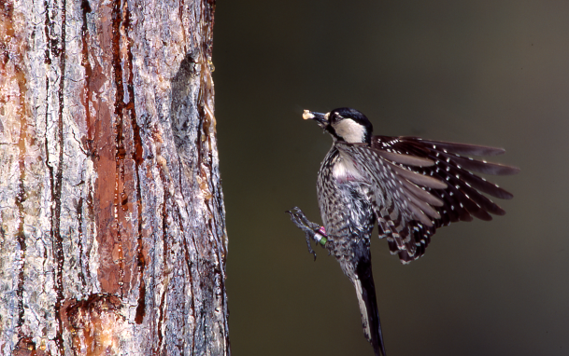
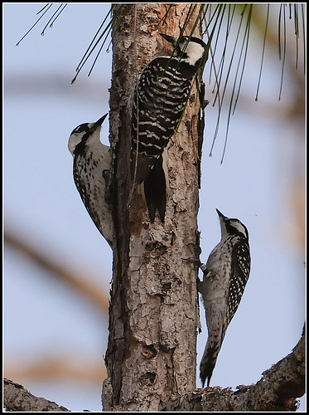
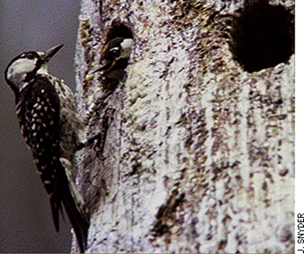
RCW Translocation (5 Pair per year from Osceola NF)

Slide 13
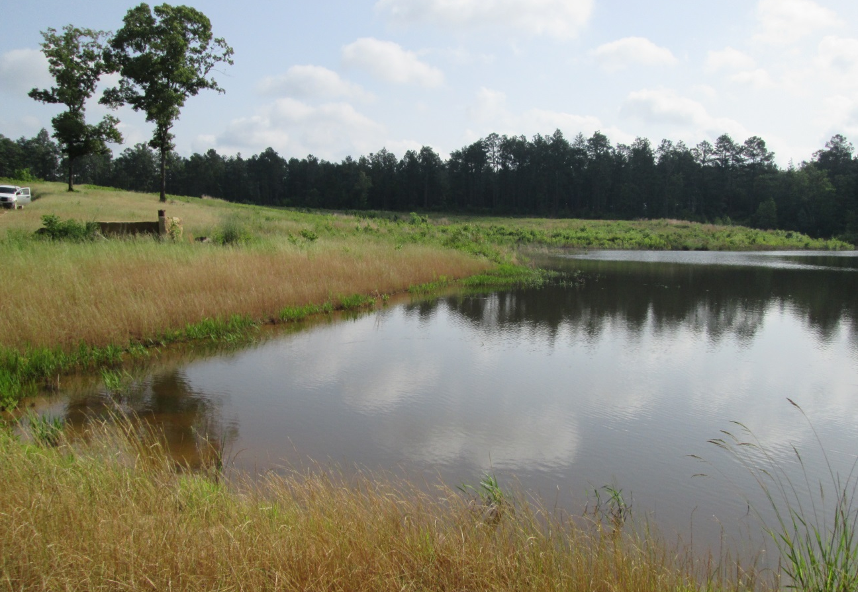
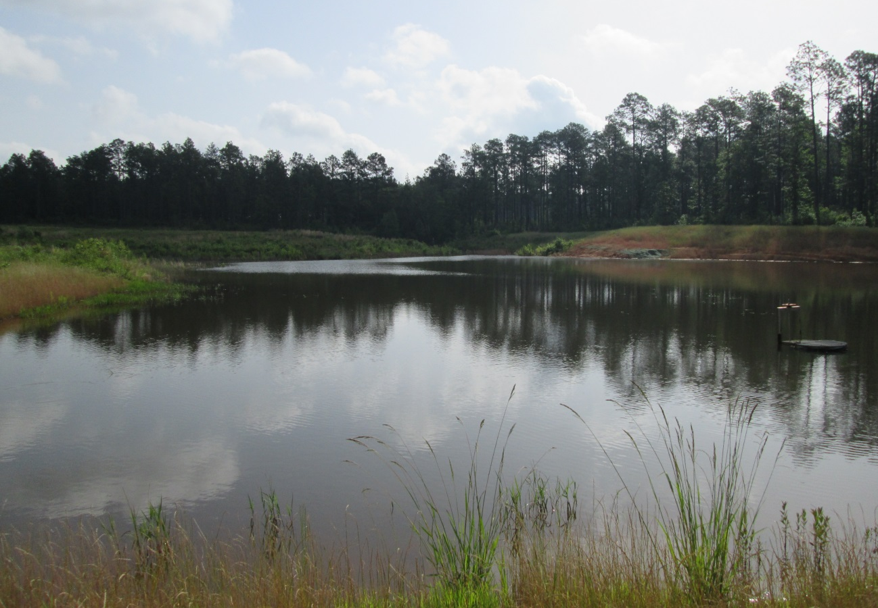
Camp Shelby Stewardship Agreement
Progress
Ashley Pond Restoration
Stocked with Bass and Bream

Slide 14
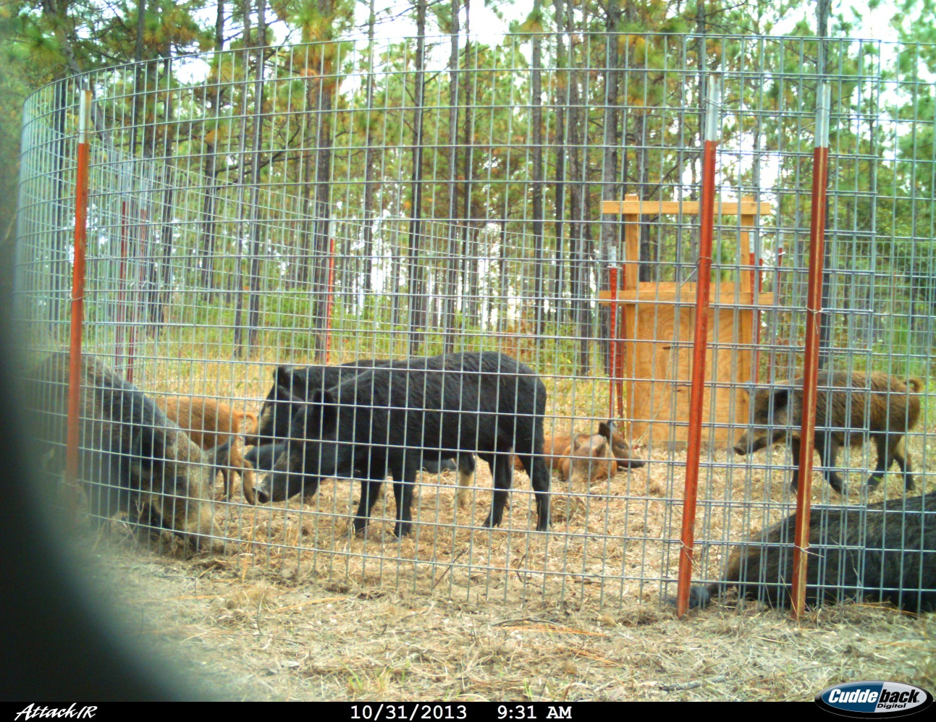
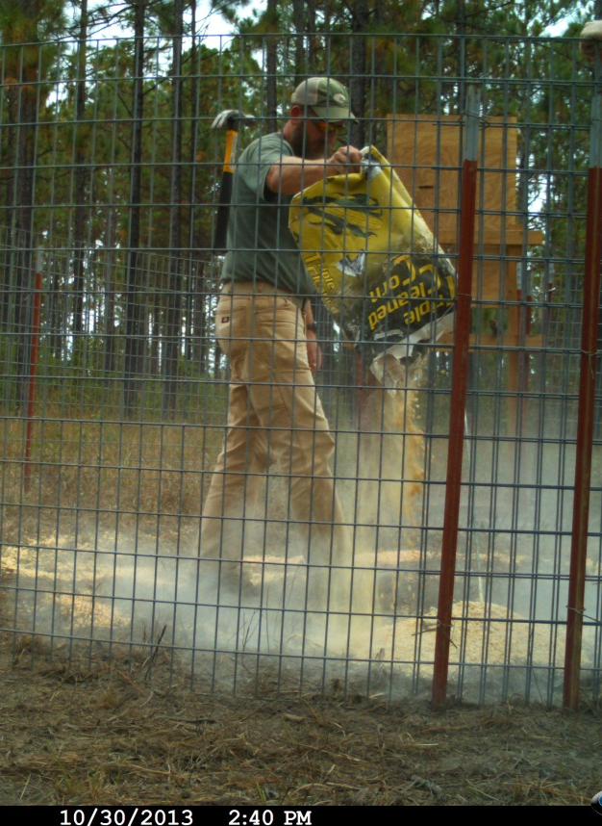
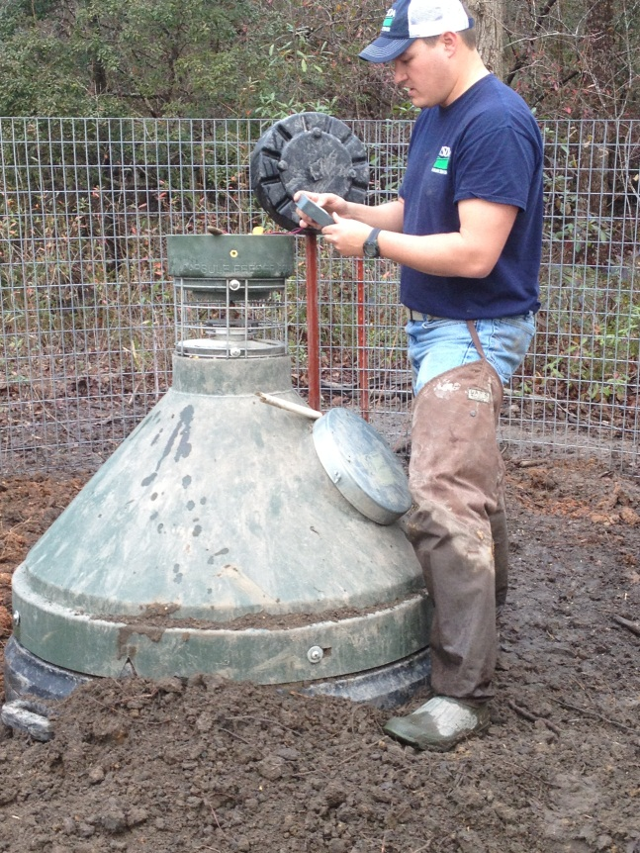
Progress:
Stewardship partially funds Camp Shelby nuisance wildlife control in Impact Closure Area
APHIS Contract started in August 2013, 140+ pigs to date.

Slide 15
Camp Shelby Stewardship
Continuing On…
Cogongrass Control
Gopher Tortoise Habitat Enhancement
Feral Pig Control
Prescribed Fire
RCW Translocation

Slide 16
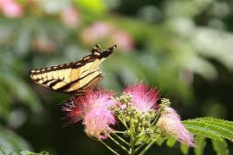
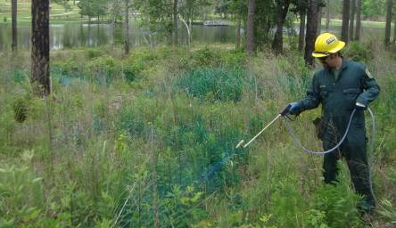
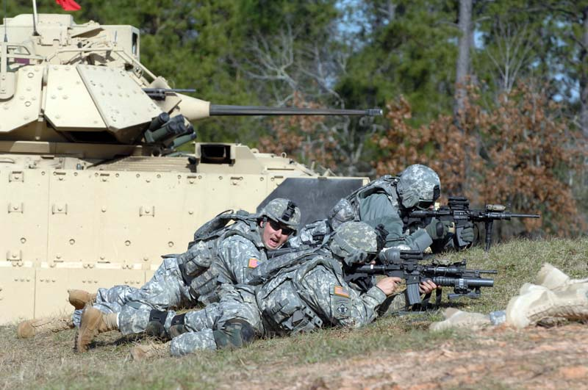
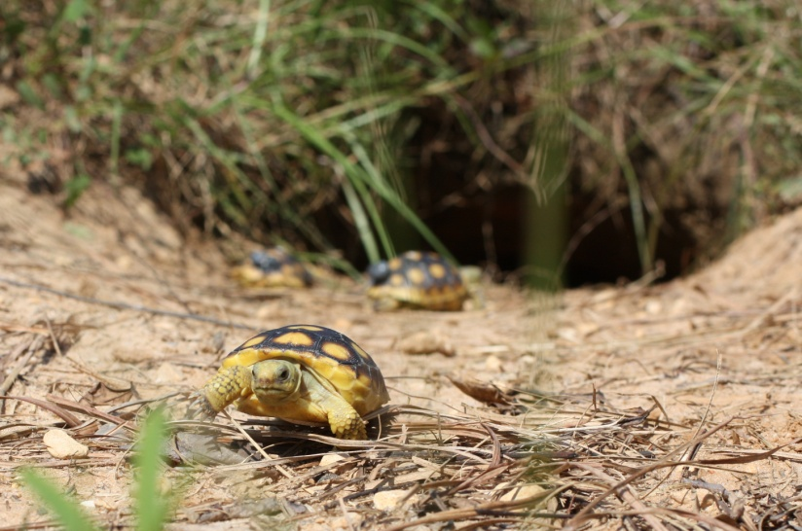
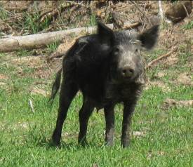
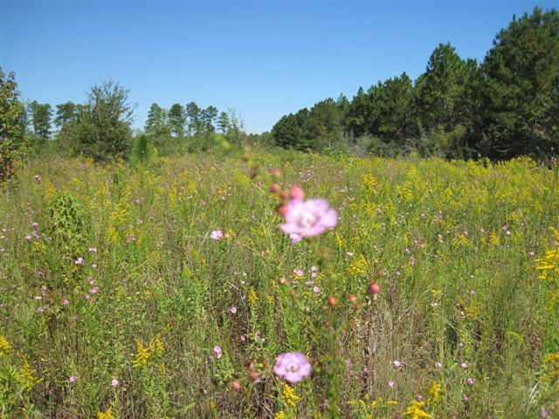
Questions?

