Slide 1
Sage-Grouse 101
David Dahlgren, PhD
Utah State University

Slide 2
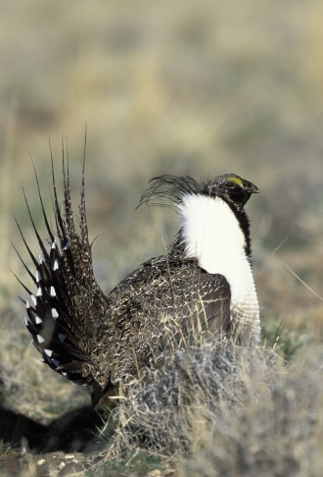
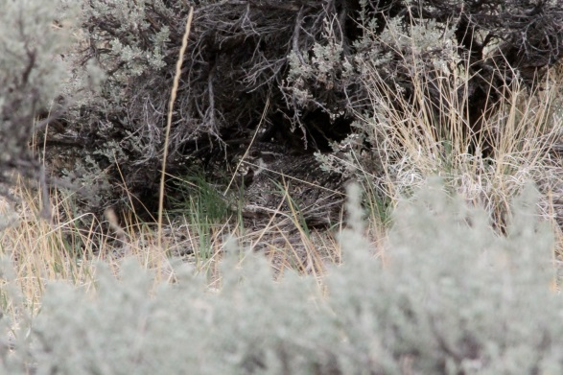
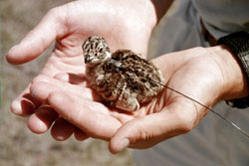
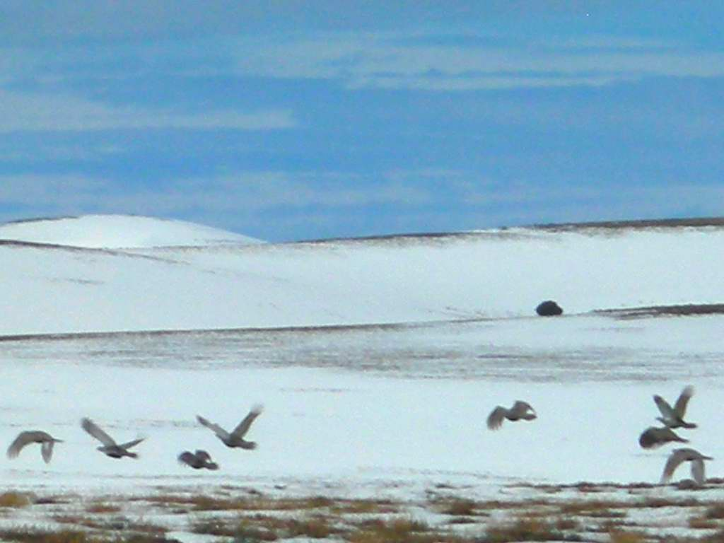
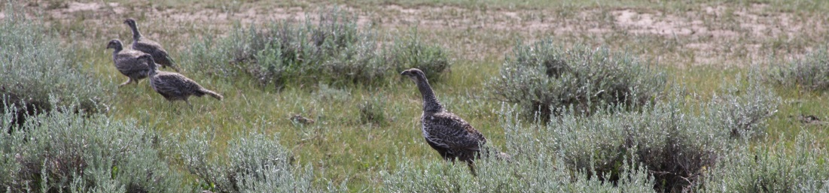
Life Cycle

Slide 3
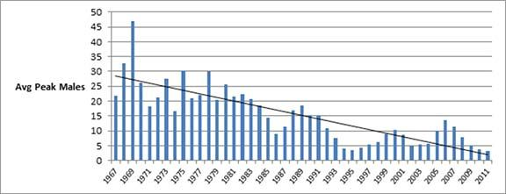
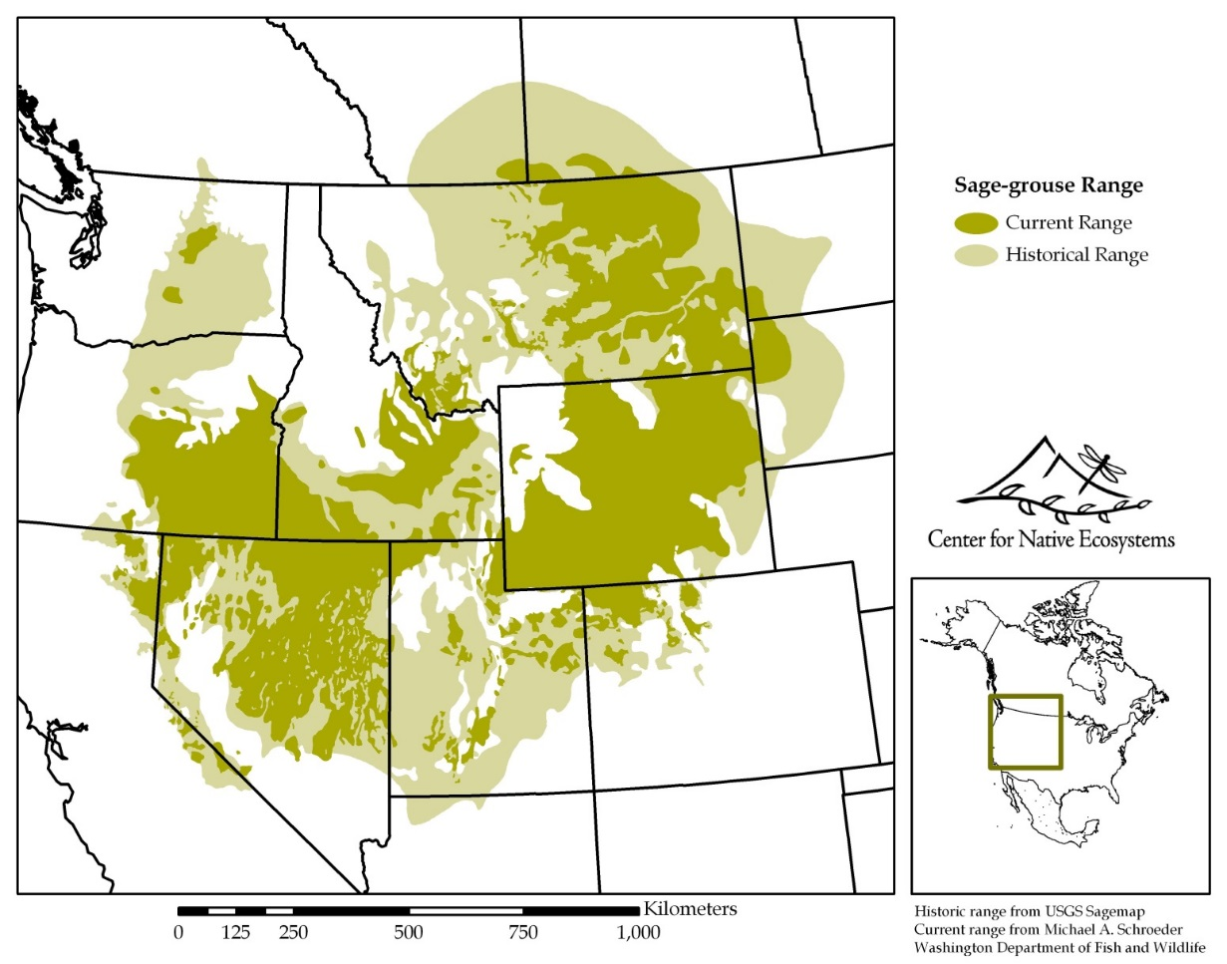
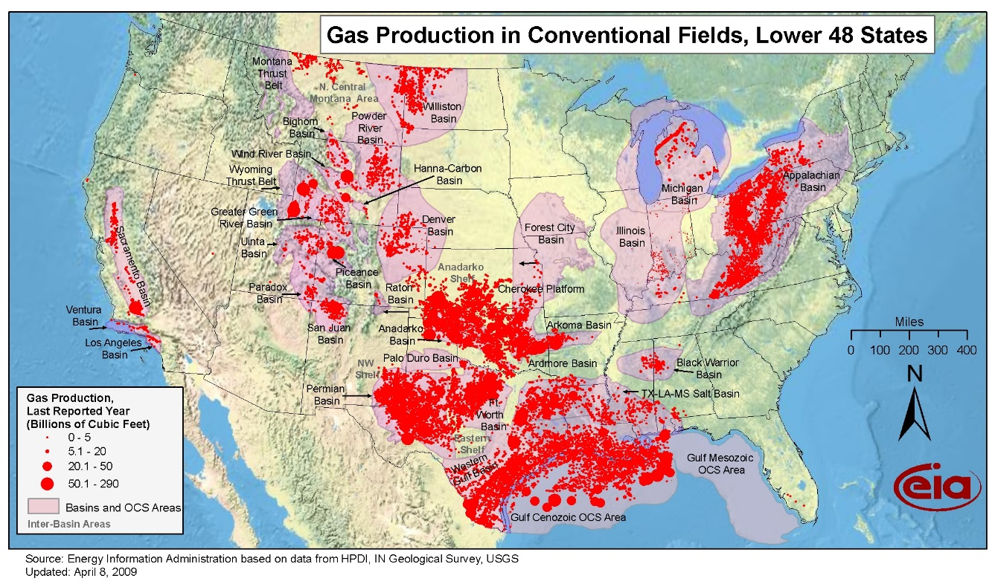
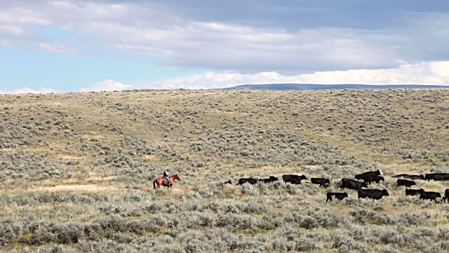
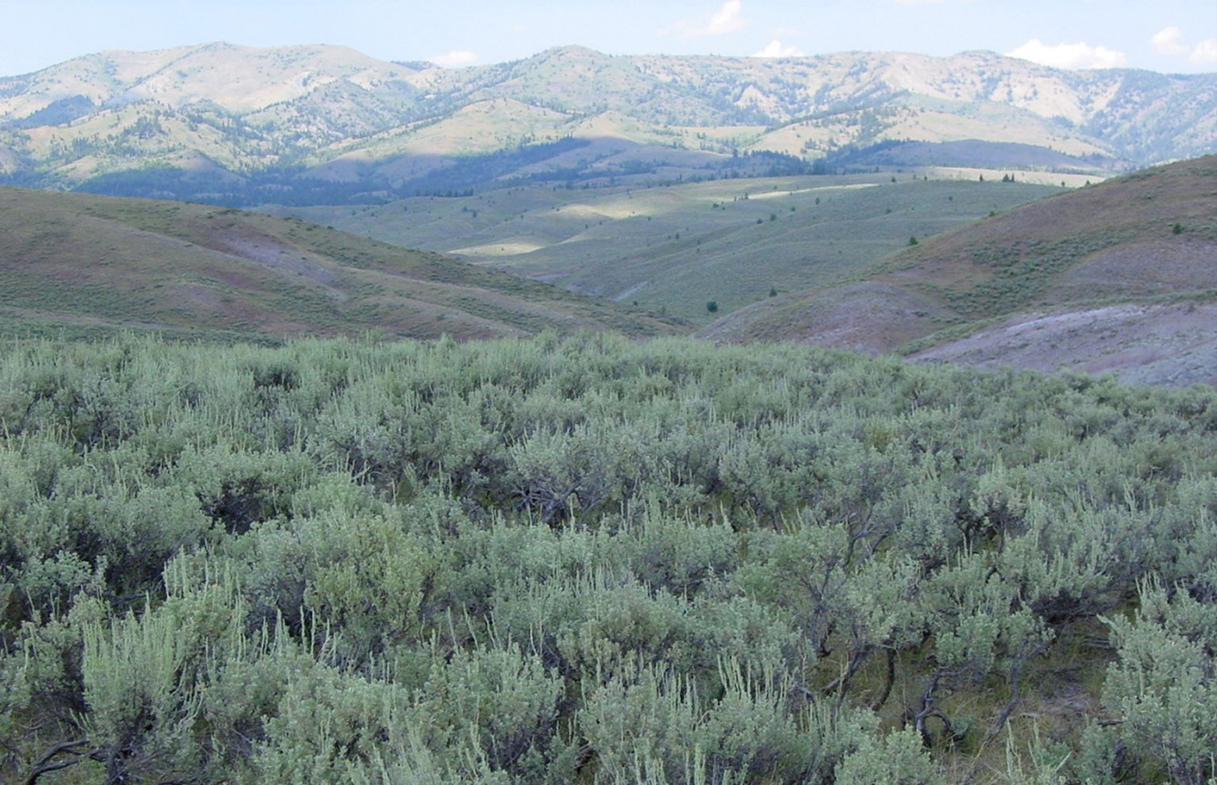
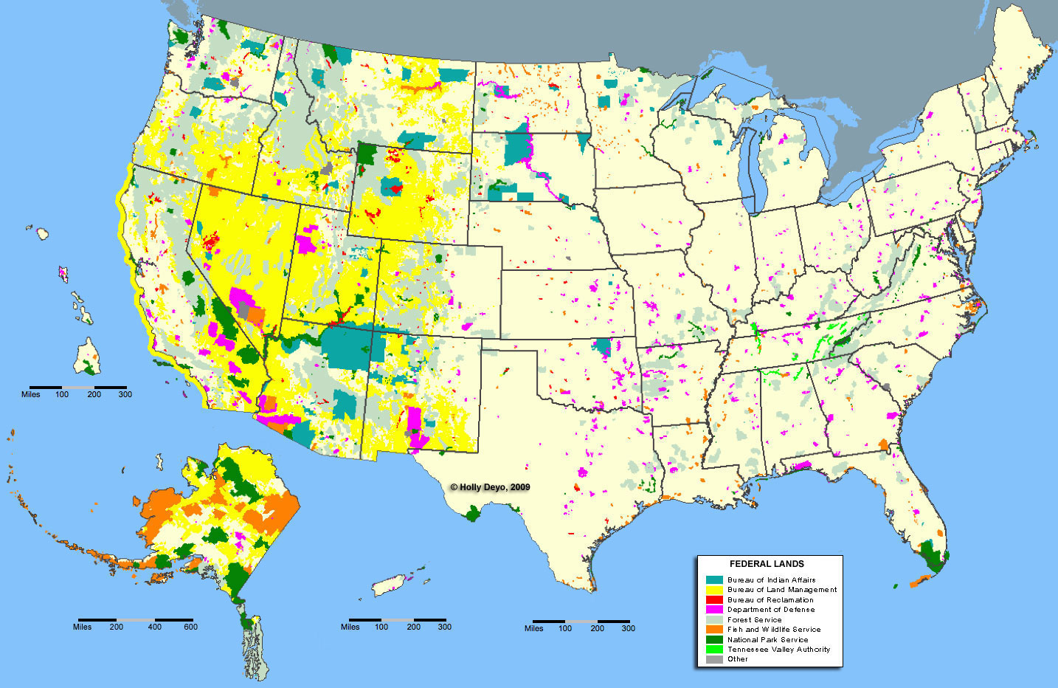
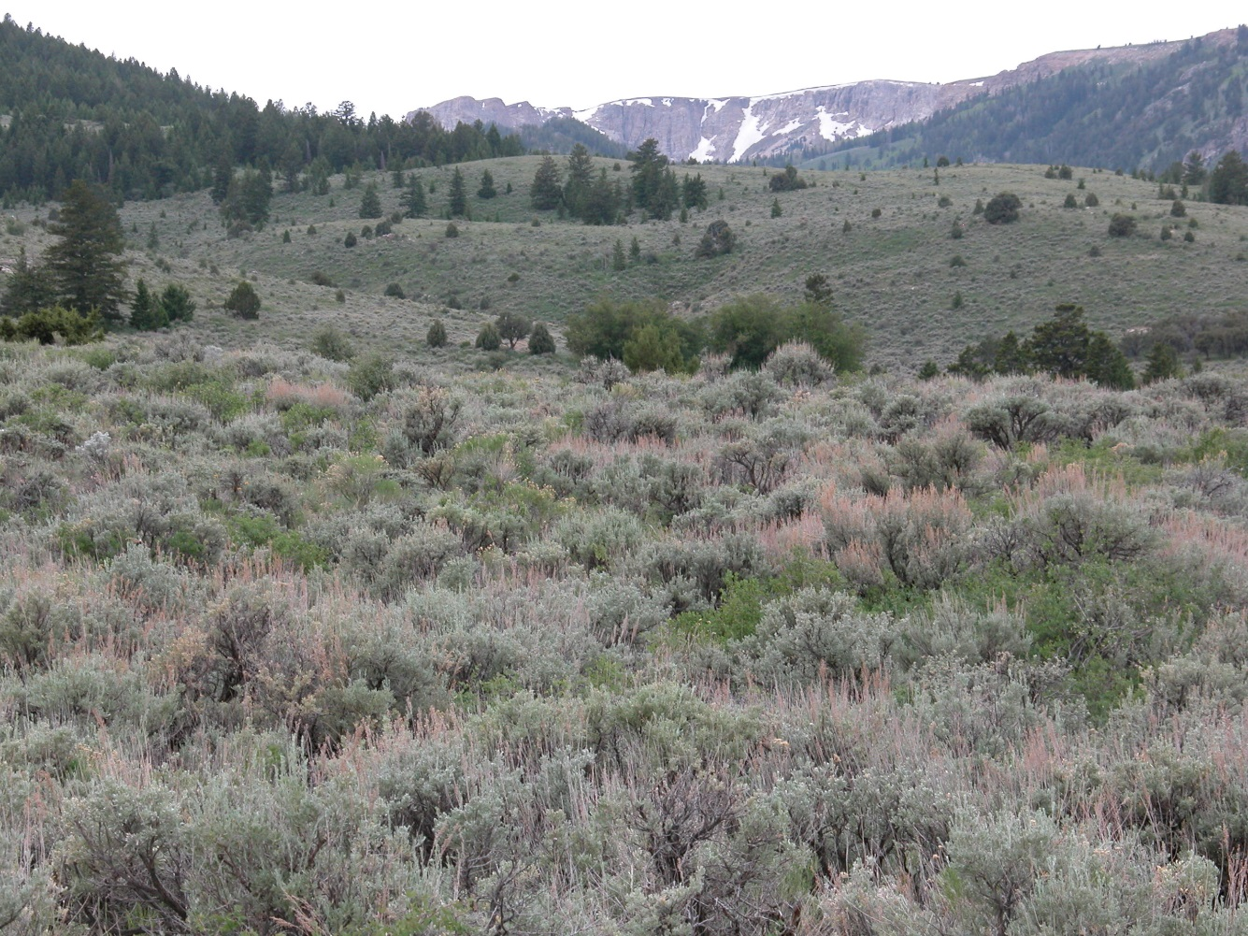
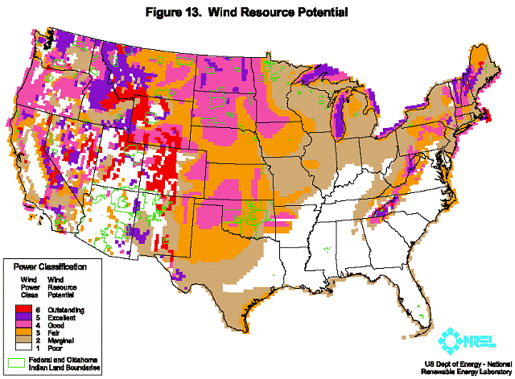
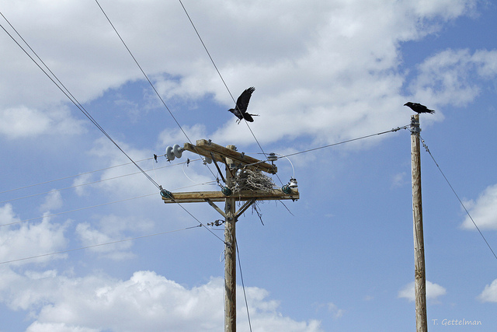
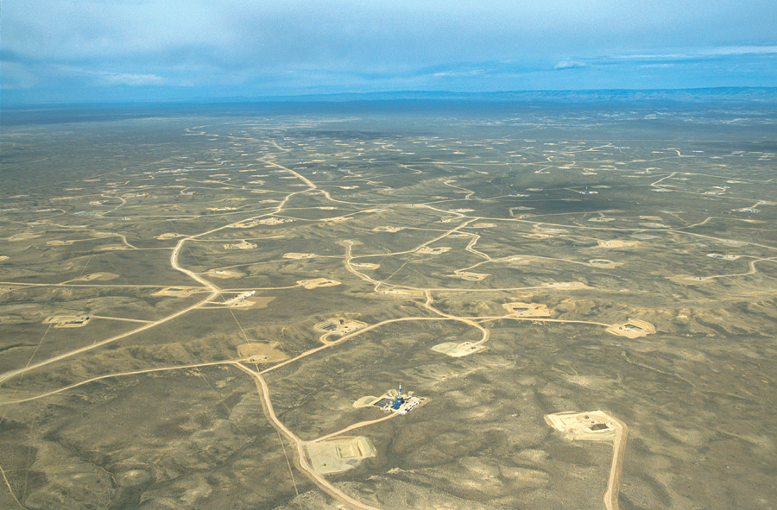
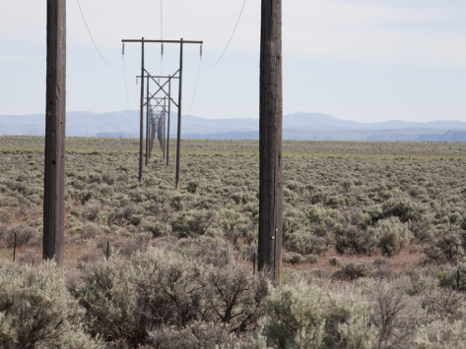
What’s the Big Deal?

Slide 4
Threats
Habitat Loss and Fragmentation (Number 1)
  energy development, infrastructure, conversion to cropland, urban/ex-urban development, wild fire (invasive grasses), conifer encroachment
Habitat Degradation
    Improper grazing (livestock, wild horses/burros), drought, invasive plants

Slide 5
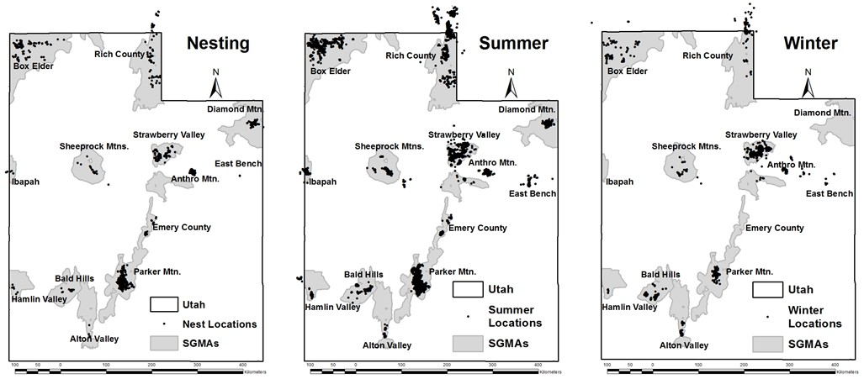
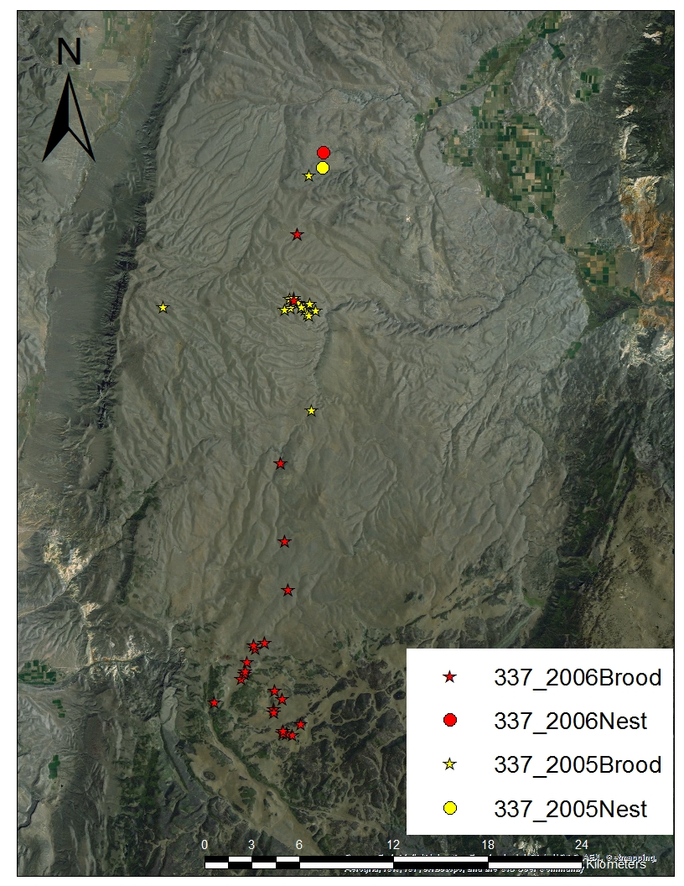
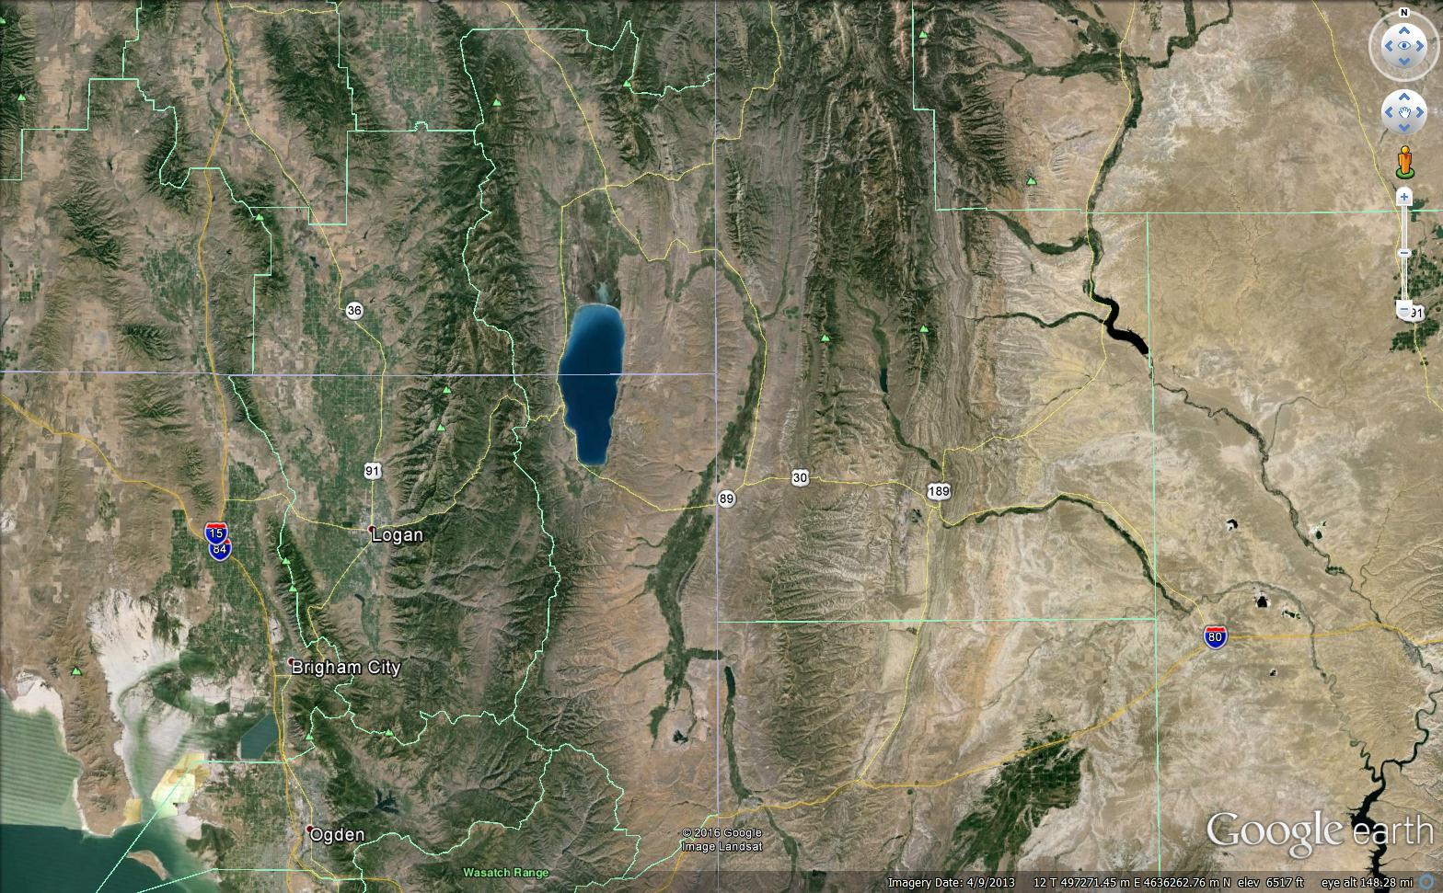
Seasonal Movements

Slide 6
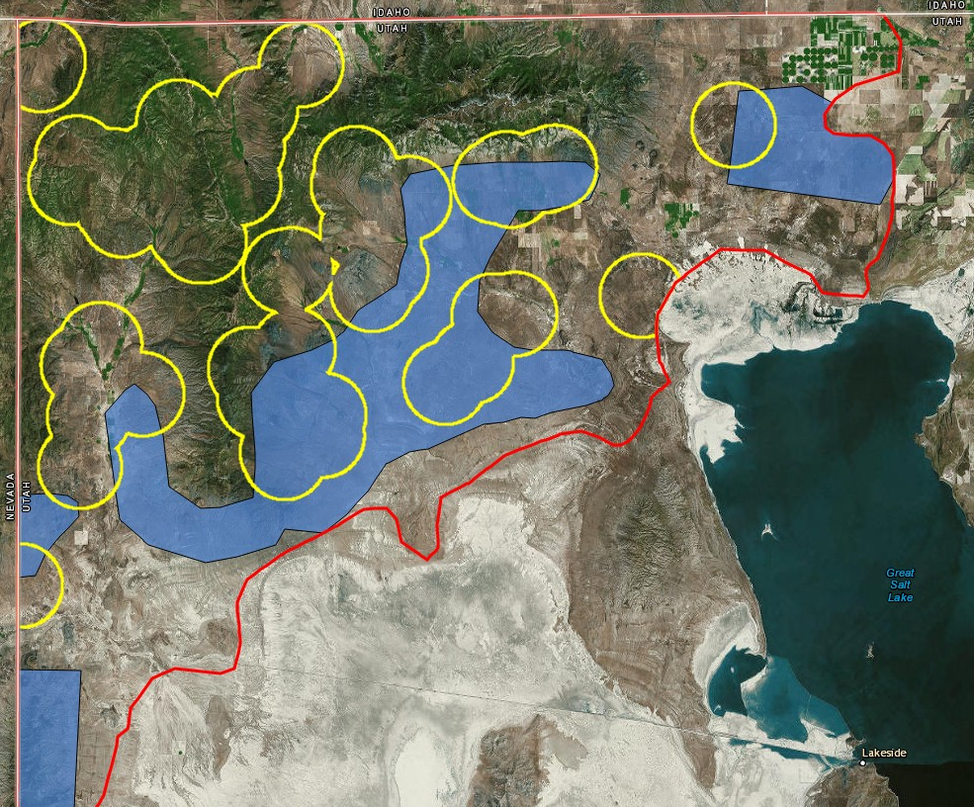
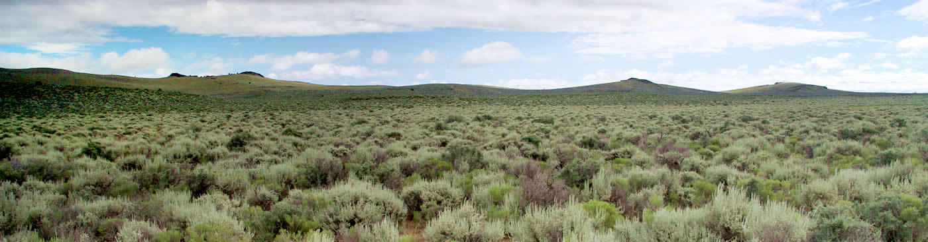
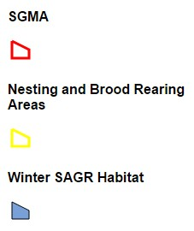
Habitat
Characteristics
Shrub and Herbaceous: cover, height, density, composition, diversity
Think MULTIPLE SCALES (1st, 2nd, 3rd, 4th Orders of Habitat)

Slide 7
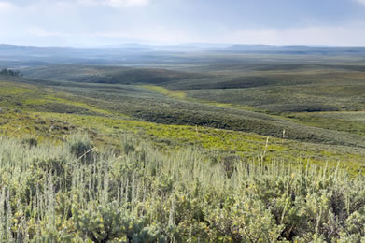
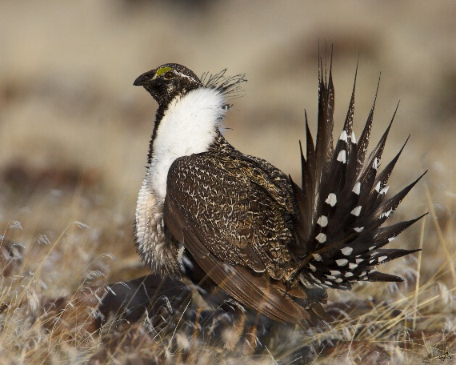
Percentage of Sagebrush on Landscape
< 25% within 5km of Lek = 0
25-45% within 5km of Lek = + & -
45-65% within 5km of Lek = Variable, but mostly stable
> 65% within 5km of Lek = Stable and Increasing

Slide 8
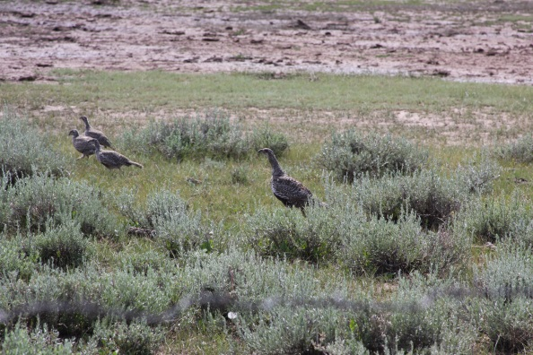
Seasonal Habitat Characteristics
Breeding (Pre-laying, Lekking, Nesting, Early Brood-Rearing)
Summer (Late Brood-Rearing)
Winter

Slide 9
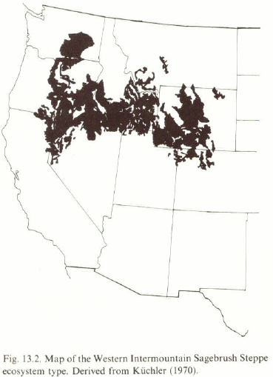
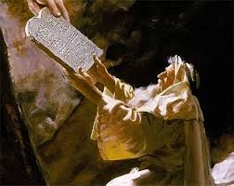
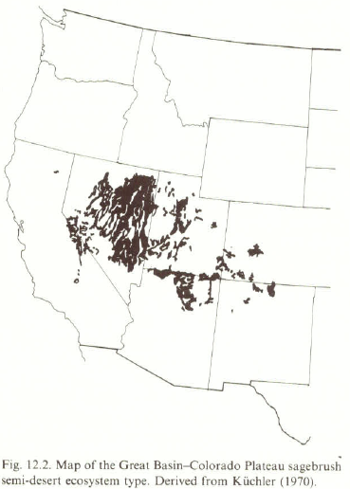
Habitat Standards
Sage-Grouse Habitat Guidelines (Connelly et al. 2000)
Sagebrush Steppe vs. Sagebrush Semi-Desert
“Local differences in conditions that affect sage grouse populations may occur and should be considered in conservation plans.” (Conservation Strategies, page 981)

Slide 10

Stubble Height of Grass
What about 7 inches?
Doherty et al. 2014 and Author Response
“Improper grazing (by domestic livestock and free-roaming horses and burros) can have negative impacts to sagebrush and greater sage-grouse at local scales. However, in 2010, the Service did not find that this was a principal factor affecting the status of the species.” http://www.fws.gov/greatersagegrouse/findings.php

Slide 11
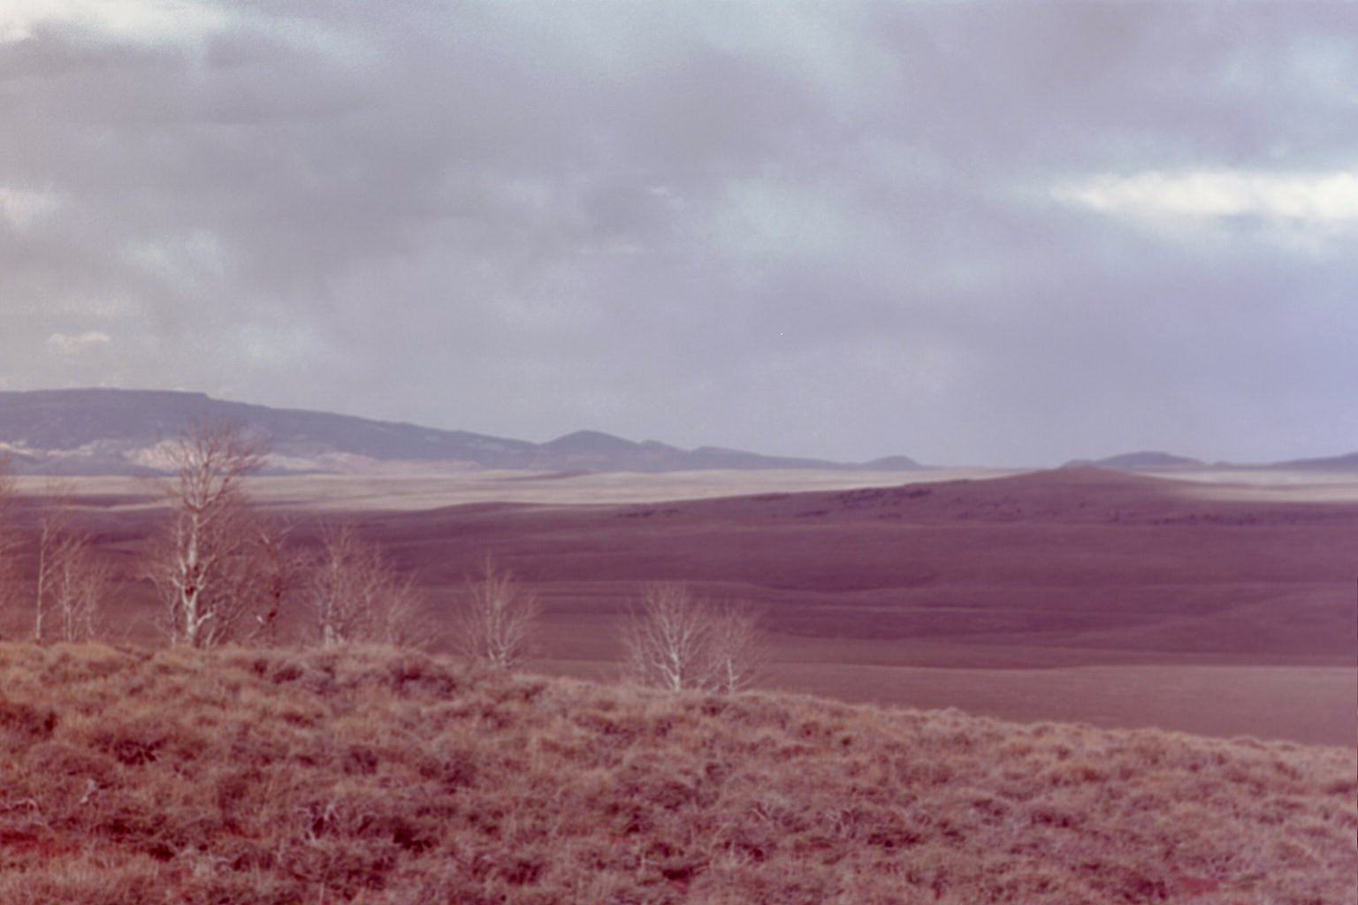
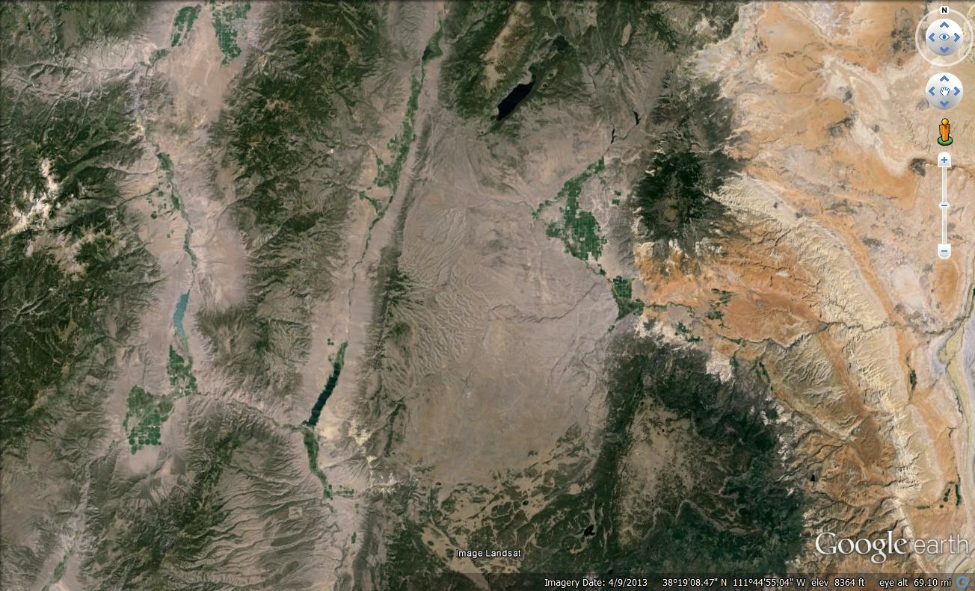
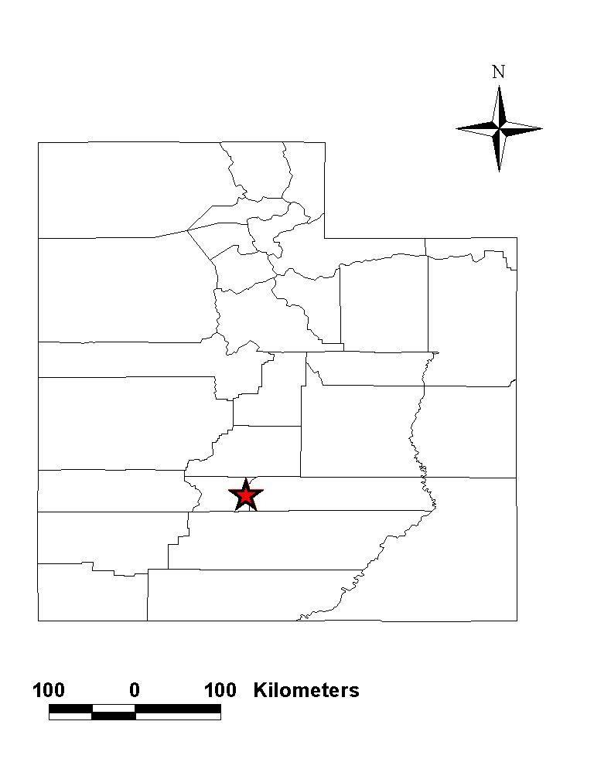
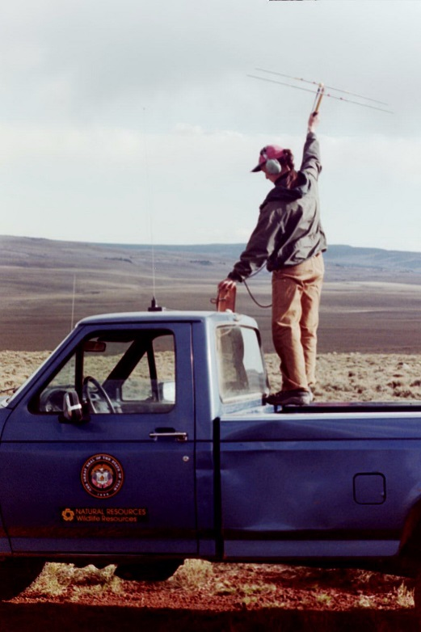
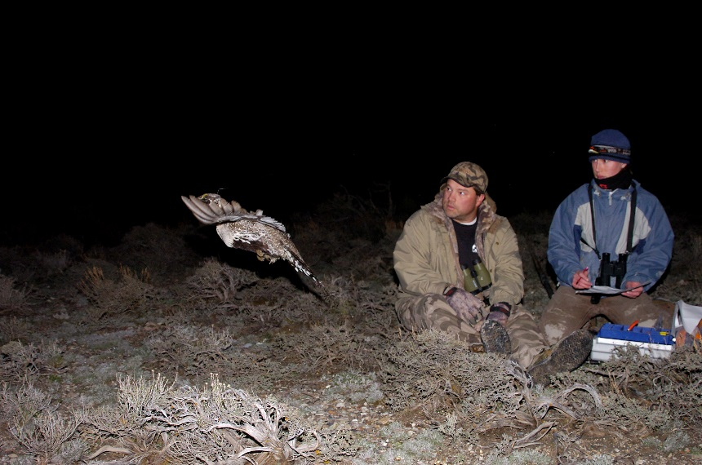
Parker Mountain Story
PARM 1998 – Parker Mtn. Grazing Association – Andy Taft
1998 – 2010: Radio Marked Female Sage-Grouse

Slide 12
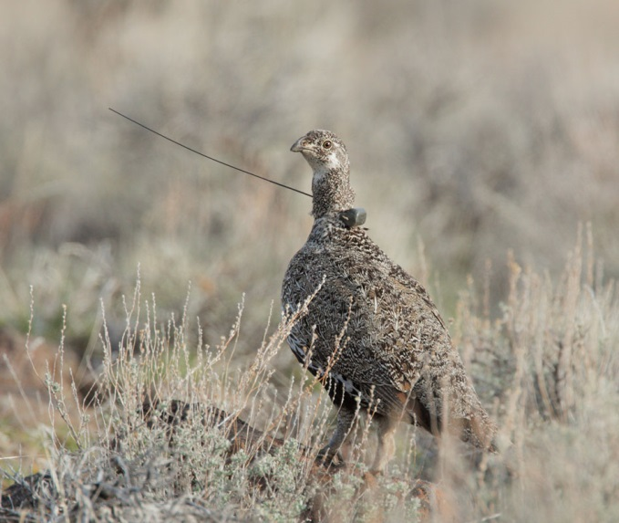
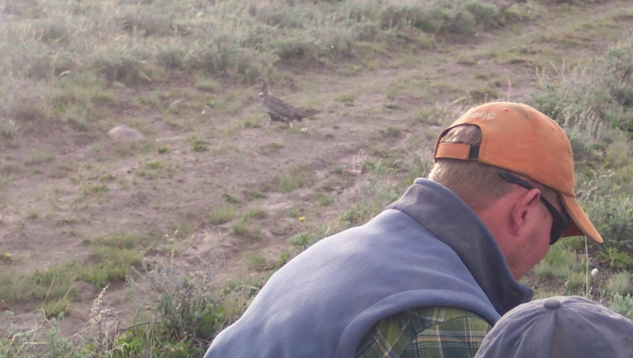

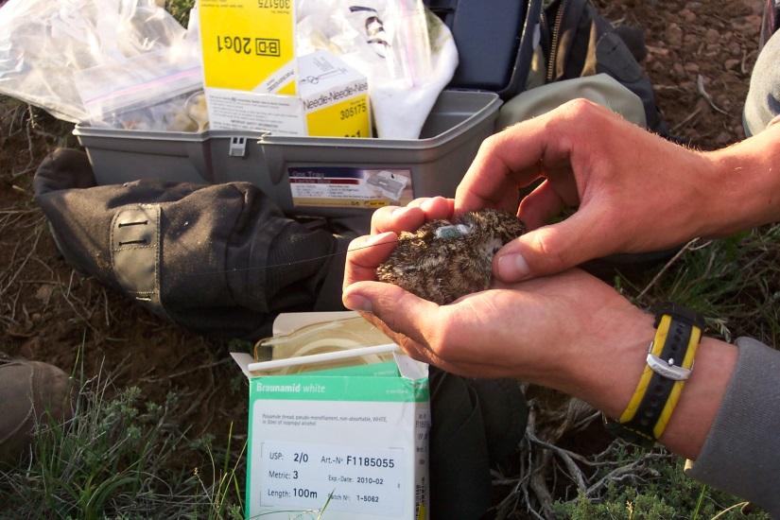
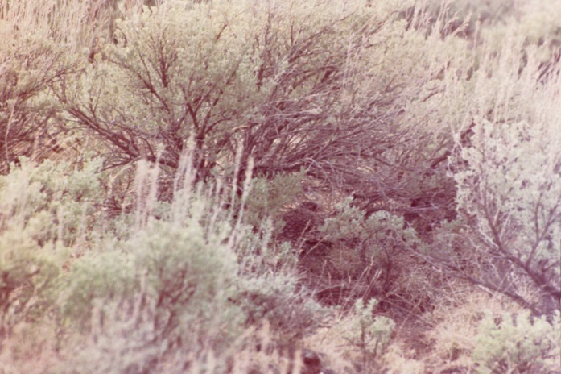
Parker Mtn.: Chick Survival
Grazing!!!!!

Slide 13
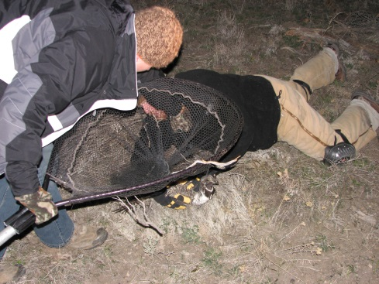

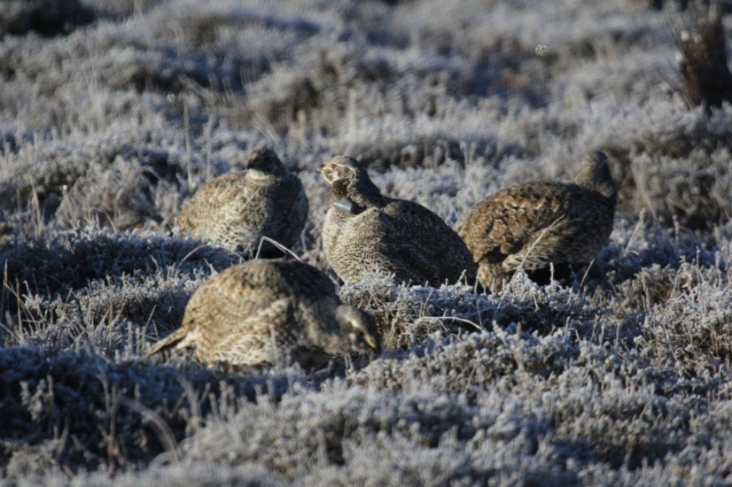
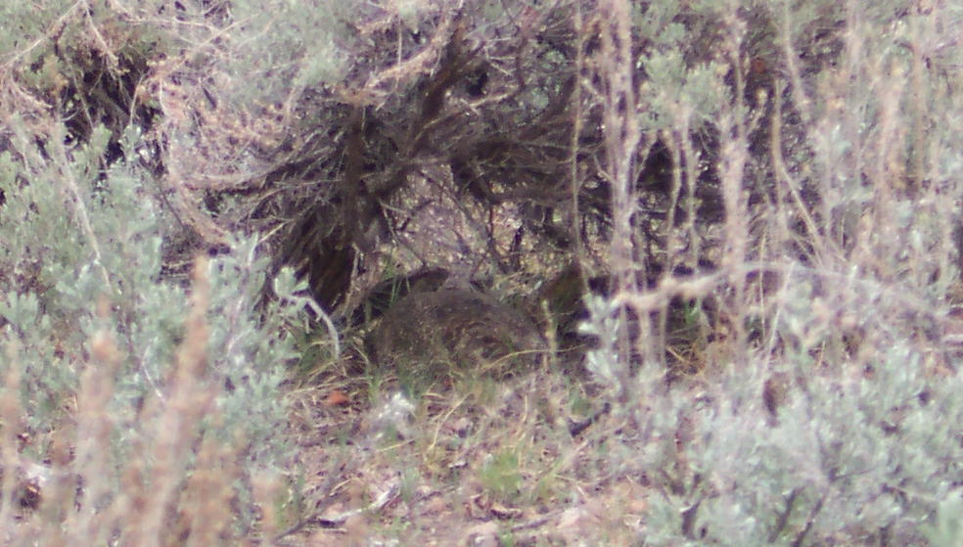
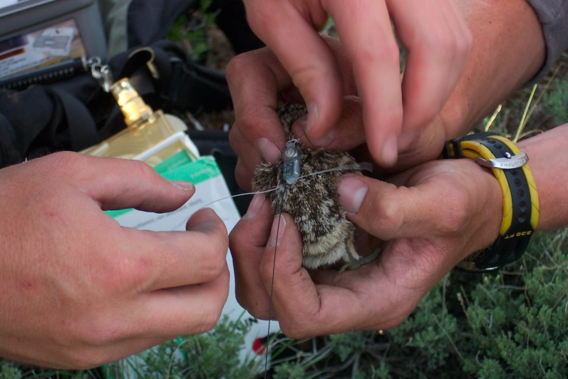
Parker Mtn. Population Model
SY
ASY
λ = 0.97 (SE = 0.025)
Take Home – !!!!!!STABLE!!!!!
Post-Fledgling Survival
(Juvenile- Hatch year Sept-March)
(Yearling-Second Year)
(Adult-After Second Year)

Slide 14
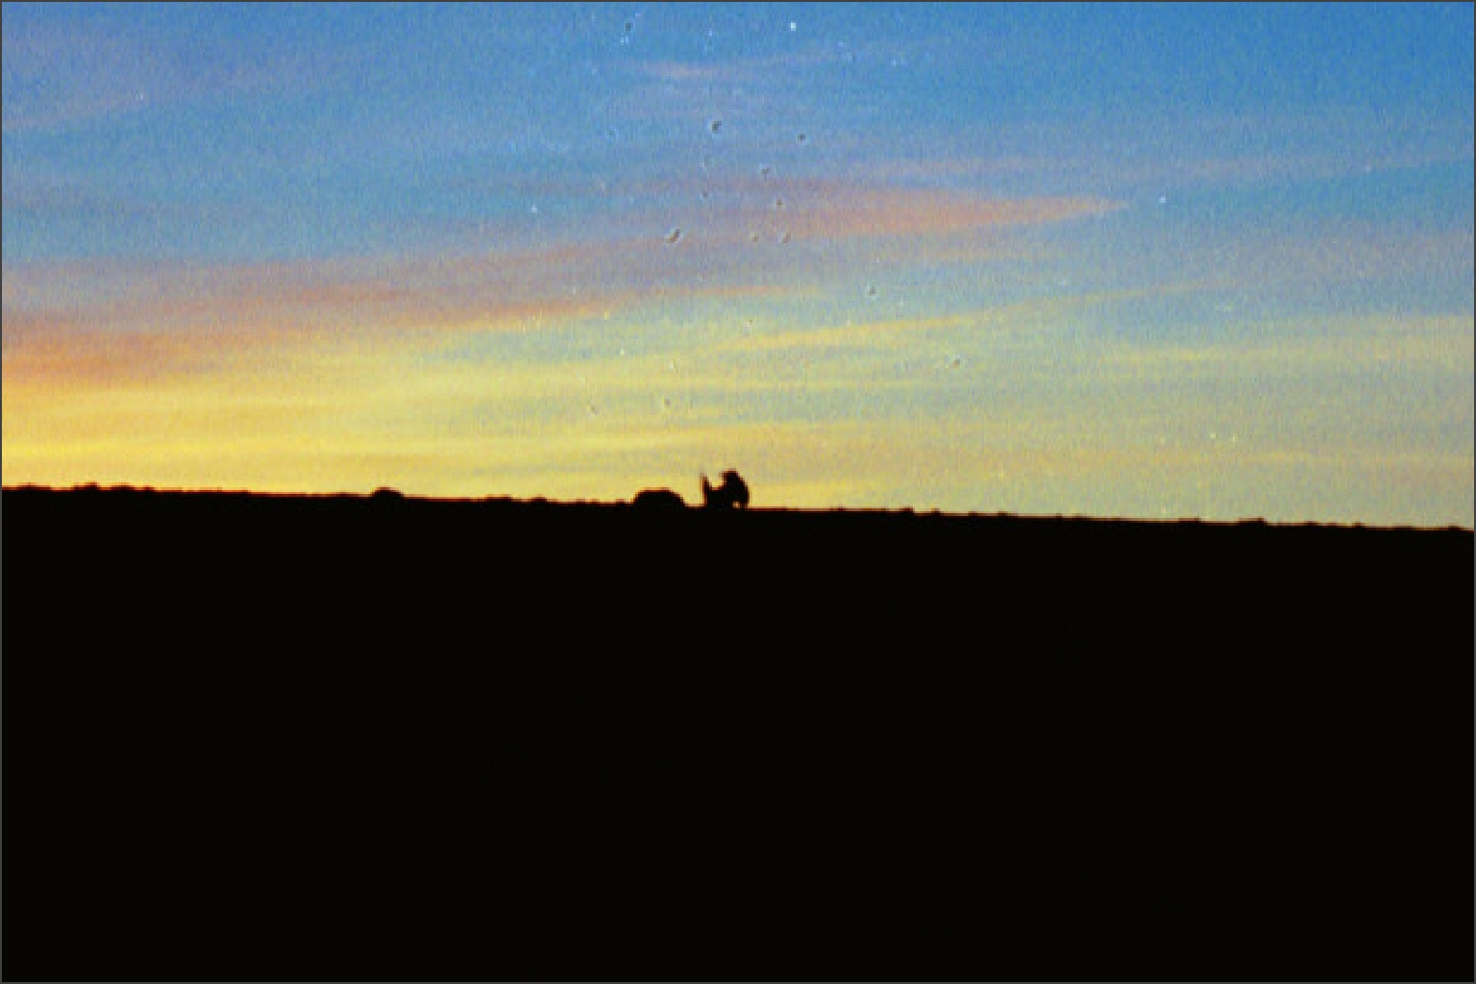
Parker Mountain
Population Characteristics
Average to above average Nest Initiation & Survival
Nest survival did not contribute to λ (popn growth rate)
50+% Chick Survival (Highest Chick Survival in Literature)
Good Juvenile Survival
Variable, but good Adult Survival
Below average Clutch Size
STABLE/GROWING POPULATION
Key Points
Large Intact Sagebrush Landscape
No Development (except Dirt Roads)
Below Habitat Guidelines
Historical and Continual Livestock Grazing (Sheep and Cattle)
Nest Site Veg
  Type % Cover Height
  Shrub 28% 23 cm (9 in)
  Grass 7% 11 cm (4.3 in)
  Forb 3.5% 7 cm (2.75 in)
Brood Site Veg
  Type % Cover Height
  Shrub 23% N/A
  Grass 11% N/A
  Forb 8% N/A
  Dahlgren et al. 2016
  Caudill et al. 2014
  Guttery et al. 2013
  Dahlgren et al. 2011

Slide 15
Take Home
Sagebrush on the Landscape
Variability in Population Dynamics and Habitat
Manage with input from Local Data and Partners

