Slide 1
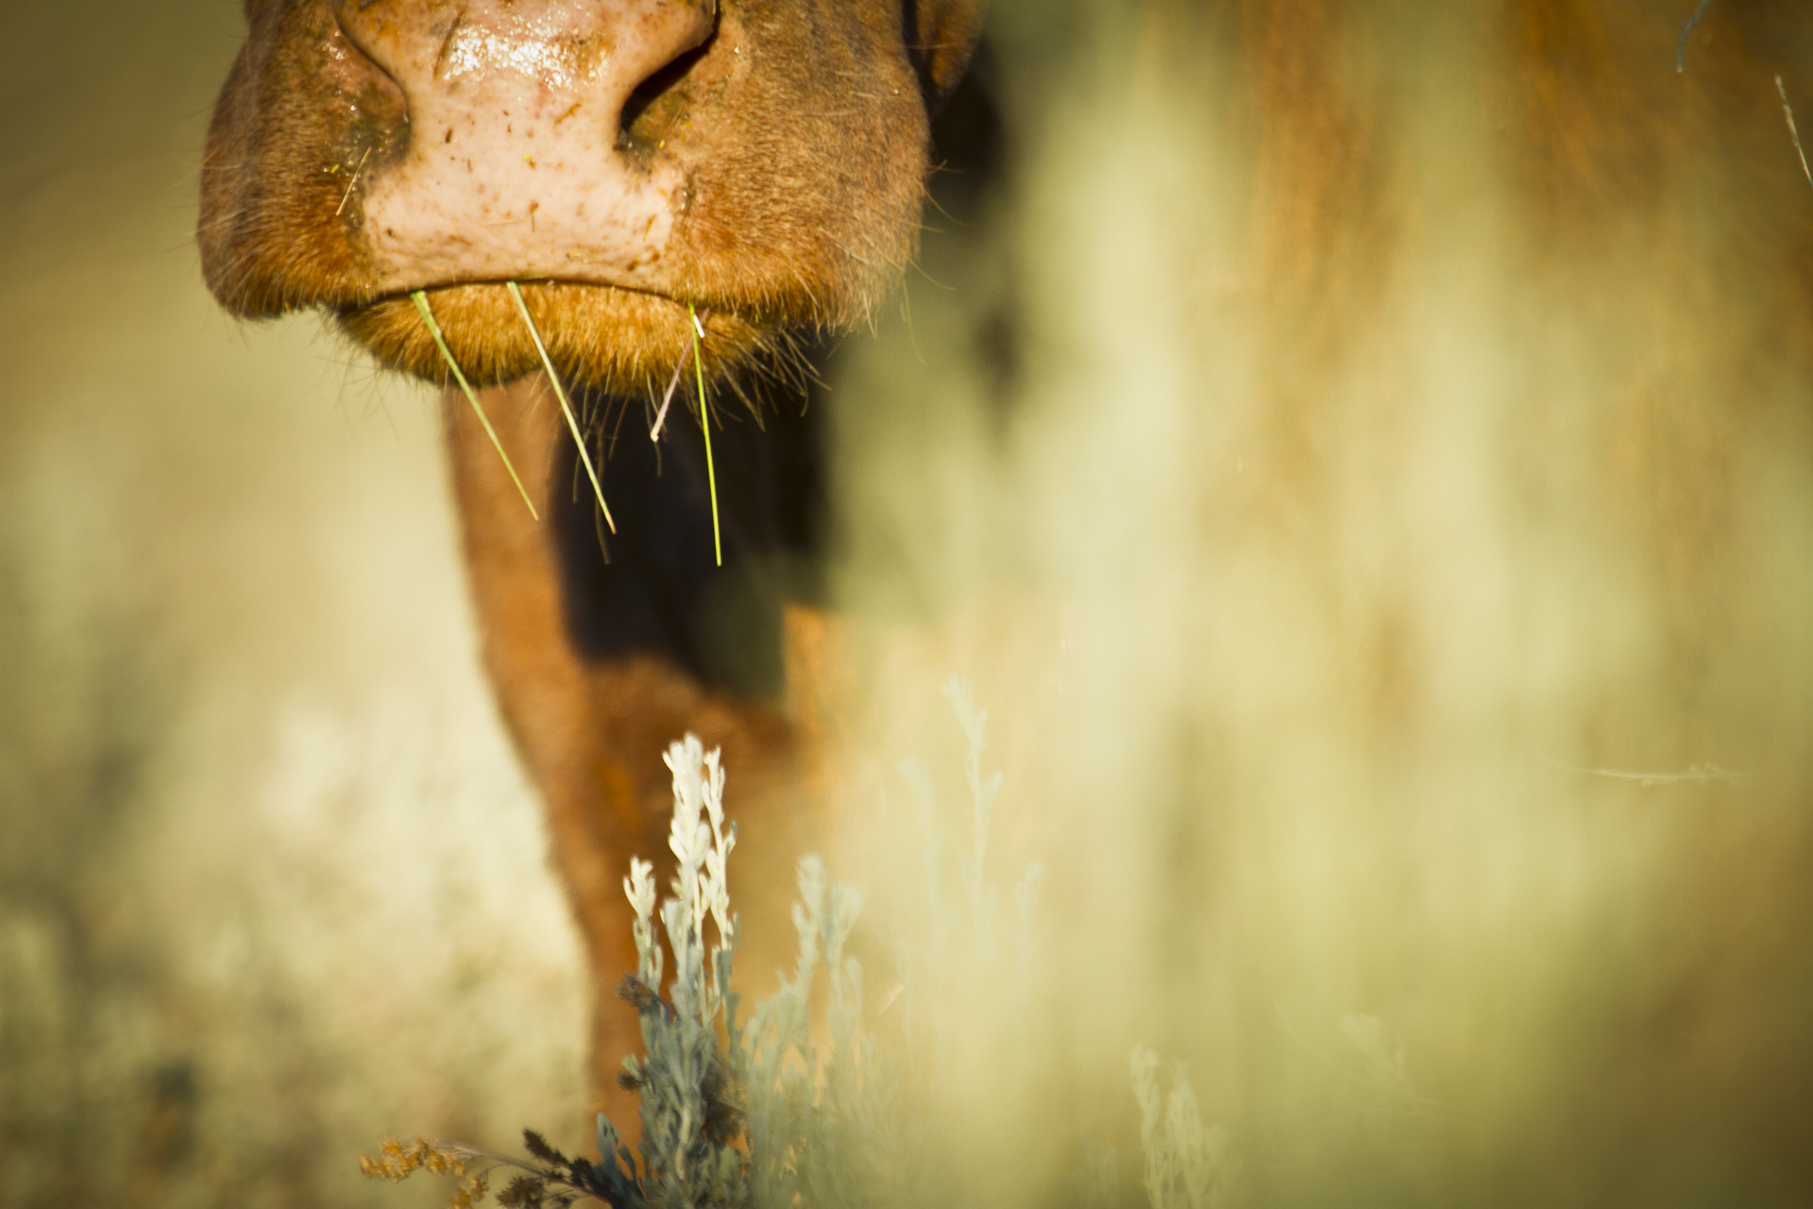
Grazing and Consensus: Can It Work?
Mary O’Brien
Grand Canyon Trust
Sagebrush-Steppe Workshop
Denver, CO
April 26-27, 2016
maryobrien10@gmail.com

Slide 2
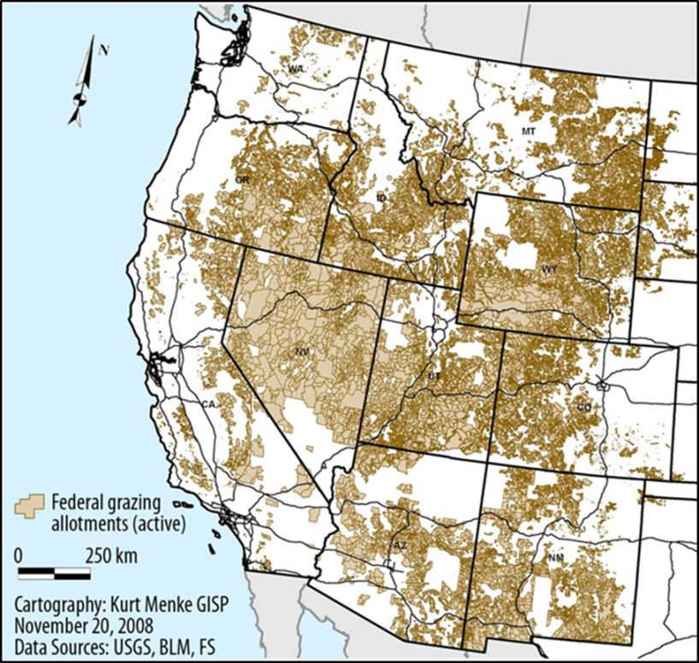
Greater Sage-Grouse
in the West
Federal grazing allotments in the West
Sagebrush is typically heavily grazed and browsed

Slide 3
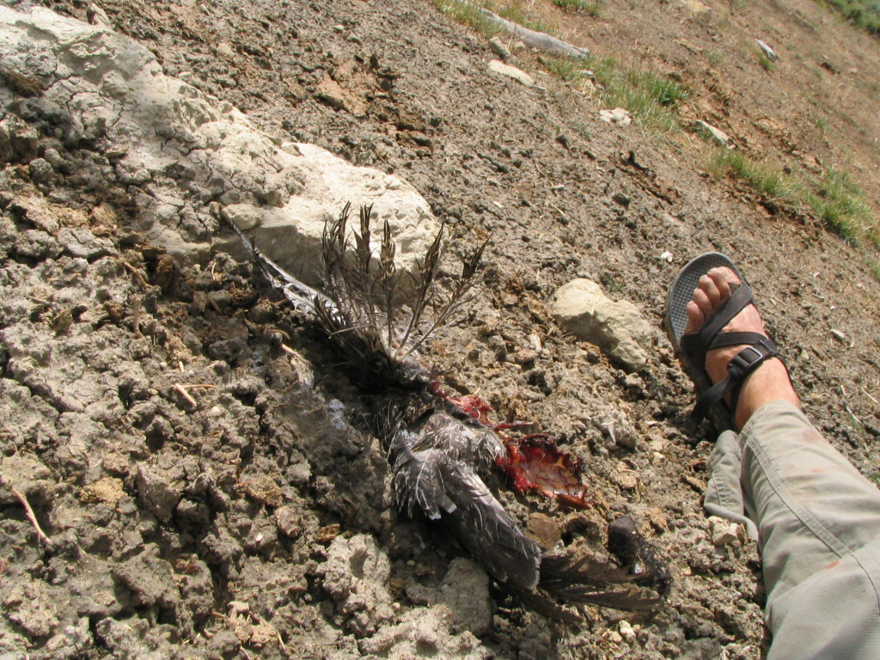
The Key Question Scientists Have Not Been Asking
What is the impact of livestock grazing on grouse survival
and reproduction?
What is the impact of livestock grazing on grouse survival
and reproduction?

Slide 4
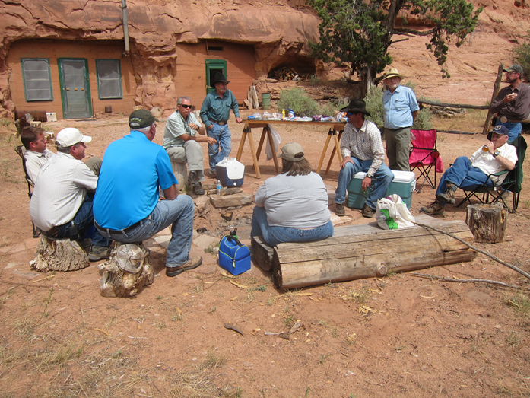
Why Consensus Collaborations?
Consensus requires everyone to deal with each other
Misperceptions and inaccuracies die in consensus collaboration.
The chances are greater that there will be broad buy-in for recommendations

Slide 5
Why Consensus Grazing Collaborations?
Ungulate grazing affects multiple national forest stakeholders
Grazing is one use among many national forest uses
Livestock grazing has long focused narrowly on forage and ground cover
Changes in livestock grazing can be divisive; consensus collaborations promote agreement

Slide 6
Tushar Allotments Collaboration
First grazing consensus collaboration in Utah (2007-2009)
Diverse stakeholders; state wildlife agency as well as Forest Service participating
First time utilization was set at 30%, for recovery
A 47-acre riparian and upland reference area was established.

Slide 7
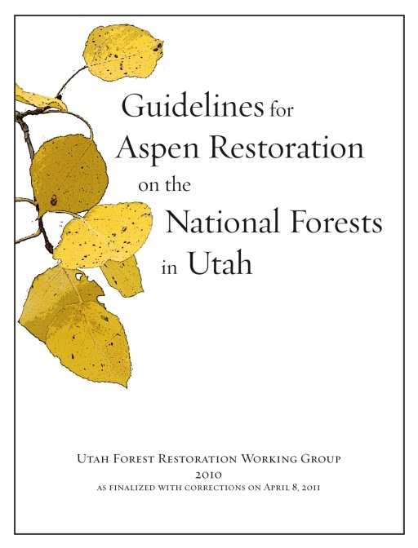
Utah Forest Restoration Working Group
Guidelines for aspen restoration
First time attention is given not only to conifer-overtopped aspen, but to over-browsed persistent aspen (i.e., conifer not significantly present)

Slide 8
Monroe Mountain Working Group
Tests UFRWG aspen restoration guidelines
Multiple field tours, subgroup monitoring
Establishes quantitative triggers for reduction of excessive ungulate browsing.
State wildlife (elk) and federal livestock (cattle, sheep) alike subject to browse limits

Slide 9
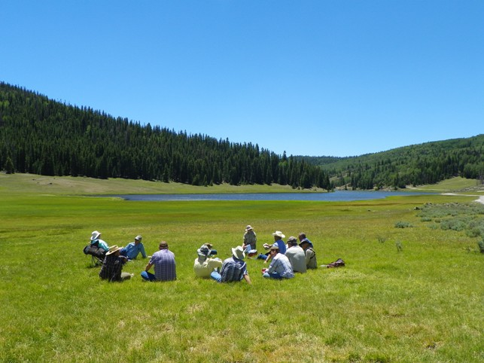
Collaborative on Sustainable Grazing for national forests in Southern Utah
Collaborative Group on Sustainable Grazing for U.S. Forest Service Lands in Southern Utah
Final Report and Consensus Recommendations December 2012
Jointly convened by the Utah Department of Agriculture and Food and the Utah Department of Natural Resources
Report compiled by Michele Straube, University of Utah and Lorien Belton, Utah State University
Convened by UT Dept of Natural Resources and UT Dept of Agriculture and Food
Recommends diverse stakeholders, diverse indicators of sustainable grazing, and diverse grazing arrangements.
An appendix of 80+ simple monitoring methods for use by agencies or stakeholders.

Slide 10
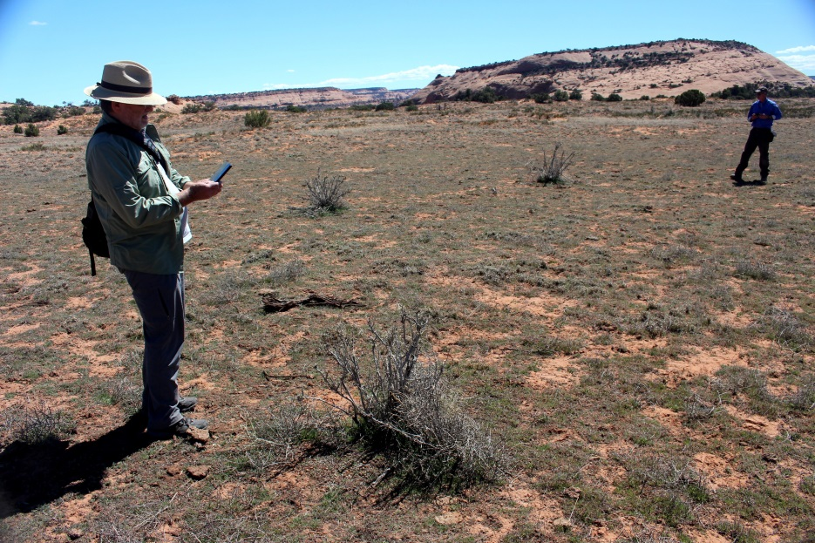
La Sals Sustainability Collaboration
First consensus grazing collaboration in Utah with both FS and BLM allotments.
Seven allotments; two permittees.
Currently developing desired conditions; differing opinions as to conditions and
capacity for improvement with the same number of cattle.

Slide 11
What Works: It’s All In
Consensus
Everyone is there who needs to be there
Every topic is on the table
All data are to be considered on basis of objectivity and repeatability, regardless of source
Non-permittees are legitimately engaged in grazing decisions

Slide 12
What Works: Science
Collaborative agrees re: questions to ask and methods to use
Joint and individual monitoring on ground
Legitimacy of citizen monitoring with different methods
A scientist of particular characteristics is a collaboration member:
Does not assume others don’t know relevant science
Goes out in the field with collaboration members
Pitches in with science- and consensus-based problem-solving

Slide 13
What Works: USFS Willing to Leave Comfort Zone
Acceptance of citizen monitoring with non-FS methods
The will to accept different solutions than the FS would have suggested
The will to use actual decision space
Acknowledgment that grazing as a “multiple use” doesn’t mean “grazing everywhere”
The will to use ungrazed reference areas for comparison

Slide 14
What Works: Facilitation
Skilled
Neutral
Tracks and reminds collaboration of decisions, commitments
Notes progress; avoids discouragement

Slide 15
What Has Interfered?
Subsequent FS District Ranger and/or Supervisor reverses earlier agreements
FS resistance to manage for sustainable grazing, especially numbers of animals
FS failure to address scientific studies about grazing, global warming
FS failure to advocate for considering pollinators, biocrusts, other species normally not considered in grazing management.

Slide 16
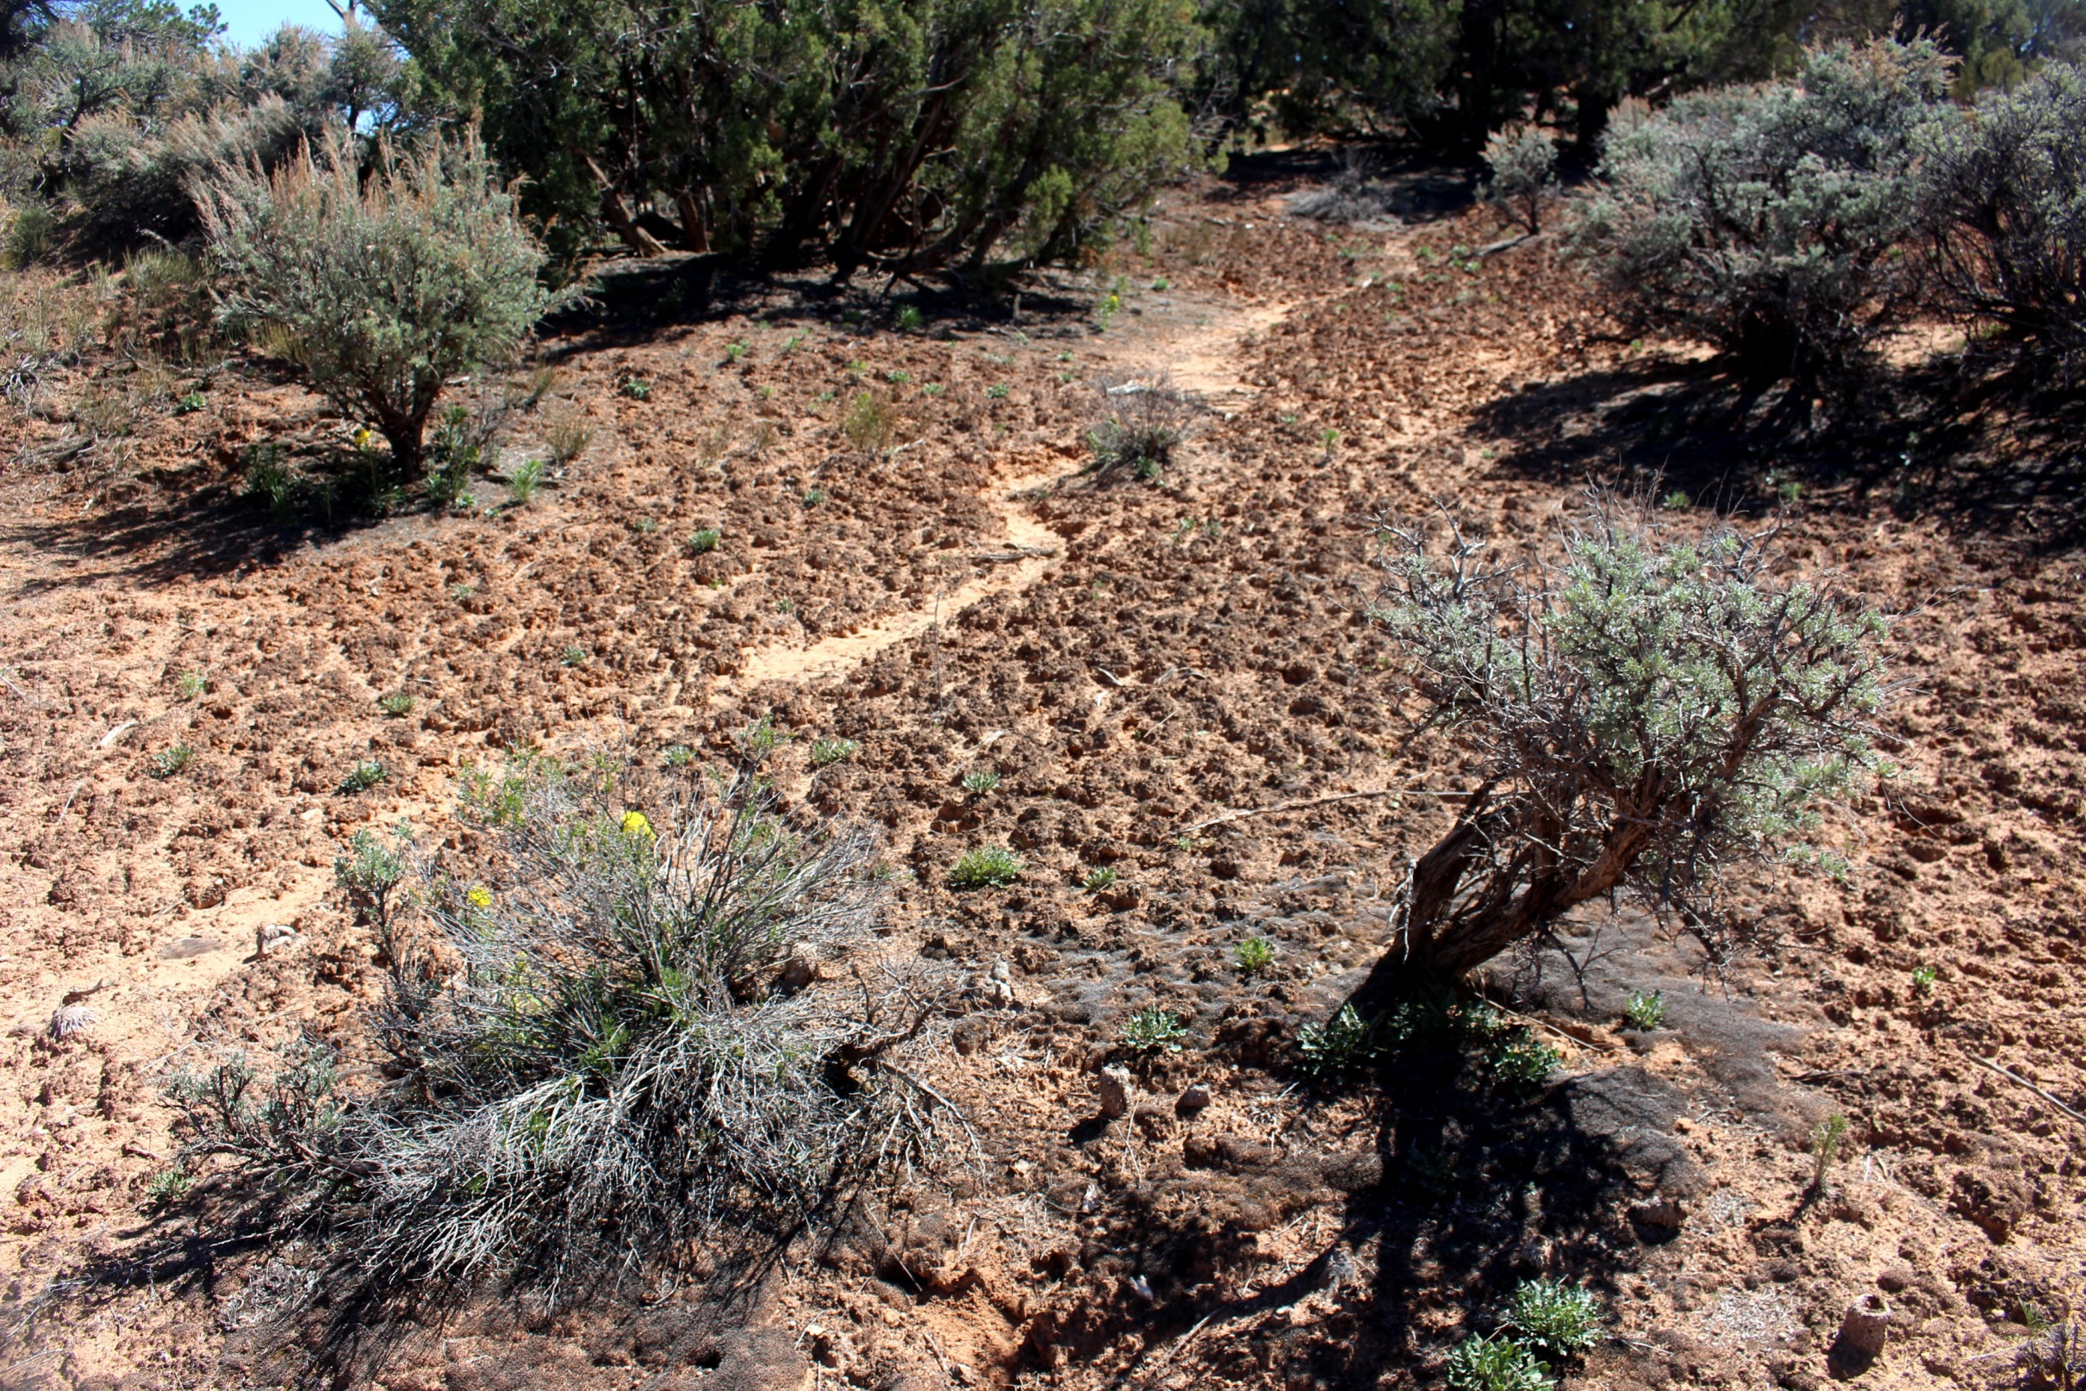
Thoughts? Questions?

