Slide 1
The CFLRP Researchers Network: Research to Date and Future Directions
Courtney Schultz
Assistant Professor of Forest Policy
Colorado State University
National Forest Foundation Collaborative Restoration Workshop
April 26-27, Denver, CO

Slide 2
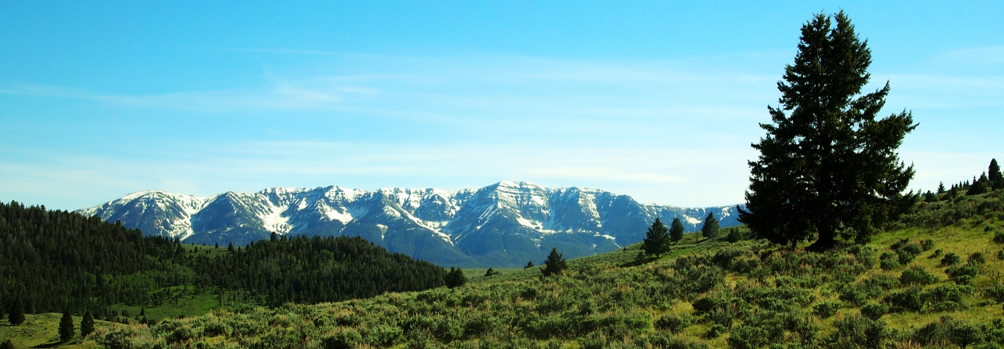
The Interest in CFLRP
A national movement towards more collaborative and adaptive forms of governance
CFLRP as the most recent policy model for supporting adaptive governance
Uniqueness of funding mechanism, scale, prioritization, and competition
A ready-made set of cases on similar timelines
My personal interest

Slide 3
CFLRP Researchers Network
Convened in 2012 to prevent overlap, interviewee or project frustration/exhaustion, identify possible synergies
Topics researched include:
Identifying Desired Conditions
Use of Science in CFLRP
Collaborative Structure and Process throughout the CFLRP Phases
Role of Biomass Utilization
Challenges of Scaling Up, Achieving Adaptive Management, and Building Trust
Building Collaborative Capacity at Landscape Scales
Mental Models of Forest Restoration
All-Lands Planning
Longitudinal Analyses of Individual Projects
Outcomes: Symposia, Publications, Webinars

Slide 4
Important Questions that Remain
Pinchot Institute Identified Gaps (e.g. targets & leadership)
Other Pressing Questions
Has the promise of CFLRP played out?
Is collaborative, adaptive governance happening in practice?
Does the current governance system create adequate space for both collaboration and adaptive management?
Has/will this policy model lead to better outcomes on the ground? How can these be demonstrated?
Should the CFLRP be extended and to whom and to what extent?

Slide 5
CFLRP as an Incubator
Monitoring and Adaptive Management
Scaling up NEPA
Engaging Industry
Collaborating from Planning, through Implementation and Monitoring
Identifying Desired Conditions
Maintaining Restoration
Are places with these experiences better positioned for future planning?

Slide 6
The Importance of Social Science Research in this Arena
How do we define collaboration and do we need to?
How do we sustain collaboration and build trust?
How do we create an organization capable of learning, sharing lessons learned, and supporting new forms of governance?
How can we capture and diffuse lessons learned about collaborating, using science, building effective monitoring programs, creating restoration objectives, and defining desired conditions to other contexts, like forest planning?

