Slide 1
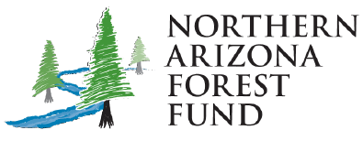
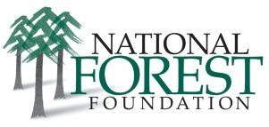
A Watershed Investment Model
Marcus Selig
National Forest Foundation
April 27, 2016

Slide 3
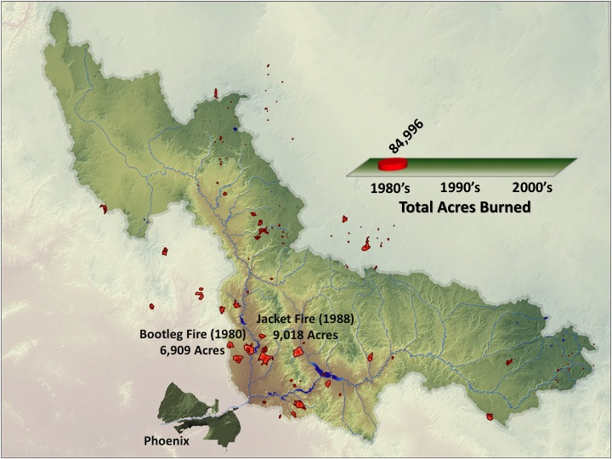

Slide 4
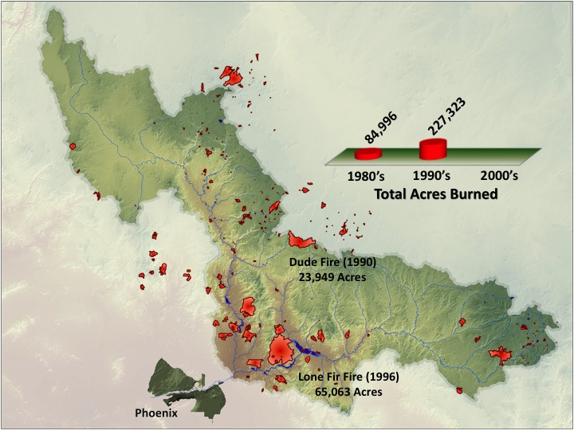

Slide 5
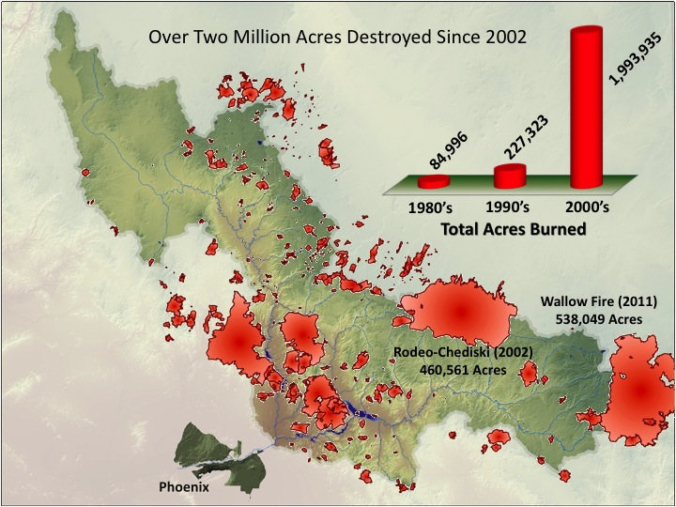

Slide 6
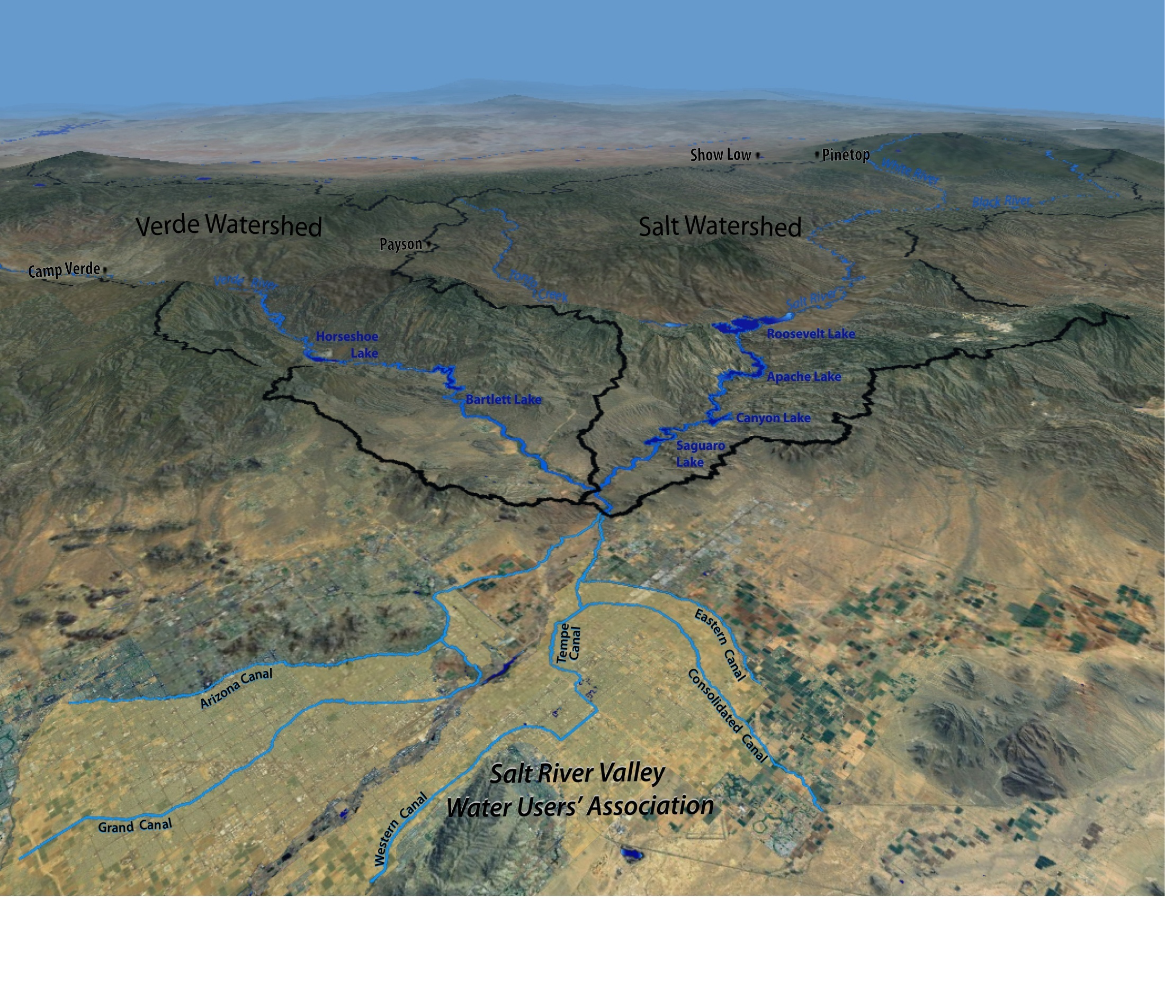
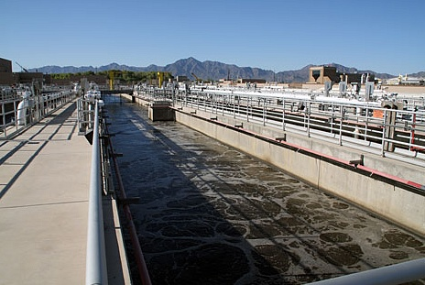
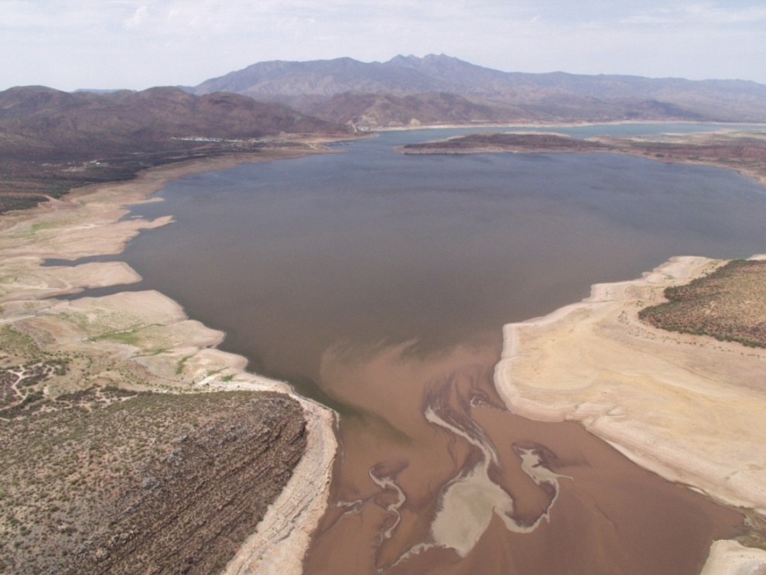
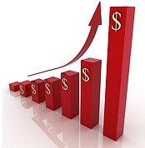
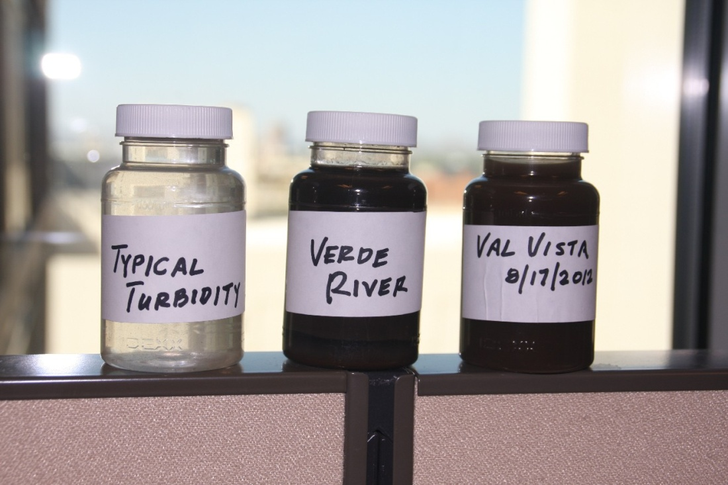
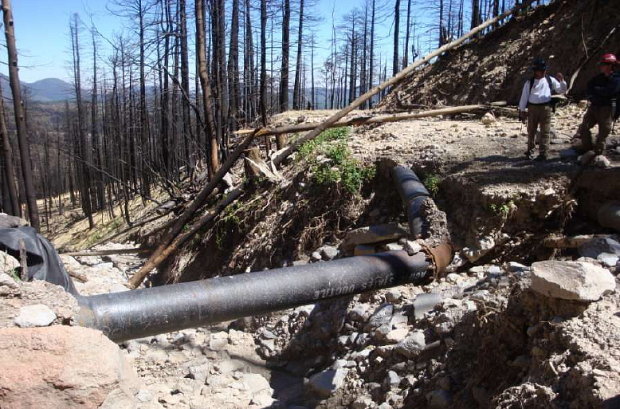
Water Resource Impacts
- Mount Baldy
09/09/2014, Council Meeting: Education Series, B. L. Hallin
10

Slide 7
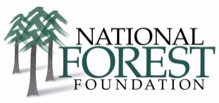
The National Forest Foundation
Founded by Congressional charter in 1991, the NFF engages America in community-based and national programs that promote the health and public enjoyment of the 193-million-acre National Forest System.
Since 2001:
1,500 distinct projects • 10,500 miles of trails work • 4.3 million trees planted
117,000 acres of habitat improvement • 46,000 youth employed or engaged
120,000 volunteers – over 1.5 million hours of work
Protecting America’s Backyard

Slide 8
Building a Solution
Find the right partners
Identify projects “ready to go”
Build private investment
Accelerate treatments that protect watersheds
Bring project success stories to local and downstream communities
Build restoration capacity and public support

Slide 9
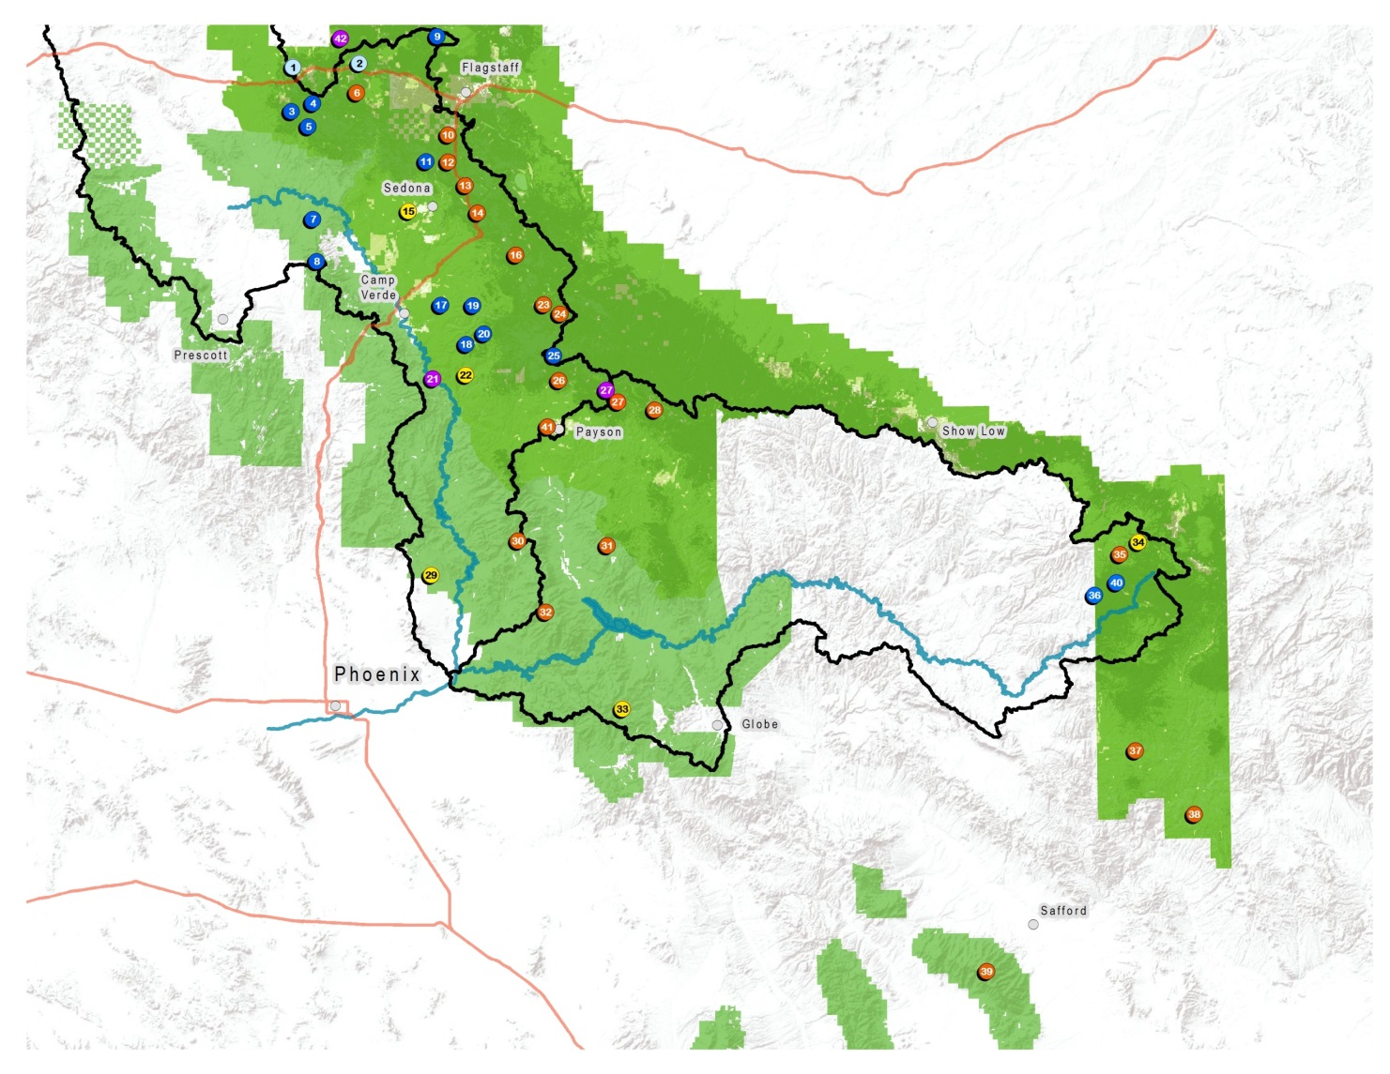
Total Funds Needed ($ in Thousands)

Slide 14
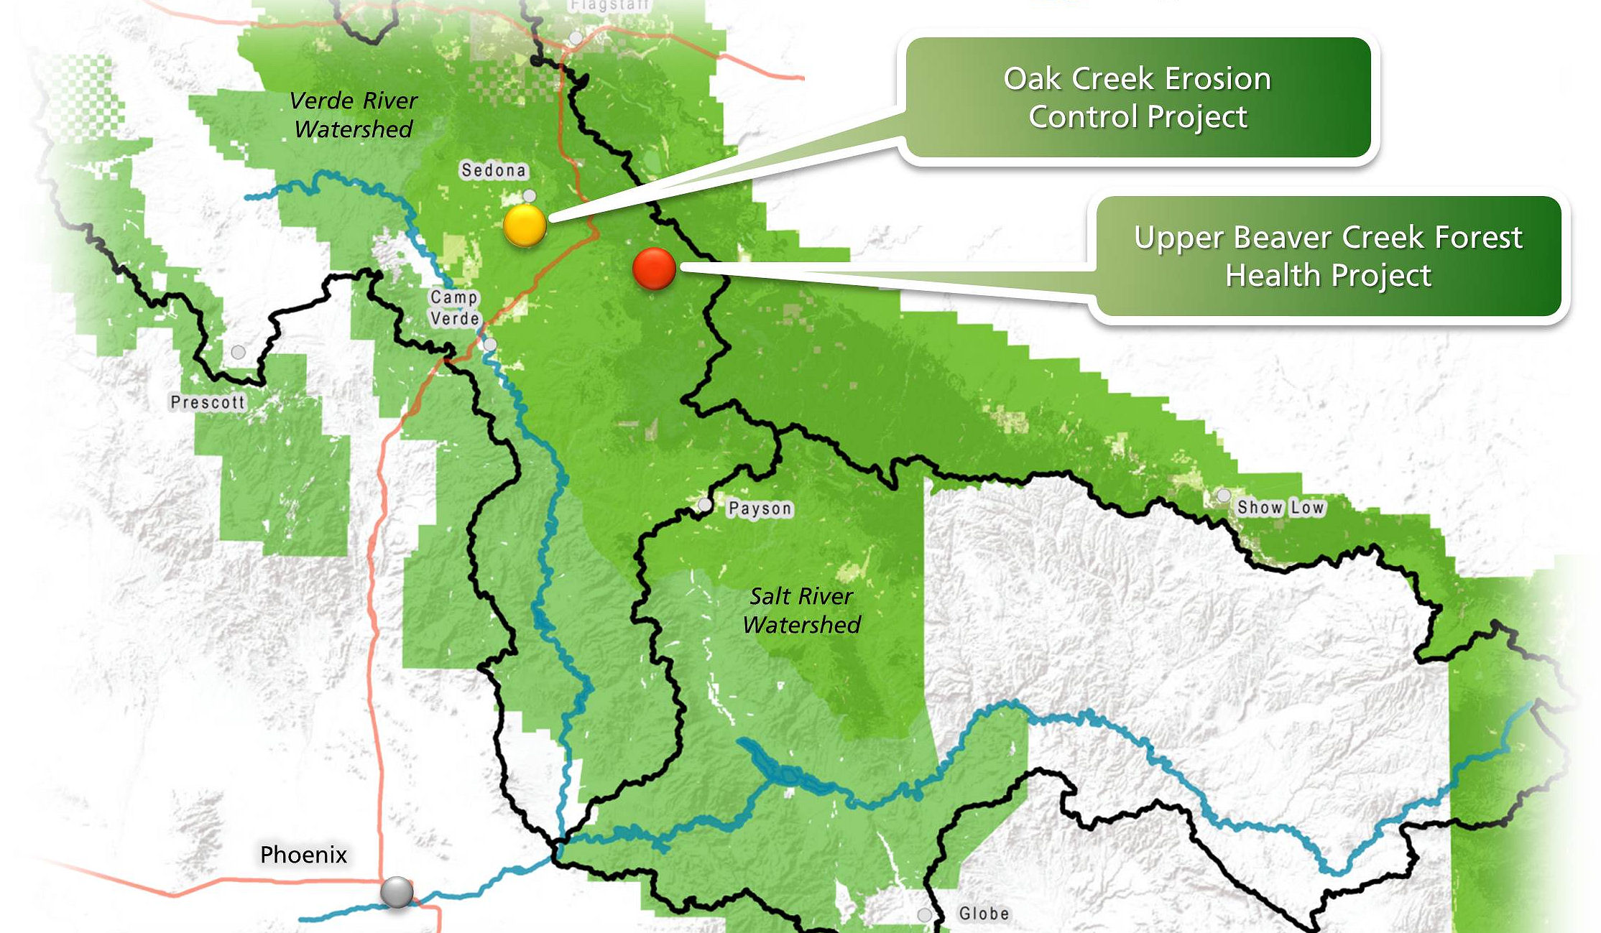
Northern Arizona Forest Fund 2014-15 Projects

Slide 15
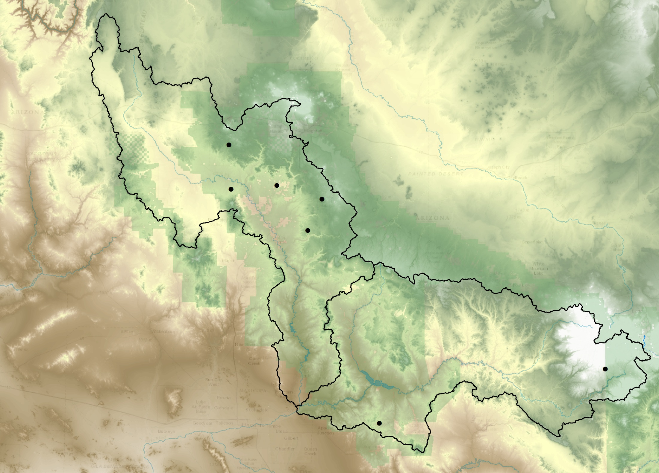
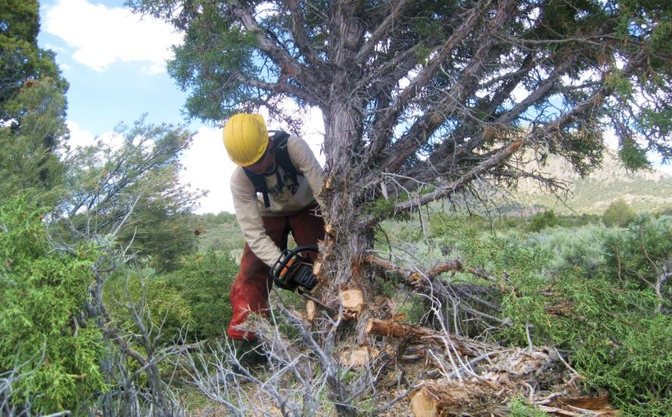
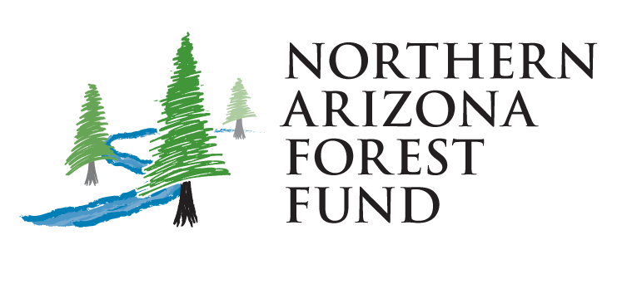
Northern Arizona Forest Fund 2015-16 Projects
Verde River
Watershed
Investment in watershed restoration through the Northern Arizona Forest Fund protects vital water supplies and shows your commitment to environmental stewardship in the landscape that serves your business and community.
McCracken Woodland Health and Habitat Improvement
Oak Creek Erosion Control
(Schnebly Hill Road)
Red Flat Meadow Restoration
Stoneman Lake Watershed Health and Habitat Protection
Salt River
Watershed
Black River Stream and Riparian Protection
West Pinto Creek Trail Rehabilitation and Erosion Control

Slide 16
How it Works
Priority projects are identified
Downstream beneficiaries invest in projects
National Forest Foundation and partners implement projects
Monitoring and reporting of accomplishments

Slide 17
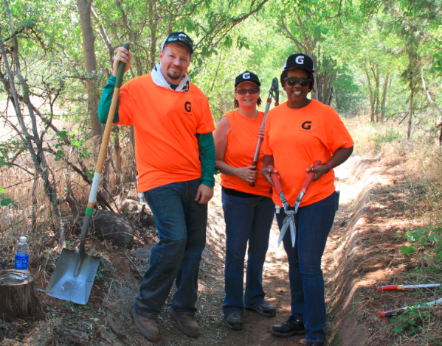
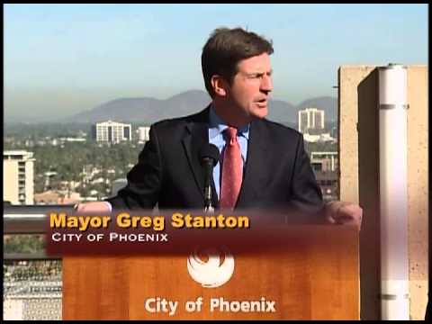
How Partners Engage
Dollar Investment
Employee Volunteerism
In-Kind Contributions
Communication and Outreach

Slide 18
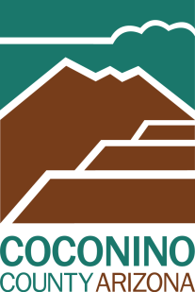
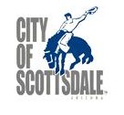
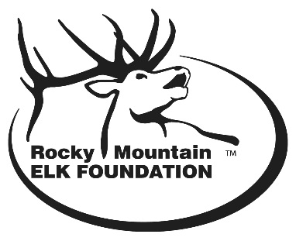
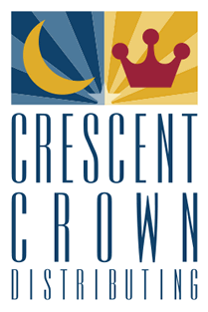
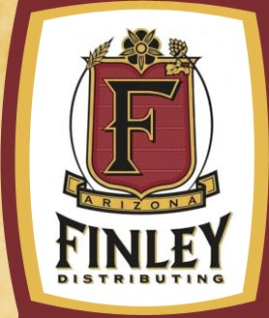
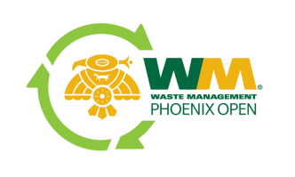
Current Accomplishments and Watershed Partners
Almost $2 Million Invested!

Slide 19
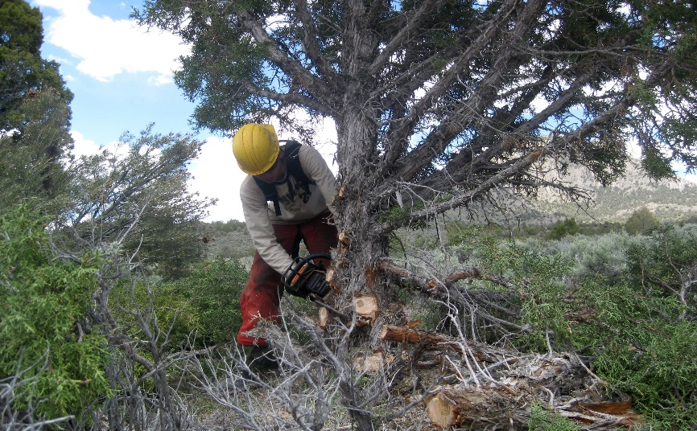
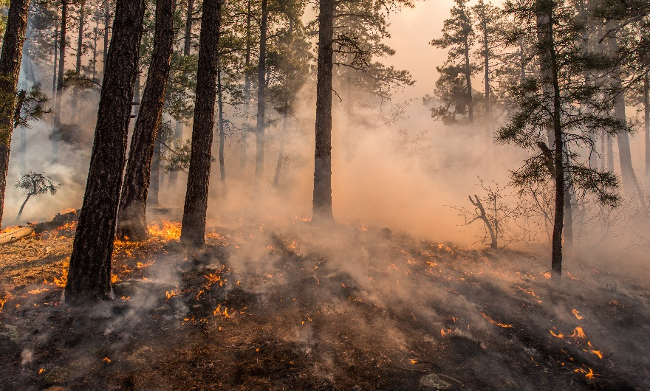
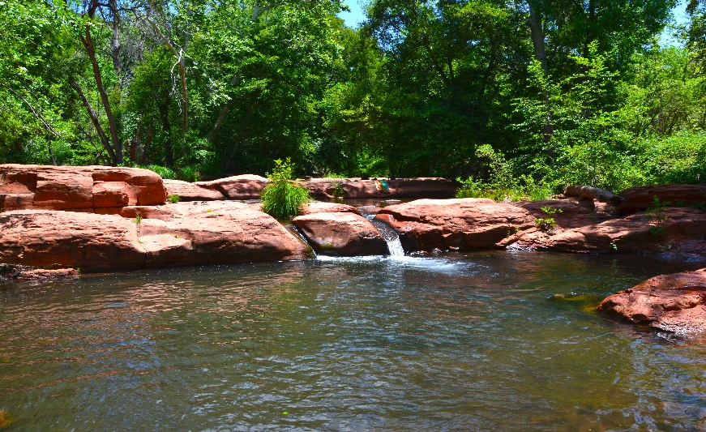
Local Projects, Local Benefits
Measurable Results
Resilient Landscapes
Dependable Water Supplies

Slide 20
PR and Communication Benefits

Slide 21
TapToTop.com

Slide 22
Making the Connection

Slide 23
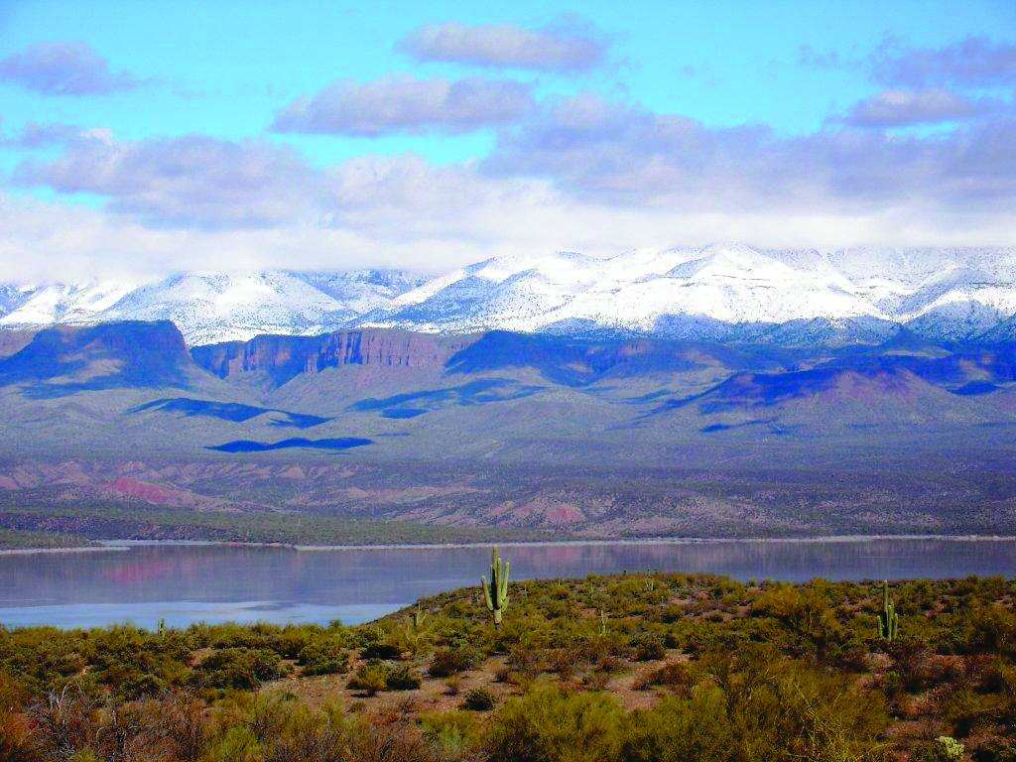
Questions?

