Slide 1
Why is adequate assessment important?
Notes:
My believe is that once you have good responsible people then how well you can measure, will determine how well you can manage and market.
Peter Drucker said; What get measure get managed and what get measured improves.

Slide 2
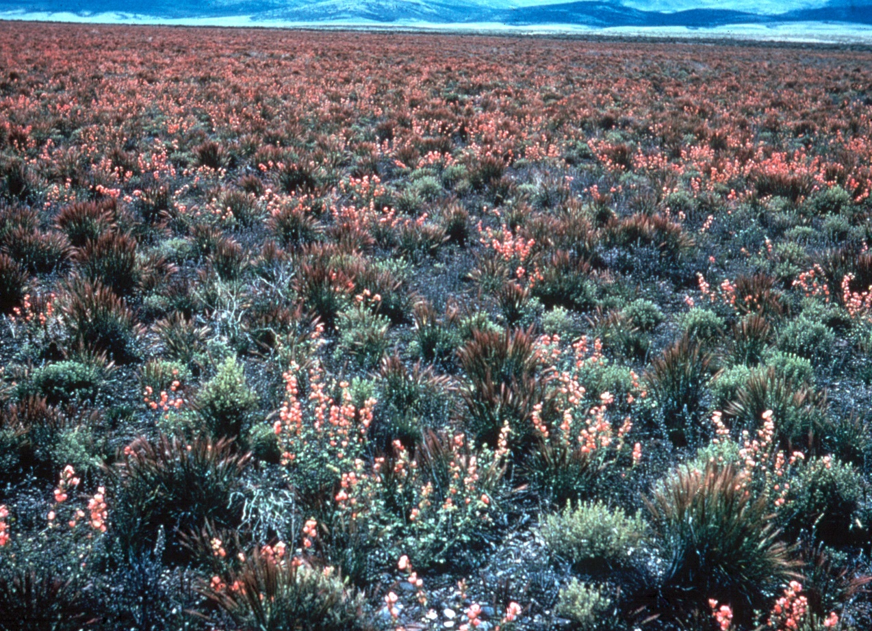
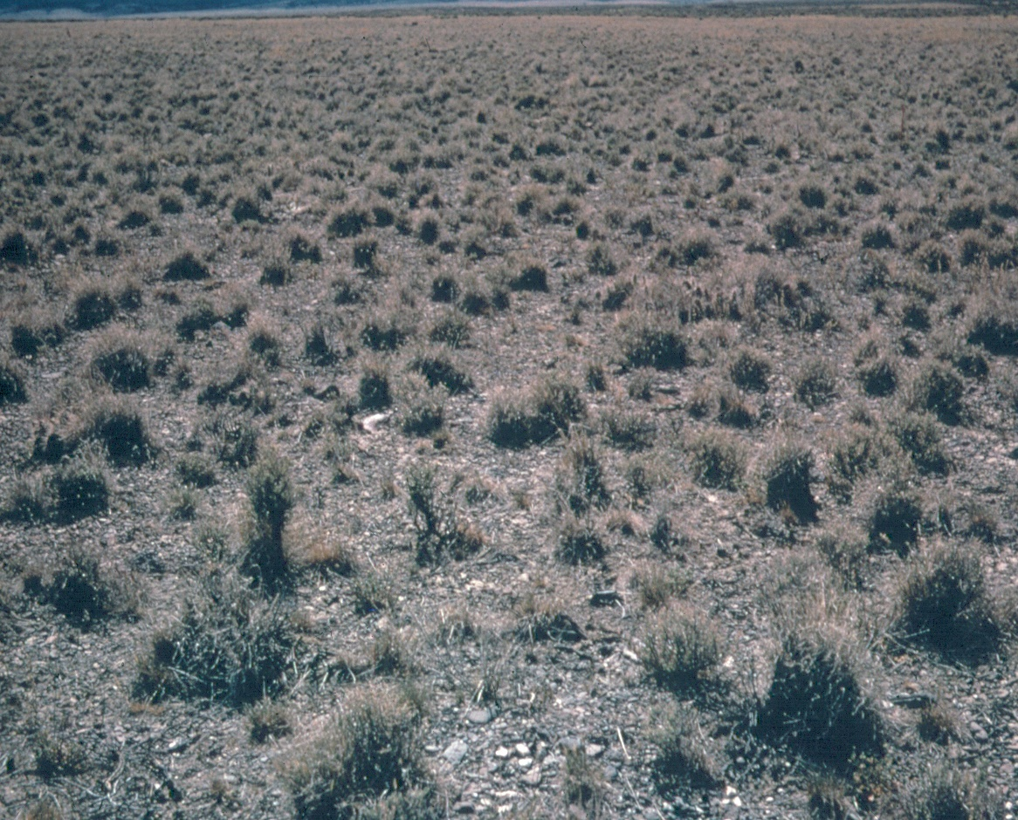
Variation is the Norm
1964
1966
Notes:
The variation is the norm.

Slide 3
Winnemucca NV
Notes:
Data from NGBER…mean precip is about 28cm…lines are + or – 10% of the mean. 11 inches- 5-22”
20 years out of 71 were within 10% of the mean (or about 1 in 4)
From 1951 to 1967 (16 year time horizon) only 1 year within 10% of the mean, but even these conditions seem to be changing and becoming more extreme

Slide 4
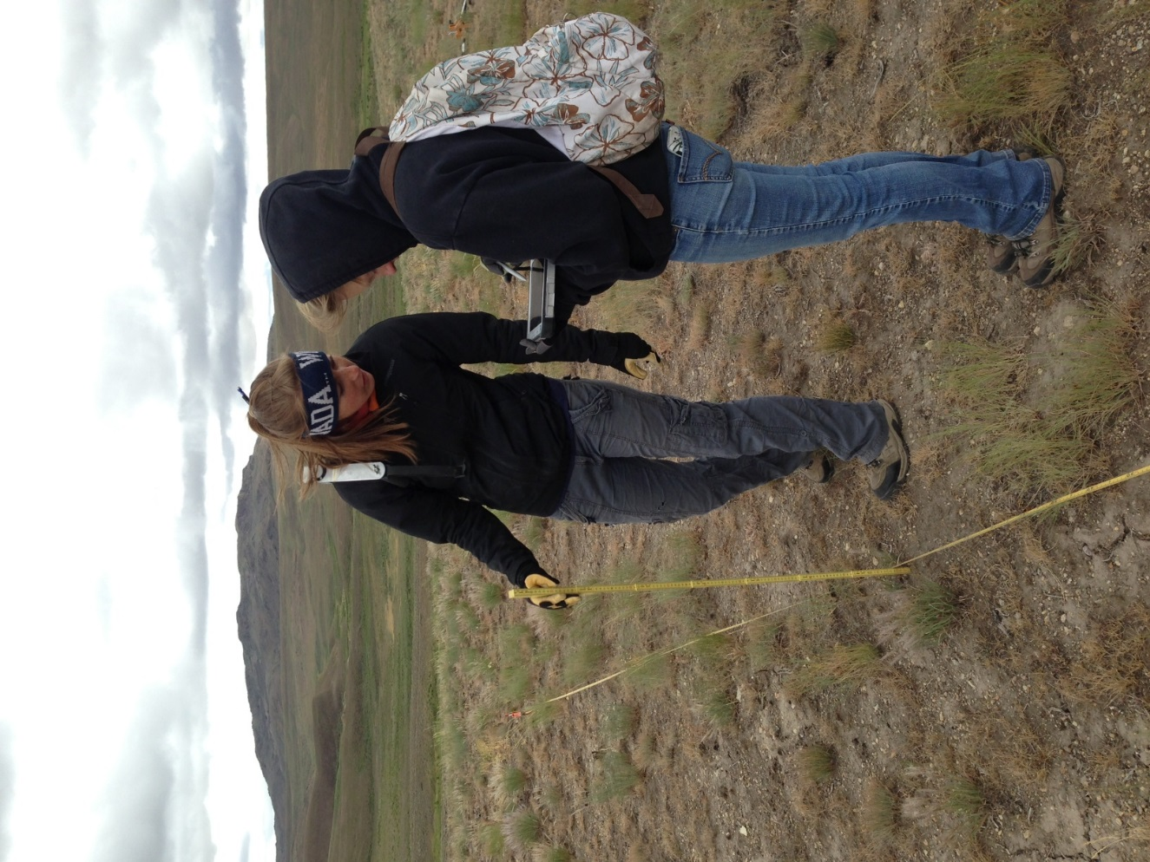
Comparing LPI vs Photo Plots in Great Basin; Pillord and Arkle (REM, Nov 2013
Notes:
Traditional method collect 100-300 samples per plot and the BLM usually has one plot per 30,000+ acres. One needs 2000 sample points per ground cover attributes to have statical confidence. Tradition methods do not have the ability to measure range land, can not be extrapolated beyond where and when they data was collected and even where and when collected the standard error is only with in 20% of actual. Not only does this data tell you nothing about how a landscape is functioning but it costly to collect. This is probably why they haven’t collected it consistently or regurally.
Whereas, each one of our plots has 18 million sample points and with using satellite imagery can be exstrapolated over the entire landscape with confidence and cheaply. Now people can learn, do, test and market goods and services and ideas.

Slide 5
Notes:
This shows the orders of perspectives that have been adopted by sage grouse folks, at least conceptually, in all the planning documents I’ve reviewed. Our technology allows for integration of assessment data starting at the finest scale to be use to inform every other scale.

Slide 6
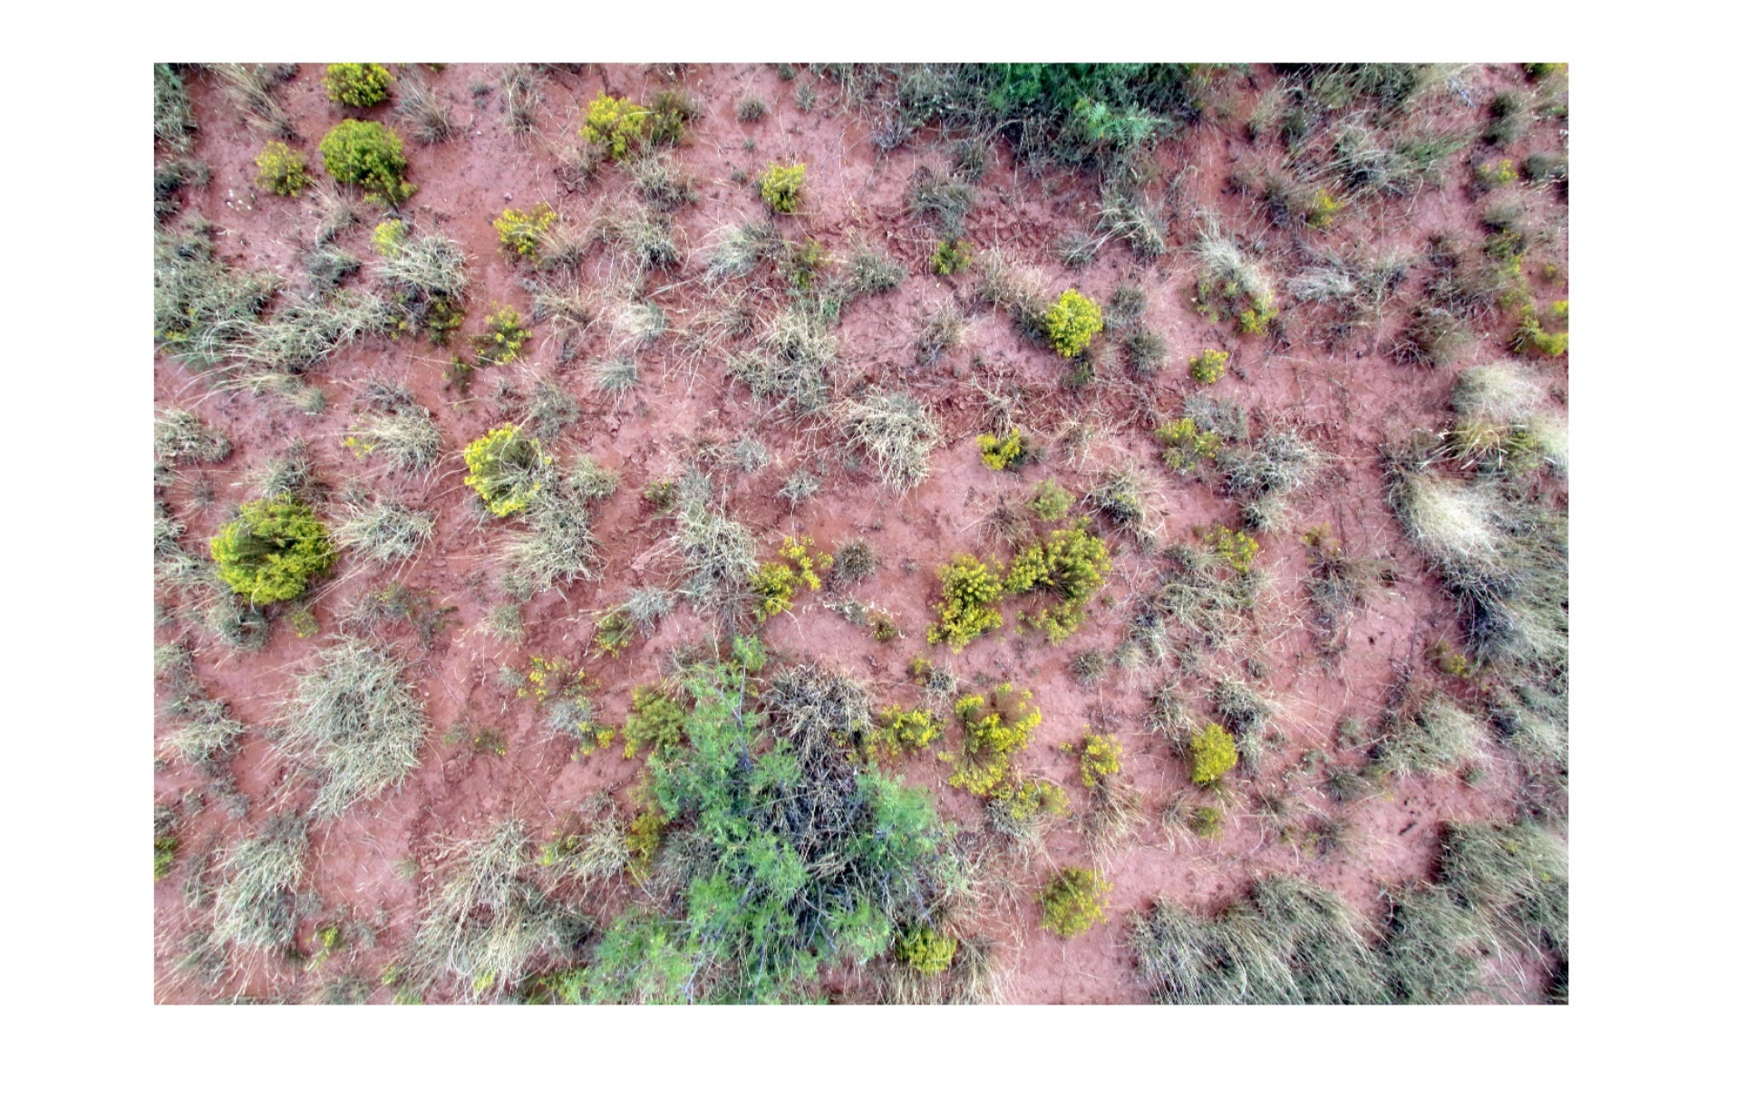
Comparing LPI vs Photo Plots in Great Basin; Pillord and Arkle (REM, Nov 2013
Notes:
Traditional method collect 100-300 samples per plot and the BLM usually has one plot per 30,000+ acres. One needs 2000 sample points per ground cover attributes to have statical confidence. Tradition methods do not have the ability to measure range land, can not be extrapolated beyond where and when they data was collected and even where and when collected the standard error is only with in 20% of actual. Not only does this data tell you nothing about how a landscape is functioning but it costly to collect. This is probably why they haven’t collected it consistently or regurally.
Whereas, each one of our plots has 18 million sample points and with using satellite imagery can be exstrapolated over the entire landscape with confidence and cheaply. Now people can learn, do, test and market goods and services and ideas.

Slide 7
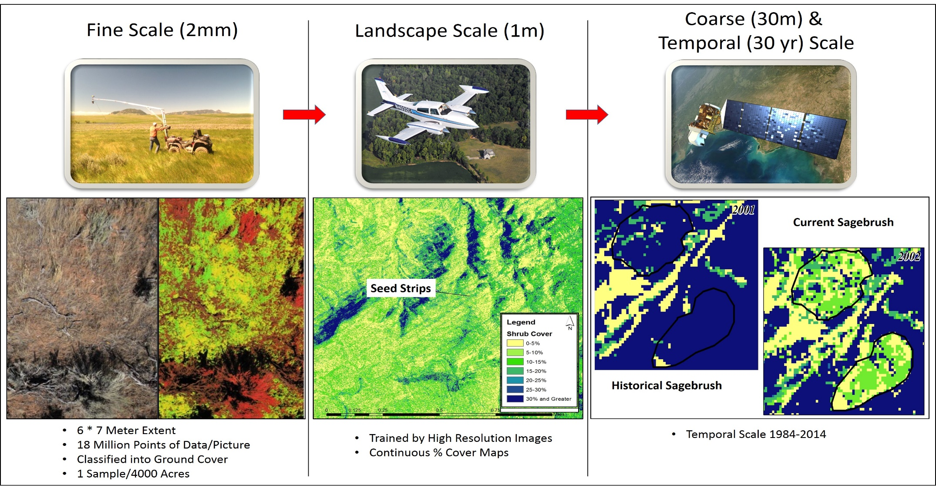


Slide 8
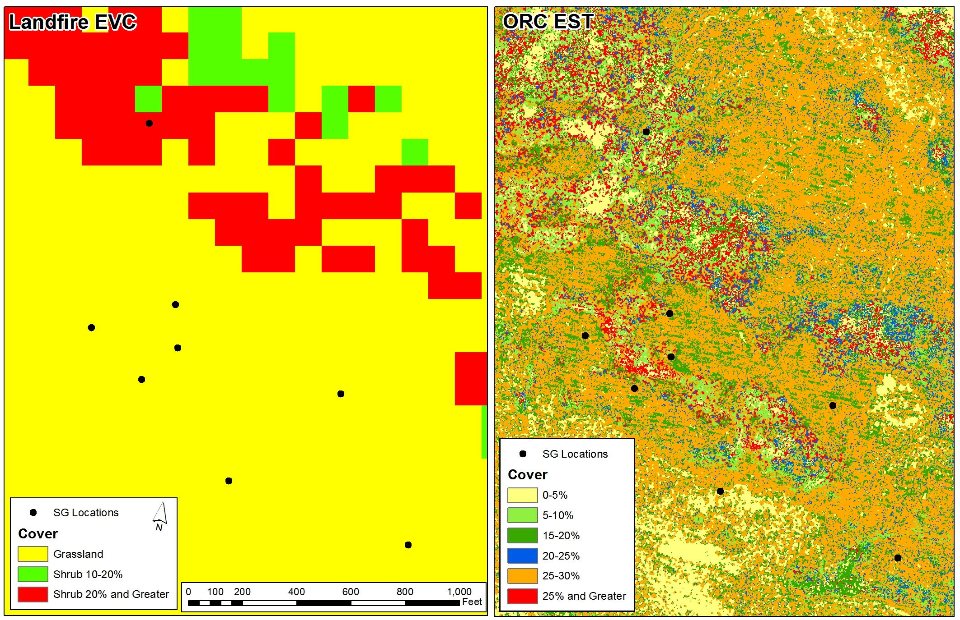

Slide 9
Rangeland Health
Fixed Terms & Conditions
Notes:
I believe that the fixed terms and conditions are to static to allow us to adapt to the these wild condition. The analyoge that comes to my mind it would be like trying to sail across and ocean based on knowing the average wind speed. Long-term peer review records show that the average wind speed is the Alantic is 10 knot from the SE. Having inflexible terms and conditions is like sailing the sagebrush seas with a fixed sail and rudder. This is why we are upside down

Slide 10
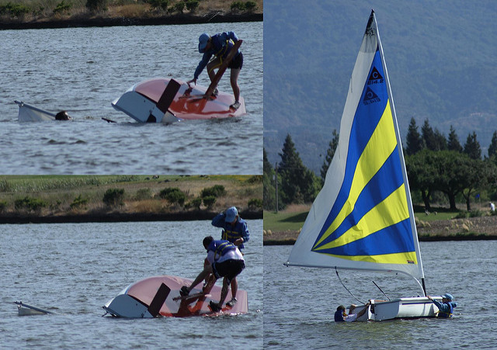
Notes:
This is the result.

Slide 11
Rangeland Health
Flexible Terms & Conditions
Notes:
Fixed terms and conditions focus on telling us what to do for the 10 year term and doesn’t allow for the flexibility to creativity adapt to varying conditions obtain the results that we all would likeWhat if we had flexible terms and conditions?

Slide 12
Rangeland Health
RDG: Measurable Goals Relevant to Rangeland Health and Viable Ranching
Valid, accurate, timely, cost effective feedback
Notes:
The reasons that our grazing management haven’t been outcome base and that term and conditions of the permit have fixed the practices have been fixed are three fold: one is that we’ve historically had inadequate metrics to measure rangeland health
,that ranchers’ could not be trusted to do the right thing, it is generally believed that rangeland diseases are from to many animals and that what ranchers greatest motivation is cattle production not rangeland health.

Slide 13

Notes:
By having the flexibility to adapt each allotments management to stay on course by having adequate feedback to navigating to key results, then we can build a relations that would allow us to achieve our goals and support the next generation of sailors and the future generation of those that benefit from these public lands.

