Slide 1
Ecological Condition Model for the Apalachicola National Forest
April 26, 2016
Jason Drake
Matthew Trager (mdtrager@fs.fed.us)
National Forests in Florida

Slide 2
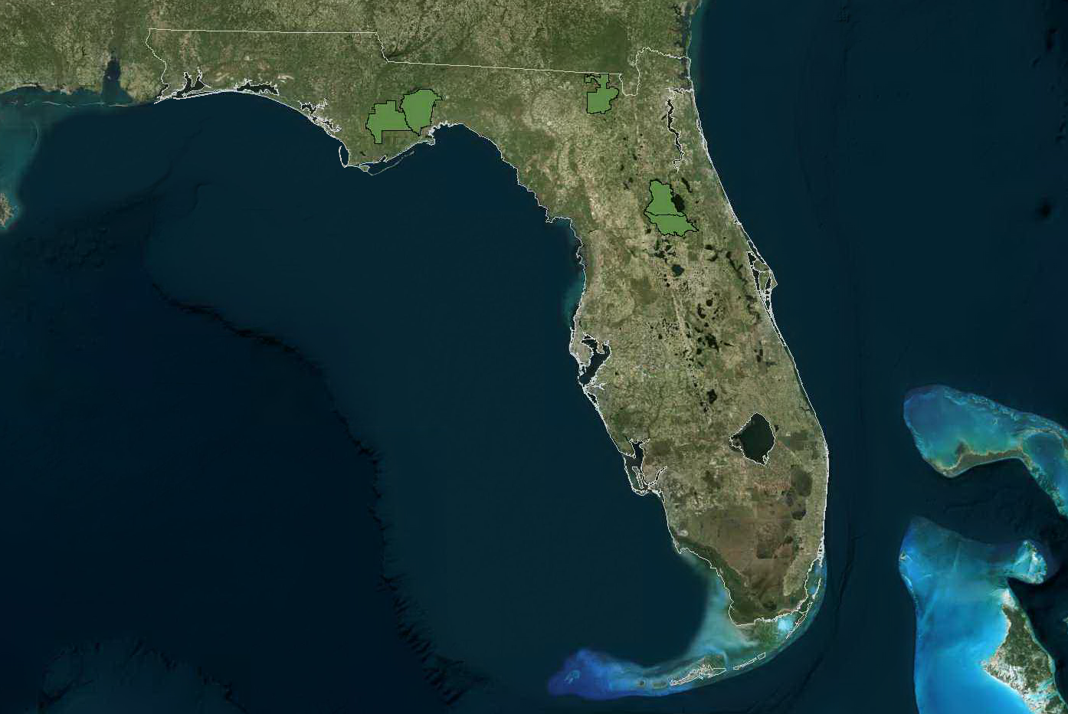
National Forests in Florida
Osceola NF
Apalachicola NF
Ocala NF
Approximately 1.2 Million Acres
Over 500,000 acres of longleaf pine
(current or historical natural communities)
Notes:
First a quick background on the NFs in Florida
We manage almost 1.2 million acres
Of which, approximately 400,000 acres are or were historically a longleaf natural community (including flatwoods, sandhills and pine savannas)

Slide 3
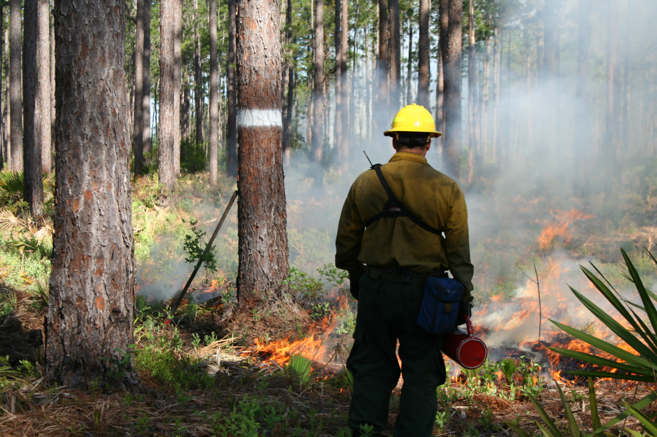
Management priorities
pbmedley@fs.fed.us

Slide 4
Information and communication challenges
1. What natural communities are here (or were here)?
2. To what extent do they differ from desired conditions?
3. How can we communicate this information to the public?
  Objective measures
  Reliable
  Simple
  Responsive to management
Notes:
First a quick background on the NFs in Florida
We manage almost 1.2 million acres
Of which, approximately 400,000 acres are or were historically a longleaf natural community (including flatwoods, sandhills and pine savannas)

Slide 5
Ecological condition model
Geospatial model developed to quantify current ecological condition of the forest’s longleaf natural communities
  Integrates best available information from GIS, remote sensing and field sources
  Combines remote sensing, field surveys and database information into a simple condition score (1-5)
  Make strategic management decisions
    Identify specific restoration needs
    Balance restoration with maintenance activities
    Recognize multiple uses

Slide 6
ECM process
Step 1. Map historic longleaf natural communities
Step 2. Define DFC and tier classes for each historic natural community
Step 3. Collect field data across range of field conditions
Step 4. Compile necessary input layers for the model
Step 5. Summarize/integrate input layers at appropriate mapping unit scale
Step 6. Estimate ecological condition based on relationship between model input layers and field measured conditions

Slide 7
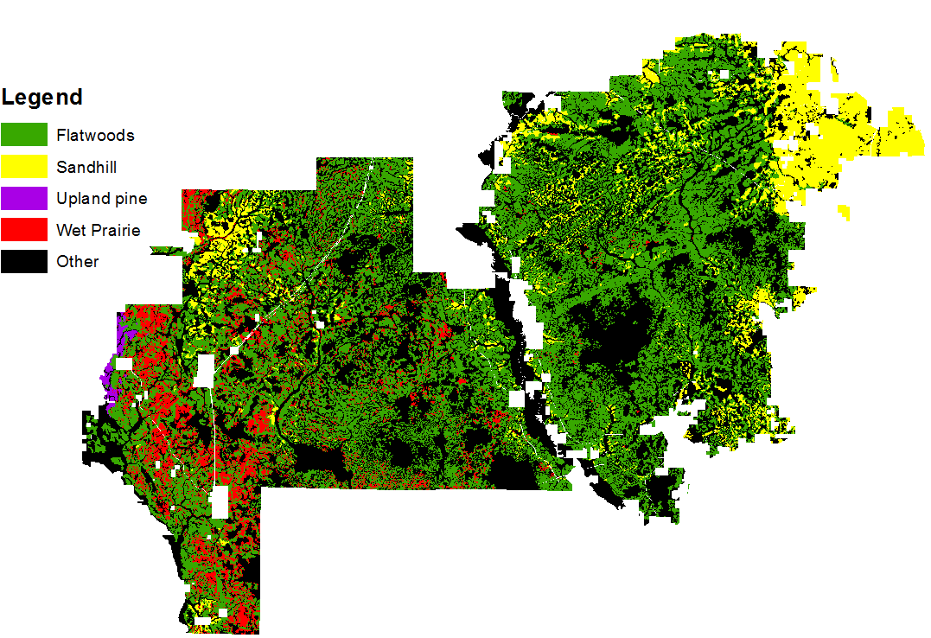
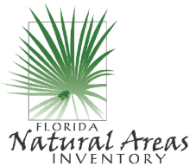
Step 1: Historical Natural Communities
Historical Natural Community | Area (acres) | Percent
Flatwoods (includes wet and mesic flatwoods) | 247,156 | 43.2%
Sandhill | 54,289 | 9.5%
Wet savanna | 36,705 | 6.4%
Upland pine | 1,631 | 0.3%
Freshwater forested wetlands | 230,849 | 40.4%
Other | <1,000 | 0.2%

Slide 8
Step 2: Define condition class
Condition Class
  Tier 1: Excellent condition (old growth/near old growth), at DFC, maintained with prescribed (Rx) fire
  Tier 2: Good condition, maintained with Rx fire
  Tier 3: Fair condition, transitional, some restoration followed by Rx fire
  Tier 4: Poor condition, multiple restoration activities required
  Tier 5: Very poor condition, substantial restoration required
Specific for each historic natural community type
  e.g., 40-60 BA is ideal for Flatwoods, but not for wet prairie/savannah

Slide 9
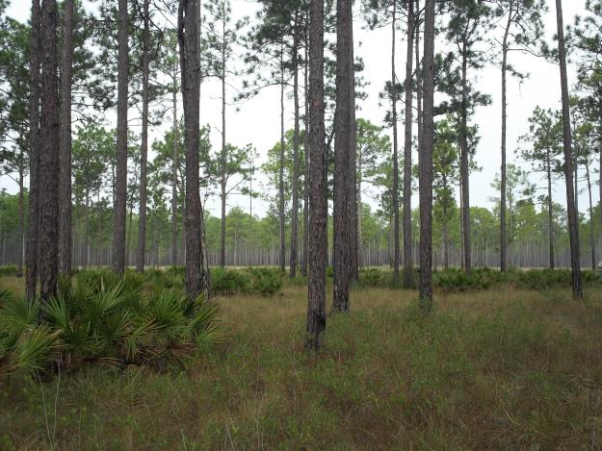
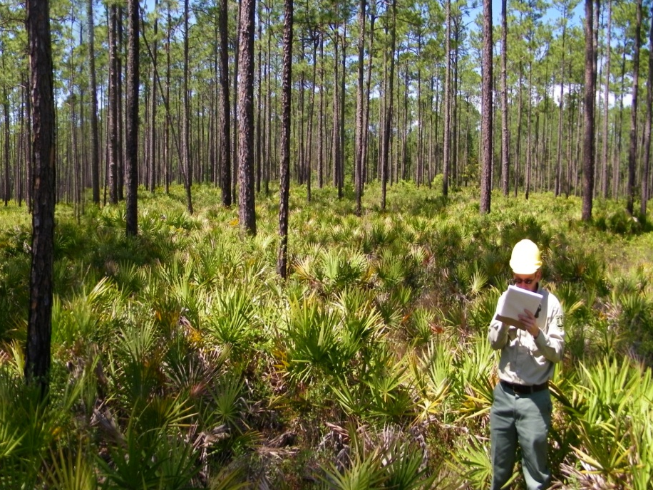
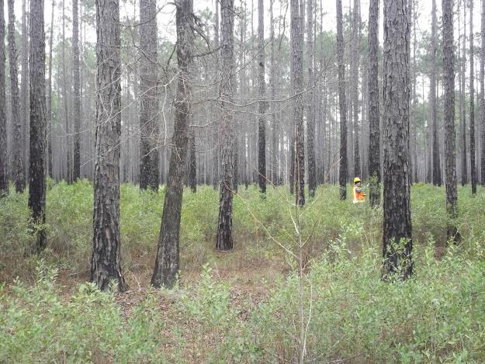
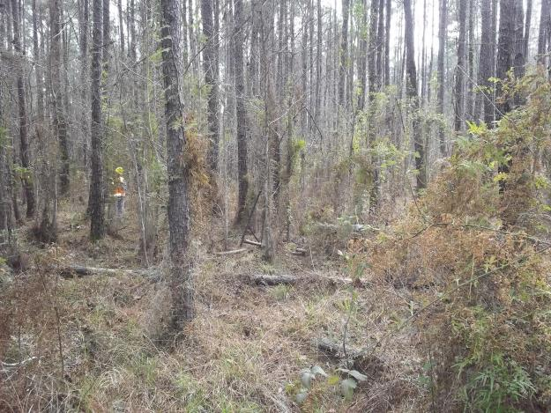
Step 2: DFC and Tier Classes (Flatwoods)
Excellent/Good Quality
CPT 44 , ECM Point ID 330
Fair Quality
CPT 43 , ECM Point ID 335
Fair Quality
CPT 84, ECM Point ID 11
Poor Quality
CPT 25 , ECM Point ID 359
Very Poor Quality
CPT 74 , ECM Point ID 365

Slide 10
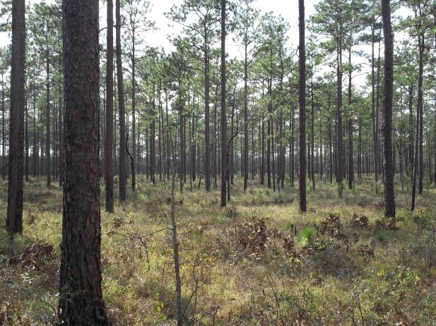
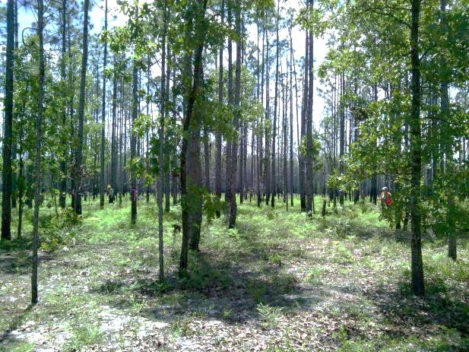
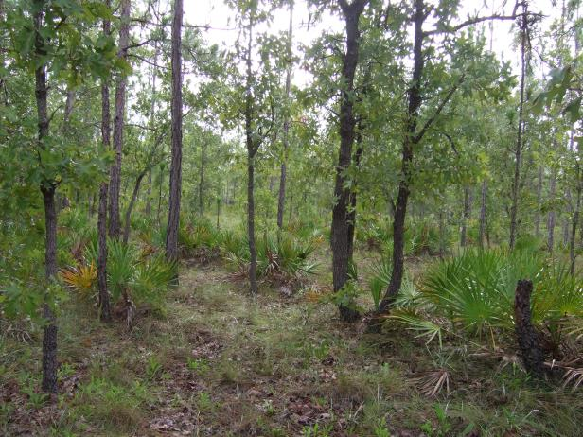
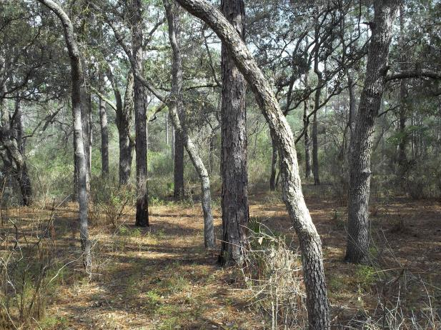
Step 2: DFC and Tier Classes (Sandhills)
Excellent/Good Quality
CPT 223, ECM Point ID 423
Fair Quality
CPT 305, ECM Point ID 55
Poor Quality
CPT 31, ECM Point ID 901
Very Poor Quality
CPT 224, ECM Point ID 424

Slide 11
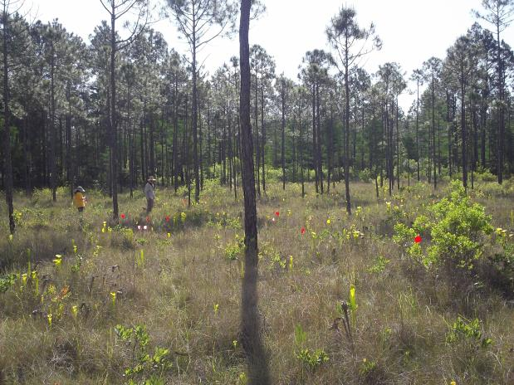
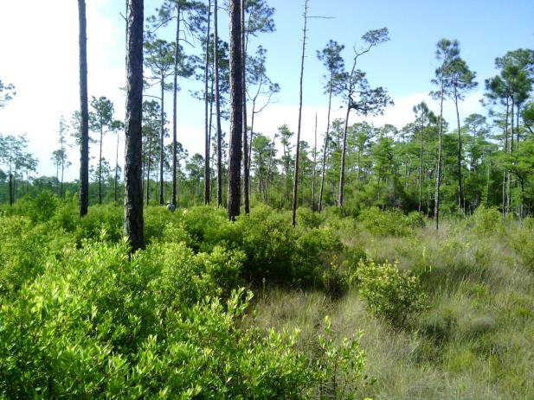
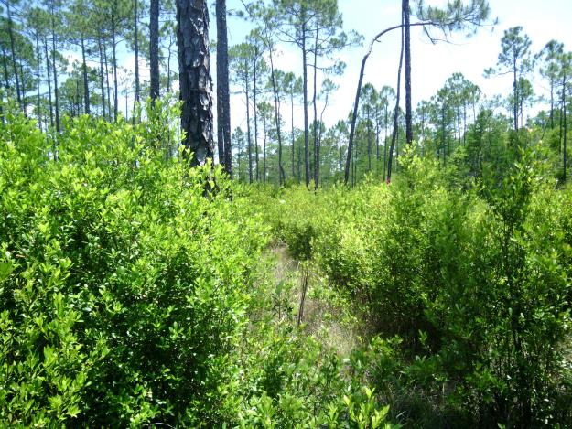
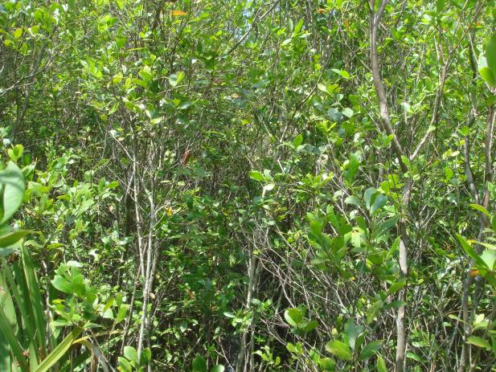
Step 2: DFC and Tier Classes (Wet Prairies)
Excellent/Good Quality
080501_CPT077_HAFL3_00004
Fair Quality
080501_CPT068_HAFL3_00067
Poor Quality
080501_CPT068_HAFL3_00064
Very Poor Quality
Near 080501_CPT0106_HAFL3_00041

Slide 12
Step 3: ECM Field Data
Longleaf Rapid Assessment protocol (R8, Nature Serve, FNAI)
20 m (66 ft, 1 chain) radius plot
Natural community type, Overall condition
Canopy
  species, basal area, cover, height, etc.
Midstory
  Species, Density, Cover
Shrub
  Species, cover, herbacious
Groundcover
  Species, cover, rare plants
Photo
ECM plot ID: 080501_CPT068_HAFL3_00067

Slide 13
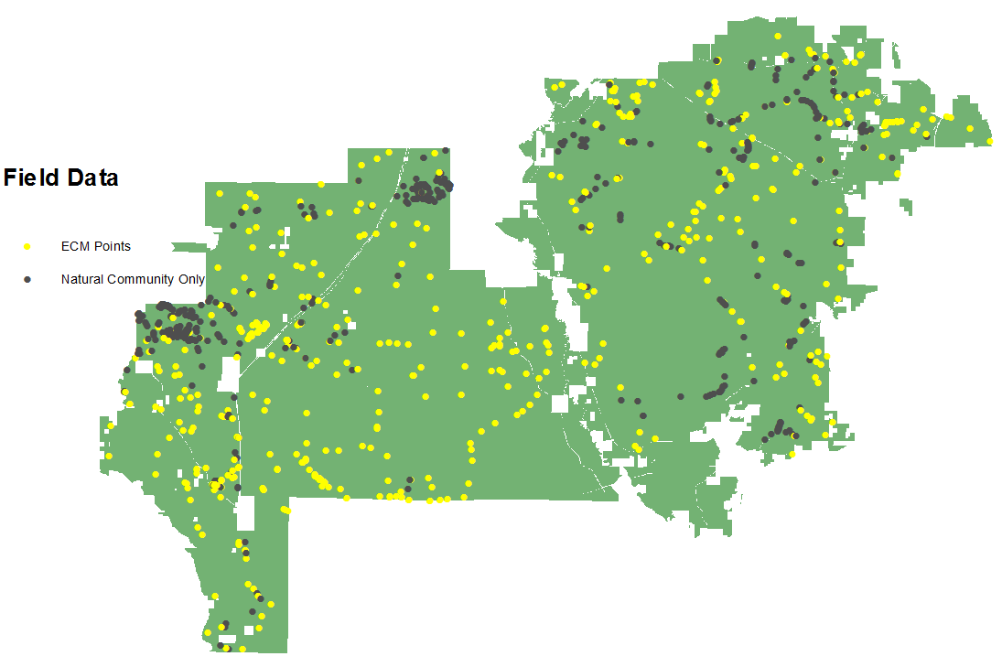
Step 3: ECM Field Data
~400 plots with ECM field data
~500 additional Historic Natural Community points

Slide 14
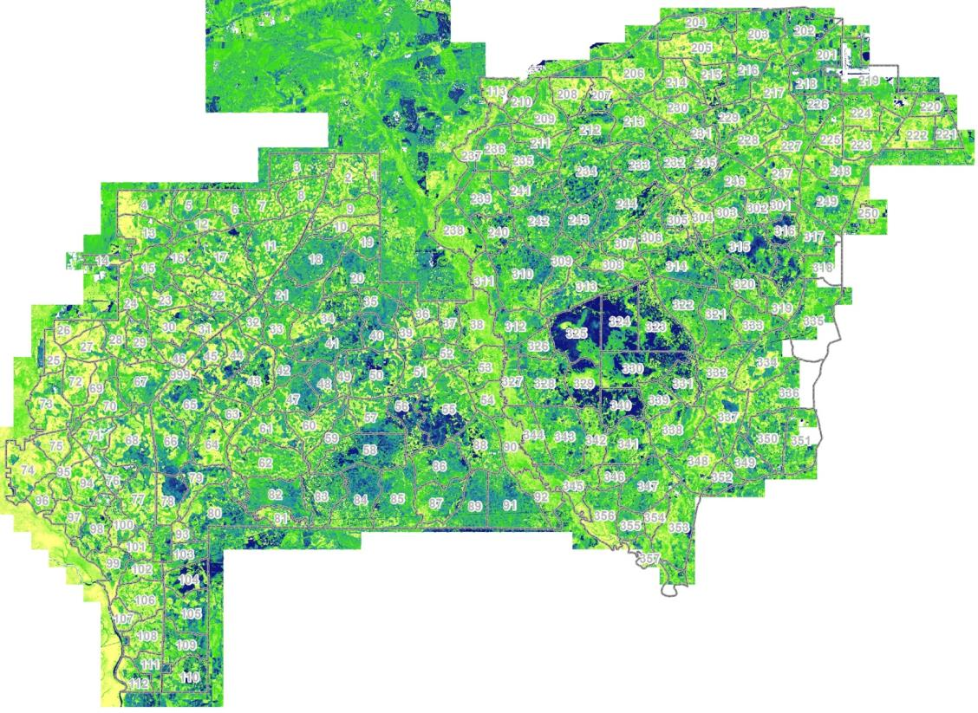
Step 4: Airborne LiDAR Data
9 separate flights from 2007-2010
LiDAR-derived canopy height (50th percentile)

Slide 15
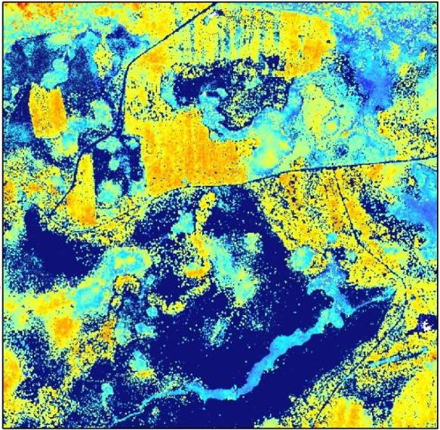
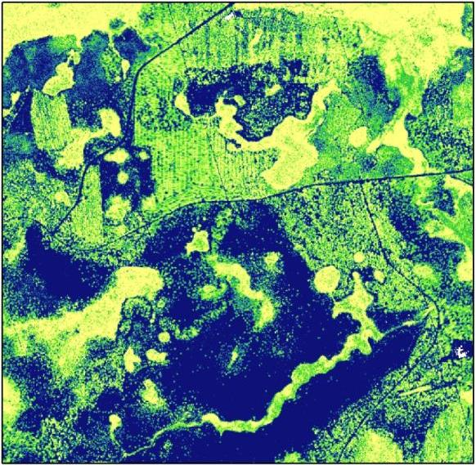
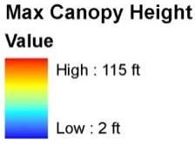
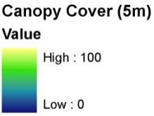
LiDAR Products

Slide 16
LiDAR Metrics
http://www.fs.fed.us/eng/rsac/fusion
Midstory Relative Density
Ground (DEM)

Slide 17
Canopy Tiers
Predominant Canopy Species
  GIS - Stands: Forest Type
Age
  GIS - Stands: Age_Year
Canopy Cover and Canopy Relative Density
  LiDAR- RDgt45ft
  Tier “break points” based on subset of ECM field plot data of predefined Tier classes
Basal Area
  LiDAR- Canopy Cover, Canopy Height percentiles
  Relationship based on field data from FSVeg plots in sandhills and flatwoods

Slide 18
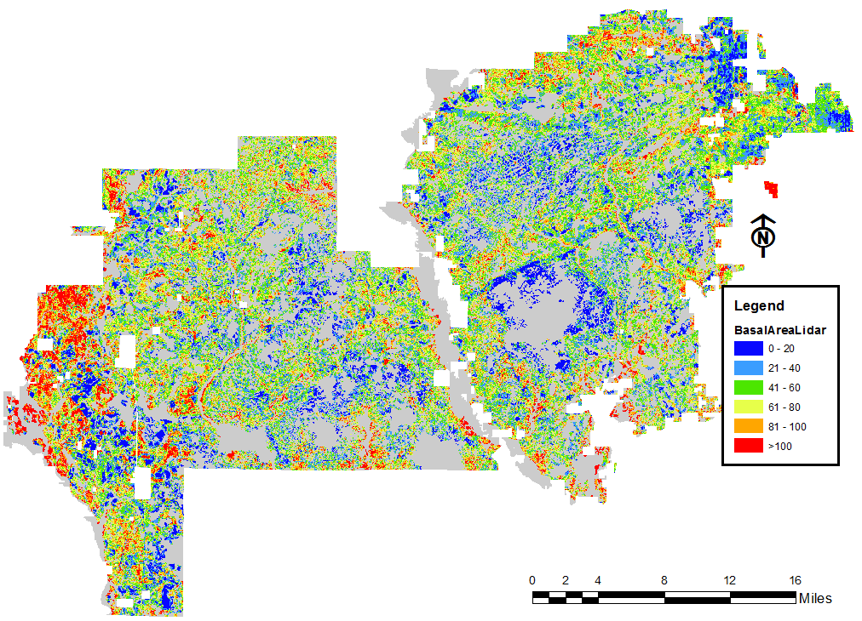
Canopy Conditions

Slide 19
Midstory Tiers
Midstory relative density
  LiDAR - RD20to45ft (only for canopies > 45 ft)
  LiDAR - RD6to20ft
  Tier “break points” based on subset of ECM field plot data
Landsat derived hardwood estimate
  Landfire Existing Veg Type (EVT)- Live Oak and all other hardwood types in historic LLP communities

Slide 20
Shrub/Ground Cover Tiers
Shrub relative density
  LiDAR - RD2to6ft
  Tier “break points” based on subset of ECM field plot data
Number of burns
  At Burn unit level
Years since last fire
  At Burn unit level
Remotely sensed total burn severity
  From 1995-2010 Landsat data following MTBS (Picotte) methods
Canopy Cover
  LiDAR - CCgt2ft
  Tier “break points” based on subset of ECM field plot data
Site preparation (Activities)
  Mechanical site prep for planting/seeding

Slide 21
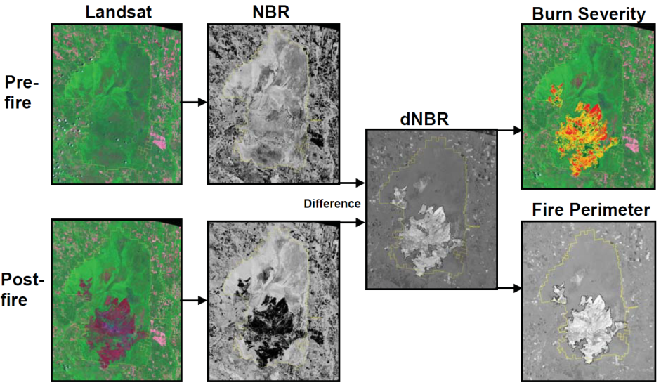
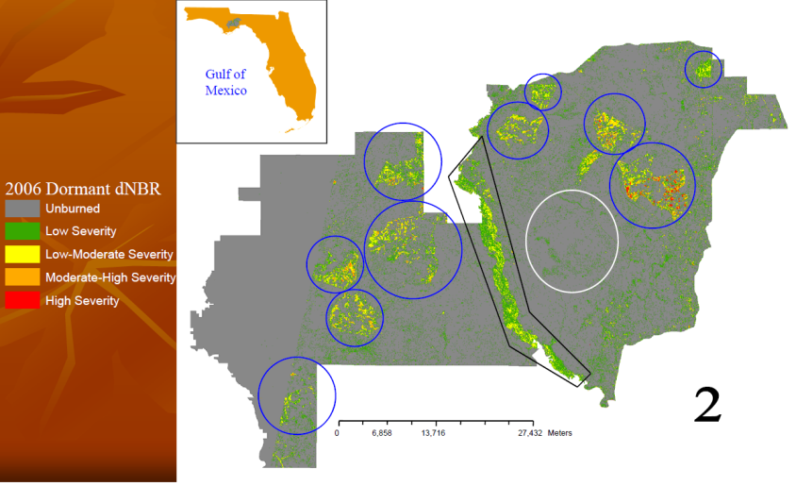
Burn History- Remote Sensing
Burn Severity Mapping (Key and Benson 1996)
  Normalized Burn Ratio from Landsat
    NBR = (R₄- R₇)/ (R₄ + R₇)
    dNBR = NBR prefire – NBR postfire
    More info at: www.mtbs.gov
Robertson and Picotte (2011)
  Apalachicola and
  Osceola NFs

Slide 22
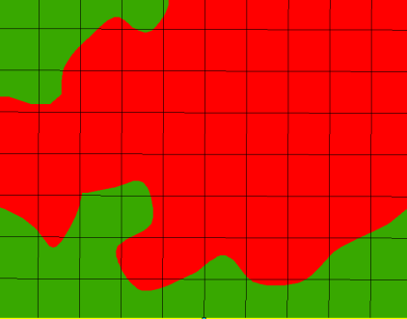
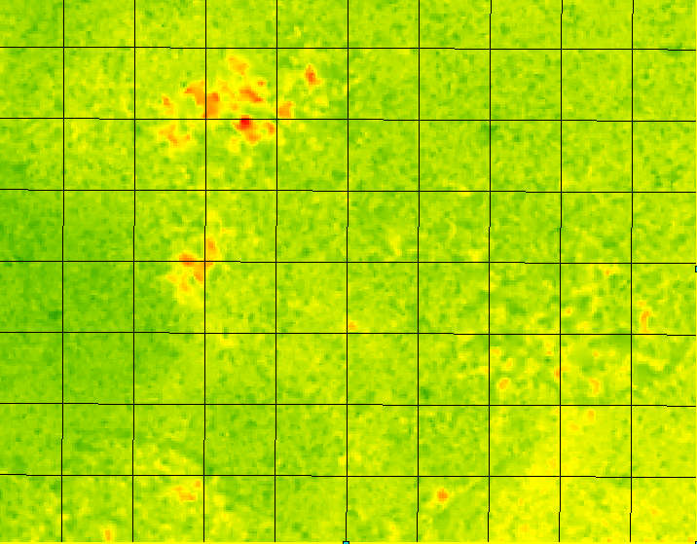
Step 5: Integration of Layers
Categorical Data
Majority value assigned to cell
Example: Historic Natural Community
Final, forest-wide product contains these summary values for all input datasets
(0.5 ac cells)
Continuous Data
Summary stats (e.g., mean, median) assigned to cell
Example: Lidar Shrub Density
1/2 acre cell

Slide 23
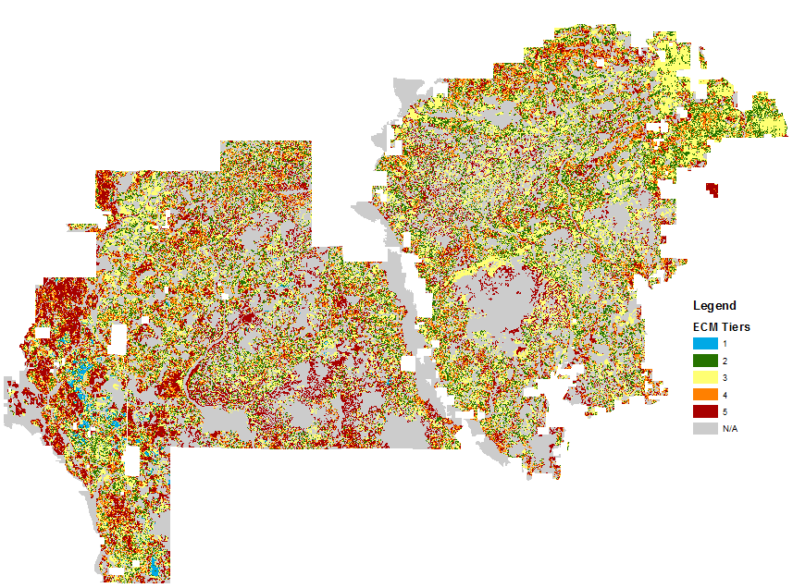
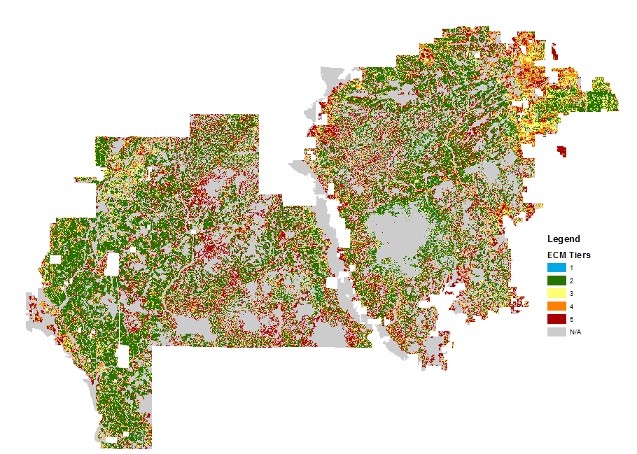
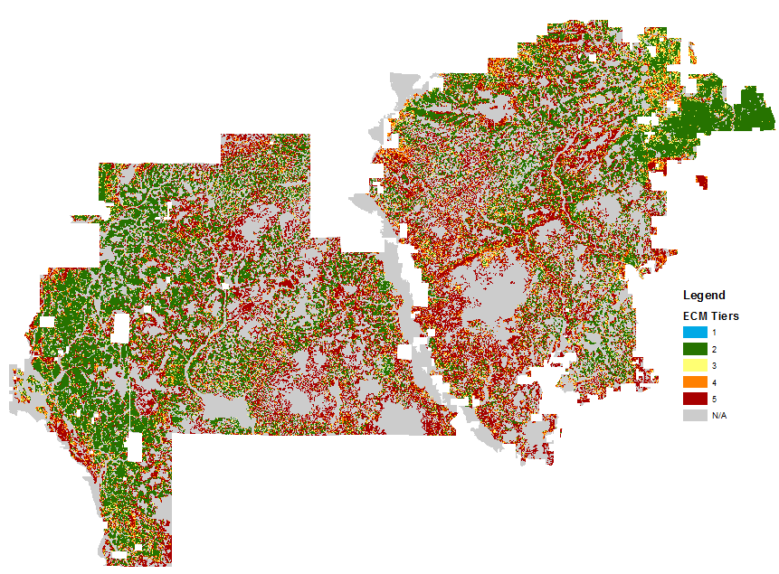
Step 6: Overall ECM Tier Score
+
Basal Area Tiers
Midstory Density Tiers
+
+
…all other input layers
Shrub Density Tiers

Slide 24
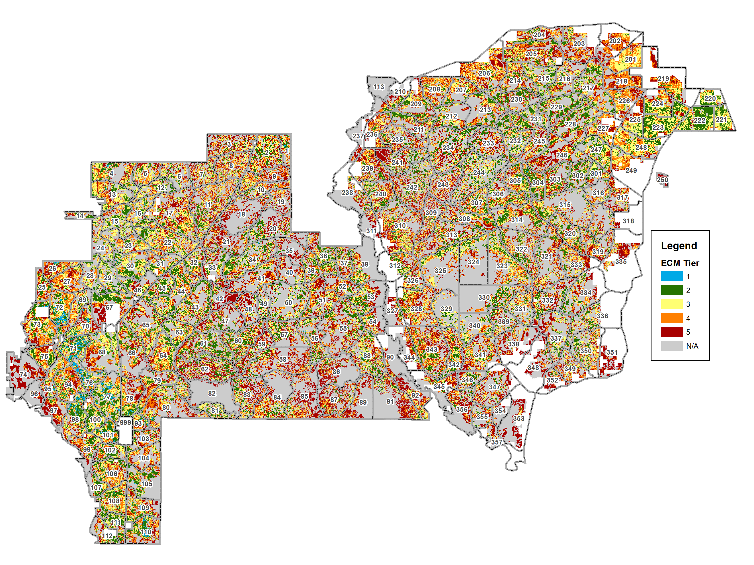
Results
ECM Tiers
Tier 1: 1,952 ac ( 0.6%)
Tier 2: 77,183 (23%)
Tier 3: 97,140 (28%)
Tier 4: 73,571 (23%)
Tier 5: 91,232 (26%)

Slide 25
Summary
Provides a mid-level planning tool for identifying restoration opportunities and priorities
Demonstrates management progress (e.g., annual monitoring report)
Allows more open and transparent management decisions
Facilitates collaboration with public/private agencies and stakeholders
Notes:
In summary, the ECM helps build synergy across different staff management areas (fire, timber, wildlife, etc.)
Provides a mid-level planning tool to help us get from ~10-15 year Forest Plan to project level work
And the management decisions are more open/transparent and can be developed in collaboration with stakeholders
ECM also will form basis of our new Forest Plan and can be used to track progress through time

Slide 26
Ongoing and future work
Journal of Forestry manuscript in preparation
Streamline and operationalize modeling process
  Partnership with USFS (NFF, RMRS, FIA), FNAI and Longleaf Alliance more efficiently develop and update models
    NAIP Imagery and FIA field data
    Function modeling and parallel processing
  Work with NFWF and Longleaf Partnership Council on standards for model development and application
  On track for “Version 2” preliminary results 2016
Translate to other ecosystems (scrub, etc.)

Slide 27
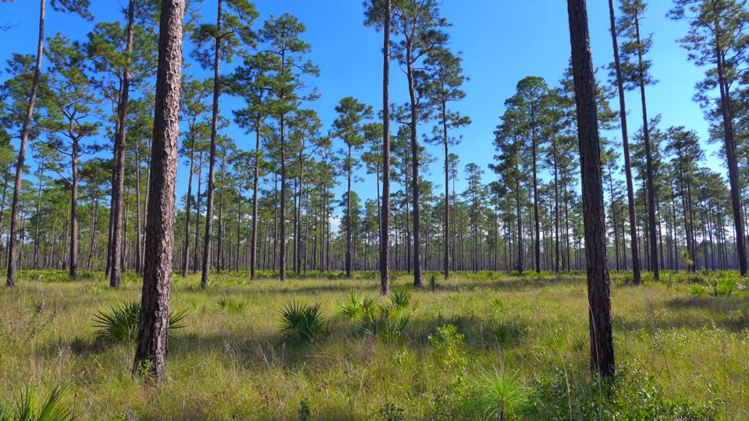
Questions?
Photo courtesy of Amy Jenkins, FNAI

Slide 28
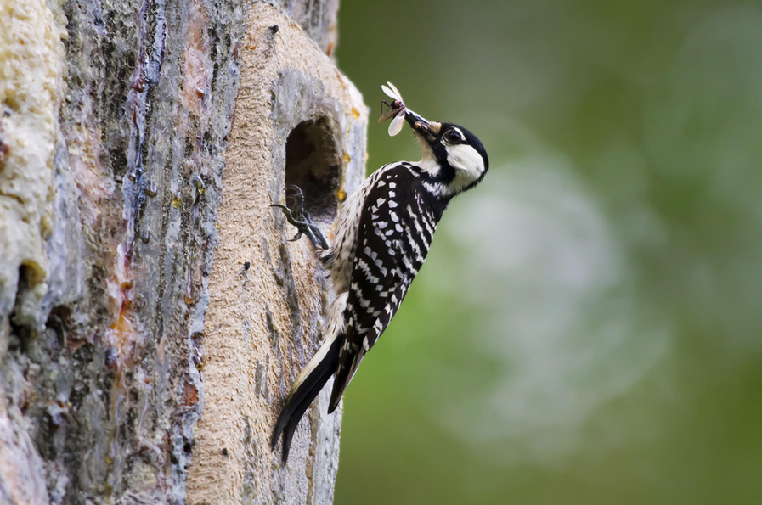
Red-cockaded woodpecker habitat use

Slide 29
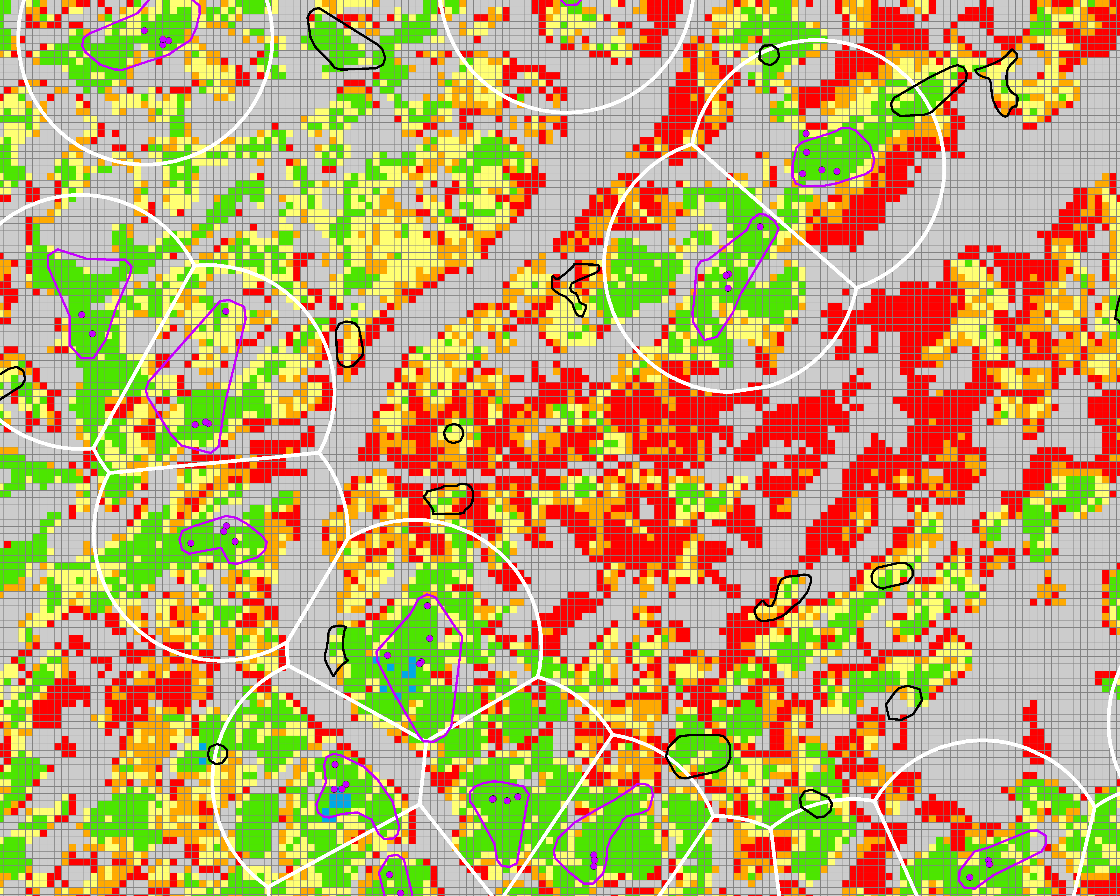
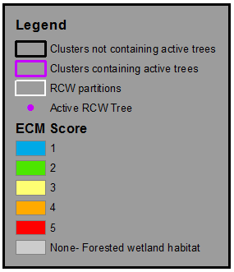
Spatial structure of territories

Slide 30
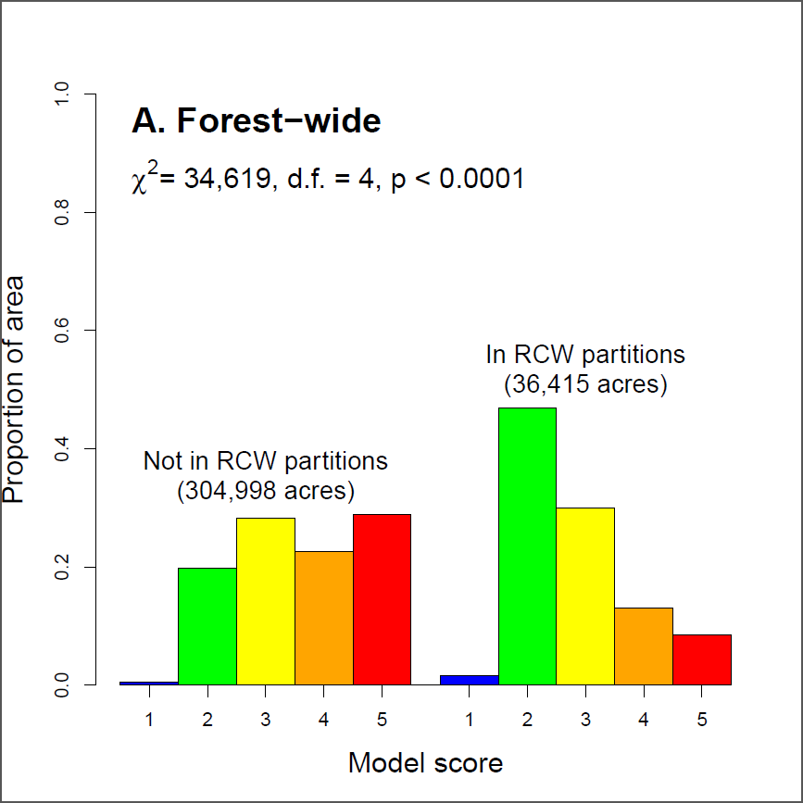
Foraging partitions

Slide 31
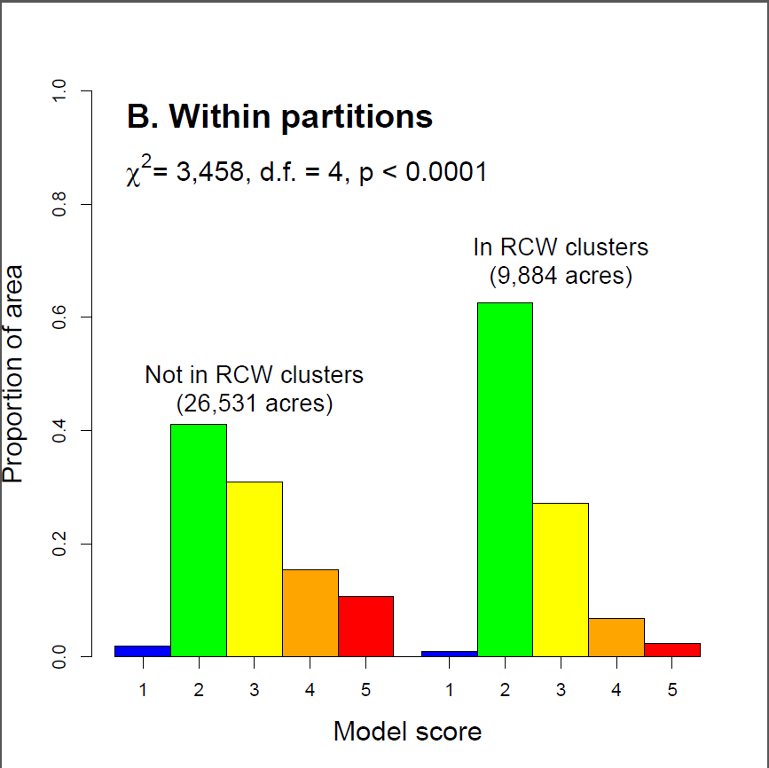
Clusters

Slide 32
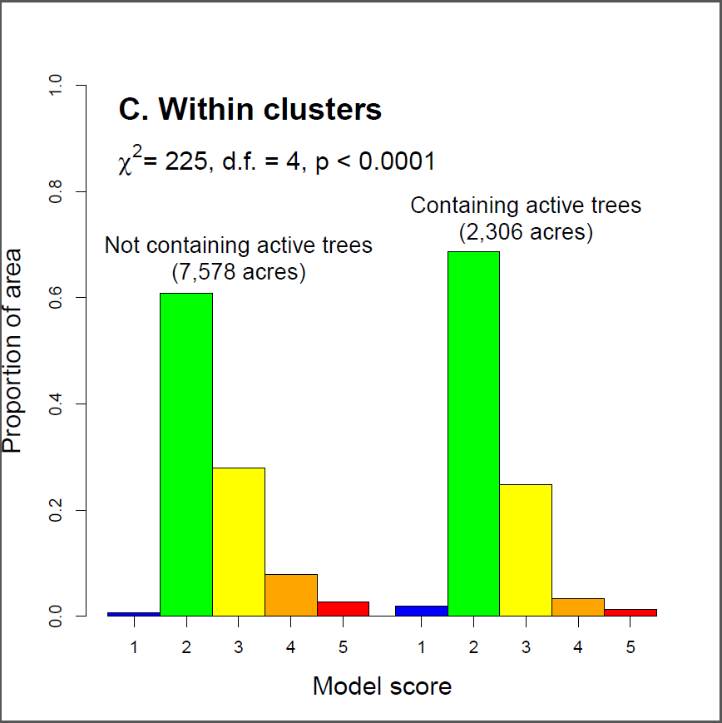
Active cavity trees

Slide 33
What the woodpeckers say
ECM scores align well with habitat characteristics important to RCW
Demonstrates that the ECM is credible for an iconic species of longleaf pine forests
Practical applications for RCW management:
  Identify areas where unknown clusters are most likely to be present
  Identify areas where recruitment clusters are most likely to be successful
  Identify areas where restoration (thinning or fire) would improve and connect RCW territories

