Slide 1
Understanding the History of Grazing in the West
Matthew A. Pearce, Ph.D.
University of Oklahoma

Slide 3
Restoration of Sage Grouse Habitat
Explore opportunities to restore and maintain sagebrush-steppe ecosystems through collaboration
Overview of the cultural setting
Provide historical perspective for the communities and customs that developed on the western range
Compare values of ranchers and administrative agencies

Slide 4
Rangelands and Culture
Rangelands and range management are historical constructs
Product of politics and economics as well as ecology
Our understandings of rangelands and range management evolves as politics and economics change
A comprehensive definition of rangelands does not exist
One must be aware of broader conversations regarding rangelands when examining issues such as collaboration and restoration

Slide 5
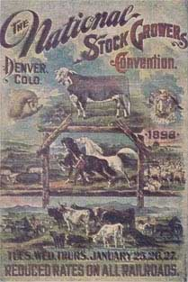
Rangelands, Livestock, and Ranchers
Connection between humans, domestic livestock, and the range
“commons”
the three “P’s”
Property
Proximity
Prior use (priority)
Leads to a fourth “P”: preference
Defense of range claims through livestock associations

Slide 6
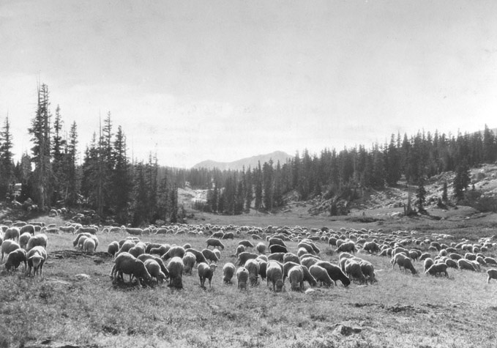
National Forests and the U.S. Forest Service
Permit process
Livestock grazing occurred alongside other forest uses—timber production and watershed protection
Grazing the product of an intense administrative process
Notes:
Sheep grazing under permit on the Medicine Bow National Forest, Wyoming. Aug.-Sept. 1927. Sheep belonging to Dana Meadows Sheep Co. grazing in the La Plata region adjacent to Libby Creek (Libby Flats). Snowy range in the background. Timber line grass & weed type. Shipp, E. S., for the U.S. Forest Service
U.S. Forest Service photo courtesy of the Forest History Society, Durham, N.C.

Slide 7
The Taylor Grazing Act (1934)
Established a political partnership between western ranchers and the federal government
“to stop injury to the public grazing lands”
to provide for the “orderly use, improvement, and development” of public rangelands
“to stabilize the livestock industry dependent upon the public range”
Expanded federal administrative responsibilities
Distributed rangeland resources to ranchers
grazing advisory boards

Slide 8
Multiple Use and Environmental Regulation
The politics of multiple-use
A product of evolving perceptions of the landscape, its proper use, and the role of stockgrowers and range scientists in its management
Modern environmental movement
Debates and disputes on the ground influenced policy
Multiple Use-Sustained Yield Act (1960)
Wilderness Act (1964)
National Environmental Policy Act (1970)
Endangered Species Act (1973)

Slide 11
In your spare time…
Peter F. Cannavò, The Working Landscape: Founding, Preservation, and the Politics of Place (2007)
Leisl Carr Childers, The Size of the Risk: Histories of Multiple Use in the Great Basin (2015)
Matthew A. Pearce, The National Domain: The Taylor Grazing Act of 1934 and the Creation of Your Public Lands (forthcoming)
Marsha Weisiger, Dreaming of Sheep in Navajo Country (2009)
Courtney White, Revolution on the Range: The Rise of a New Ranch in the American West (2008)

Slide 12
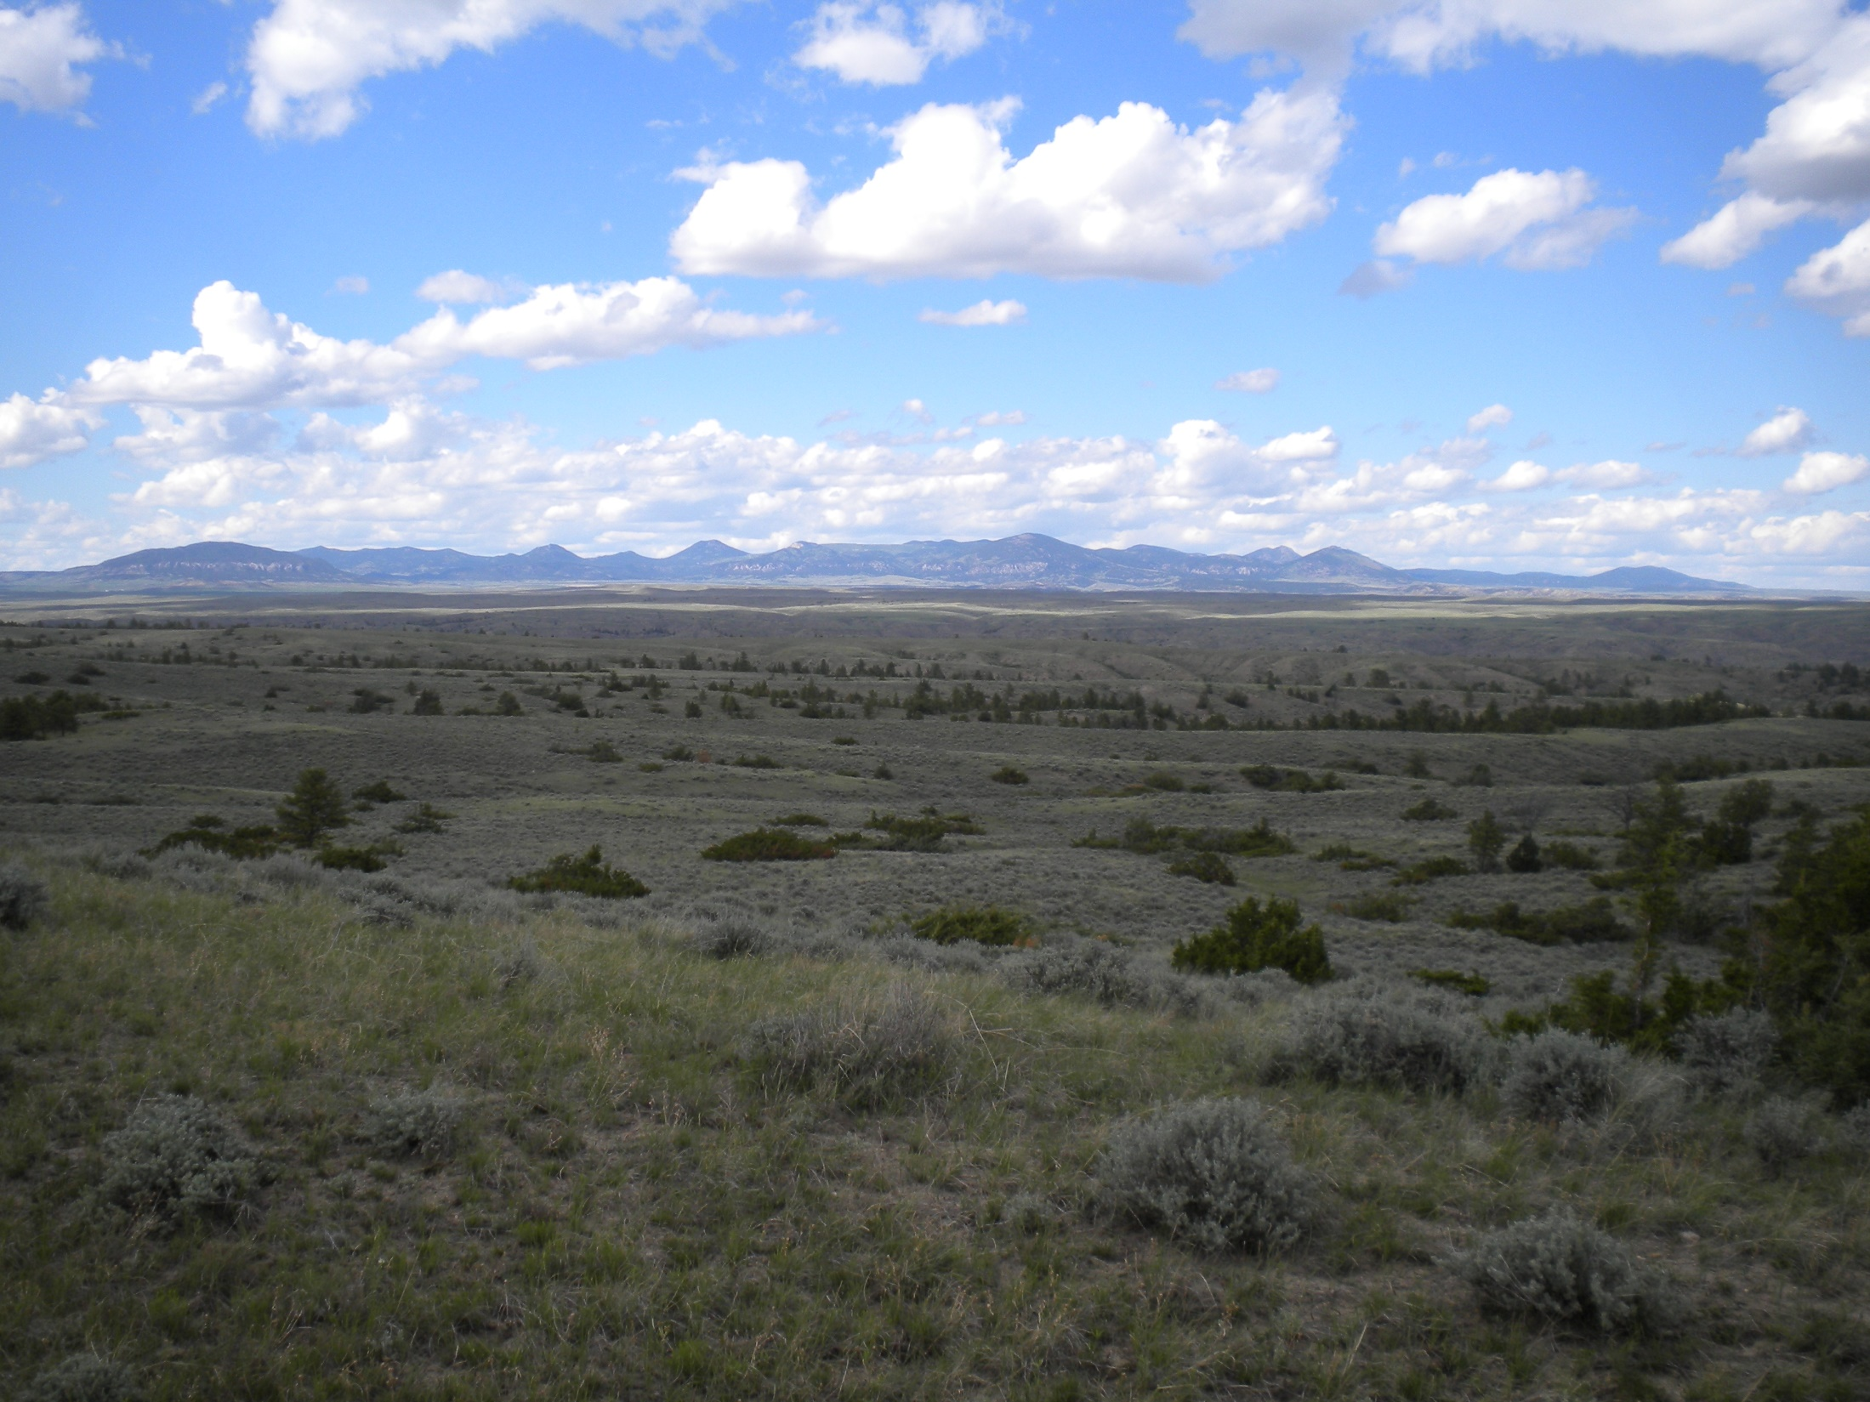
Questions?

