Slide 1
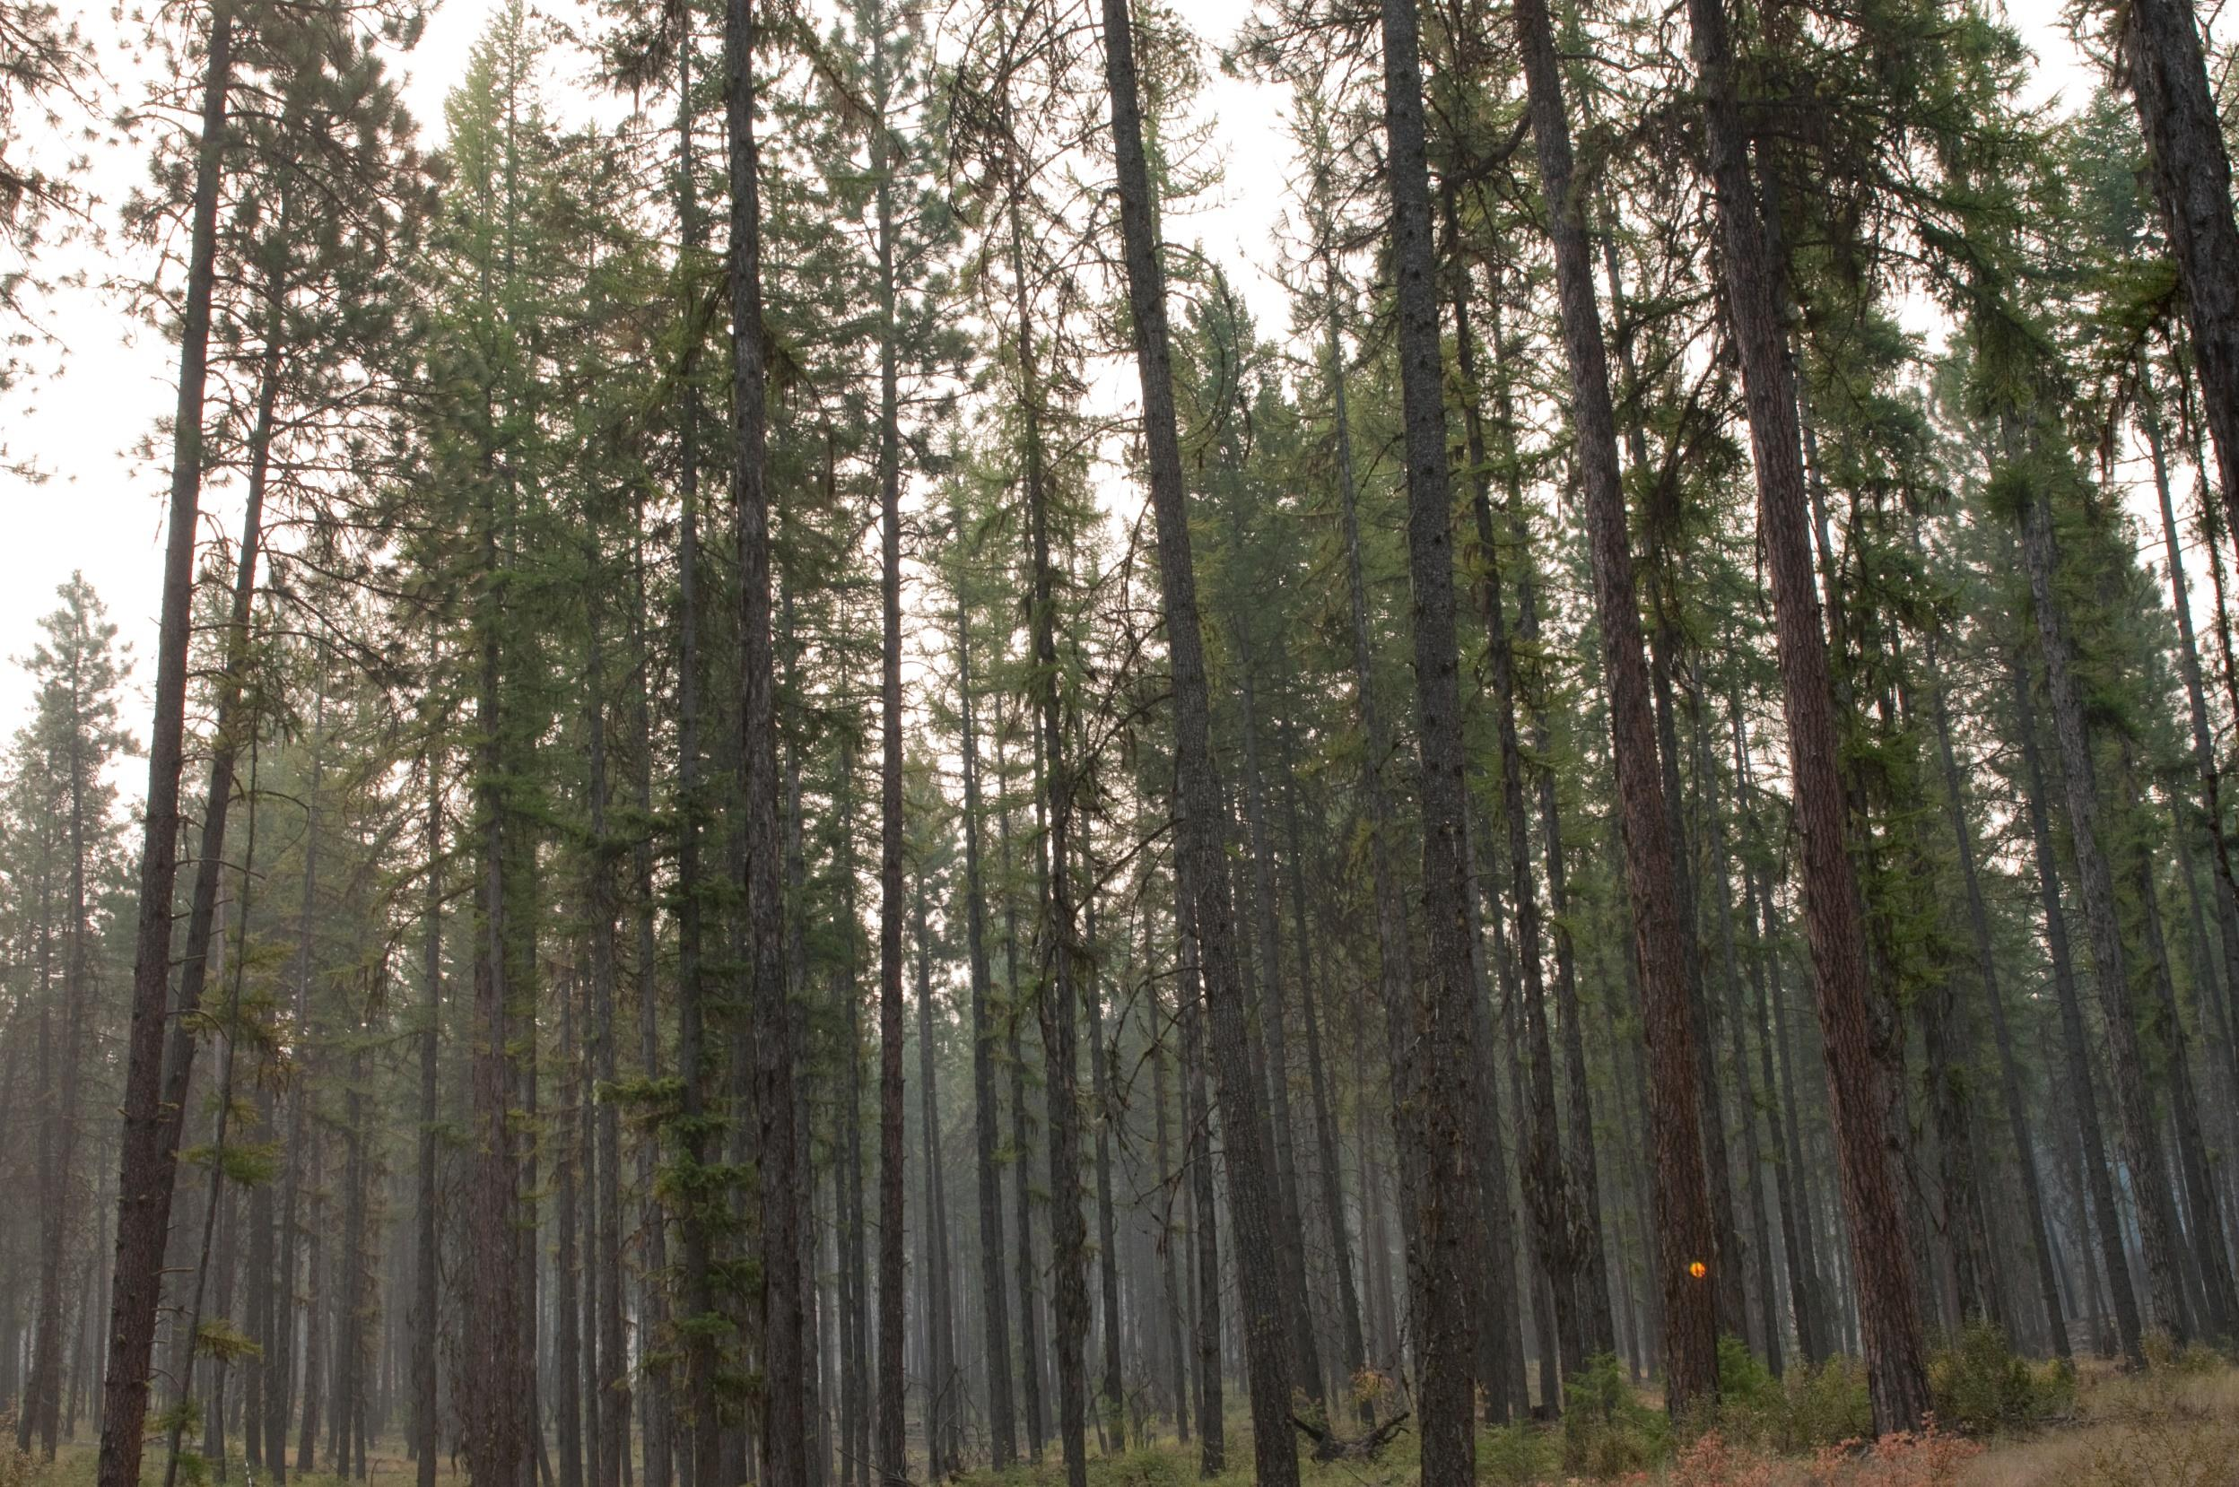
Realities of the A to Z Project on the CNF
Russ Vaagen, Vaagen Bros/NEWFC

Slide 2
Response to Common USFS Concerns
Concerns
Response
Not enough budget
Not enough personnel
Too many acres to restore
It’s not in the 5 year plan
Can we use Private funds?
Can we use qualified, dedicated contractors?
Can we find a landscape level treatment area that’s not in the 5 year plan?

Slide 3
The Answer was Yes
We located the Mill Creek watershed about 10 miles from Colville
About 55,000 acre project area
Separated into a North and South planning area
The area has an existing road system, had been actively managed in the past, and lots of mixed recreation
The USFS created an RFP, Vaagen was the only bidder

Slide 4
How does it work?
Vaagen interviewed 3 potential contractors to conduct NEPA (Planning, public outreach, collaboration) and come up with a project layout and design
Cramer Fish Sciences was selected based on their past experience and plans to utilize local and regional specialists
2014 the work began
USFS oversight of Cramer, Vaagen maintains “Arm’s Length” relationship with Cramer

Slide 5
Collaborative Support

Slide 6
A Landscape in Need

Slide 7
Units Marked to leave

Slide 8
Forest Thinning

Slide 11
Where is A to Z now?
2015, NEPA work on North Fork was complete and decision signed
Objection caused FS to require more detailed work by Cramer
2016 Decision signed on North Fork and similar objections
Objectors want EIS instead of EA, object on the basis of privatization, etc
Vaagen Bros and NEWFC hope to start work this summer
South Fork decision should be this summer as well

Slide 12
This is the very real alternative

Slide 13
This is bigger than just people,
we need new tools to fix our landscapes

