Slide 1
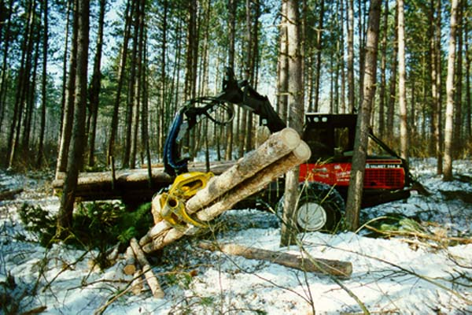
Chequamegon-Nicolet NF, Wisconsin Department of Natural Resources & Good Neighbor Authority Wisconsin Timber SPA Experience
March 30, 2016;
Prepared for Collaborative Restoration Workshop
By: Karl Welch

Slide 2
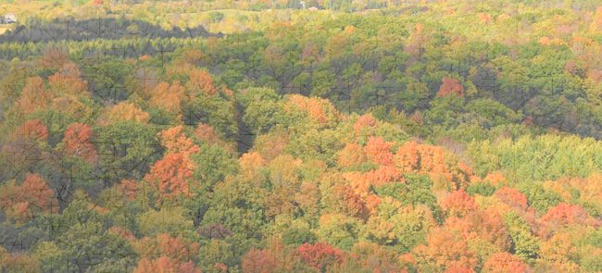
Wisconsin Forest Resources
16.7 million acres of Forestland
10.6 million acres Non-Industrial Private (63%)
2.4 million acres County Owned (15%)
1.5 million acres Chequamegon-Nicolet NF (9%)
1.2 million acres State Owned Lands (7%)
0.9 million acres Industrial Private (5%)
0.4 million acres Other; local, other federal (2%)

Slide 3
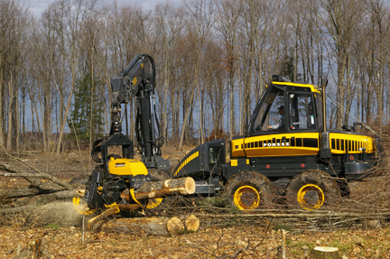
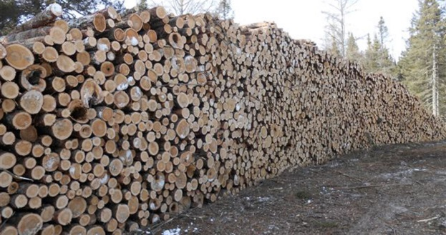
Timber Production in Wisconsin
4,900,000 cords (2.4 billion board feet) of roundwood harvested in 2009
3,700,000 cords (1.8 billion board feet) of industrial roundwood
1,200,000 cords (0.6 billion board feet) of residential fuelwood
Notes:
National Forest Land 9% of Total Forest land within Wisconsin, however contributes 3% of the harvest. At ASQ National Forest would represent 7% of harvest IF total industrial roundwood harvest remained flat. National Forest Lands will never be managed as intensively as private, County or even State properties. During FY 15 CNNF sold 166,000 cord equivalents of Industrial Roundwood. (35% increase over 2009 numbers indicated)

Slide 4
Forest Industry in Wisconsin
Second Largest Manufacturing Industry in the State
Over $18.0 Billion/year Forest Industry Shipments
60,000 Forest Industry Employees
Over $3.0 Billion/year in employee wages
Over 1,200 Wood Manufacturing Establishments
Over 200 primary wood processing mills
Number 1 paper producing State in the nation for the past 50 years
Notes:
The Forest Industry is important to the overall health and well being of the economy of Wisconsin. Also these impacts are not equally distributed throughout the State but tend to be concentrated. Beyond the direct impacts the indirect impacts are cumulative in regards to collections to the General Revenue of the State, Counties and local levels in terms of taxes received, stability of school enrollments etc Without Forest Industry the financial incentive to keep Private Forests as Forests is also be reduced leading to habitat loss for wildlife and fish as well as recreational opportunities.

Slide 5
Why partner with WI DNR through GNA Agreement?
Well Short of Stated Objectives and Desired Future Conditions in 2004 Forest Plan
Willing/Invested Partner at the Table
Intense Pressure on the CNNF to increase the rate of Forest Management Practices
Existing Volume through NEPA Analysis
Notes:
*resulting in a loss of Economic/Social/Environmental Benefits associated with Plan implementation
*Wisconsin DNR is well recognized for their expertise and leadership in Forest Management in the State. State Legislature passed additional appropriation of $750,000 to provide “seed” money prior to the onset of earned Program Income
*Multiple levels Local, State, Congressional and Industry; 2014 Farm Bill recognized as the venue that provided “new” tools to the National Forest System
*Approximately 320 MMBF of NEPA analyzed volume ready for implementation as of October 1, 2015; with little prospect of increasing implementation schedules due to funding limitations

Slide 6
The Wisconsin Timber SPA
First in the Nation Timber SPA and First use of the Authority East of the Mississippi River
All resource related goals and objectives described in the Chequamegon-Nicolet National Forest Land and Resource Management Plan are “restorative” in nature
Notes:
Farm Bill PL 113-79 Defines “Forest, rangeland, and watershed restoration services” means
Activities to treat insect and disease infected trees
Activities to reduce hazardous fuels
Any other activities to restore or improve forest, rangeland, and watershed health, including fish and wildlife habitat

Slide 7
The Wisconsin Timber SPA
Negotiations with the WI DNR indicated their desire to prepare and administer 25 MMBF/year (4,000 – 5,000 acres) of National Forest Timber
CNNF internal capacity ceiling is 85 MMBF/yr
Designed to be “no-cost” to the WI DNR
Program Income earned through the Sale of Stumpage will compensate the State for all realized expenses
Flexible Enough for the inclusion of any work conceptualized in the Forest Plan to allow for the expenditure of Program Income in excess of Timber Sale Preparation/Administration costs
Notes:
No anticipation of increased funding to further build internal capacity. Needed to look to “new authorities” to supplement internal abilities. Addition of 25 MMBF/yr results in a 30% increase in volume output AND 30% increase in acres treated through silvicultural management techniques, bringing the Forest closer to creating/sustaining habitats and ecosystem functions described in the Forest Plan. Example: Early Successional habitats

Slide 8
The Wisconsin Timber SPA Design & Scope of Work
Broad – covers the entire suite of activities that meet the goals and objectives identified in the Forest Plan and that are authorized activities under Good Neighbor Authority Law
10-Year Agreement
Agreement Years 1-3: Primary Focus on Commercial Timber Harvest Forest Restoration Projects (Establish Program Income)
Agreement Years 4-5: Focus on both Timber and Non-Timber Restoration Projects (Establish and Expend Program Income)
Agreement Years 6-10: Focus to Shift to Implementation of Non-Timber Restoration Projects and Finishing Previously Contracted Commercial Timber Harvest Projects (Expend Remaining Program Income prior to Agreement Expiration)
Notes:
Direct Language form the Appendix A Scope of Work; Many different activities occurring concurrently.
Intent is to enter into 2nd SPA about year 5 to earn Program Income during years 6-10 of the Existing Agreement while insuring complete expenditure of Program Income in SPA #1. The overlap allows the State and FS to continue work as seamlessly as possible with jeopardizing earned funds.

Slide 9
What is Included in the SPA??
Clear and Concise Description of the Roles and Responsibilities of the Forest Service and Wisconsin DNR
Approximately 10,200 acres of Timbered Stands through the NEPA process and ready for implementation
The 10,200 acres is estimated to yield 50 MMBF with an estimated stumpage value of $4,250,000
Agreement of Standards, Procedures, Quality Control and Oversight of the currently Included WI DNR Activities
Silvicultural Prescription Writing
Project Design Layout
Marking/Cruising
Appraisals
Contract Development, Maps
Advertisements/Sale Awards
Financial Records
Sale Administration
Reporting
Notes:
Eyes wide open approach. All parties know and understand the risks/benefits of entering into the agreement and the sideboards are concisely defined. The start of the SPA is focused on Timber however it will broaden into additional ecosystem services in the near term.
***Such items as Roads management, Apprisals, Payments, Billings, Reforestation, Law Enforcement etc.
5,800 acres identified in year 1 and just completed year 2 modification with additional 4,400 acres

Slide 10
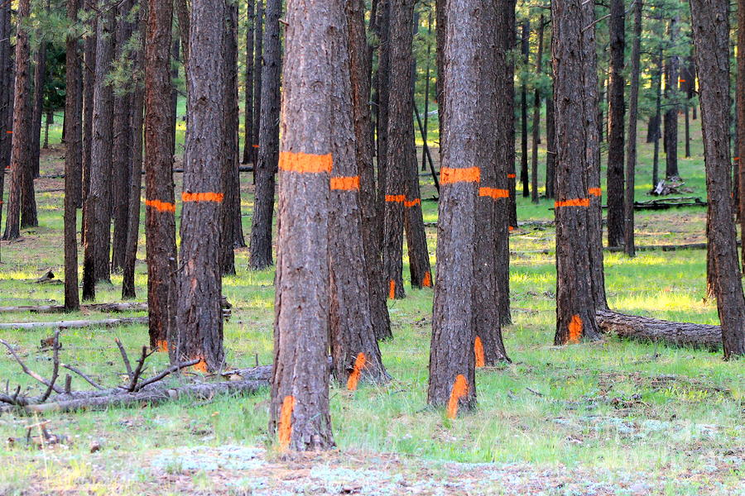
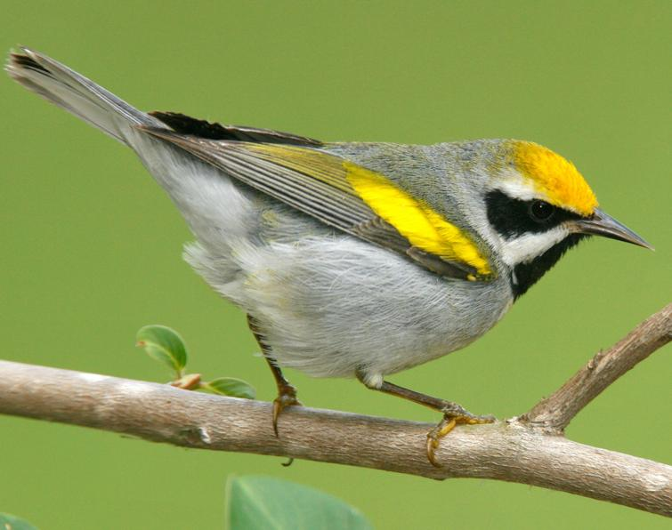
What have been the Outcomes?
WI DNR “Staffed marking and cruising of Sale Areas to Private Contractors and willing Wisconsin County Forestry Departments
Approximately 1,300 acres of SPA Prepared, Approved and Advertised
8 Individual Timber Sales Currently Advertised for April 2016 Bid Opening; with a project value of $447,000
Additional 2,800 acres of silvicultural prescriptions have been approved and 1,000 acres of additional sale prep marking/cruising completed
First Reporting period is approaching and both parties are in agreement to begin the process of SPA modification to include a new stand list with second 25 MMBF
Up” and has begun to sub-award
Notes:
Bid opening scheduled for April 20, 2016
Modification completed and with revised Appendix C Stand List sent to state for review/signature April 11, 2016
Goldenwinged warbler, pictured species associated with early successional habitat often through silvicultural treatments species is in dramatic decline as is the nesting habitat within the north-central US

Slide 11
What’s Next??
Internal commitment to identify future acreage and formalize procedures to select and sustain this level
Continue meetings between with WI State Forester, CNNF Forest Supervisor and key staff as needed
Discussions will become “inclusive” to identify other restoration services, to be conducted by the state after WI legislative loan payback is complete and Program Income becomes available
Current Financial Plan estimates that $600,000-$750,000/year of Program Income will be earned after reimbursement of state costs to prepare and administer sales
Notes:
Multitude of opportunities to explore including stream habitat restoration, prescribed burning/fuels treatments partnerships, road decommissioning, terrestrial habitat, Compartment Inventory, Species Diversification, etc. Infinite options, the challange is to focus and plan.
10 yr agreement could result in as much as 40,000 – 50,000 additional acres treated yielding upwards of 250 MMBF with a project value $21,000,000 - $25,000,000 and

Slide 12
Lessons Learned….
All parties need to be empowered by their agency to make decisions, be prepared to clearly communicate, be willing to listen and negotiate in good faith to achieve mutually desired outcomes
Consistent joint public outreach/external communications describing this effort are already paying dividends with local, state and federal interested parties
Internal communications describing what is expected and why as well as what is NOT expected need to occur early and often to avoid confusion and the spread of misinformation
Notes:
Negotiating Teams must be able to make decisions and speak for their respective units.
Keep time frames reasonable based on the size of the projects.
Significant commitments are required by all parties to balance additional workloads
While there are reduced costs in regards to appropriations there remain real costs associated with these projects
The outcomes outweigh the costs but costs must be recognized

Slide 13
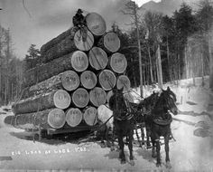
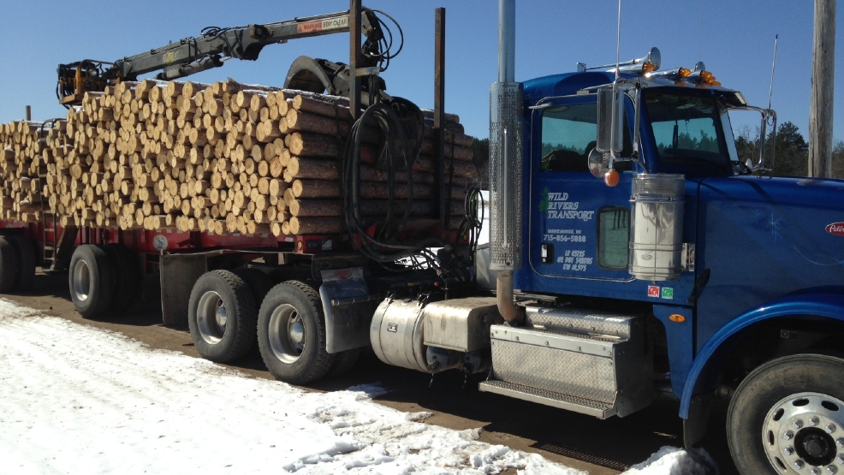
The evolution from
Forest Extraction
-to-
Forest Restoration
in Wisconsin
Thank You for the opportunity to share our Wisconsin experience.
Prepared by: Karl Welch
kwelch@fs.fed.us
Timber Program Manager/Timber Contracting Officer
Chequamegon-Nicolet National Forest

Slide 14
The U.S. Department of Agriculture (USDA) prohibits discrimination in all its programs and activities on the basis of race, color, national origin, age, disability, and where applicable, sex, marital status, familial status, parental status, religion, sexual orientation, genetic information, political beliefs, reprisal, or because all or part of an individual’s income is derived from any public assistance program. (Not all prohibited bases apply to all programs.) Persons with disabilities who require alternative means for communication of program information (Braille, large print, audiotape, etc.) should contact USDA’s TARGET Center at (202) 720-2600 (voice and TDD). To file a complaint of discrimination, write USDA, Director, Office of Civil Rights, 1400 Independence Avenue, S.W., Washington, D.C. 20250-9410, or call (800) 795-3272 (voice) or (202) 720-6382 (TDD). USDA is an equal opportunity provider and employer.

