Slide 1
4FRI Biophysical Monitoring Indicators: Assigning Metrics of Success (or Failure)
4FRI Landscape Strategy & Science and Monitoring
Working Groups – 2011-2014

Slide 2
Science Application Developing an Adaptive Management & Monitoring Plan
Needs of USFS/ Expectations of Stakeholders
Incorporates Stakeholder desired conditions with management guidelines
Small group, science-based work on indicators
Prioritization
Parameterization (for a.m.)

Slide 3
Monitoring is Critical
Effectiveness vs. Implementation
Foundation of much of what we know
Cornerstone of adaptive management
Plan
Act
Monitor
Evaluate
Inform
Monitor

Slide 4
SMWG – LSWG work
Prioritization
Parameterization

Slide 5
SMWG Work (2010-11):
Monitoring Indicators:
Social and Economic (Anne Mottek Lucas)
Biophysical (Pete Fule, Matt Williamson, Dave Huffman, Ed Smith)
Notes:
Acknowledge

Slide 6
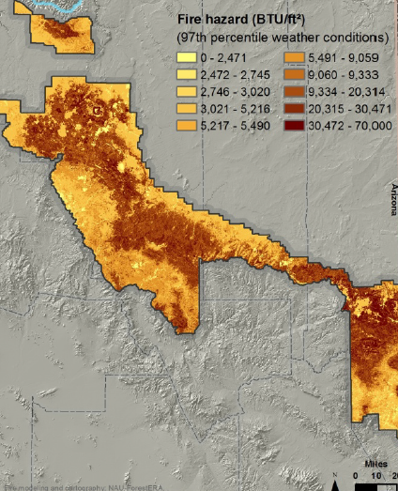
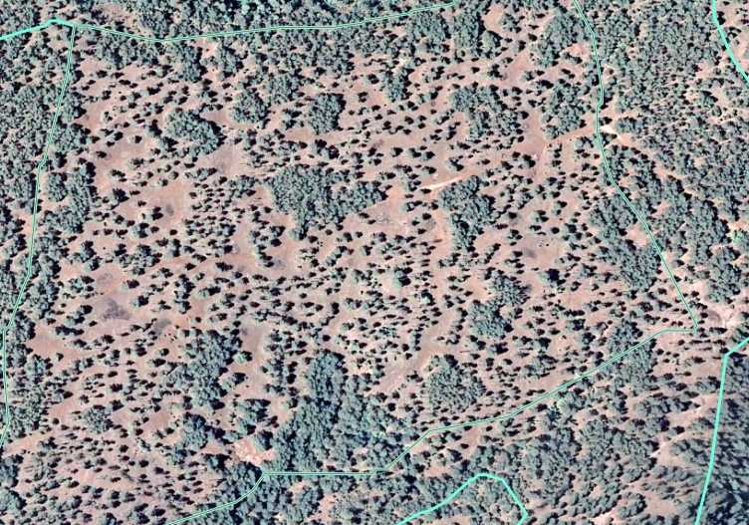
Developing objectives: An example
Reduce basal area of ponderosa pine by 30%.
Stand-Level: Restore resiliency to ponderosa pine stands.
Treatment Unit Level: Ponderosa pine systems have a range of canopy
closure at Restoration Unit scales from 20% to 60%.
Treatment Unit Level: Ponderosa pine ecosystems are heterogeneous in structure and distribution.
Restoration-unit, Analysis Area, & Landscape –Levels: Crown fire potential is reduced to less than 10% across Fire Regime I forests.
Restoration-unit, Analysis Area, & Landscape –Levels: There is low potential for unnaturally severe fire to spread…

Slide 7
Biophysical Indicators
STRUCTURE | COMPOSITION | PROCESS
Tree Size Distribution | Snags | Tree Mortality
Spatial Aggregation | Old Trees | Regeneration
Canopy Openness | Rare/ Unique Habitats | Insect Pathogens
Landscape Structure | Understory Composition | Fuel Hazard
 | Invasive Plants | Potential Fire Behavior
 | Response of Wildlife T&E | Fire Characteristics
 | Habitat Suitability | Watershed Function
 | Diversity (plant/wildlife) | Soils
 | Wildlife Response (Habitat) | Air Quality

Slide 8
SMWG: Setting Benchmarks and Thresholds or Triggers:
Science-based literature review to determine if parameters exist
“Restoration treatments should reduce the risk of active crown fire by xx% - xx% within Restoration Unit 1”
“Restoration treatments should not increase invasive species cover by more than xx% -xx% annually”
Need for broader stakeholder engagement to record social zones of agreement/ consensus.

Slide 9
Biophysical Indicator Prioritization
In order to prioritize indicators for parameterization, the group identified those unintended consequences / effects that, if realized after 20 years of implementation, would be “show stoppers.”
Invasive Species – spread of invasive species that change long-term ecological function and restoration trajectory
Soils – irretrievable compaction, erosion, soil moisture
Diversity of Plant and Animal Communities – loss of endemic or canopy dependent species
Fire – large scale crown fire and type shifts rather than characteristic fire behaviors and frequencies being reestablished at landscape scales
Forest Structure – Landscape structure
STRUCTURE | COMPOSITION | PROCESS
Tree Size Distribution | Snags | Tree Mortality
Spatial Aggregation | Old Trees | Regeneration
Canopy Openness | Rare/ Unique Habitats | Insect Pathogens
Landscape Structure | Understory Composition | Fuel Hazard
 | Invasive Plants | Potential Fire Behavior
 | Response of Wildlife T&E | Fire Characteristics
 | Habitat Suitability | Watershed Function
 | Diversity (plant/wildlife) | Soils
 | Wildlife Response (Habitat) | Air Quality

Slide 10
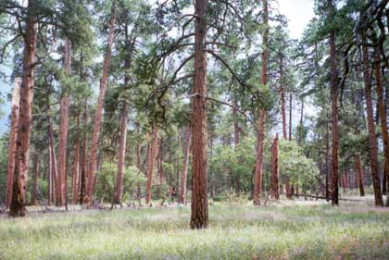
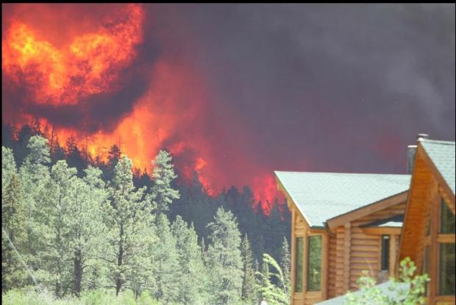
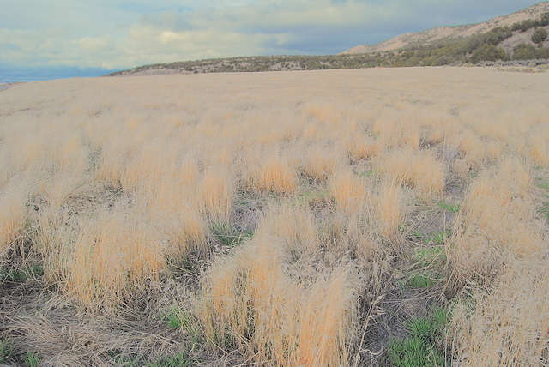
Parameterization of Indicators
Based on “most” Desirable Conditions?
Based on “most” Undesirable Conditions?

Slide 11
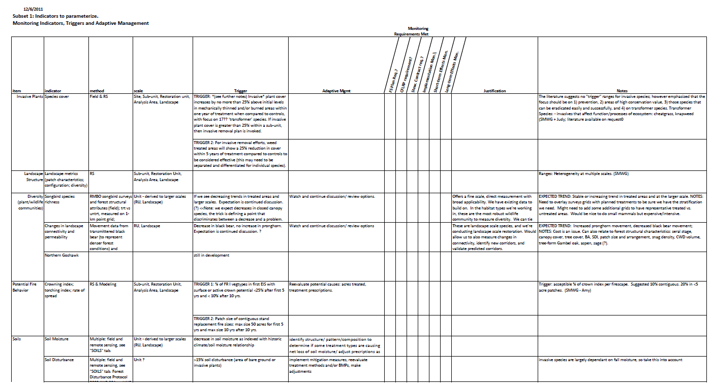
LSWG – SMWG work

Slide 12
Indicator | Measurable variable | Trigger
Invasive Plants | Species cover | TRIGGER: Identification of new or existing “watch list” or “high risk” invasive species populations
 |  | TRIGGER 2: Identification of areas at high risk of cheatgrass introduction, spread or dominance
Landscape Structure | Landscape metrics (patch characteristics; configuration; diversity) | TBD
Diversity (understory community) | Bare Soil | Within 5 years of treatment (mechanical and/or fire), bare soil should comprise less than 20% of area affected by treatment.
 | Songbird | Fine Scale- TBD Broad Scale-Any non-zero decline over a 5-year period
Potential Fire Behavior | Severity and size of fire; acres of high severity fire; and total acres burned | TRIGGER 1: Patch size of adjacent pixels expressing stand replacing fires is greater than 50 acres after 5 years § Patch size of adjacent pixels expressing stand replacing fires is greater than 10 acres after 10 years
Soils | Soil Moisture | Trends of decreasing soil moisture (after adjusting for climatic variability) in stands with similar treatment types and/or physiographic characteristics.

Slide 13
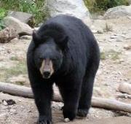
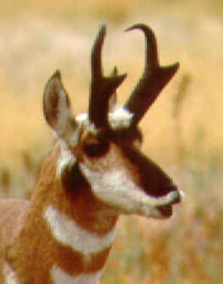
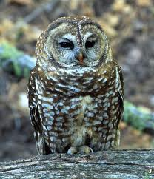
Parameterization of Indicators
Science baseline
Informed by stakeholders

Slide 14
What is Adaptive Management?
Monitoring data must evaluated with respect to our objectives
Developing thresholds and benchmarks determines when management should change (or not)
Plan
Act
Monitor
Evaluate
Inform

Slide 15
4FRI Adaptive Management
Desired Conditions¹
Monitoring Questions
Monitoring Plan
USFS Monitoring Coordinators:
100% Forest Service
Cost-shared (doesn’t exist!)
Change Needed:
Within NEPA effects.
Chapter 18 needed.
New NEPA
Data Collection & Database Coordination & Storage
No Management Change Needed
Activity Reports
Data Analysis
Adaptive Management Response
Implementation targets
Effectiveness triggers and thresholds
COLLABORATIVE PROCESS
^{Semi-annual}
Knowledge Summary and Dissemination
Forest Service Leadership & Staff
4FRI Stakeholder Group
Monitoring Board

Slide 16
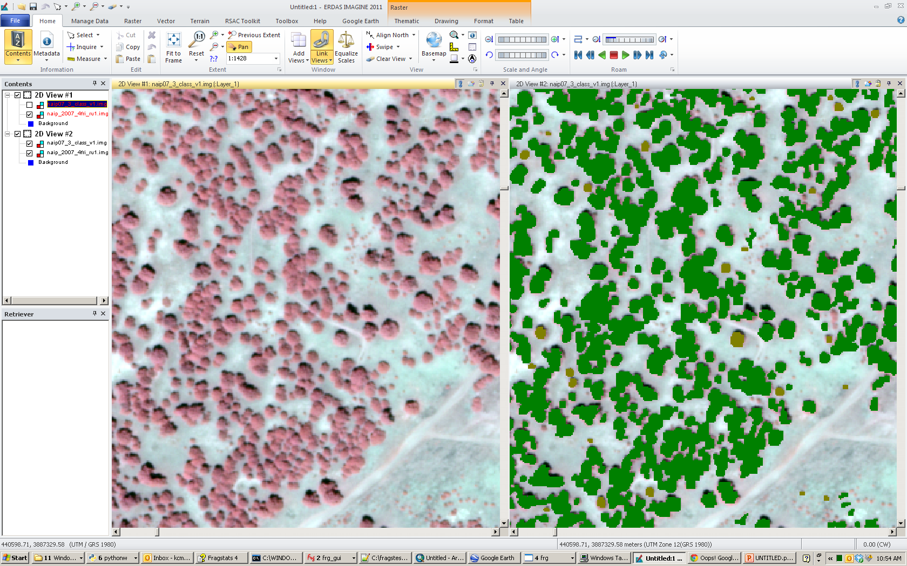
Openness
Indicator: Canopy Cover
Method: RSAC protocol and tool/ Contract work with NAU/ CSP
Trigger: Trigger is unexpected deviation from Table 64/ Silvi Report (update with Final EIS) desired conditions.
AM: Increase or focus monitoring efforts on areas with unexpected deviation. Re-assess with SHG.
Learning Objective: this is a starting point to learn how treatments impact trends in openness.

Slide 17
Questions

