Slide 1
Restoration Under a Future Climate
Understanding and managing climate change effects on federal lands
Dr. Cynthia West, Director
Office of Sustainability & Climate Change
U.S. Forest Service

Slide 2
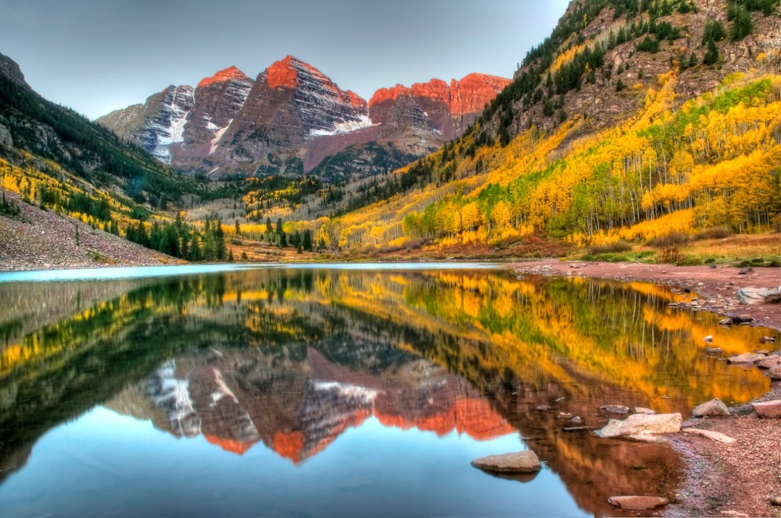
What we do
193 million acres
500 million acres
57,000 miles of trails
4,300 campgrounds
$13 billion
Notes:
First, let me give you some numbers:
The FS manages over 193 million acres of forest and grasslands, including 154 National Forests, 20 National Grasslands and nine National Monuments
The FS also supports sustainable management on approximately 500 million acres of private, state and tribal forests
In addition to our roads, we manage 57,000 miles of trails and 4,300 campgrounds
Visitors to National Forests contribute 13 billion dollars annually to the U.S. economy.

Slide 3
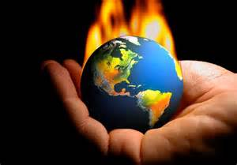
Climate change challenge
Notes:
We as public and private mangers do all of this while facing the climate change challenge. This week was the start of the COP21 meeting in Paris to develop agreements to limit global temperature rise which climate scientists link to

Slide 4
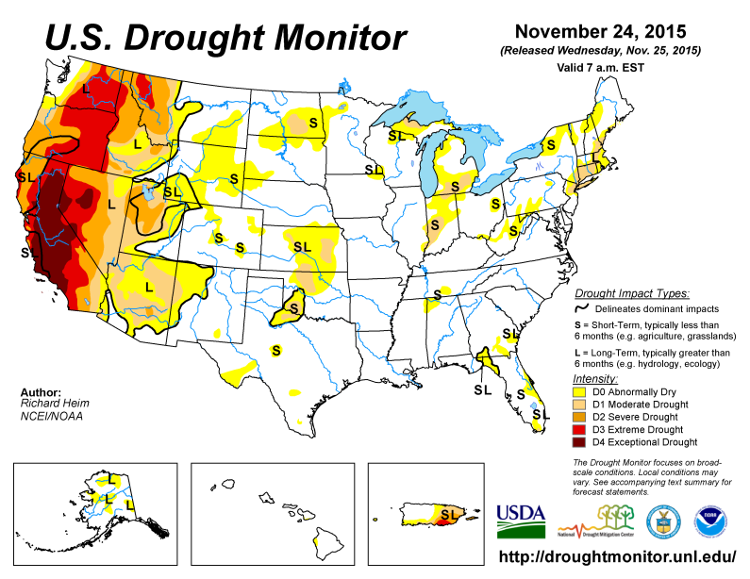
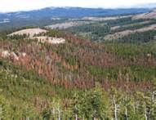
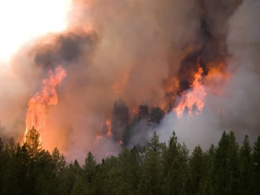
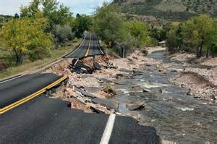
Disturbance
Notes:
Link to an increase in the frequency and severity of disturbance events. Next month a new forest drought assessment will be released. It is not surprise to many here that changing weather patterns and drought is doubling down on risk to forest and grasslands.
How we mitigate this risk is the topic of this workshop.

Slide 5
Are we prepared?

Slide 6
Understand Climate Change Effects on Federal Forest Lands
CLIMATE CHANGE PERFORMANCE SCORECARD
WHAT: A “balanced scorecard” for tracking organizational performance
WHY: Implement National Roadmap for Responding to Climate Change
WHERE: All National Forest System units
WHO: Climate Change and Sustainable Operations Coordinator networks
WHEN: Launched in FY 2011, being updated for FY 2017

Slide 7
Dimension | Element
I. Organizational Capacity | 1. Employee Education
 | 2. Designated Climate Change Coordinators
 | 3. Program Guidance
II. Engagement | 4. Science and Management Partnerships
 | 5. Other Partnerships
III. Adaptation | 6. Assessing Vulnerability
 | 7. Adaptation Actions
 | 8. Monitoring
IV. Mitigation & Sustainable Consumption | 9. Carbon Assessment and Stewardship
 | 10. Sustainable Operations

Slide 8
Dimension III: Adaptation
6. Assessing Vulnerability | Has the Unit engaged in developing relevant information about the vulnerability of key resources, such as human communities and ecosystem elements, to the impacts of climate change?
7. Adaptation Actions | Does the Unit conduct management actions that reduce the vulnerability of resources and places to climate change?
8. Monitoring | Is monitoring being conducted to track climate change impacts and the effectiveness of adaptation activities?

Slide 9
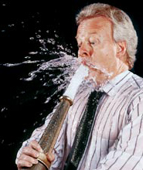
Climate change science and resource management

Slide 10
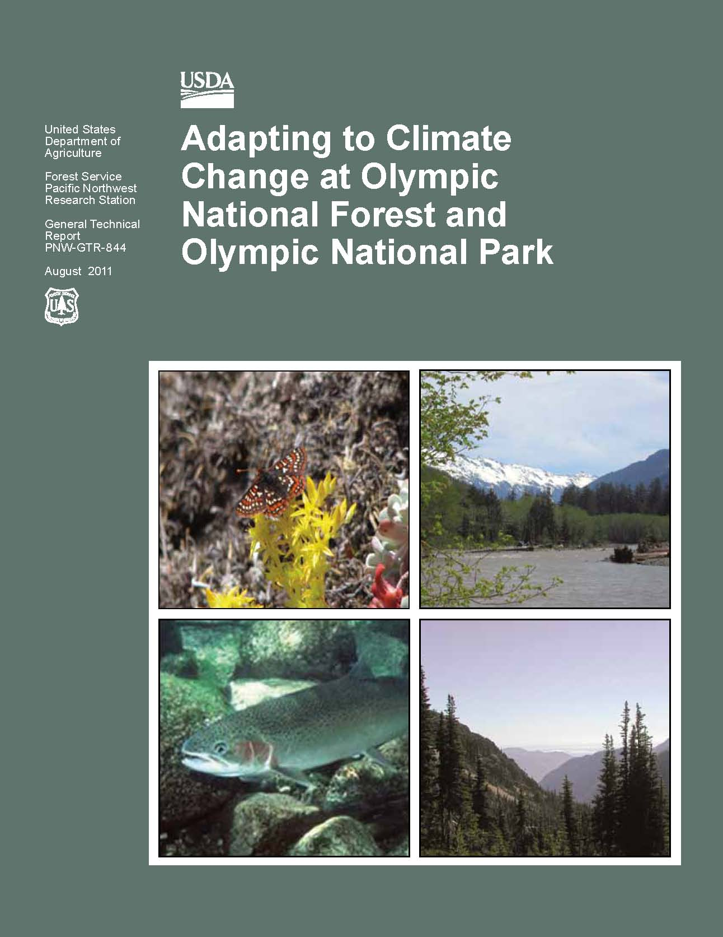
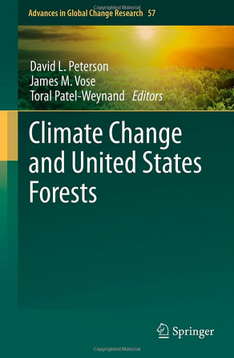
Adaptation to climate change information & tools

Slide 11
Northern Institute of Applied Climate Science
http://forestadaptation.org/
Chris Swanston
Forest Service R&D
Northern Research Station
cswanston@fs.fed.us

Slide 12
Assessing and Adapting to Climate Change
Vulnerability assessment: Evaluation of the degree to which systems are susceptible to the effects of climate change
Adaptation: Adjustment in natural or human systems to mitigate harm or exploit benefits of climate change (building in resilience to change)

Slide 13
The adaptation process
Science – Management Partnership
Education
Increase climate change awareness among employees & stakeholders.
2.Vulnerability Assessment
Review
climate projections
and identify resource sensitivities.
Adaptation Planning
Develop science-based adaptation options.
4. Implementation
Incorporate adaptation strategies into existing management plans.
Notes:
The adaptation process has four primary objectives: climate change education, vulnerability assessment, adaptation planning, and implementation.
Climate change education: getting all park and forest staff on the same page with a basic overview of climate change science, projects, and expected effects in the region.
Vulnerability: assess the vulnerability of park and forest resources to climate change and identify key sensitivities.
Adaptation: identify adaptation strategies and tactics that are based on the best available science
Implementation: Implement climate change thinking and adaptation strategies into existing plans. The product of this process is not meant to be a separate planning document and it is not a large change in the way the land and resources are managed. This is intended to be small changes in existing objectives and plans.

Slide 14
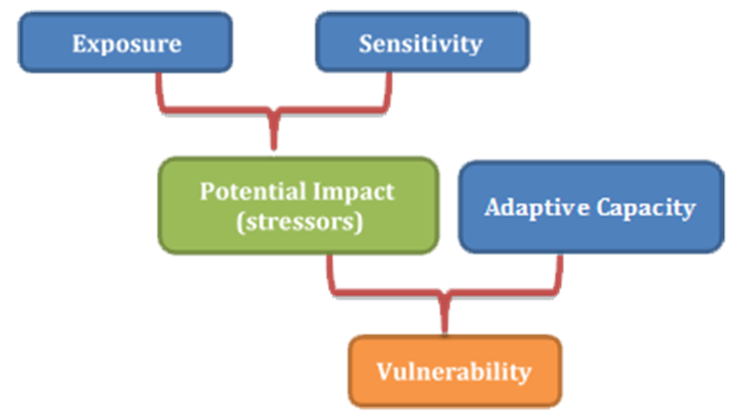
Vulnerability Assessment
Notes:
Conduct a vulnerability assessment of priority resources (species, ecosystems, ecosystem services)
The assessment focuses on climate trends, water resources, fisheries, wildlife, forested and non-forested vegetation, disturbance regimes, recreation, and ecosystem services.
A vulnerability assessment is more than a literature review. It’s an evaluation of the quality and credibility of existing scientific information on potential climate change impacts.
Vulnerability is a function of exposure, sensitivity, and adaptive capacity
Sensitivity: environmental tolerance or thresholds; dependence/interactions on other species/processes; specialized habitats, disturbance, other stressors
Exposure: primary factors (e.g. temperature, precipitation) and secondary factors (e.g. hydrology, sea level rise, vegetation changes) and non-climate stressors (e.g. development, invasive species)
Adaptive Capacity: plasticity, dispersal abilities, evolutionary potential, landscape permeability

Slide 15
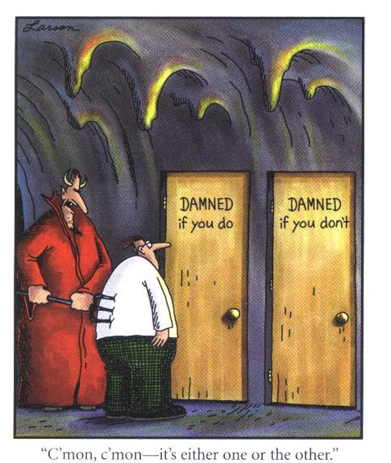
What is climate change adaptation?
Fine tuning of existing management plans and projects
Component of sustainable resource management
A form of risk management
Required by climate change response and planning guidance for agencies

Slide 16
Workshop Objectives
Downscale information from the regional assessment to the subregional and unit scales to address subregional variation not captured in the regional assessment.
Develop potential adaptation strategies and tactics to promote resilience, facilitate transitions, or maintain status.

Slide 17
Workshop Overview
Day 1 - Vulnerability Assessment
Session 1: Resource chapter presentations
Session 2: Feedback on vulnerability assessment information
Day 2 - Adaptation Strategies
Session 3: Develop strategies and tactics
Session 4: Explore application of strategies and tactics

Slide 18
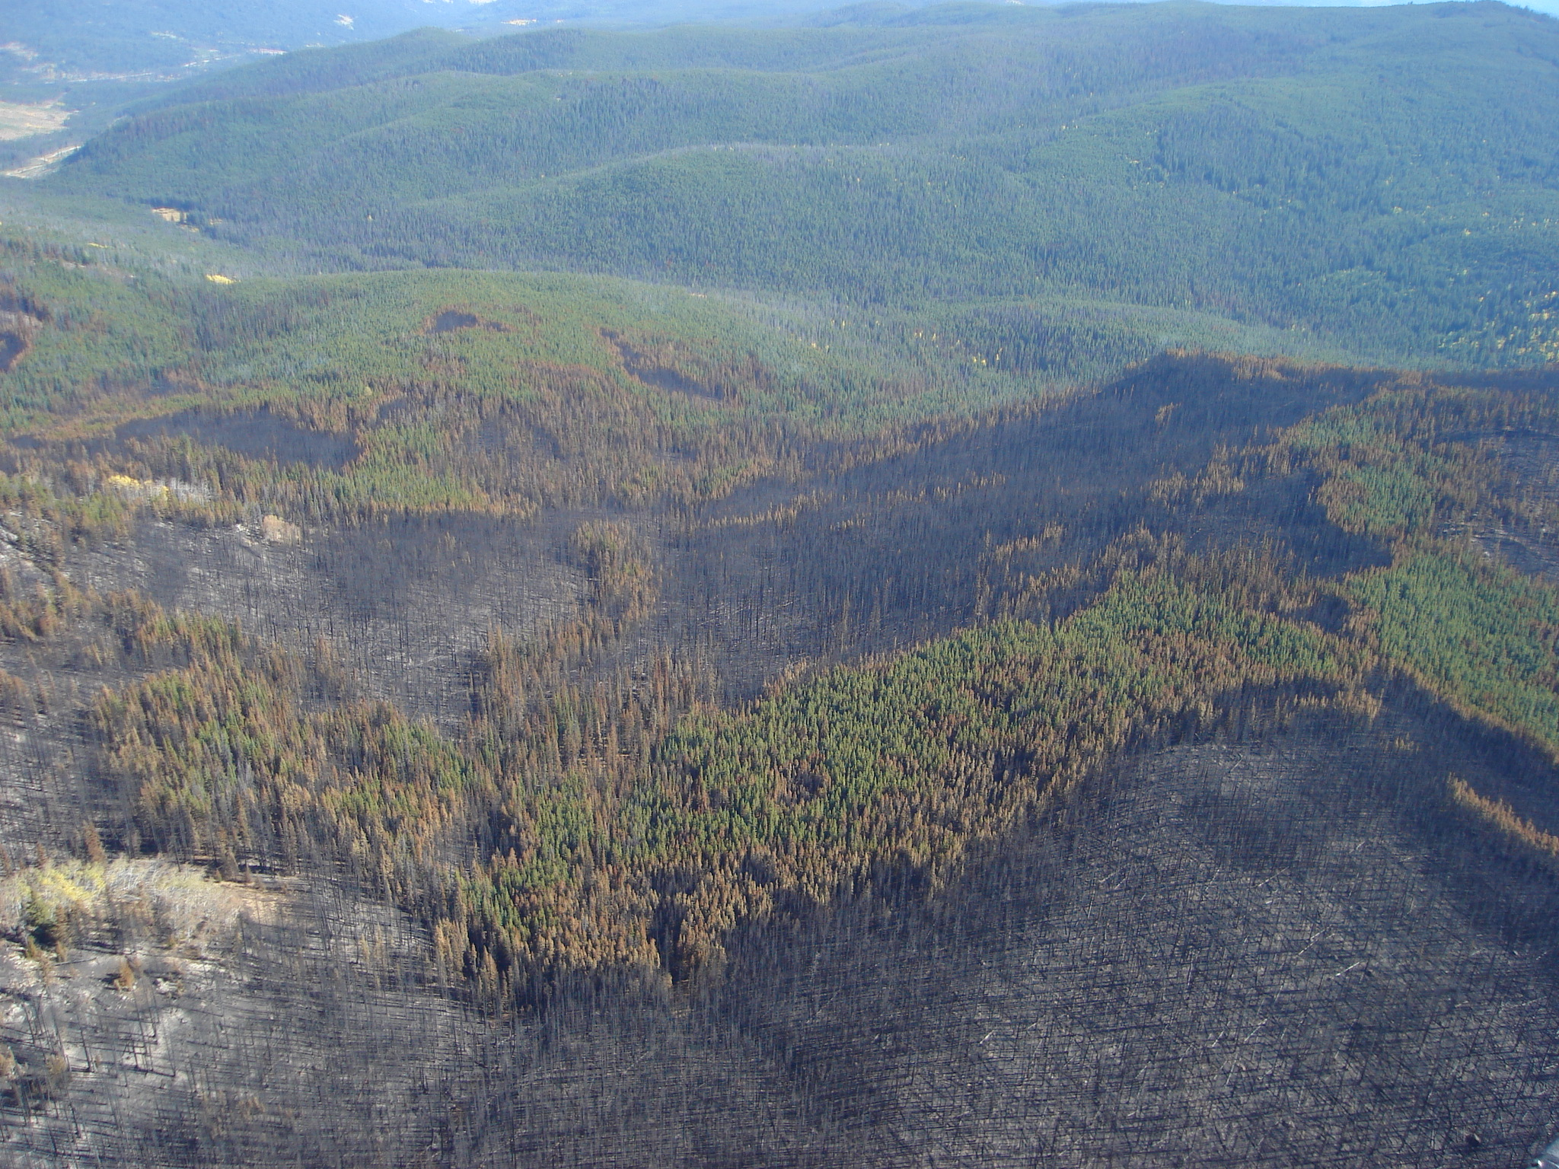
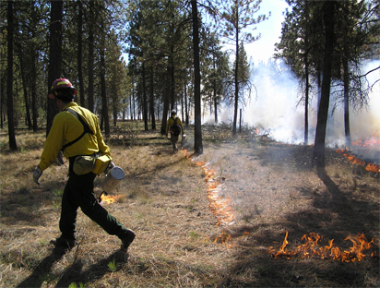
What is climate change adaptation?
Strategic
Overarching guidance to maintain ecosystem function and sustainability
Tactical
On-the-ground actions that address specific vulnerabilities and resources

Slide 19
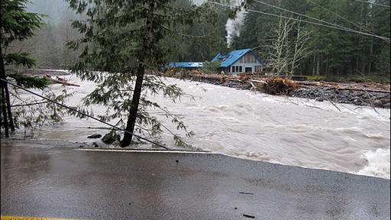
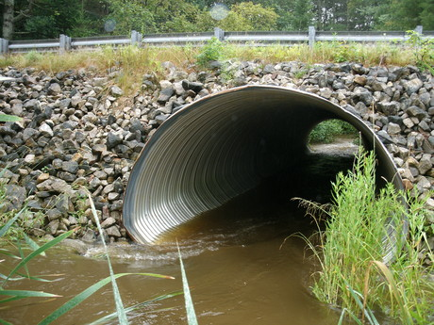
Vulnerabilities and adaptation WATER
Vulnerability
Higher peak flows in fall and winter
Adaptation strategy
Design infrastructure to accommodate higher peak flows

Slide 20
Vulnerabilities and adaptation WATER
Vulnerability
Higher peak flows in fall and winter
Adaptation tactics
Install larger culverts
Decommission roads in floodplains
Relocate campgrounds subject to flooding

Slide 21
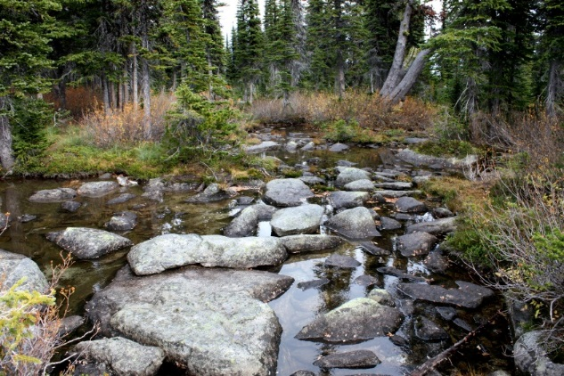
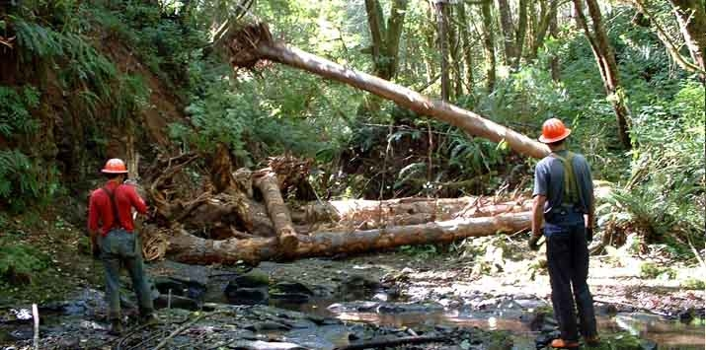
Vulnerabilities and adaptation FISHERIES
Vulnerability
Higher stream temperatures will degrade habitat
Adaptation strategy
Restore and maintain cold-water habitat

Slide 22
Vulnerabilities and adaptation FISHERIES
Vulnerability
Higher stream temperatures will degrade habitat
Adaptation tactics
Map cold-water habitat
Restore side channels
Increase shade in riparian areas

Slide 23
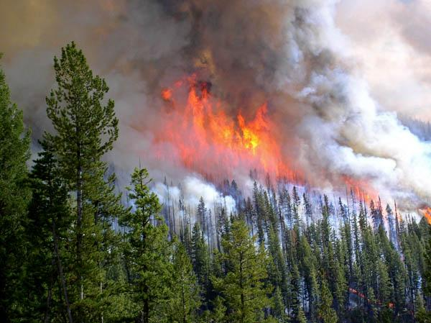
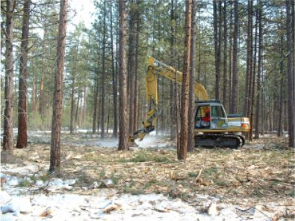
Vulnerabilities and adaptation VEGETATION
Vulnerability
Wildfire will burn more area and over a longer fire season
Adaptation strategy
Increase resilience of forest ecosystems to more frequent fire

Slide 24
Vulnerabilities and adaptation VEGETATION
Vulnerability
Wildfire will burn more area and over a longer fire season
Adaptation tactics
Reduce stand densities
Accelerate hazardous fuel treatments
Manage for diversity of stand ages

Slide 25
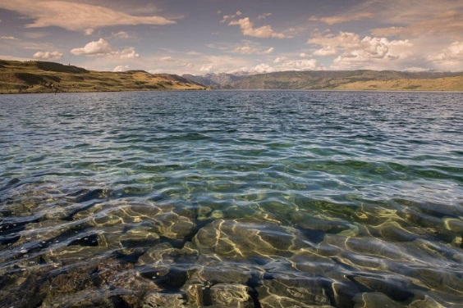
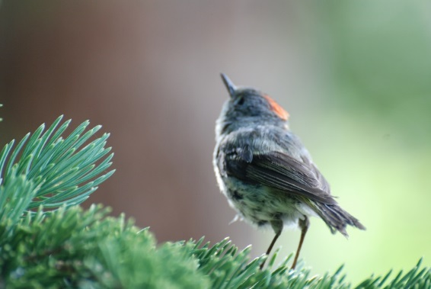
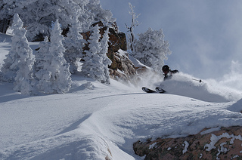
Key Focus Areas
Hydrology, Soil, and Water Resources
Terrestrial and Aquatic Species
Vegetation and Disturbance
Terrestrial Animals
Recreation
Infrastructure
Cultural Heritage
Ecosystem Services

Slide 26
Implementing adaptation strategies and tactics
Notes:
We’ll also be working with managers to implement these adaptation strategies and tactics they developed, in their planning, monitoring, and on-the-ground projects.
Assessments and adaptation options developed by Adaptation Partners are resulting in revised management approaches on the ground.
For example, Olympic National Forest has modified its stand density management guidelines in light of a warmer climate.
Several national forests in the Pacific Northwest have modified engineering guidelines for roads and culverts in anticipation of higher peak flows (flooding) in the winter.
National forests and national parks throughout the West are modifying conservation strategies for cold-water fish, especially bull trout, which will experience stress from low summer streamflows and high temperatures.
National forests in Oregon and Utah are considering how to increase the flexibility of recreation management to accommodate increased summer recreation and decreased winter recreation in a future with less snowpack.
Assessment and adaptation information is being integrated in national forest plan revisions as well as long-term ecological restoration plans. This information is critical for complying with requirements of the 2012 Planning Rule of the U.S. Forest Service and related guidance.

Slide 27
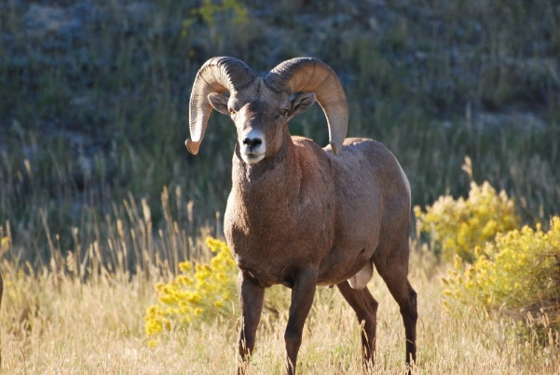
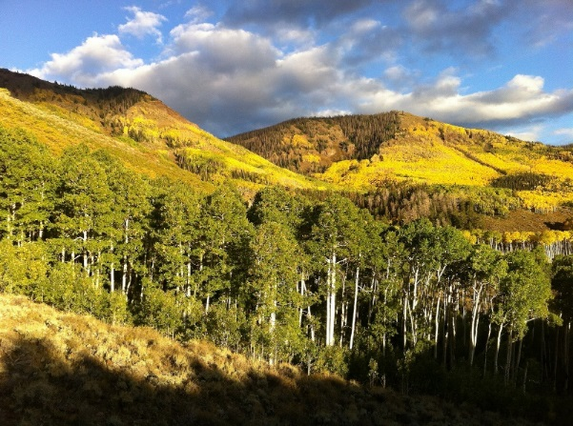
The Intermountain Adaptation Partnership (IAP)
A science-management partnership whose goals are to:
Increase climate change awareness
Assess vulnerability of natural resources
Develop adaptation strategies and tactics
Notes:
These were all science-management partnerships, involving scientists from the research branch of the Forest Service and natural resource managers from National Forests. The main goals of these partnerships were to increase the awareness of climate change in the National Forest System and in other land management entities, to conduct science-based climate change vulnerability assessments, and to use the vulnerability assessments as the basis for development of adaptation strategies and more specific on-the-ground tactics.

Slide 28
Intermountain Adaptation Partners
Dave Peterson
Forest Service R&D
Peterson@fs.fed.us
206-732-7812
Jessica Halofsky
University of Wash. jhalo@uw.edu
Natalie Little
Forest Service, R-4 nlittle@fs.fed.us, 801-625-5776
http://www.adaptationpartners.org/iap/index.php

Slide 29
Northern Institute of Applied Climate Science
http://forestadaptation.org/
Chris Swanston
Forest Service R&D
Northern Research Station
cswanston@fs.fed.us

Slide 30
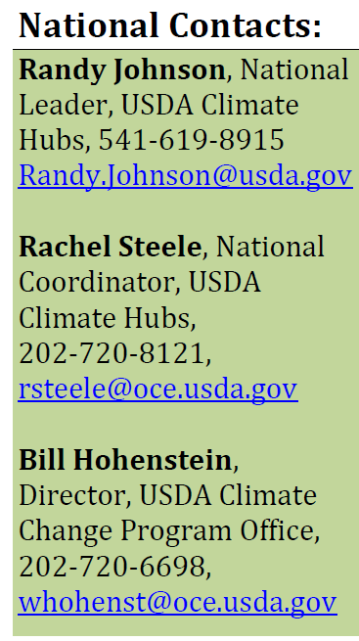
USDA Climate Hubs
http://www.climatehubs.oce.usda.gov/

Slide 31
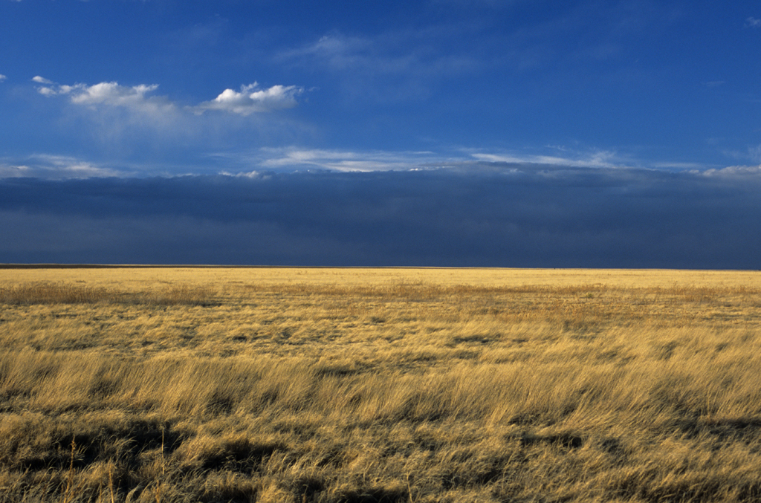
Thank You
Notes:
We’ll also be working with managers to implement these adaptation strategies and tactics they developed, in their planning, monitoring, and on-the-ground projects.
Assessments and adaptation options developed by Adaptation Partners are resulting in revised management approaches on the ground.
For example, Olympic National Forest has modified its stand density management guidelines in light of a warmer climate.
Several national forests in the Pacific Northwest have modified engineering guidelines for roads and culverts in anticipation of higher peak flows (flooding) in the winter.
National forests and national parks throughout the West are modifying conservation strategies for cold-water fish, especially bull trout, which will experience stress from low summer streamflows and high temperatures.
National forests in Oregon and Utah are considering how to increase the flexibility of recreation management to accommodate increased summer recreation and decreased winter recreation in a future with less snowpack.
Assessment and adaptation information is being integrated in national forest plan revisions as well as long-term ecological restoration plans. This information is critical for complying with requirements of the 2012 Planning Rule of the U.S. Forest Service and related guidance.
This is Comanche National Grassland-Prairie

