Slide 1
Integrating Science and Action: Toward Place-Based
Collaborative Learning
Daniel R. Williams
Rocky Mountain Research Station
drwilliams@fs.fed.us
www.fs.fed.us/rmrs/people/williams-daniel-r
Notes:
I want to first thank Rosemarie for hosting me here at the University and arranging the lectures and my participation later at the EPA meeting.
My talk centers around the task of “making sense of place research”. My approach here will be to share with you the evolution of my own thinking over some 35 years of research. Indeed, as I look back over my career I can see that experience and management of places has been an ongoing concern. But as I have pursued this notion I have come to regard place as not only a powerful explanatory tool for making sense of the social science of nature contact and management, but also a cogent framework for thinking about the role of science more generally in conservation practice. Thus as the title of my talk suggests making sense of place can help us to make sense of natural resource science (and if I may add to my title, conservation practice).

Slide 2
What is not working:
The Newtonian Model of Science
Notes:
Lets look at integrated science through the lens of philosophy of science (as a normative endeavor)
The pursuit of integrated science (common in RFPs/Programmatic areas of national science institutes e.g., US NSF) start with one or two assumptions about the nature of science. One is that scientific knowledge is “universal” true regardless of time and place, “world-views” cultural backgrounds or what some call “positionality” of the observer. In other words observers in principle can objectively observe the world. As a result scientific knowledge is like pieces of a puzzle, results from different disciplines accumulate and can be pieced together like a gig-saw puzzle. What economic concepts, theories and observations can be combined with ecological, social and physical sciences.

Slide 3
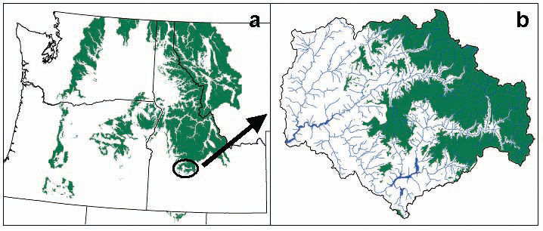
Newtonian Science as Puzzle Solving
Climatology
Ecology
Integrating science more than a matter of fitting the different ‘disciplined’ pieces of a puzzle together
Economy
Society
Notes:
Lets look at integrated science through the lens of philosophy of science (as a normative endeavor)
The pursuit of integrated science (common in RFPs/Programmatic areas of national science institutes e.g., US NSF) start with one or two assumptions about the nature of science. One is that scientific knowledge is “universal” true regardless of time and place, “world-views” cultural backgrounds or what some call “positionality” of the observer. In other words observers in principle can objectively observe the world. As a result scientific knowledge is like pieces of a puzzle, results from different disciplines accumulate and can be pieced together like a gig-saw puzzle. What economic concepts, theories and observations can be combined with ecological, social and physical sciences.

Slide 4
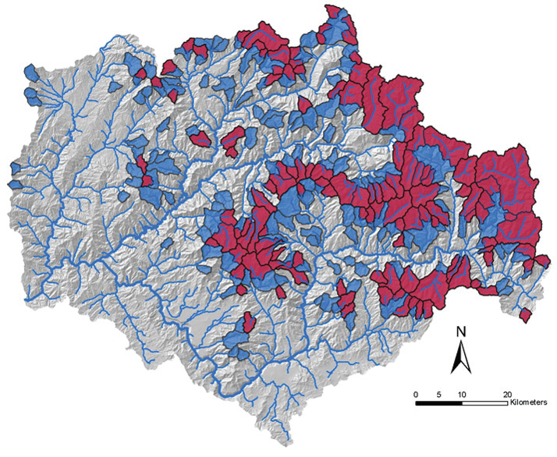
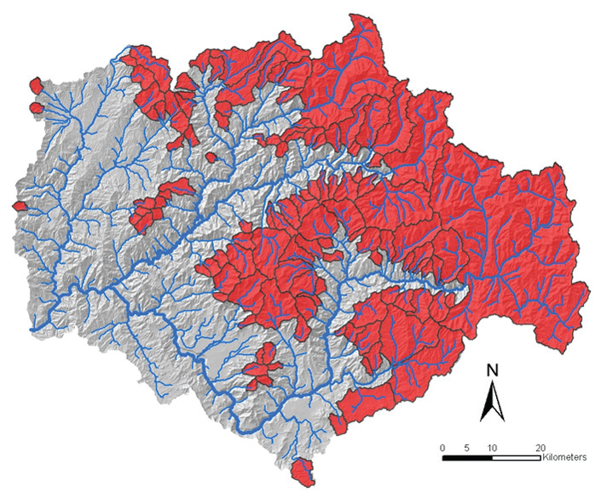
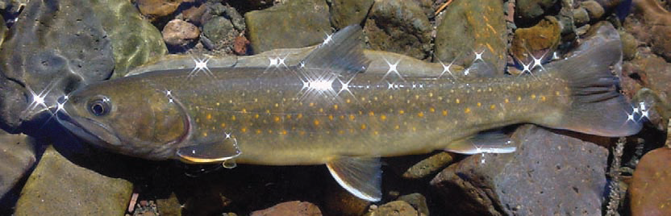
Fish and Fire example
Ecologists pointed out ever greater complexity of the phenomenon (patchy, multi-scaled, dynamic landscapes)
The right prescription for any one stream network was indeterminate
Conclusion of 100 years of science: From “put it out by 10am” to “It depends”

Slide 5
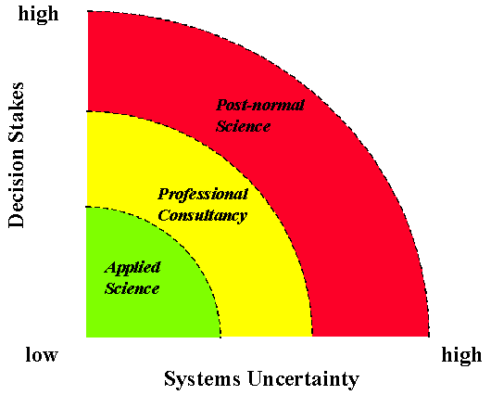
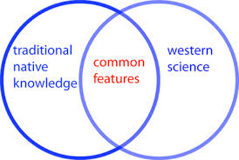
The Limitations of Newtonian Science
Funtowicz & Ravetz (1993). Science for the post-normal age. Futures, 739-755
Nature of complex adaptive systems
Post-normal science
Marked by complexity, uncertainty, and fact-value controversy
Recognition of diverse forms of knowledge (e.g., local, indigenous)
Notes:
In the paper I introduce the first of these sets of concepts (pluralism and positionality) and in the book and a subsequent chapter I include some discussion of complex adaptive systems and post-normal science. The former is more fundamentally about knowledge and the latter a bit more focused on management.

Slide 6
What might work instead:
Place-based Collaborative Social Learning
Notes:
Lets look at integrated science through the lens of philosophy of science (as a normative endeavor)
The pursuit of integrated science (common in RFPs/Programmatic areas of national science institutes e.g., US NSF) start with one or two assumptions about the nature of science. One is that scientific knowledge is “universal” true regardless of time and place, “world-views” cultural backgrounds or what some call “positionality” of the observer. In other words observers in principle can objectively observe the world. As a result scientific knowledge is like pieces of a puzzle, results from different disciplines accumulate and can be pieced together like a gig-saw puzzle. What economic concepts, theories and observations can be combined with ecological, social and physical sciences.

Slide 7
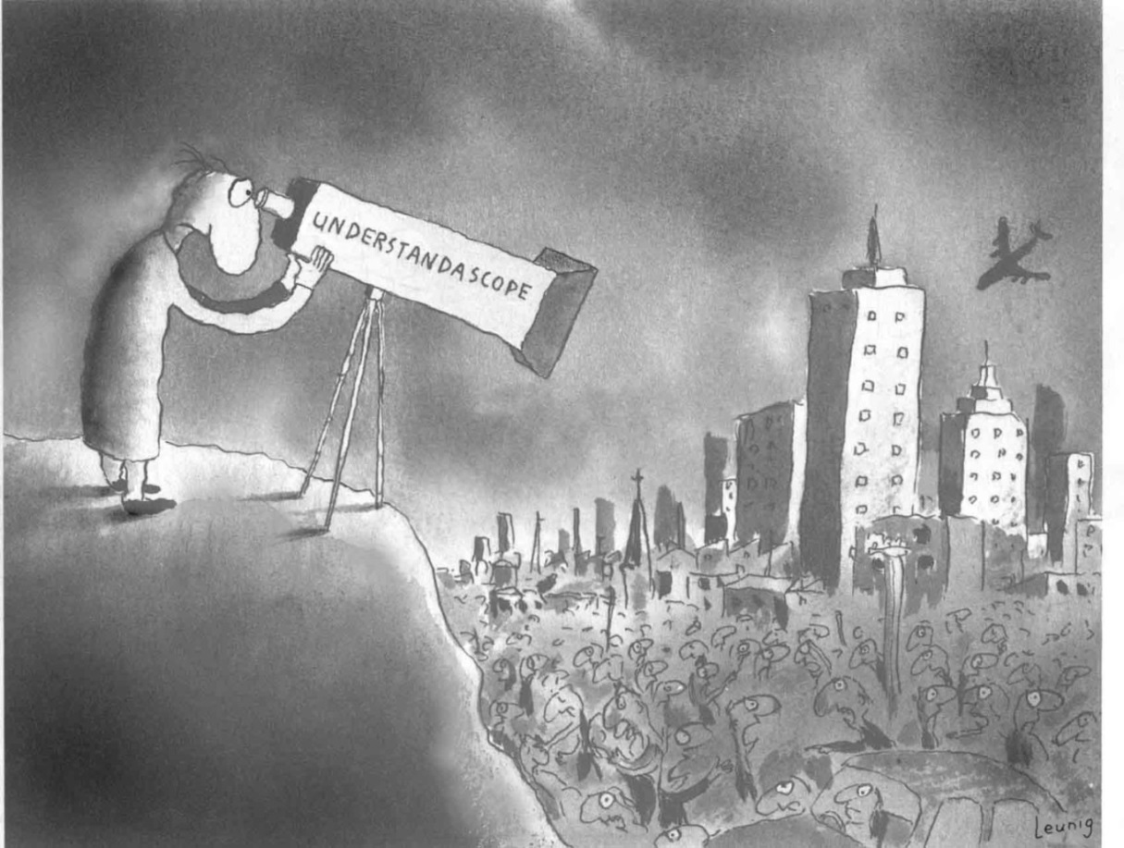
The integration problem is “how to combine the perspective of a particular person inside the world with an objective view of that same world, that person and his viewpoint included.”
-- Thomas Nagel (1986) The View from Nowhere
NATURE
SOCIAL
RELATIONS
PLACE
MEANING
Forces
http://understandascope.org/wp-content/uploads/2012/06/understandascope-compressed.jpg
Notes:
Another facet of understanding place-making is the reflexive nature of the social sciences. That is they not only seek to understand the social world, but as part of that social world seek to understand the observers (the scientists) themselves. You can not have a complete picture of the world without including those behind the “understandascope”. Another way to think of this is that the kinds of pluralism and positionality that characterizes a social learning situation applies as well to the conduct of science. Viewing NRM problems from a distance is much like the scientist looking through a disciplinary lens (understanascope) to observe landscapes/places. Nagel notes an important epistemological “problem” of how to combine ….
In other words how to combine the experience of the world from the point of view of the subject in the world with the “objective” view of an observer. This in my view is a key feature of social science … to turn the understandascope on the person in the landscape and include his/her viewpoint and experience. This is what has happened to NR practice in recent decades … we have begun to train our understandascope on the local, context rich situation.

Slide 8


Integration involves many ‘Understandascopes’
View from Nowhere
Perspectives
NATURE (materiality)
SOCIAL
RELATIONS
PLACE
MEANING
Forces
View from Somewhere
Notes:
He adds a fourth aspect he calls perspectives. Awareness of place involves multiple perspectives or views ranging from an intimate, embedded view from somewhere to an abstract, remote view from nowhere. The key idea represented in this dimension is that our knowledge, experience, and values towards a place vary along a continuum between Somewhere and Nowhere. This perspective exists in a vertical plane relative to the place forces (which occupy the horizontal plane). A good illustration of the difference between the view from somewhere and nowhere is how I initially investigated the place Foz do Iguacu. I used Google Maps and got the view from nowhere. I read accounts on wikipedia ettc. This is the “birds-eye” or God’s eye view. Even the street view in Google is still an experience from nowhere as you can’t get that truly inimate feeling for a place until, like yesterday afternoon I was experiencing the street view first hand. But it is not the same for a Brazilian or even more local resident who can read and interpret what they see and feel from cultural/local perspective. This tension between somewhere and nowhere can be more clearly illustrated by adding ….

Slide 9
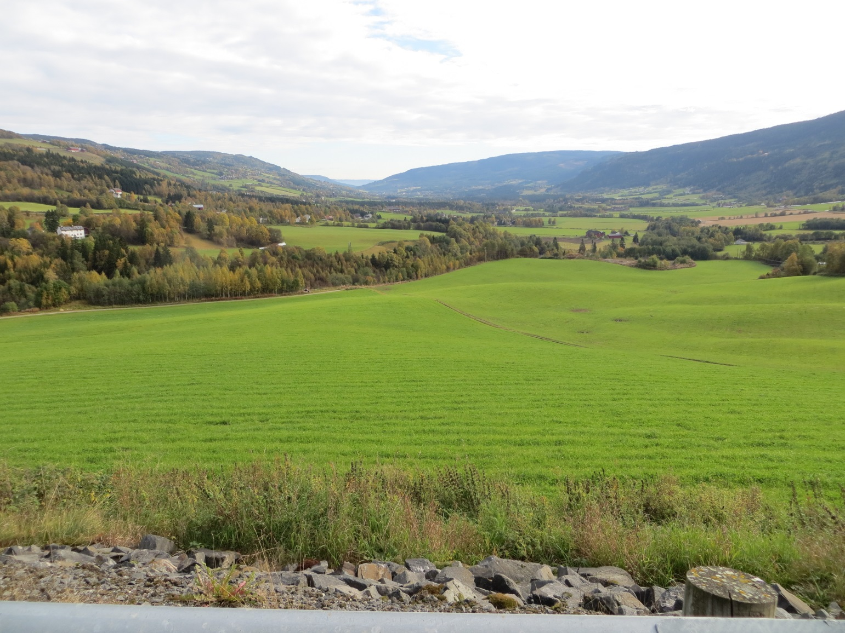
Collaborative Social Learning
Positionality = recognizing multiple stakeholders, which means ….
Collins, K. (2013). Designing social learning systems. Presentation at ISSRM, Estes Park, CO
Notes:
Kevin Collins who works on collaborative governance of water catchments builds his notion of social learning by starting with the idea of a systems view of a given policy situation. He notes how within a place (catchment) there are multiple stakeholders differently positioned or situated in the landscape. Thus each has knowledge of only some part of the larger system. Recognizing multiple stakeholders, which means …

Slide 10

… recognizing plural viewpoints, values and partial understandings of the ‘landscape’
Notes:
Recognizing multiple viewpoints, values and partial understandings of the “situation”

Slide 11
… a messy/wicked situation with multiple …
… Disciplines
Perspectives
Epistemologies
Boundary choices
Values
Practices
Interdependencies
Contexts
Notes:
In recent planning theories this situation is sometimes described as a wicked or messy situation in which there are multiple disciplines, perspectives, epistemologies, boundary choices, values, practice, interdependencies and contexts

Slide 12

…creates a potential social learning system:
“a process of socially constructing an issue or problem by actors in which their understandings and practices change, and transform the system though collective / concerted action”
Based on Collins, K. (2013). Designing social learning systems. Presentation at ISSRM, Estes Park, CO
Notes:
But as diversity is structured around a concrete place it also creates a potential learning system: Defined here as “a process of socially constructing an issue or problem by actors (stakeholders) in which there understandings and practices change, and transform the system through collective concerted action”. The challenge is to create the social conditions for social learning. Collaborative tools try to structure dialogue in a way that brings people together because they share an interest in the place/context even if they share little else. It helps bring legitimacy to the different viewpoints. At least that is the theory behind place-based collaboration.

Slide 13
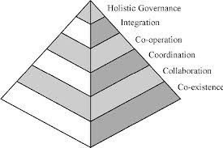
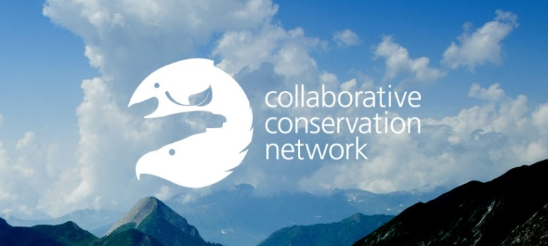
Governance as social learning
Involves place centric co-ordination networks, partnerships, and collaboration
Benefits from a diversity of actors organized in multi-scaled formal and informal networks
Notes:
The basic idea of governance is that it is different from government (which is the usual target of theory/analysis). Government is state-centric the whereas governance is society/place centric. The argument I am making here is that “place” functions as (1) context for governance --
gives adaptive governance its structure … that is adaptive governance is emergent at multiple scales and (2) constituted by governance process (e.g., place-making, contestation).
In its broadest meaning of the term governance involves “place centric” coordination of networks, and collaboration across diverse actors and organizations and actually benefits from this diversity. This coordination can be spontaneous as well as deliberate or purposeful.

Slide 14
Some Examples of Collaborative Governance
High Country News article on Water Governance in SW
  Dec. 7, 2015
Iterative scenario building in climate change adaptation:
  Big Hole Valley
  Southwest Colorado
  Gausdal, Norway
Notes:
A UMT team of natural scientists, in collaboration with a hydrologist from NCAR, created scenarios of possible futures for the upper Big Hole. They used historic information about the area, downscaled climate models, and data on current trends and conditions – all specific to this landscape - as well as just current scientific thinking about western landscapes more broadly to produce the scenarios.
The scenarios are 20 years out, which allows for the possibility of considerable change, but at a temporal scale that is within reach of landowners and human communities. It’s close enough to imagine how it would impact you and your family. We produced three qualitative narrative scenarios (approx. 400 words each) to describe these possible futures, using lay language as opposed to scientific jargon. These scenarios started with changes to temperature and precipitation but really focused on what those changes might mean for physical and ecological processes and important species and resources – changes to forests, rangelands, and aquatic systems. These are a lot like the scenarios used in scenario planning exercises.
Some like it hot -- Widespread drought – warming winters, lower snowpack, earlier snowmelt, longer summer, lower late summer streamflow, deeper drought, longer fire season, stressed fish. The seasons they are a changing -- Warmer but wetter winter and spring with deep summer drought and BIG FIRES. Feast or famine -- Year-to-year variability: some years with deep winters and cool summers and others with warm winters and deep drought, Flash floods are common, big fires every few years

Slide 15
Ontological Diversity
View from Nowhere
Economy
Population
Organismic
Biome
Scientific Ecologies
Community
Experiential
Psychology
Landscape
Ecosystem
Epistemological Perspectives
Allen & Hoekstra (1992) Toward a unified ecology.
Berkes (2008). Sacred ecology.
Sacred Ecologies
NATURE (materiality)
SOCIAL
RELATIONS
PLACE
View from Somewhere
Ontological
Forces
MEANING
Notes:
A cogent example from ecology is to contrast scientific ecologies from “sacred” ecologies. But places are more than their ecologies however contextualized. You can imagine virtually infinite lenses through which one might try to understand a place. For example, I started by discussing the experiential psychology of places building off my studies of Canyonlands NP. Certainly the economic lens has been important in NRM.

Slide 16
Knowledge/Scientific Perspectives
Ontological Diversity
Governance
Perspectives
View from Nowhere
Management Frameworks
Population
Organismic
Economic
Expert
Biome
Scientific Ecologies
Community
Landscape
Ecosystem
Semiotic
Participatory
Scientific Mgt
Epistemological Perspectives
Sacred Ecologies
Adaptive Mgt
Learning
NATURE (materiality)
SOCIAL
RELATIONS
PLACE
View from Somewhere
Ontological
Forces
MEANING
Notes:
Here I have added not only a variety of lenses and experiential perspectives, but also varying governance ideals from scientific management as a gods eye perspective through a more contextualized approach we might call adaptive management to an even more embedded governance process I described earlier as social learning. What social science teaches us are two things here:
1 Is to be sensitive to the view from somewhere – that is what is subjective, actor oriented research brings to light.
2 Is to bring a kind of sociology of science (science and technologies studies) that highlights what I am calling here ontological pluralism as different domains of knowledge (social, ecological, moral, experiential) which are not easily integrated in some algorithm or model. These are the lessons coming from the post-normal (wicked) science discussion.
Rather what place teaches us is that

Slide 17
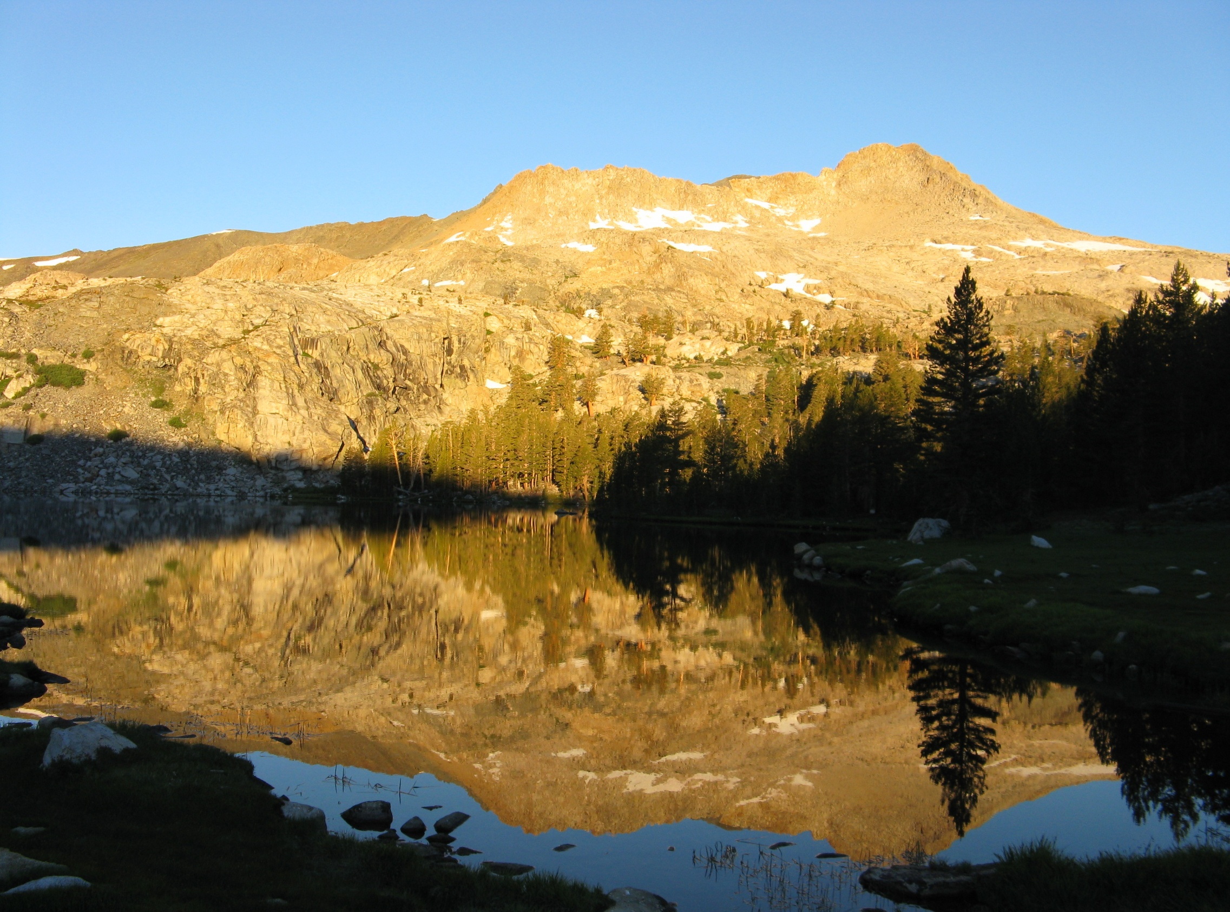

US Forest Service
Rocky Mountain Research Station
Daniel R. Williams
240 West Prospect Road
Fort Collins, Colorado
80526 USA
drwilliams@fs.fed.us
www.fs.fed.us/rmrs

