Slide 1
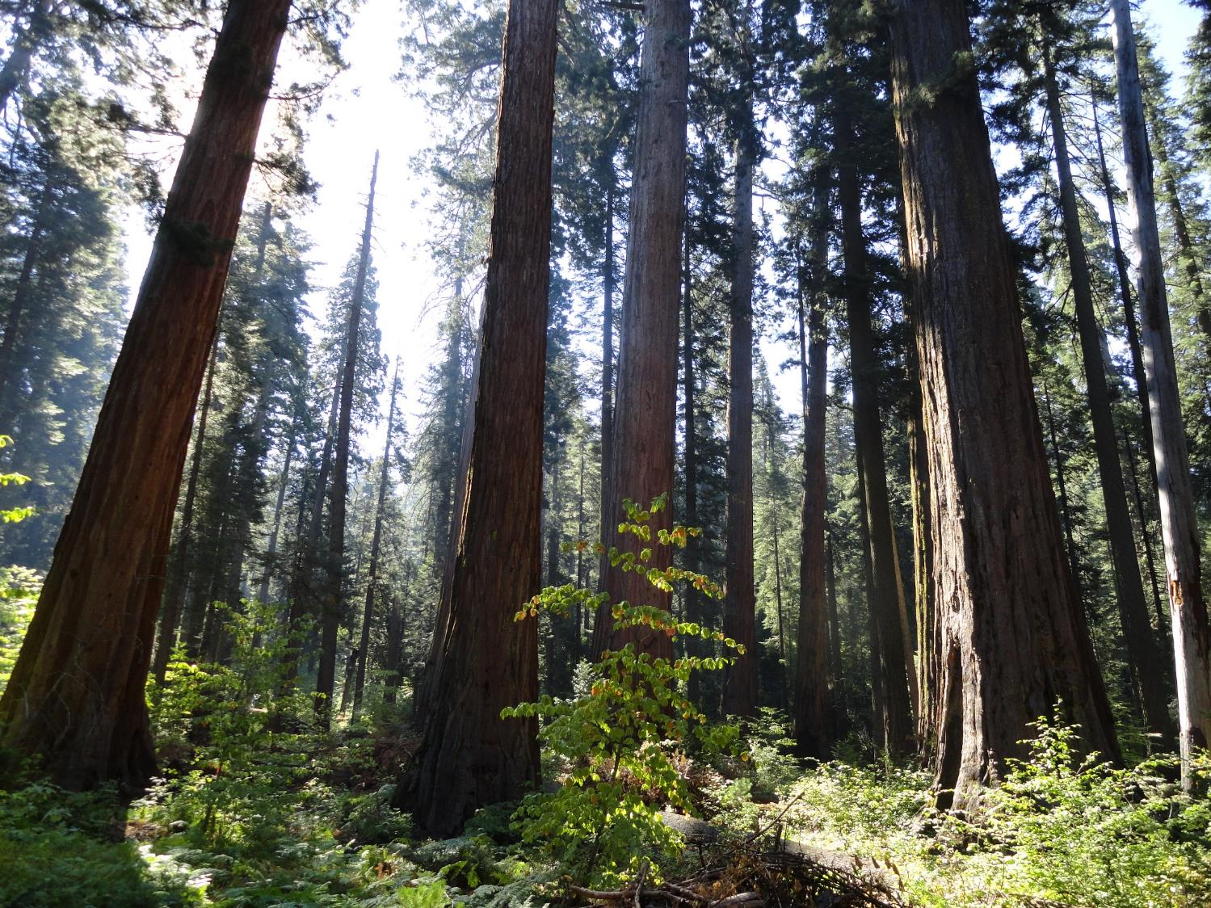
Opportunities and obstacles for incorporating climate information into forest restoration
Matthew A. Williamson¹, Christine M. Albano¹, Mark W. Schwartz¹, Gwen B. Arnold²
¹John Muir Institute of the Environment and ²Department of Environmental Science and Policy, University of California, Davis

Slide 2
So much to say, so little time…
The challenge of integrating climate information
“Current conditions” of climate information use
How might collaborative forest restoration change the way we integrate climate information into forest management?

Slide 3
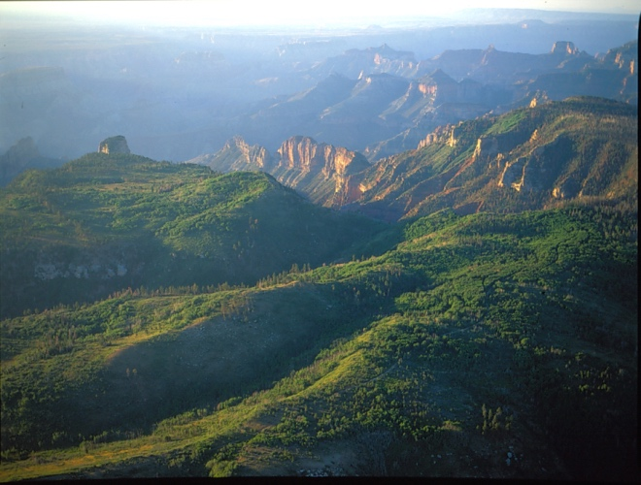
The challenge of integrating climate information

Slide 4
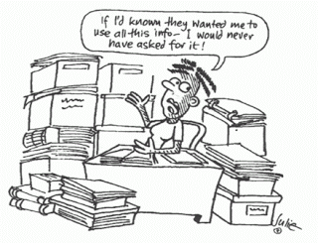
Information overload!!
Supply and demand problem (Sarewitz and Pielke 2007)
“Needs” and “Use” often not the same
Credibility and the role of problem solving (Dilling and Lemos 2011)

Slide 5
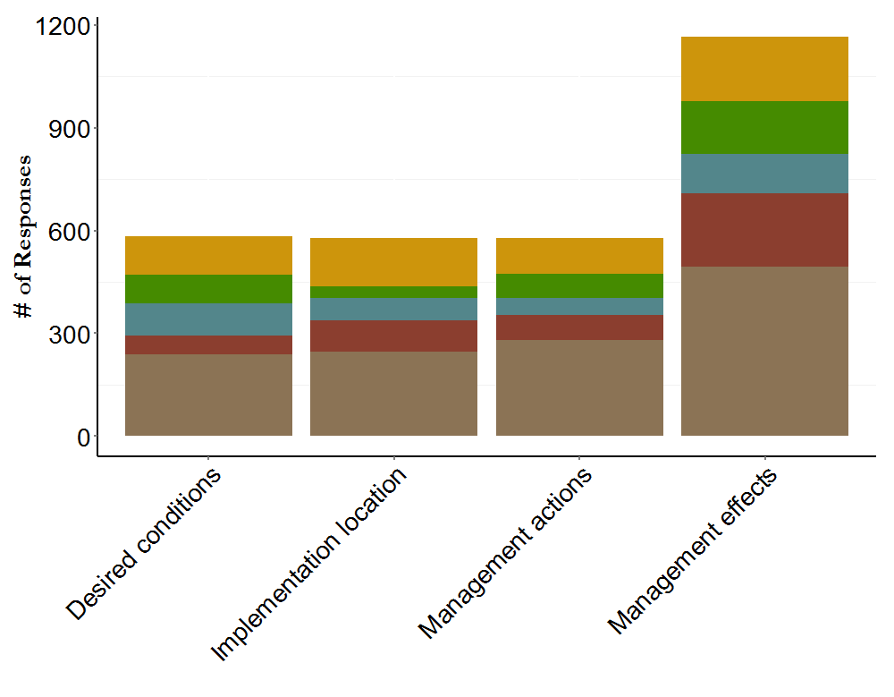
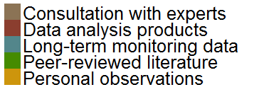
Where do you get your information?
?

Slide 6
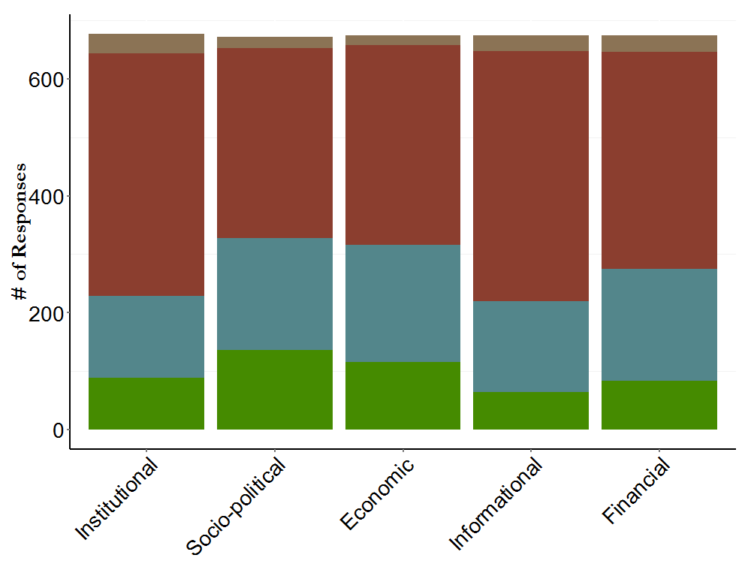
How significant are constraints?

Slide 7
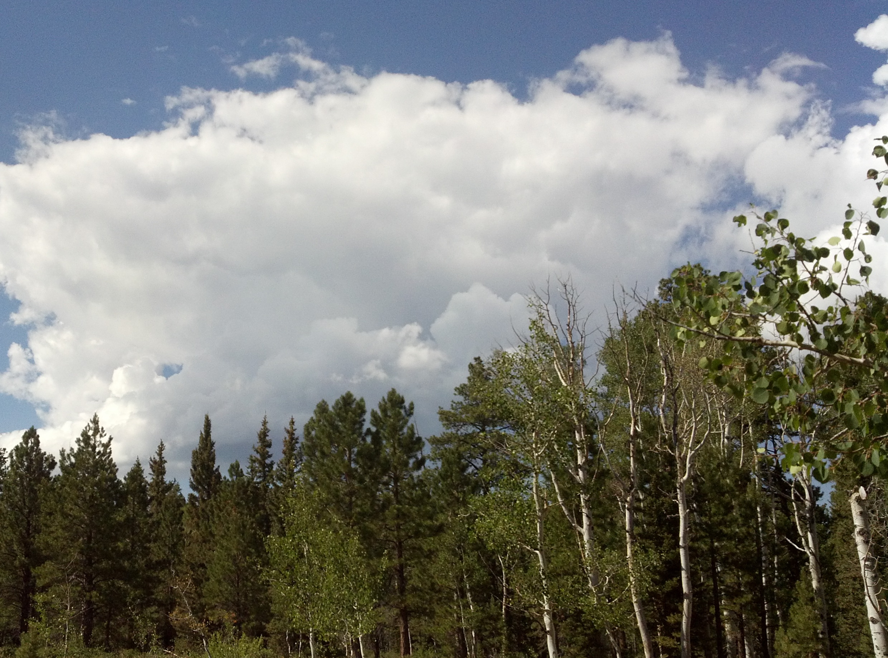
“Current conditions” of climate information use

Slide 8
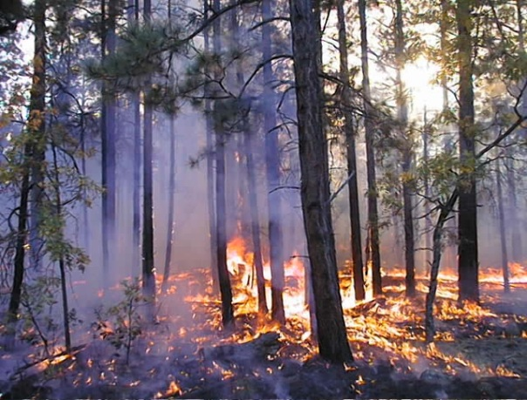
Sometimes climate information is not relevant…
but that’s rare: 489 out of 667 decisions deemed to be affected by climate
Biggest influences:
Objectives for decision
Emissions considered
Plan type
Spatial extent
Agency
Relevant:
Fire and fuels
Restoration
Range management

Slide 9
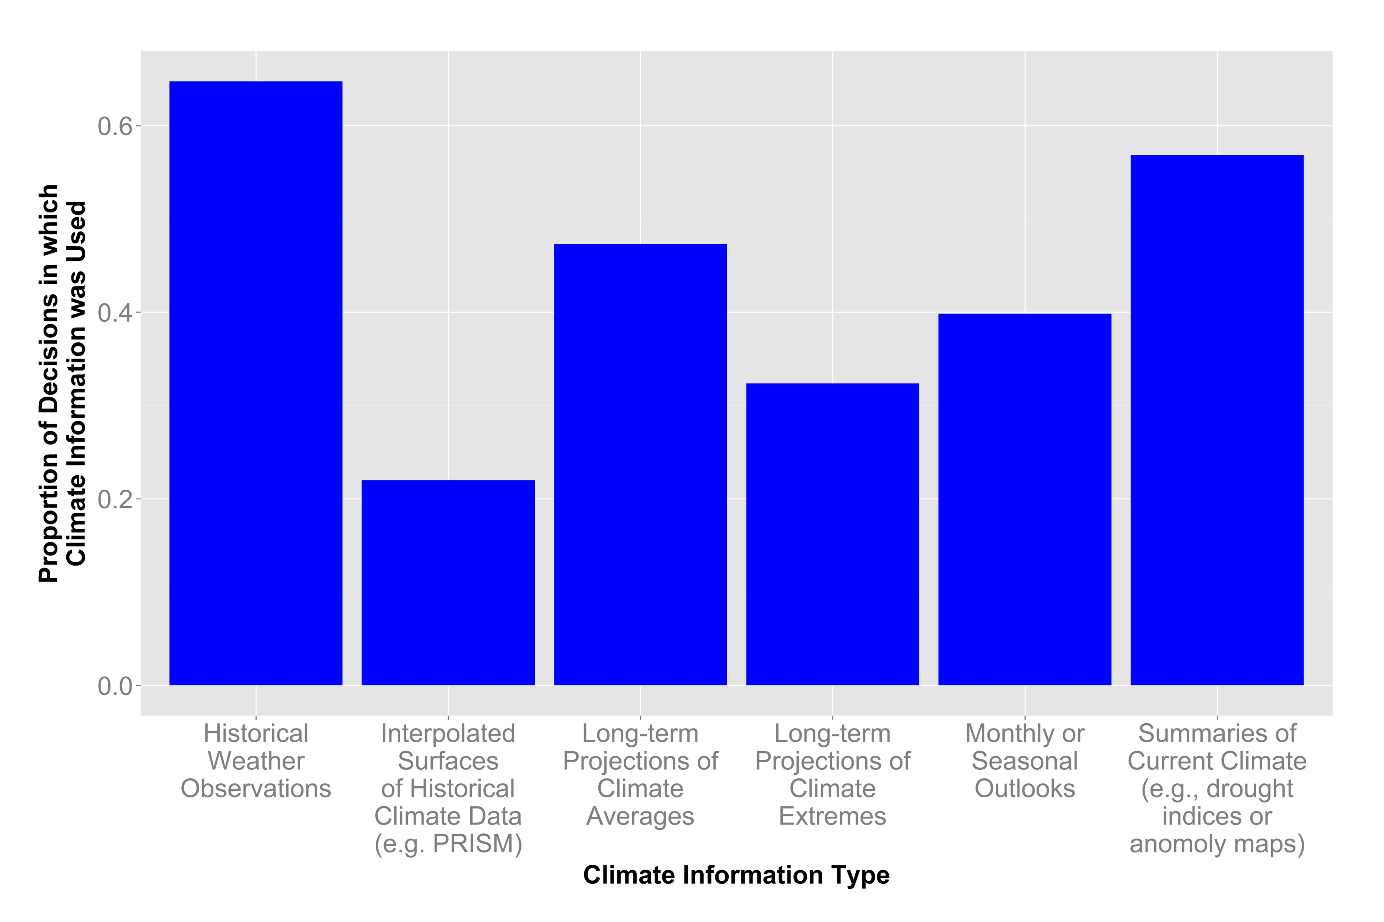
But use is variable….
Only about 0.5 of the projects report using any climate information

Slide 10
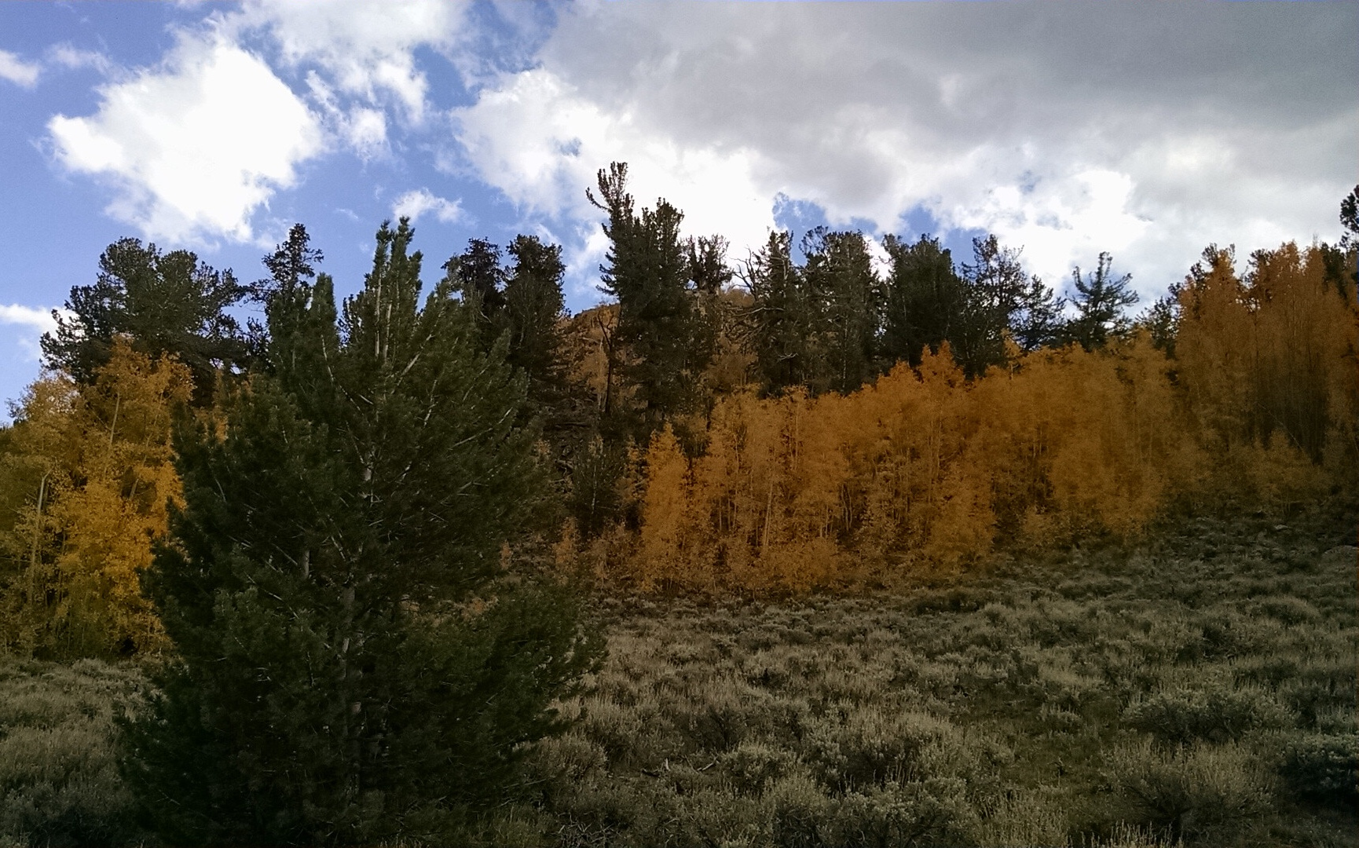
But use is variable….
Historic Climate Info:
Fire and fuels
Water management
Range management
Future Climate Info:
Water management
Restoration/Forest management
Wildlife management

Slide 11
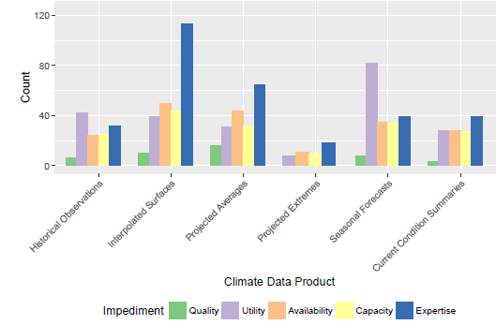
What prevents the use of climate information?

Slide 12
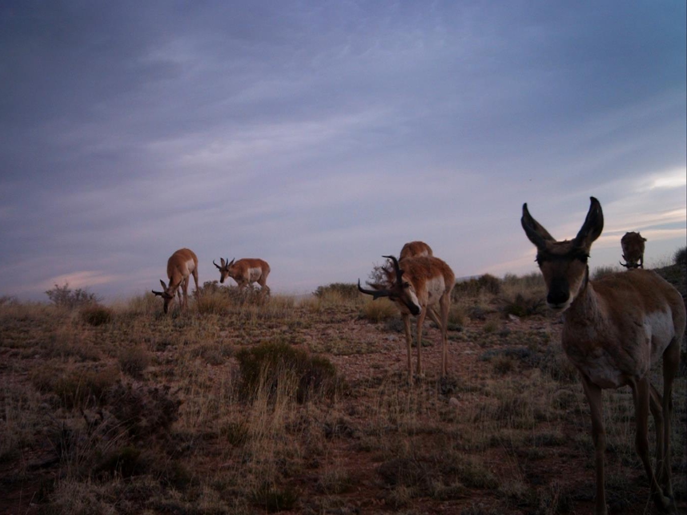
Looking forward: Collaboration and climate change

Slide 13
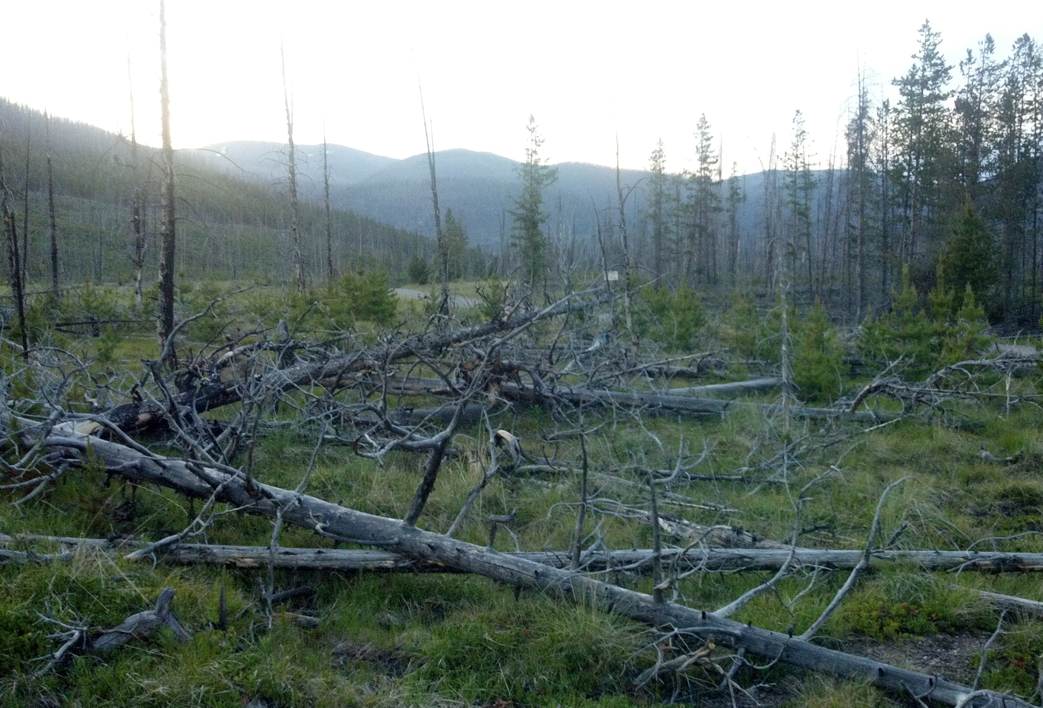
Demand is increasing
“The nation's forests and grasslands are at risk due to the effects of climate change and other major drivers of landscape change. But the Forest Service is already doing much to help ecosystems adapt. We can and will do more, but we cannot succeed alone.” -- Forest Service Chief Tom Tidwell
“Our shared vision begins with restoration. Restoration means managing forest lands first and foremost to protect our water resources, while making our forests more resilient to climate change.”
~ USDA Secretary Tom Vilsack

Slide 14
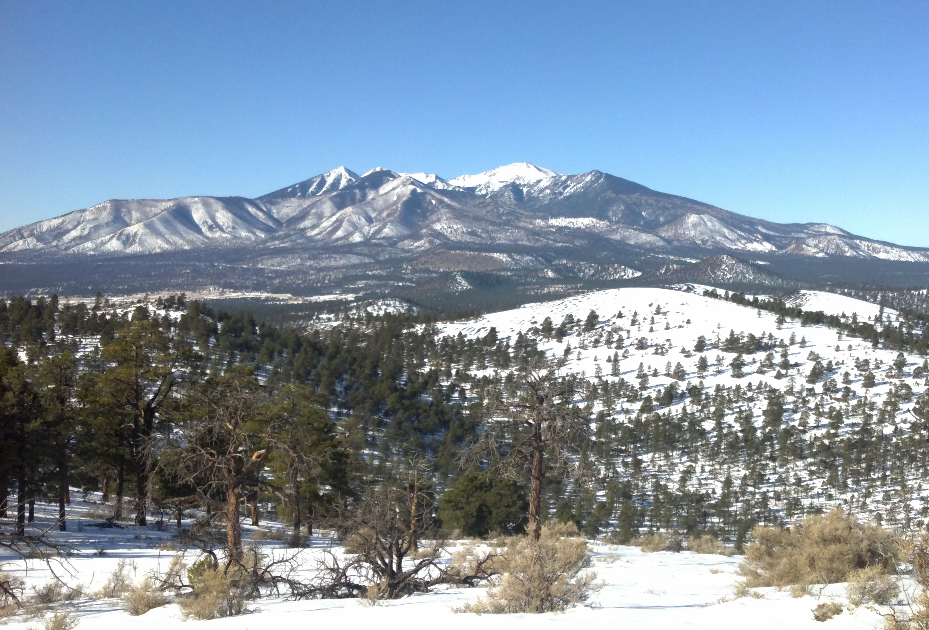
Overcoming limitations
Collaboratives provide access to a broader suite of expertise and capacity
Collaboratives provide context to ensure credibility ad utility
Collaboratives can alter the sociopolitical context for decision-making

Slide 15
Giving credit where it’s due…
The Southwest Climate Science Center
California, Desert, Great Basin, and Southern Rockies LCCs
John Muir Institute of the Environment
Consultative group participants
Survey beta-testers and respondents
The National Forest Foundation

Slide 16
