Slide 1

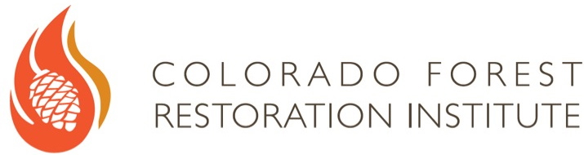

The Yin and Yang of Monitoring:
Lessons Learned From Development of Monitoring Programs on Federal and Private Lands
Brett Wolk
Colorado Forest Restoration Institute
Colorado State University
Brett.wolk@colostate.edu
Collaborative Restoration Workshop, Denver, CO, April 27th, 2016

Slide 2

Yin and Yang
Apparently opposite or contrary forces are actually complementary, interconnected, and interdependent in the natural world

Slide 3


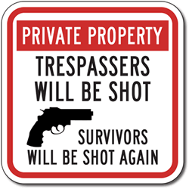
Are Monitoring Programs on Private and Federal Lands Diabolical Opposites, or Actually Complimentary?
Notes:
Two monitoring programs that span a large geography and diversity of management actions have recently been implemented in Colorado. The development, implementation, and assessment using monitoring data with the USFS Collaborative Forest Landscape Restoration Program and the Colorado Department of Natural Resources Wildfire Risk Reduction Grant Program will be compared and contrasted.

Slide 4
Collaborative Forest Landscape Restoration Program
Colorado Wildfire Risk Reduction Grant Program
Notes:
Two monitoring programs that span a large geography and diversity of management actions have recently been implemented in Colorado. The development, implementation, and assessment using monitoring data with the USFS Collaborative Forest Landscape Restoration Program and the Colorado Department of Natural Resources Wildfire Risk Reduction Grant Program will be compared and contrasted.

Slide 5

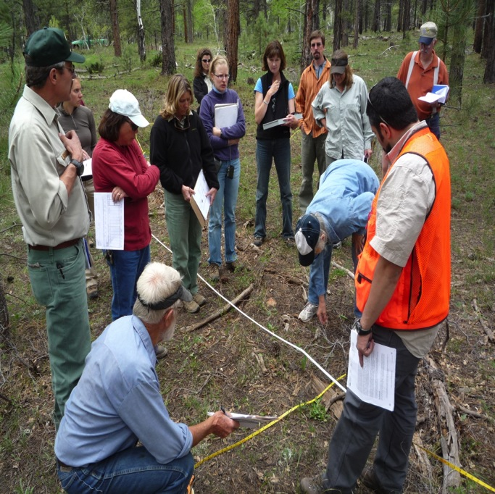
Types of Monitoring Programs
Independent 3rd Party
Collaborative “Group Hug”

Slide 6
Monitoring Examples
Federal Lands
Private Lands
CFLRP
Colorado Front Range Collaborative Forest Landscape Restoration Program
WRRG
Colorado Wildfire Risk Reduction Grant Program

Slide 7
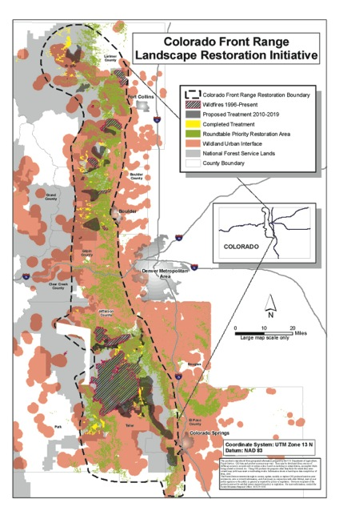
Collaborative Developed Monitoring
Front Range CFLRP
LOTS of science and input
  Complicated methods and lots of metrics to measure.
  After 5 years, struggling to answer basic question of are we achieving desired outcomes?

Slide 8
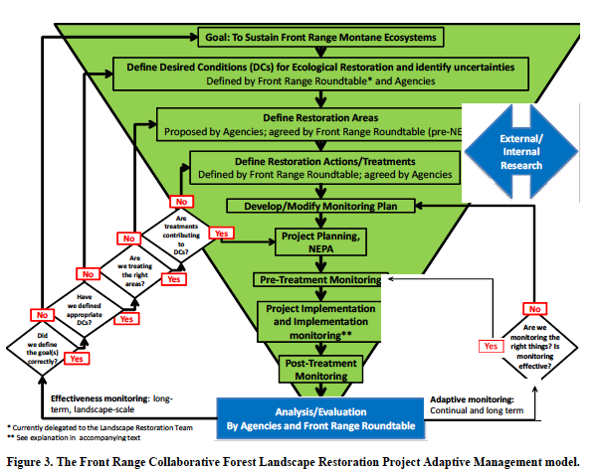
Complex Adaptive Management
FEDERAL CFLRP

Slide 9

Non-Federal: Wildfire Risk Reduction Grant Program
2013 Colorado State Assembly authorized $9.8 million from general funds for fire mitigation.
Fuels management on non-federal lands in Colorado.
Colorado Forest Restoration Institute contracted to determine program effectiveness.

Slide 10
Non-Federal 3rd Party Monitoring
Colorado Wildfire Risk Reduction Grant
Streamlined Monitoring
  Simple questions (Fuels focused).
  Straightforward results.
  Rapid feedback loops.
Little monitoring currently on non-federal lands.
Increases trust and information transfer.
  Build it and they will come!

Slide 11
Streamlined Monitoring Reports

Slide 12
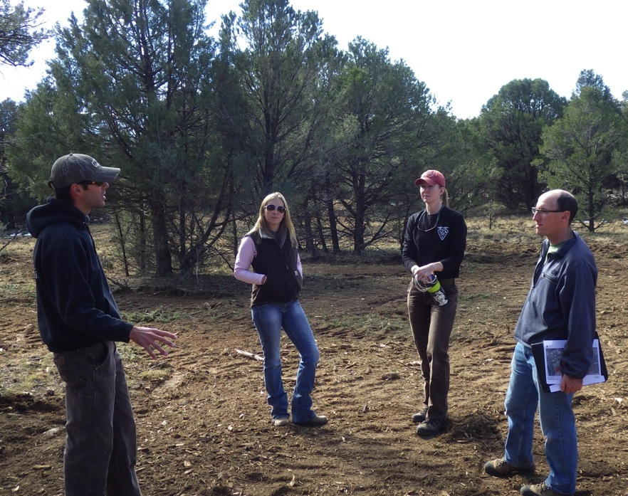
Streamlined Adaptive Management
NON-FEDERAL WRRG
Data > Talk with Managers >
Talk with Contractors > Done!

Slide 13
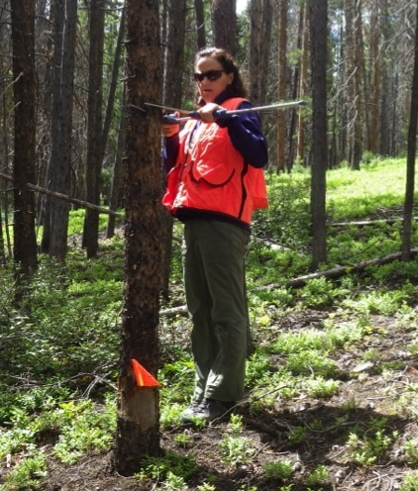
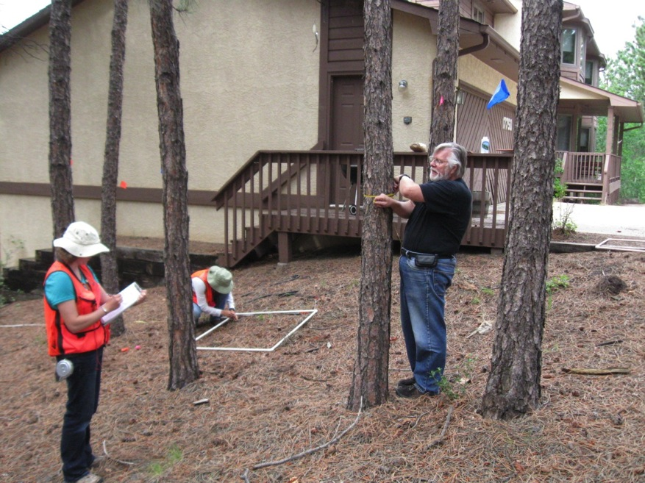
Non-Federal: Collaboration –
Monitoring Not Just CFRI Crews!
Notes:
CFRI is learning from grant recipients during monitoring process – not just one way 3rd party monitoring.

Slide 14
Monitoring Methods
SAME field based metrics
Tree Basal Area
Canopy Cover
Fuels abundance
Understory plant cover
Etc.
Radically DIFFERENT monitoring programs

Slide 15
National Cohesive Strategy
Work collaboratively among all stakeholders and across all landscapes, using best science, to make meaningful progress towards the three goals:
Landscape Resilience
Fire Adapted Communities
Safe and Effective Fire Response

Slide 16
Upper South Platte Partnership
10 organizations, Federal and Non-Federal (Front Range Roundtable members)
  Formed 2015
Best available science and monitoring central to Upper South Platte Partnership.
  Optimize treatment locations to leverage resources and maximize impact.

Slide 17

Complementary, Interconnected, and Interdependent
Upper South Platte Partnership – Cohesive Strategy
Non-Federal: Want more comprehensive monitoring (understory plants, wildlife, etc.) > CFRLP.
Federal: Want more streamlined monitoring and adaptive management > WRRG.
ALL want monitoring to increase trust.

Slide 18
Sources for Determining Success with the Upper South Platte Partnership
Don’t reinvent the wheel!
Colorado Front Range CFLRP documents
Rio Grande Watershed Fund Monitoring Plan
(outside ideas are good too!)

Slide 19
Sources for Determining Success with the Upper South Platte Partnership
OK to make mistakes, but make new ones.
Tom DeMeo

Slide 20
Upper South Platte Partnership Success Criteria

Slide 21
Upper South Platte Partnership Success Criteria
Method: Remote Sensing
Forest Canopy Cover
Species and Arrangement
Surface Fuels
Method: Remote Sensing

Slide 22
Upper South Platte Partnership Success Criteria
Science Based Targets.
Allowing For Innovation.
Finding Consensus and trust.
Tree Canopy Cover Goals
10% Min Average
Source: Professional Judgment
(no clearcuts)
30% Average
Source:
Local Science (Reference conditions)
40% Max Average
Source:
Local Science + Professional Judgment
(reduce crown fire)
Maximize Variability 0% - 100% within Stands

Slide 23
Monitoring = Learning
Everyone Benefits From Learning Across Boundaries
Keep it Simple!

Slide 24
Thanks!
Brett Wolk
Colorado Forest Restoration Institute
Colorado State University
Brett.wolk@colostate.edu
Collaborative Restoration Workshop,
Denver, CO, April 27th, 2016

Slide 25

Ecological Restoration
The process of assisting the recovery of an ecosystem that has been degraded, damaged, or destroyed.

Slide 26
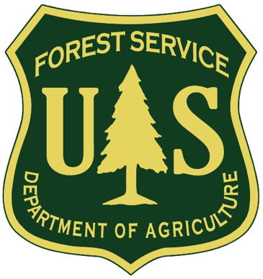
2012 USFS Planning Rule
Restoration. The process of assisting the recovery of an ecosystem that has been degraded, damaged, or destroyed. Ecological restoration focuses on reestablishing the composition, structure, pattern, and ecological processes necessary to facilitate terrestrial and aquatic ecosystems sustainability, resilience, and health under current and future conditions.
USDA. 2012. 36 CFR Part 219. National forest system land management planning. Fed. Regist. 77(68):21162–21276. http://www.gpo.gov/fdsys/pkg/FR-2012-04-09/html/2012-7502.htm

Slide 27
Sources for Determining Success with the Upper South Platte Partnership
Lots of CFLRP documents and sources – Don’t reinvent the wheel!
Landscape Resilience
CFLRP Monitoring Plan (2011)
Desired Conditions of a Restored Front Range (2014)
Upper Monument Creek Monitoring and Adaptive Management Report (2016)
Front Range Forest Reconstruction Network
Other literature and published reports
Professional Opinion.
Rio Grande Water Fund Monitoring Report (2015)

