Slide 1
Biomass in Arizona: Utilization and Market Opportunities
Bradley Worsley – President/CEO of Novo Power
Collaborative Restoration Workshop
4/27/16

Slide 2
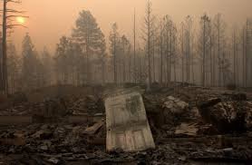
Undeniable need for Biomass mitigation in AZ
- Repairing the impact of the last 100 years of forest management policy
- Catastrophic fire has burned 25% of our National Forests in the last 15 years.
- We are in 14+ year drought
- We have the largest restoration project in the American West which includes four of our National Forests in Arizona (4FRI, 2.4 Million Acres).
- The problem…we have a Biomass Bottleneck!
Notes:
We have to remove all the wood – the bark, the limbs, the tips, the pine needles, the PCT. That is 50% of the fiber on a given acre.

Slide 3
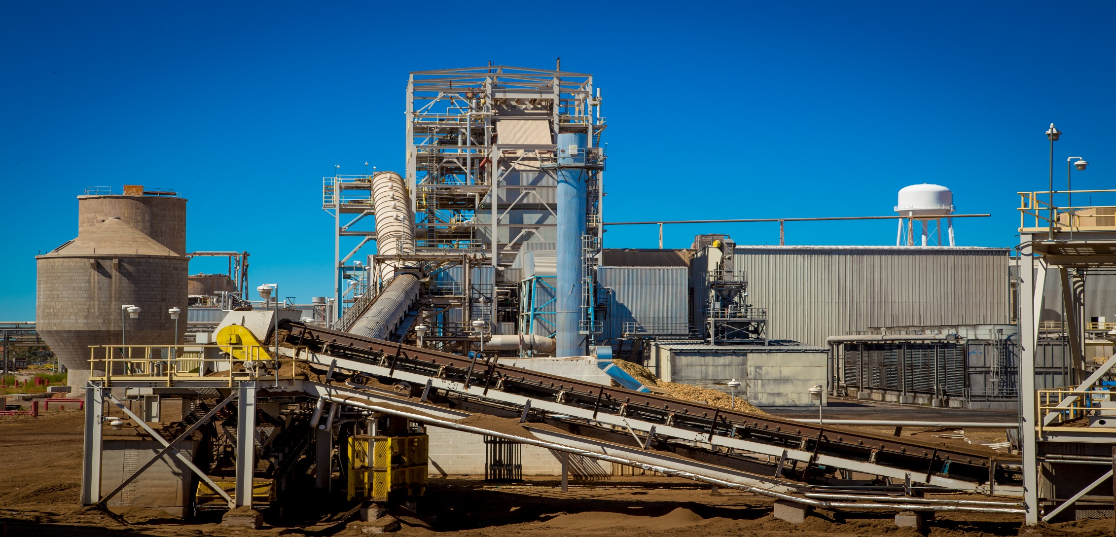
Novo Biopower
28MW B&W BFB Boiler
24x7 365 Baseload Power Source
PPA’s with SRP and APS
38 Direct Employees
>100 jobs Created indirectly
>$14M spent in local economy annually
>210k MW’s of Renewable power generated annually
>200k Bone Dry Ton of Biomass burned annually
>15k acres treated annually for Biomass removal
In 2015, our Capacity Factor to Budget was 100.3%
Notes:
Bubbling Fluidized Bed boiler from B&W – We burn raw chipped and ground biomass

Slide 4
Not all Electrons are created equal…
Impact of Biomass power vs others on local economy
Forest Health Restoration
Controlled burning savings >$1M annually to USFS
Fighting Catastrophic Wildfire cost of >$150M between Rodeo/Chedeski, Wallow, and San Juan fires
Watershed Impact
Augmentation of current watershed by 20%
Reservoir Protection
>$62M spent by Denver Water on erosion control, dredging, and treatment in protection of reservoirs, like CC Cragin, from 150k acres fire)
Local ranchers received >$2M of grassland restoration at no cost in 2014
Baseload vs Intermittent
Local Power Production
Emissions Benefit
Notes:
Carbon Neutrality – We are using carbon that is active in our atmosphere and is being release in catastrophic fire (25% of the largest standing ponderosa pine forest has burnt to the ground in the last 15 years) This is non-sequestered carbon.

Slide 5
What else can a Free Market Economy do with Biomass?

Slide 6
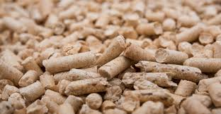
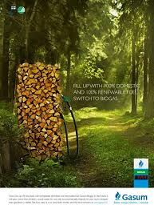
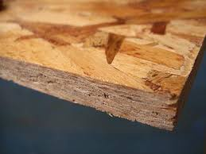
PELLETS
BIO-FUEL
OSB
SOILS
POWER
Market Maturity - Medium
Market Size – Saturated
Market Future – Uncertain
Market Location – Foreign
Subsidy - Needed
Capital Required – High
Biomass Usage – 100%
Market Maturity - Low
Market Size – Large
Market Future – Good
Market Location – Local
Subsidy - Helpful
Capital Required – Very High
Biomass Usage – 50-75%
Market Maturity - High
Market Size – Large
Market Future – Good
Market Location – Local
Subsidy - None
Capital Required – Very High
Biomass Usage – 75% +
Market Maturity - High
Market Size – Medium
Market Future – Stable
Market Location – Local
Subsidy - None
Capital Required – Low
Biomass Usage – 100%
Market Maturity - High
Market Size – Large
Market Future – Uncertain
Market Location – Local
Subsidy - Helpful
Capital Required – High
Biomass Usage – 100%
Notes:
Pellets:
- Foreign Markets are saturated and by the time demand passes supply, the EU subsidies are at risk. The freight possibility and cost from AZ are prohibitive.
- Local use in power is very unlikely given the below discussion
Concerns from one of largest utilities in AZ:
- High alkali content and ash content of biomass material can result in fouling/slagging of the boiler
- Can cause operational issues to Selective Catalytic Reduction systems (SCRs).
- Plant modifications would be needed, mainly due to the hardness of the pellets, which requires additional pulverizes and fuel handling systems.
- A change in fuel and associated equipment could be a major modification, triggering NSR and/or PSD. If PSD is triggered, it would require a BACT top- down analysis which could result in further controls at the plants.
Bio-Fuel:
Notes from meeting with $2.75B Market Cap Company:
- Technology takes woody biomass and makes Ethanol.
- One facility currently doing this.
- A plant will manufacture 25 million gallons a year and require ~300,000 BDT of raw feedstock
- It is likely that we will get a lower yield on our mixed fuel as they use a cleaner white chip for their current facility.
- A new facility would cost ~$250 million and require 24 months to build
- No offtake agreement, spot market pricing.
OSB:
Benefits
Use all wood down to a 3” tip.
Non usable residue of only 10% of delivered raw material.
On site power generation and process steam can use 10% residue and remaining logging slash.
$30/Gt price point for raw material.
High margin business.
Problem
Capital Expense of $300M which requires a minimum of 10 year guarantee, preferably 20 years.
Off take agreement needed.
High skill workforce required

Slide 7
Questions?

