Slide 1
Branching Out: Engaging Forest Stakeholders through Collaborative Design
Created by: Brady Bender, Han Ding, & Michael Reiterman
Advisor: Heather Kulp
Fall 2016

Slide 2
How to use this tool
Begin by putting the Powerpoint in “Slide Show” mode.
Green boxes containing text are buttons. Try it out by clicking on the box below.
Forward arrow buttons ( ) at the bottom of the screen will advance you to the next relevant slide. If there is not a forward arrow button, you should use the backward arrow or home button.
Backward arrow buttons ( ) at the bottom of the screen will return you to the last slide you viewed.
Any additional buttons will clearly note their slide destination.
The home button ( ) will return you to the upcoming Home slide.
This tool is intended for use as a decision tree. Slides are not meant to be viewed consecutively. Please click through the tool rather than using your keyboard arrow buttons.
Click the forward arrow button now.
Text

Slide 3
Background
Fall 2016 Harvard Negotiation and Mediation Program (“HNMCP”) students created this tool at the request of the National Forest Foundation (“NFF”) to address the felt problem of stakeholder disengagement from forest collaboration.
Key questions to address:
Why do stakeholders engage in collaboratives?
Why do stakeholders disengage from collaboratives?
What structures and strategies can collaboratives use to promote engagement?

Slide 4
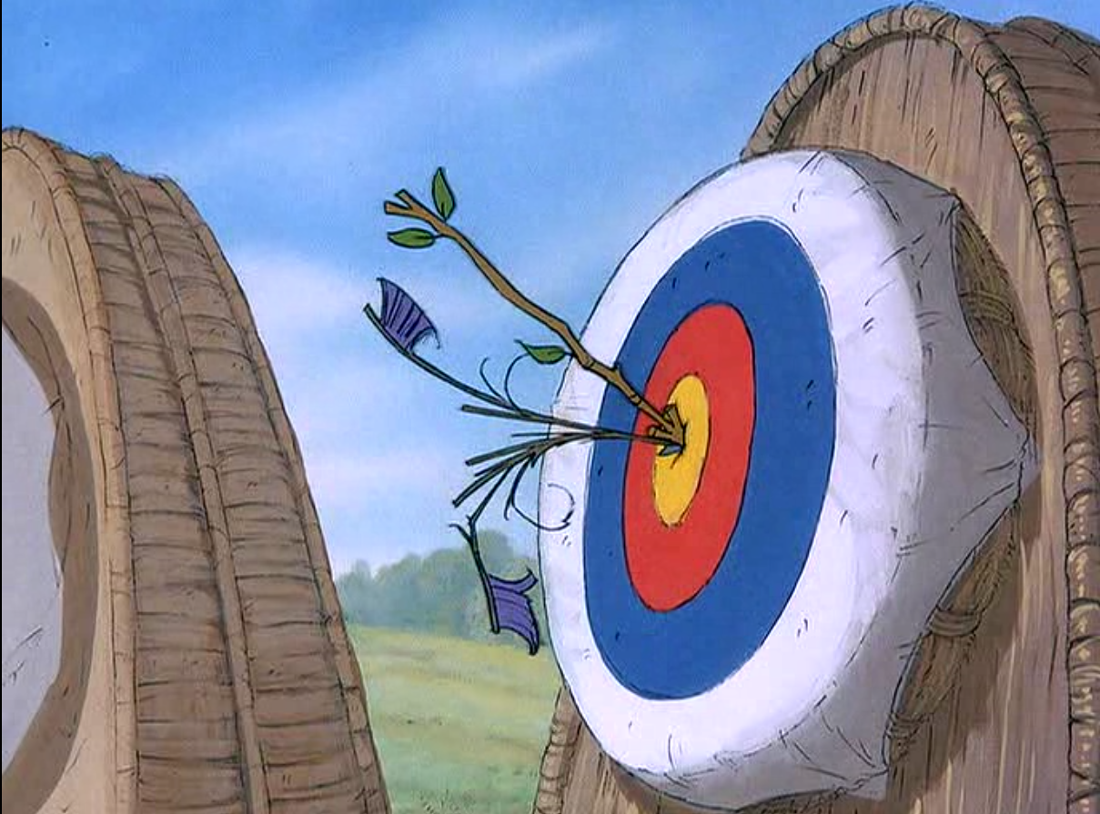
Purpose
To aid communities in designing a collaborative process that enables ongoing, effective stakeholder engagement.

Slide 5
Methodology
Our findings are supported by:
Findings
5 focus groups
2 collaborative meeting observations
27 stakeholder interviews
Review of collaborative history and materials
Academic research

Slide 6
Findings: Why Stakeholders Engage
Stakeholders engage in collaboratives…
to more effectively achieve their goals;
to learn and share information; and/or
to build relationships.

Slide 7
Findings: Why Stakeholders Disengage
Stakeholders disengage when a collaborative…
does not manage conflict well;
does not make participants feel important to the collaborative process;
demands more time than they can commit;
lacks strong relationships with government agencies; and/or
is perceived to be ineffective in meeting goals.

Slide 8
General Recommendations
Keep working groups as small as possible while meeting core interests.
Invest in integrating new participants into the collaborative process.
Engage in ongoing monitoring and adaptation of the collaborative process.
Establish a strong foundational relationship with the Forest Service.

Slide 9
Situation-Specific Recommendations
First design the collaborative process to address the collaborative’s work goal.
Next, tailor the collaborative process to address barriers to stakeholder engagement.
When designing a collaborative process:
Ensure that collaborative design meets legal requirements.
Establish clear communication guidelines within and between collaboratives.
Clarify reporting mechanisms and decision-making authority across collaboratives.

Slide 10
Home
About this tool
Groups can modify or combine elements as desired.
Groups can use elements in an individual meeting or over the course of a collaborative process.
Groups should use this tool as a starting point for discussion. The elements identified are suggestions, not prescriptions and, by reviewing this tool together, groups may come up with their own elements or ideas about how to address collaborative goals and barriers to engagement.

Slide 11
Choosing a Decision-Making Factor
Groups should make decisions based on their goal if:
They are starting a new collaboratives.
They are generally having problems meeting community needs.
They are not sure what’s stopping stakeholders from engaging.
Work Goal
Groups should make decisions based on their barriers to engagement if:
They know what specifically is causing stakeholder dissatisfaction. (E.g., time management, feeling of unimportance, etc.)
They have identified specific challenges interfering with collaborative effectiveness. (E.g., Forest Service relationship, participant conflict, etc.)
They have already taken into account the group goal.
Barriers to Engagement

Slide 12
Goal-Based Decisions: Identifying Work Goal
Goals can be identified based on:
Outside request
Previous collaborative vision
Community interest
Conveners and groups should further define their work goal by asking the following questions:
What would success look like?
What work must be done to achieve success?
How will we contribute to ensuring success?

Slide 13
Goal-Based Decisions: What is the work goal of the group?
Community Engagement
Making Recommendations
Supporting Project Implementation
Other

Slide 14
Supporting Project Implementation
Mini-Collaboratives
Subcommittees
Local Working Groups
Back to All Goals

Slide 15
Community Engagement
Liaison Outreach
Public Forum
Technology-based Collaboration
Meeting in a Box
Back to All Goals

Slide 16
Making Recommendations
Mini-Collaboratives
Independent Advisors
Local Working Groups
Leadership Committee
Subcommittees
Back to All Goals

Slide 17
Barrier-Based Decisions: Identifying Barriers
Barriers can be identified based on:
Monitoring and evaluation
Historical knowledge
Reflection and discussion
Groups should consider the following questions to help identify barriers:
Which stakeholders are not adequately represented right now? What might prevent them from participating?
Among involved stakeholders, what might stop them from participating more effectively?

Slide 18
Barrier-Based Decisions: What barrier to engagement will the group confront?
Managing stakeholder conflict
Ensuring stakeholders feel important to the process
Ensuring stakeholders have time to participate
Building relationships with government agencies
Improving perceptions of process effectiveness
Other

Slide 19
Conflict Management
Facilitated Negotiation
Caucusing
Participant Coaching
Mentoring
Team-building Activities
Back to All Barriers

Slide 20
Stakeholders’ Sense of Importance
Participant Coaching
Caucusing
Mentoring
Subcommittees
Team-building Activities
Back to All Barriers

Slide 21
Time Management
Independent Advisors
Local Working Groups
Leadership Committee
Technology-based Collaboration
Subcommittees
Back to All Barriers

Slide 22
Forest Service Relationships
Independent
Advisors
Participant Coaching
Leadership Committee
Liaison Outreach
Back to All Barriers

Slide 23
Perceptions of Effectiveness
Independent Advisors
Local Working Groups
Leadership Committee
Mini-Collaboratives
Subcommittees
Team-building Activities
Back to All Barriers

Slide 24
Caucusing
What is it? Members who share a common interest convene separately from the rest of the collaborative in order to discuss an issue or create a proposal for the larger collaborative.

Slide 25
Caucusing
Why use it?
Enables groups to communicate and clarify their interests apart from the entire collaborative.
Allows ideas and concerns to be voiced in a smaller settings and then reported back to collaborative, potentially increasing efficiency or time management.
When? Collaboratives can use caucusing when…
They want to test proposals with various representatives before submitting to the larger group.
Interest groups in a larger collaborative are in conflict with one another and caucusing may allow them to address each other’s concerns.

Slide 26
Caucusing
How?
Consider involving even stakeholders who might not otherwise participate in the collaborative process.
Identify an appropriate level of generality. Caucusing may involve a broad interest group or smaller interest groups, like members of a particular environmental organization.
For more information, view outside materials.
All Goals
All Barriers

Slide 27
Facilitated Negotiation
What is it? Facilitated negotiation enlists a neutral third party to moderate conversations and resolve conflicts between stakeholders.

Slide 28
Facilitated Negotiation
Why use it?
Improves relationships between stakeholders
Reduces unproductive arguments
Helps resolve interpersonal conflicts that may prevent agreement on substantive topics
When? Collaboratives can use facilitated negotiation when…
An interpersonal conflict arises between two or more members (whether in group meetings, over email chains, or on traditional and social media).

Slide 29
Facilitated Negotiation
How?
Select a neutral third party to reach out to the members involved in conflict. This party may be facilitator or another collaborative member who both parties perceive as neutral in the conflict.
Listen to stakeholders separately before bringing them together to discuss their differences.
Empathize with all sides but evaluate none.
Remind them and the larger group of their group norms regarding civil behavior.
For more information, view outside materials.
All Goals
All Barriers

Slide 30
Independent Advisors
What is it? An independent group of experts advises, trains, or otherwise supports stakeholders in a collaborative.

Slide 31
Independent Advisors
Why use it?
Lends expertise and informs the collaborative of best practices in collaboration
Counsels collaborative on process and content
When? Collaboratives can use enlist independent advisors when…
They want outside expertise in establishing collaborative procedures.
They want to increase collaborative efficiency and effectiveness by learning from best practices.

Slide 32
Independent Advisors
How?
Identify only a single advisor if this meets the collaborative’s needs.
Recruit independent advisors who study collaboration generally or specialize in the collaborative’s focus area.
Consider partnering with another collaborative to appoint a joint group of advisors.
For more information, view outside materials.
All Goals
All Barriers

Slide 33
Leadership Committee
What is it? A leadership committee undertakes administrative or management activities, such as financing, agenda-setting, delegation, and final decision-making. Various collaboratives may refer to it as a steering committee, an executive committee, an organizing committee, or a board of directors.

Slide 34
Leadership Committee
Why use it?
Reduces the workload on individual stakeholders by centralizing administrative tasks
Streamlines a collaborative’s decision-making
Creates sense of continuity when a process involves multiple small groups that convene and disband as each meets its goals
When? Collaboratives can use a leadership committee when…
Administrative tasks distract a collaborative from getting more substantive work done.
A process requires an overarching structure to coordinate multiple subgroups, perform oversight, and communicate with the Forest Service.

Slide 35
Leadership Committee
How?
Consider how to select leaders. Groups may elect leaders; leaders may volunteer; or a convener or facilitator may identify them.
Ensure that the leadership committee is representative of the broader stakeholder interests to avoid causing other members of the collaborative to feel left out.
Establish clear procedures for communication between the leadership committee and the larger collaborative.
Clearly define the scope of the leadership committee’s decision-making authority.
For more information, view outside materials.
All Goals
All Barriers

Slide 36
Liaison Outreach
What is it? A collaborative sends a representative n to participate in an external group’s meetings and present collaborative work to that group. The representative then reports back the external group’s news and feedback to her collaborative.

Slide 37
Liaison Outreach
Why use it?
Allows more members of a stakeholder group to provide input to collaborative work, including those unable or reluctant to join in the ongoing collaborative process.
Helps build a collaborative’s credibility in a community by keeping others informed about the collaborative’s efforts.
When? Collaboratives can use liaison outreach when…
They want to solicit the expertise of stakeholders who cannot be adequately represented by a small number of representatives.
They want to persuade external stakeholder groups to support or implement the collaborative’s recommendations.
They want to keep stakeholder groups supporting forest stewardship on the same page.

Slide 38
Liaison Outreach
How?
Host a liaison training session to promote quality communication between the liaison, the collaborative, and the external group.
Pre-schedule liaison report-outs to the whole collaborative to ensure active communication.
Encourage strong relationships between liaisons and external stakeholder groups by selecting liaisons who have pre-existing credibility with the external group or asking the liaison to connect with that group’s leadership before beginning work.
For more information, view outside materials.
All Goals
All Barriers

Slide 39
Local Working Group
What is it? Local working groups are small groups organized around participants’ proximity to one another within a geographical region.

Slide 40
Local Working Group
Why use it?
Provides a platform for local interests within a larger regional collaborative group.
Enables locally based participants to meet and work together more easily.
When? Collaboratives can use local working groups when…
They want to implement, monitor, or manage a project with a local focus.
Collaborative members find it convenient to meet because of their proximity to one another, whether working on a local or non-local project.

Slide 41
Local Working Group
How?
Seek regional and national input on whether a goal is appropriate for local work, as non-local interests may not be immediately obvious.
Establish clear reporting mechanisms to ensure transparency, legitimacy, and accountability to those outside of the local working group.
For more information, view outside materials.
All Goals
All Barriers

Slide 42
Meeting in a Box
What is it? A meeting in a box provides individuals outside a collaborative with materials and information that allows them to host their own meetings or information-gathering sessions with other interested stakeholders outside the collaborative. These individuals then return the completed materials to the collaborative after use.

Slide 43
Meeting in a Box
Why use it?
Enables citizen groups to meet at a convenient time and place to provide input into collaborative work
Lowers barriers to entry for participation
Promotes greater engagement with the community
When? Collaboratives can use a meeting in a box when…
They want to gather initial ideas about what is important to a community.
They want to solicit feedback on a project.
They want engage more members of the community.

Slide 44
Meeting in a Box
How?
Create a “Frequently Asked Questions” document or resources to aid citizens in using it.
Consider posting the meeting-in-a-box kit on the Internet or distributing hard copies at convenient locations.
In the kit, include directions for individuals interested in hosting or facilitating a meeting, discussion prompts, participant response form, feedback surveys, and instructions on how to record and return responses.
For more information, view outside materials.
All Goals
All Barriers

Slide 45
Mentoring
What is it? Mentoring assigns a more experienced member to share insight and experience with a less experienced member.
Old
Old
New
New

Slide 46
Mentoring
Why use it?
Integrates new participants into the collaborative
Builds working relationships between participants
Increases group effectiveness by helping new participants learn about how they can contribute most valuably
When? Collaboratives can use mentoring when…
They experience frequent turnover in stakeholder representation.
Stakeholders quickly disengage from the collaborative process.
New stakeholders are reticent or reluctant to fully participate in the collaborative.
Old
Old
New
New

Slide 47
Mentoring
How?
Assign mentoring pairs based on group affinity, personal connection, or shared interests.
Provide initial training for mentors regarding best practices and topics that mentors should discuss with mentees.
Check in on the status of mentoring relationships regularly to refresh the assignment of mentors to better match newcomers.
Old
Old
New
New
For more information, view outside materials.
All Goals
All Barriers

Slide 48
Mini-Collaborative
What is it? Small groups organized to include one or two representatives from each of the broad types of stakeholders involved.

Slide 49
Mini-Collaborative
Why use it?
Retains larger collaborative’s diversity of viewpoints through representative sampling
Enables nimbler decision-making that reduces time-management problems
Encourages participation from members who do not or cannot engage in larger group settings
When? Collaboratives can split into mini-collaboratives when…
They want to tackle isolated components of a larger project.
A task or project does not require the entire group to reach consensus or agreement.

Slide 50
Mini-Collaborative
How?
Ensure that the mini-collaborative is representative of the larger group.
Be thoughtful about how to classify stakeholder types (e.g., environmentalists or industry representatives) and who belongs to each type.
For more information, view outside materials.
All Goals
All Barriers

Slide 51
Participant Coaching
What is it? A facilitator or neutral party meets with an individual member between meetings to advise them on group procedures, norms, and values.

Slide 52
Participant Coaching
Why use it?
Educates individual members on group procedure and behavioral norms, and productive participation
Addresses individual concerns that may not be relevant for whole-group discussion
When? Collaboratives can use participant coaching when…
An individual member has a concern not relevant to the collaborative group as a whole
An individual member has difficulty participating effectively in the group.
An individual member misunderstands or acts contrary to the group’s norms.
Coach
Coach

Slide 53
Participant Coaching
How?
A facilitator or neutral party discreetly reaches out to an individual member and suggests a coaching session between collaborative meetings.
Over the course of one or more coaching sessions, the facilitator or neutral party discusses the individual member’s concerns and models productive participation.
Coaching can also take place through informal conversations.
Coach
Coach
For more information, view outside materials.
All Goals
All Barriers

Slide 54
Public Forum
What is it? A public forum is a meeting where any member of the public may attend, hear information about a proposal, and voice their opinion on an issue.

Slide 55
Public Forum
Why use it?
Engages a large number of stakeholders in setting goals, establishing procedures, or vetting collaborative group proposals
Reduces barriers to entry for community members who wish to contribute to the process because these events are generally limited in duration
When? Collaboratives can use a public forum when…
They want to gather information from the public efficiently.
They want to involve members of the public who are not yet involved directly with the collaborative process.

Slide 56
Public Forum
How?
Enlist a facilitator or train members to run the forum.
Brainstorm and prepare for possible issues or conflicts that may arise.
Identify methods for the public to carry over their engagement with the collaborative after the public forum ends.
For more information, view outside materials.
All Goals
All Barriers

Slide 57
Subcommittee
What is it? A subcommittee is a subdivision of a larger collaborative with specialized areas of interest or expertise.

Slide 58
Subcommittee
Why use it?
Creates smaller groups that enable stakeholders to work more efficiently and effectively
Focuses stakeholders’ expertise and effort on a particular collaborative goal
When? Collaboratives can use a subcommittee when…
The larger group is unnecessary to achieve a task or goal.
A particular task or project requires specialized expertise or working closely with outside experts.

Slide 59
Subcommittee
How?
Recruit members with an interest in the question, task, or area to be addressed and requisite time and expertise. Consider including stakeholders who are not involved in the collaborative process.
Identify a leader or facilitator to help the subcommittee establish and observe group norms and processes.
Designate a point of contact from the subcommittee to the larger collaborative or leadership group.
For more information, view outside materials.
All Goals
All Barriers

Slide 60
Team-building Activities
What is it? Formal or informal outings meant to forge personal relationships between the collaborative’s members.

Slide 61
Team-building Activities
Why use it?
Encourages connections among collaborative members that can improve working relationships
Fosters relationships that promote stakeholder engagement
When? Collaboratives can use team-building activities when…
They want to “break the ice” when first forming a collaborative.
They want to promote or maintain relationships between collaborative members.

Slide 62
Team-building Activities
How?
Team-building activities can include drinks at a pub, day-long outings to the areas affected by the collaborative group’s work, or weekend retreats, among other activities.
Team-building activities need not include all members of the collaborative. Instead, schedule activities frequently and encourage members to participate as they are able.
For more information, view outside materials.
All Goals
All Barriers

Slide 63
Technology-based Collaboration
What is it? Technology-based collaboration leverages digital tools and resources. Online, this includes teleconferencing, video chats, email, or webinars. In-person, meetings may employ audience-participation devices, such as clickers to anonymize voting.

Slide 64
Technology-based Collaboration
Why use it?
Reduces barriers to entry for collaborative participants like time and cost of travel.
Enables a larger number of people to participate in the collaborative process.
Equips the collaborative group with tools to track conversations, anonymize voting, and provide online spaces for individuals to discuss items one-on-one in parallel to the larger meeting.
When? Collaboratives can use technology-based collaboration when…
Distance discourages stakeholder attendance.
Large numbers of stakeholders want to participate in a collaborative process.
They want to broadcast information tothe public at large.

Slide 65
Technology-based Collaboration
How?
Use technology most accessible and familiar to the intended users in order to reach a broad audience.
Conduct a trial run of individuals’ comfort with technology during an in-person meeting to ease transition to subsequent tech-based collaboration.
Congregate small local groups of participants to meet in the same physical location, where they confer with each other while communicating with others online.
For more information, view outside materials.
All Goals
All Barriers

Slide 66
Other Goal or Barrier?
This tool accounts for the most common collaborative goals and barriers to engagement.
To address another goal or barrier, you can:
View a list of all elements included in this tool.
Refer to suggested outside materials and resources.
All Goals
All Barriers

Slide 67
All Elements
Caucusing
Facilitated Negotiation
Independent Advisors
Leadership Committees
Liaison
Outreach
Local Working Groups
Meeting
in a Box
Mentoring
Mini-Collaboratives
Participant Coaching
Public
Fora
Subcommittees
Team-building Activities
Technology-based Collaboration
Other
All Goals
All Barriers

Slide 68
Outside Materials and Resources
Public Participation Toolkit, from The Public Participation Handbook by Jim Creighton, p. 85–137. Available online.
Public Participation Toolbox, from the International Association for Public Participation. Available online.
Effective Engagement Toolkit, from the Department of Environment and Primary Industries, The State of Victoria. Available online.
“Collaborative Designs for Solving Shared Problems” and “Collaborative Designs for Resolving Conflicts,” from Collaborating: Finding Common Ground for Multiparty Problems, by Barbara Gray. Available in stores.
All Goals
All Barriers

Slide 69
Success!
Now click on the arrow button at the bottom of the slide to return to the previous slide.

