Slide 1
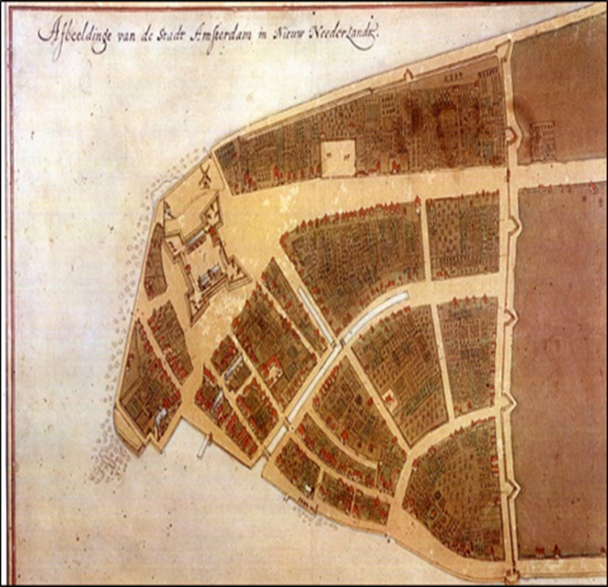
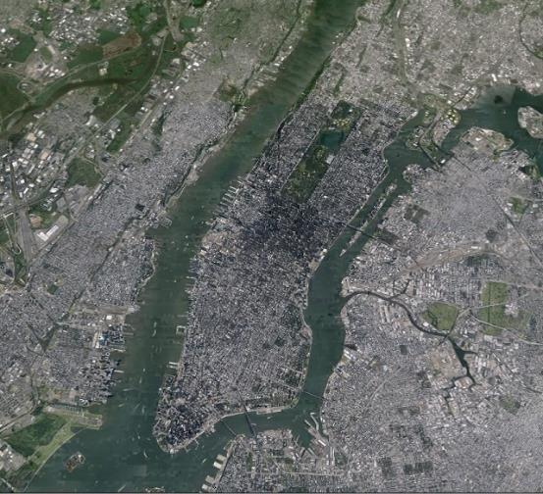
Landscape Conservation Design:
Conserving Sustainable Landscapes in a Time of Rapid Change
The Castello Plan (1660)
Jacques Cortelyou (ca 1625 - 1693)
Google Maps (2014)
Rob Campellone, USFWS
Landscape Conservation Design
Policy Advisor
Collaborative Restoration Workshop 2016

Slide 2
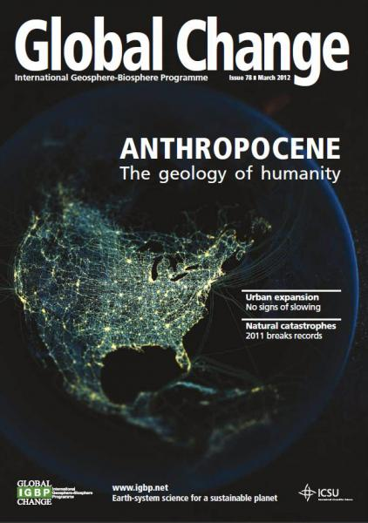

Slide 3
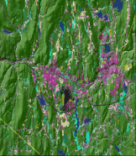
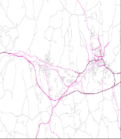
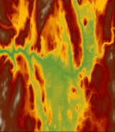
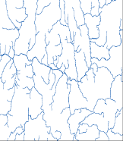
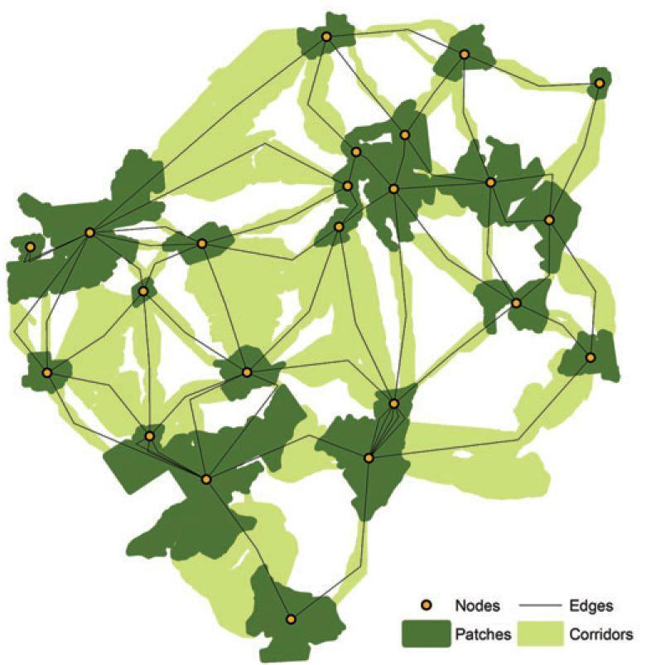
National Policy: “…plan for connectivity…”
Strategies 1-4:
Identify
Conserve
Protect
Restore….
…an ecologically-connected network of lands and waters
Source: NALCC Designing Sustainable Landscapes

Slide 4
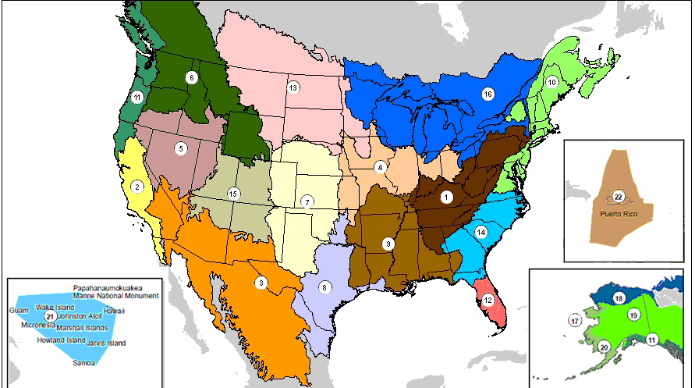
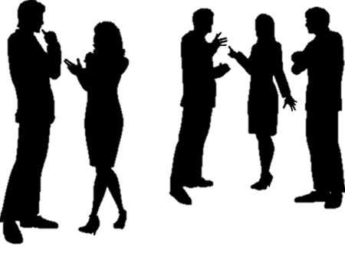
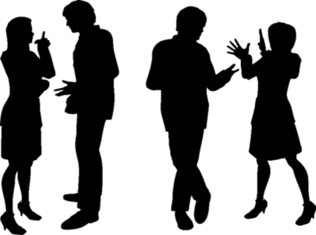
Addressing Impacts of Climate Change
DOI Policy:
“FWS…develop resilient landscape designs…”
“…work together… to develop strategies for understanding and responding to climate change…”
– SO 3289 (2009)

Slide 5
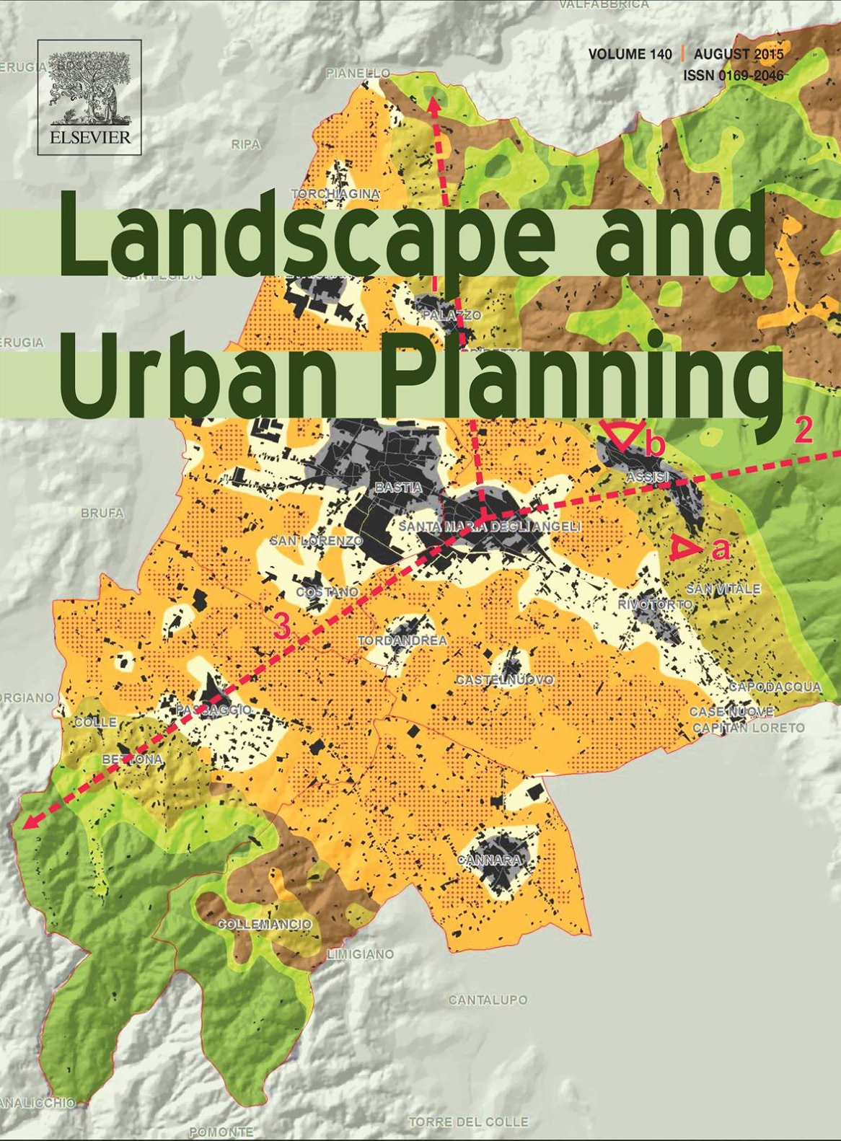
LCD and the iCASS Platform: An Adaptation Pathway to Transformation (in preparation)
Rob Campellone (USFWS)
Tina Chouinard (USFWS-Migratory Birds)
Nick Fisichelli (NPS-Climate Change Program)
John Gallo (Conservation Biology Institute)
Joseph Lujan (USFWS-NWRS)
Ron McCormick (BLM)
Tom Miewald (North Pacific LCC)
Brent Murry (Caribbean LCC)
D. John Pierce (WA Dept. of Fish and Wildlife)

Slide 6
Policy Summary
Purpose: Safeguard socio-ecological systems during a time of change
Purpose: Facilitate social learning and develop a coordinated response
People: Convene landscape stakeholders (multi-jurisdiction/-sector)
Process: Use spatial and scenario planning techniques
Products: Landscape-scale, science-based, conservation & development
Ecologically-connected networks of lands and waters (spatial design)
Adaptation strategies: coordinated response to change (strategy design)

Slide 7
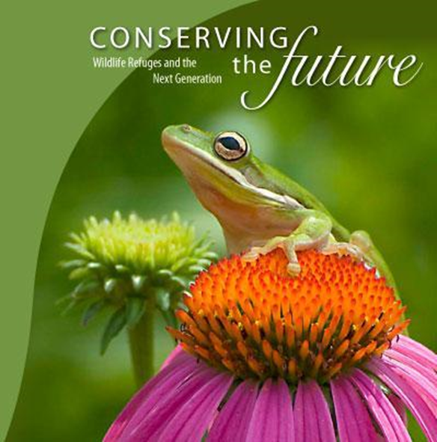
Why Landscape Conservation Design?
Purpose
(Intention)
Biodiversity
Ecosystem Services
Resilience
Sustainability

Slide 8
What is Landscape Conservation Design?
People
(Inclusive)
Process
(Interdisciplinary)
Products
(Information)
Purpose
(Integration)
Landscape stakeholders
Multi-jurisdictions
Multi-sectors
Convening
Assessing
Prototyping
Strategizing
Spatially Explicit Models
Data
Strategy Agreement
Coordinated Implementation
Collective Impact
Co-governance

Slide 9
Landscape Conservation Design: A Definition
People
(Inclusive)
Process
(Interdisciplinary)
Products
(Information)
Purpose
(Integration)
(People) LCD is a stakeholder-driven participatory process that integrates societal values and multi-jurisdiction/-sector interests with…
(Processes) …the best available interdisciplinary science to assess spatial and temporal patterns, vulnerabilities, and opportunities;
(Products) …to develop spatially-explicit products and…
(Action) …and multi-objective adaptation strategies that…
(Purpose) …reduce vulnerability to biodiversity and ecosystem services, maintain ecosystem structure and function, and increase the resilience and sustainability of social-ecological systems for future generations.

Slide 10
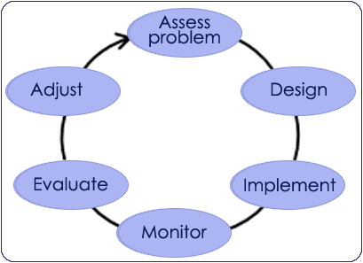
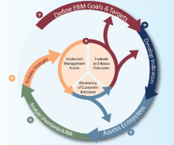
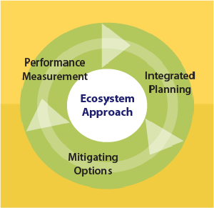
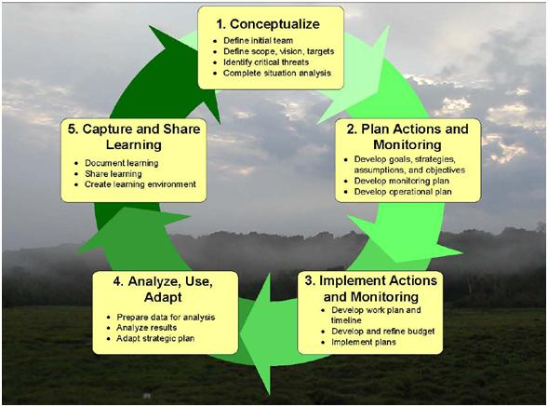
How do you build a landscape conservation design?
Tool: the iCASS Platform
Convene Landscape Stakeholders
DOI
Implement Monitor Revise
DOC
USDA
i = Innovation
Strategy Design
Assess Landscape Conditions
DOT
Adaptive Management
Spatial Design
NGO

Slide 11
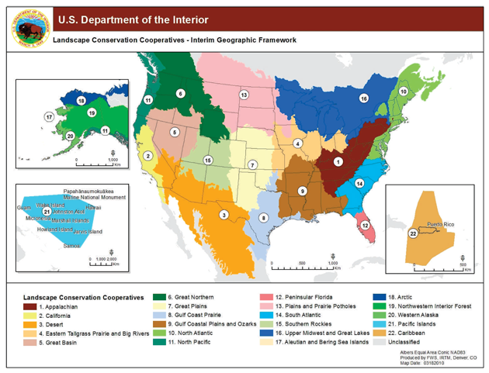
iCASS Platform:
Implement Monitor Revise
Convene Landscape Stakeholders
i = Inclusive
Strategy Design
Assess Landscape Conditions
Spatially Design

Slide 12
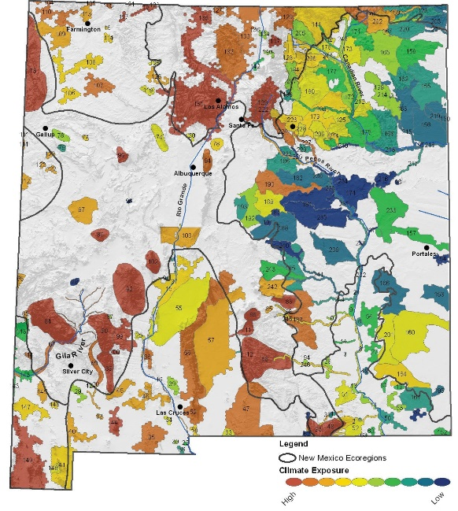
iCASS Platform:
Implement Monitor Revise
Convene Landscape Stakeholders
i = Interdisciplinary
Strategy Design
Assess Landscape Conditions
Spatially Design

Slide 13
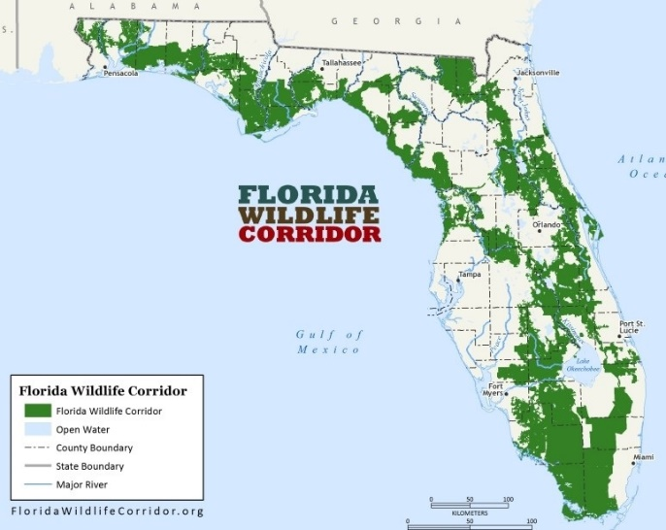
iCASS Platform:
Convene Landscape Stakeholders
Implement Monitor Revise
i = Interactive
Strategy Design
Assess Landscape Conditions
Spatially Design

Slide 14
iCASS Platform:
Implement Monitor Revise
Convene Landscape Stakeholders
Integration
Strategy Design
Assess Landscape Conditions
Spatially Design

Slide 15
Thank You!

