Slide 1
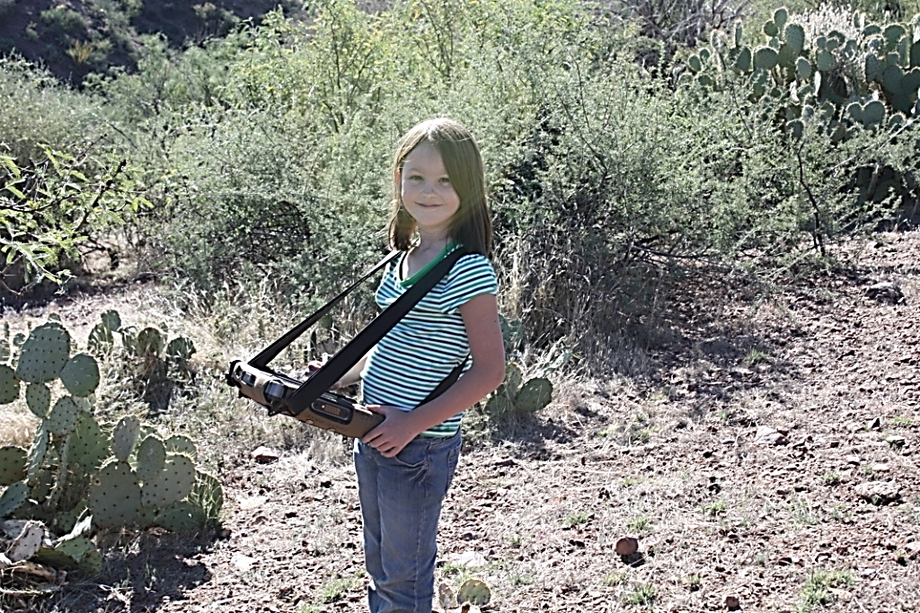
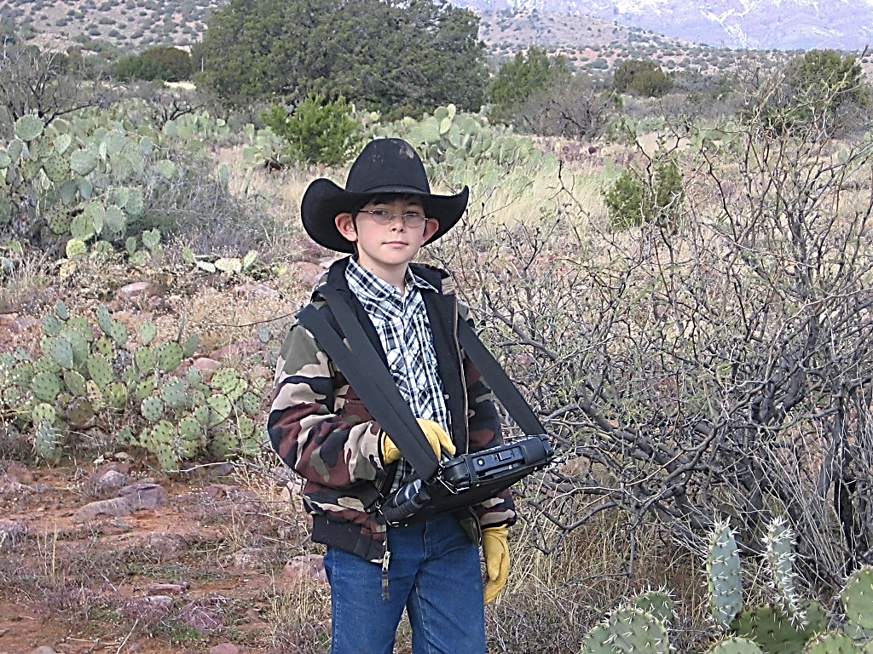
The 10 Commandments of
integrating partner and collaborative monitoring on federal Rangelands

Slide 2
The 10 Commandments:
Recognize building a program will take time.
Work with county and state level cooperative extension if possible.
When at all possible utilize common data elements across jurisdictional boundaries.
Ensure that Everyone owns the data and accepts the data
Use technology as a tool not only for data management but as a communication tool- Vegetation GIS Data system.
Bring everyone to the field, collect the data together and review the data together---at least in the beginning.
Provide training and educational Opportunities- Workshops which also address items of social and Economic Interests.
Let the resources do the talking, not agendas.
Recognize other’s Leadership Abilities.
Be honest, Transparent, and open to the ideas of others. Recognize some may be coming to the discussion with anger, fear and trepidation.

Slide 3
Recognize building a program will take time
Kind of like training a horse to relax on a couch.
(Apparently it can be done, but takes time)

Slide 4
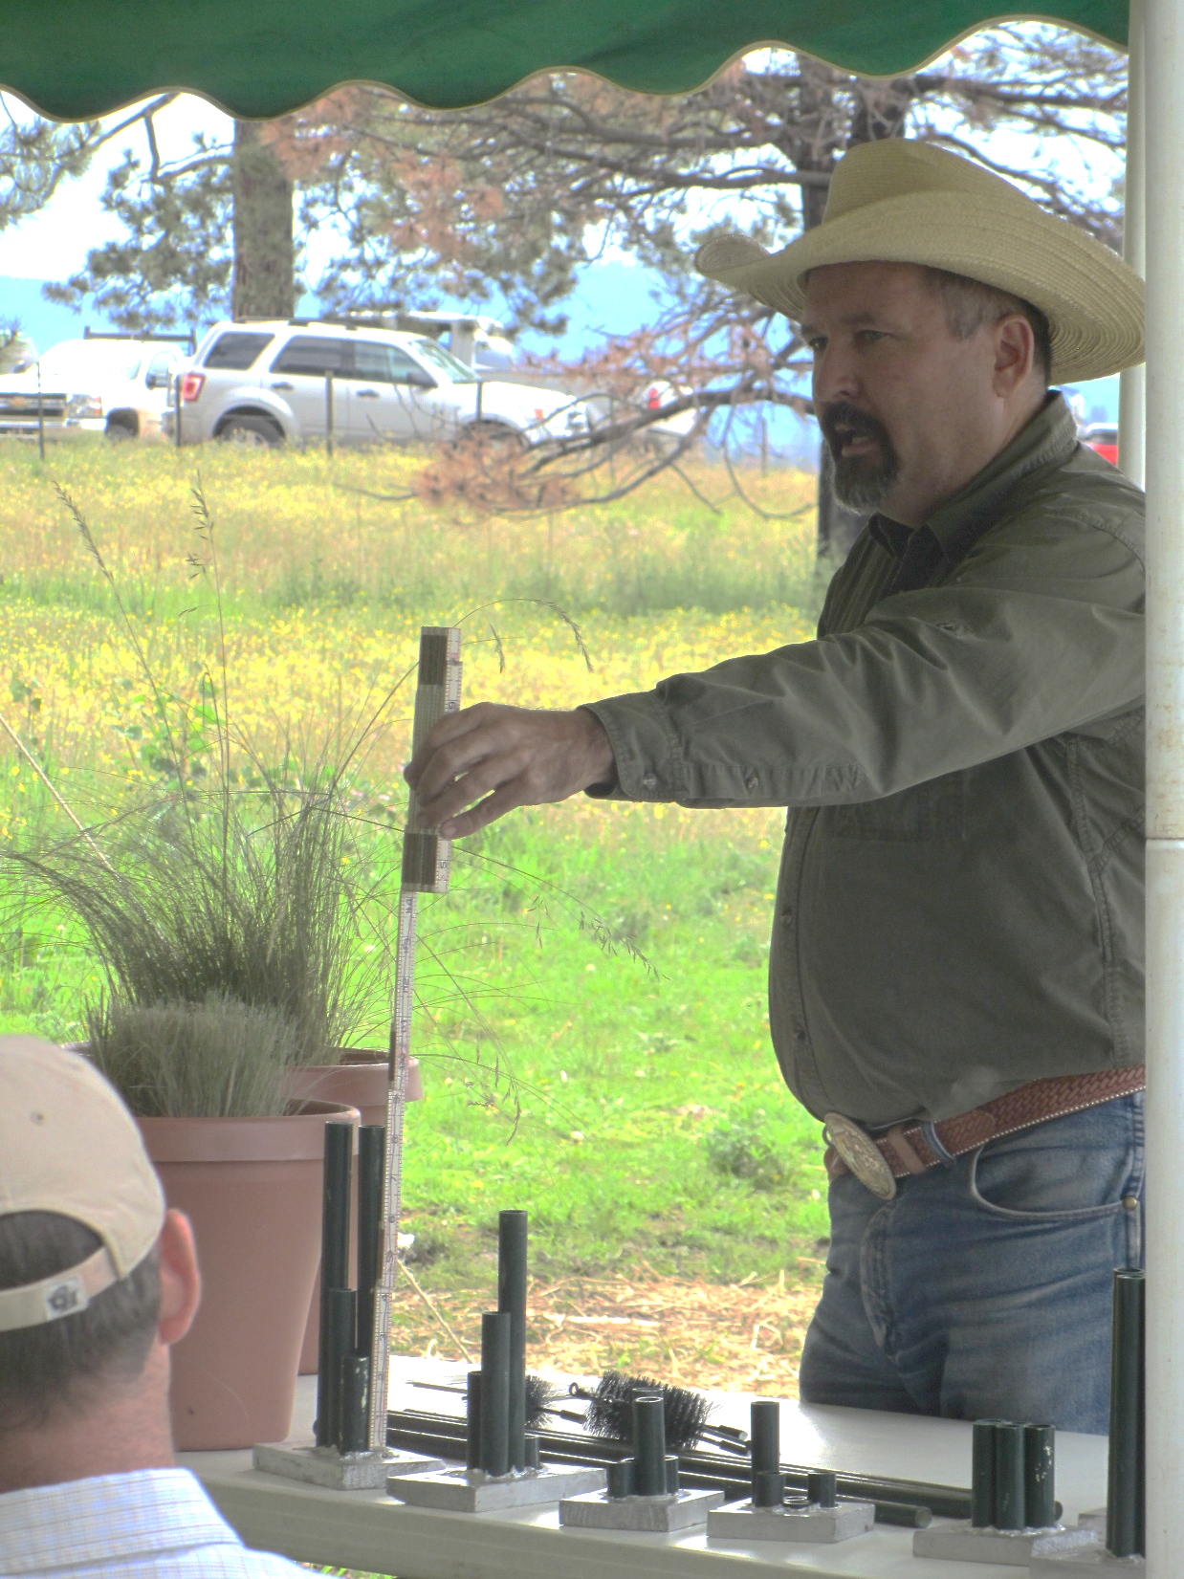
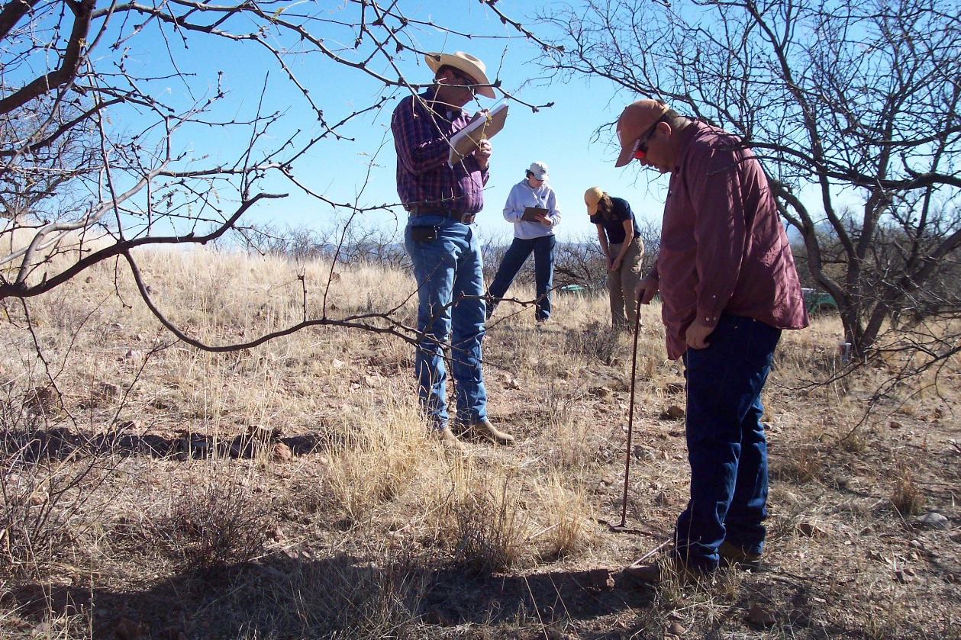
Work with county and state level cooperative extension if possible.
This are the folks ranchers turn to for information.
This provides for Local Agricultural Leadership to be involved.
Extension’s expertise is education and outreach
Forest Service can use Cost-Reimbursable Agreement.
When at all possible utilize common data elements across jurisdictional boundaries

Slide 5
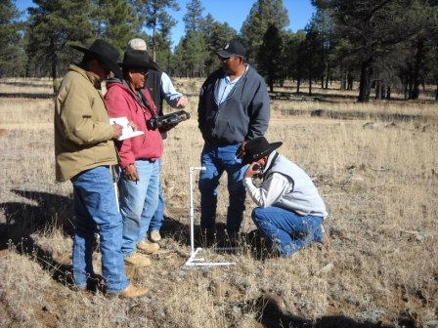
Ensure that Everyone owns the data and accepts the data
Use technology as a tool not only for data management but as a communication tool- Vegetation GIS Data system.
https://vgs.arizona.edu/

Slide 6
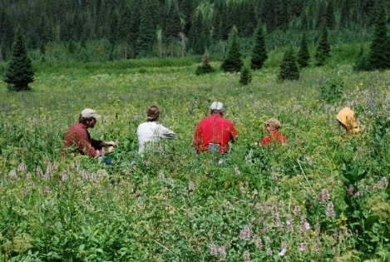
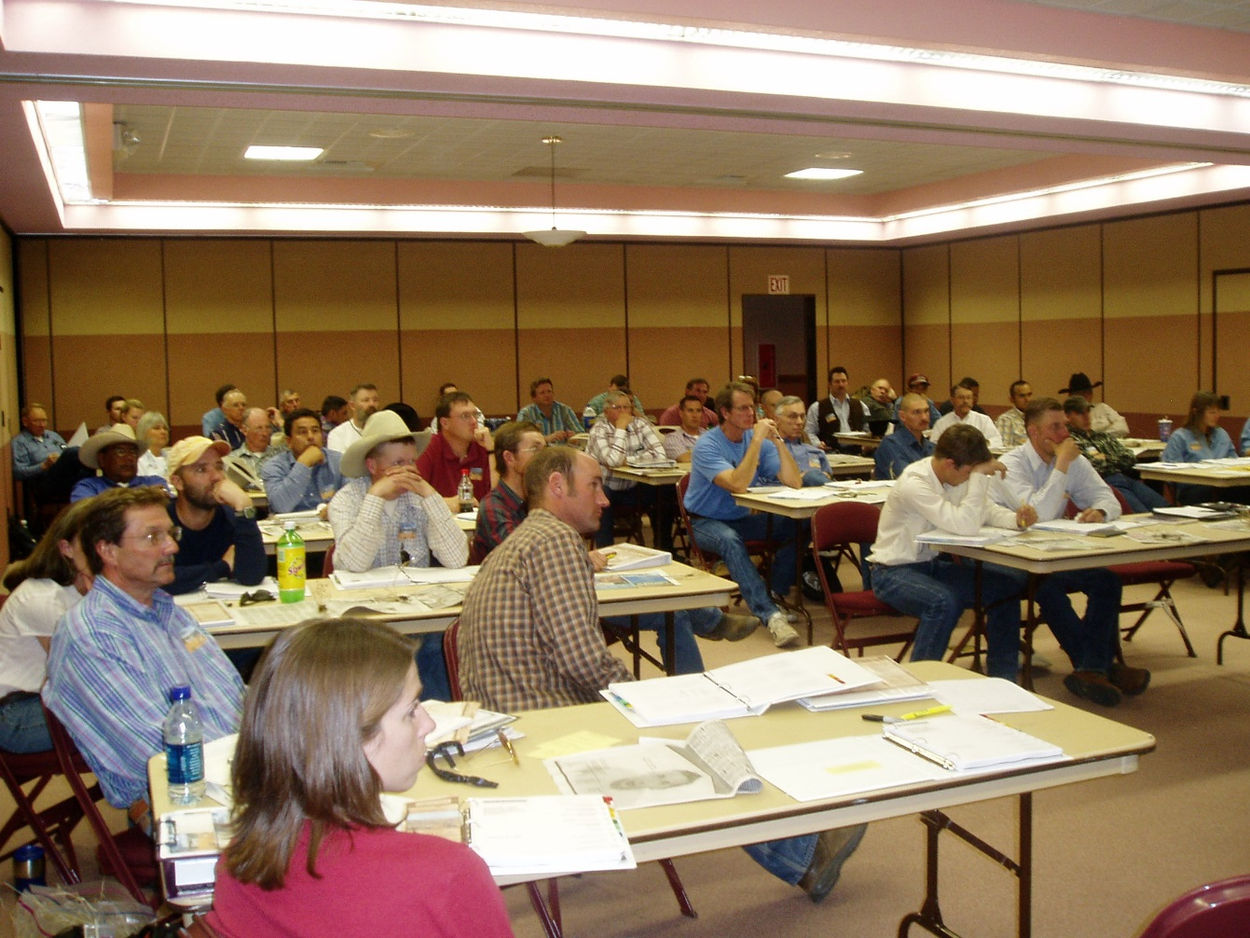
Bring everyone to the field, collect the data together and review the data together---at least in the beginning
This Builds trust in the process, the data
And each other.
Provide training and educational Opportunities- Workshops which also address items of social and Economic Interests

Slide 7
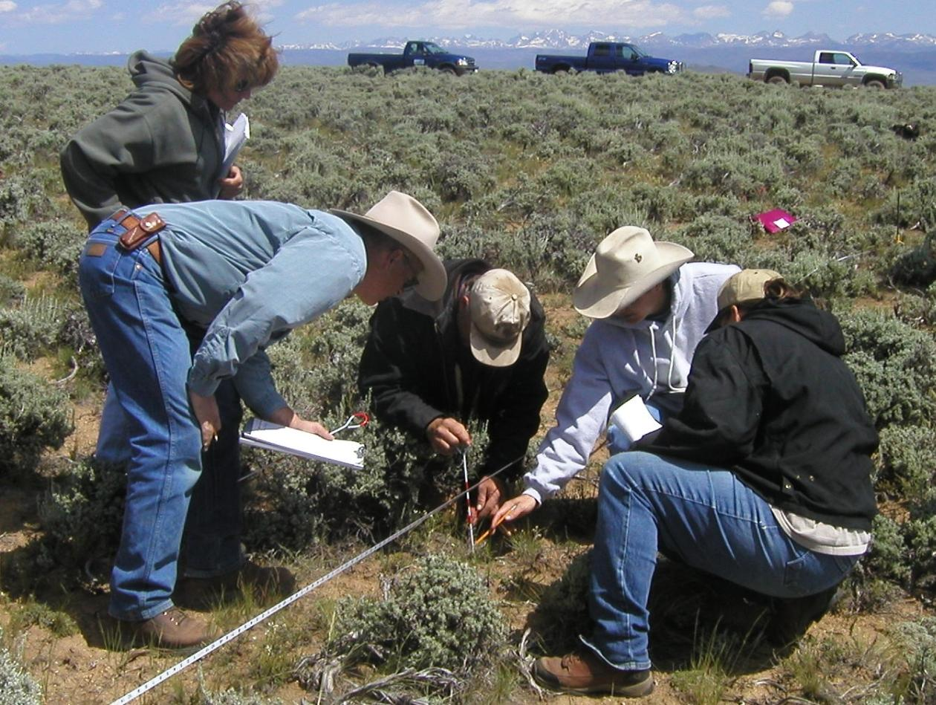
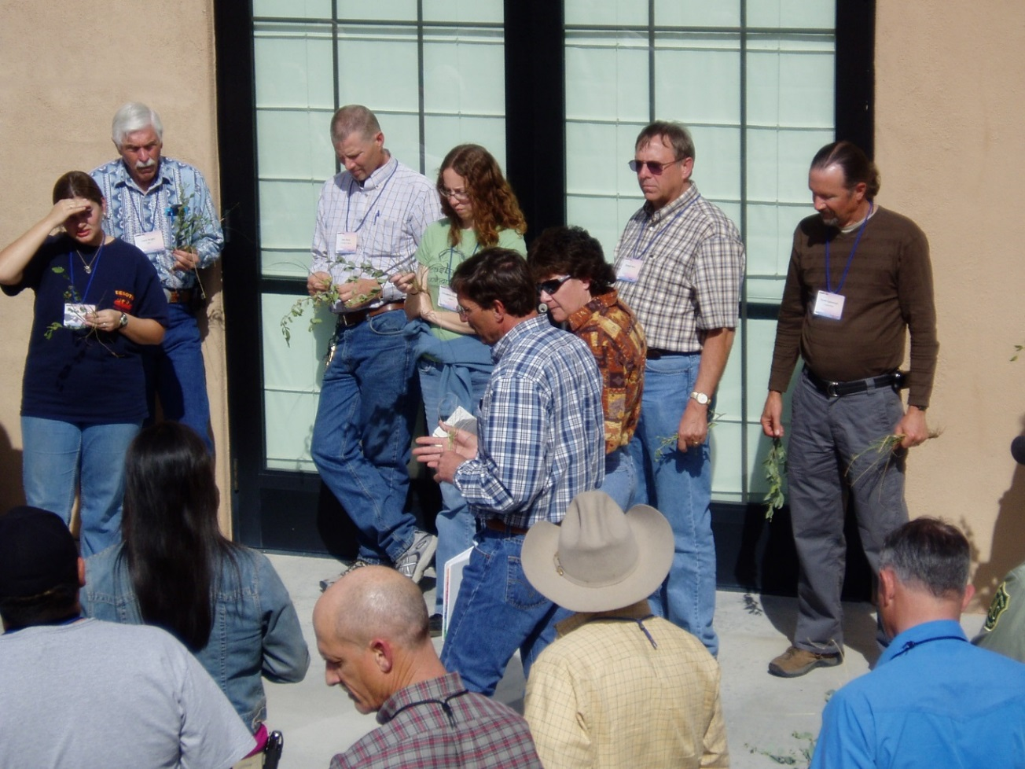
Let the resources do the talking,
not agendas.
Recognize other’s Leadership Abilities
This also builds trust and taps into other skill sets such as economic and social expertise.

Slide 8
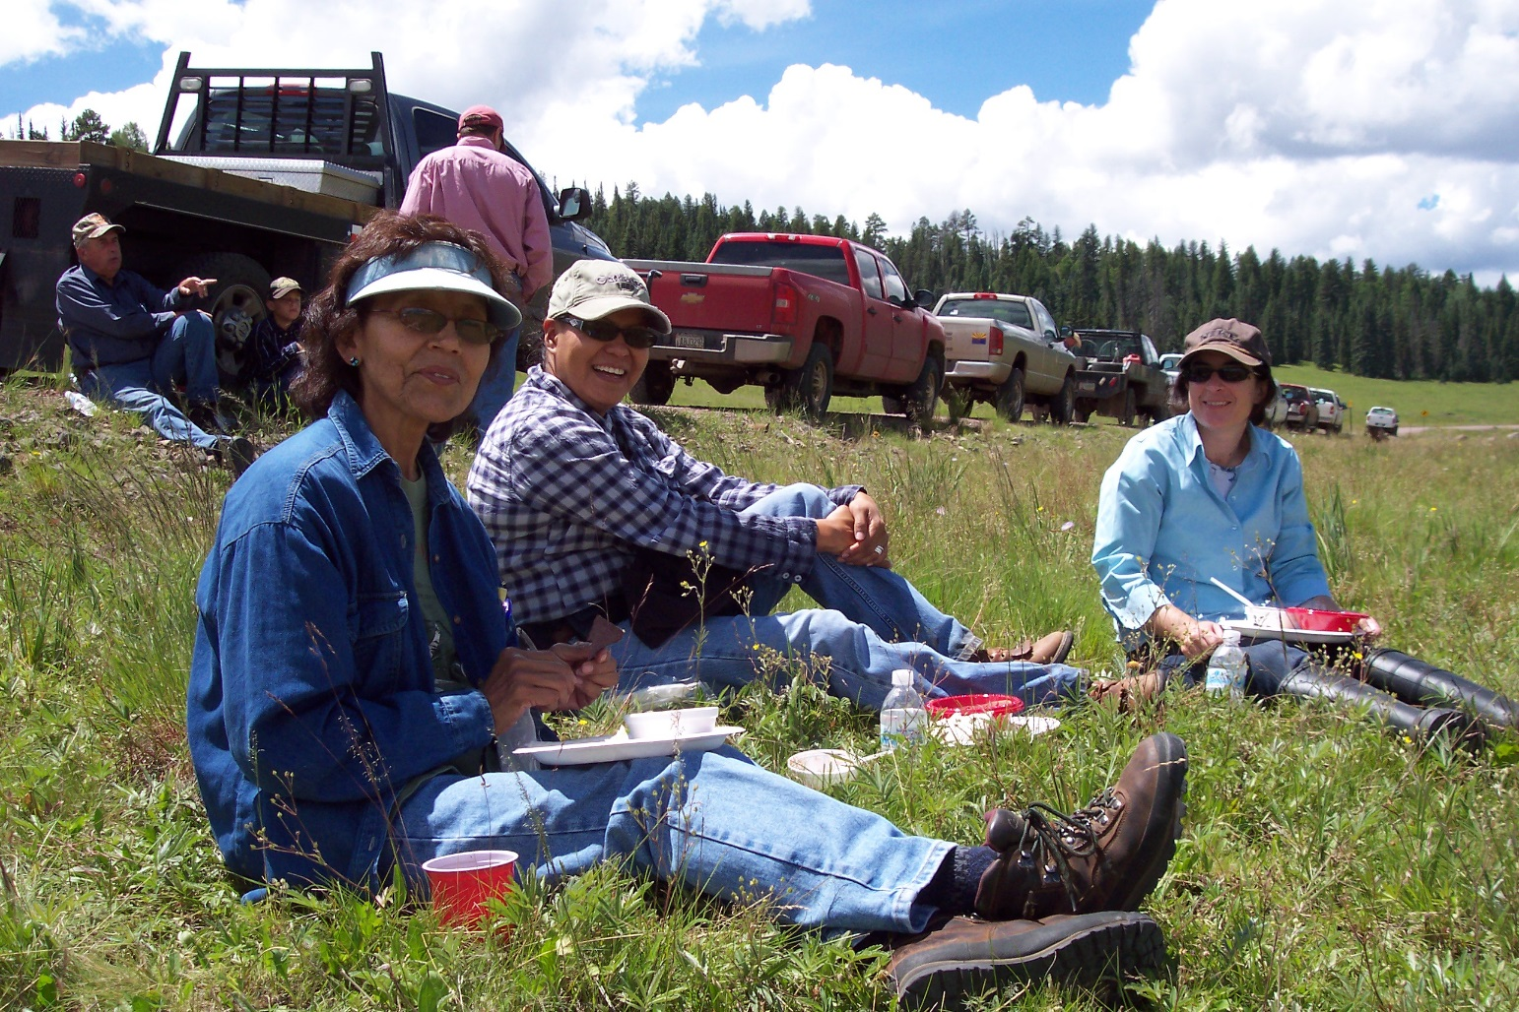
Be honest, Transparent, and open to the ideas of others. Recognize some may be coming to the discussion with anger, fear and trepidation. Collaboration can’t be forced.
And when in doubt…always have good food available. Breaking Bread together is a good thing!!

Slide 9
partners
COLLABORATION:
- Workshops
- Land use policies
- Monitoring & Fieldwork
- Research
Rancher Heritage Alliance
University Researchers Extension Service
National Riparian Service Team
USDA Forest Service
Other Ranchers on ASNF
Arizona Game & Fish Dept.
U.S. Fish & Wildlife Service
Environ-mental Groups

