Slide 1
Socioeconomic Monitoring and USFS Collaboratives
Jonathan Kusel, Ph.D.

Slide 2
Sierra Institute’s frames of reference for Socioeconomic Monitoring (SEM)
Sierra-to-California All-Lands Enhancement
CA Collaboratives unpacking the “how to” and implications of SEM
Recent National Study of CFLR SEM
Defining Local/Local Contracting
Individual SEM contracts
Dinkey Creek CFLR
Burney-Hat CFLR
Notes:
Sierra Institute has experience and perspectives on the topic of socioeconomic monitoring in several different contexts
I will be focusing on the first two during this presentation, addressing the objectives of this session:
· Discuss how to examine social attitudes toward restoration using surveys and other tools
· Demonstrate how collaborative economic monitoring augments Forest Service monitoring

Slide 3
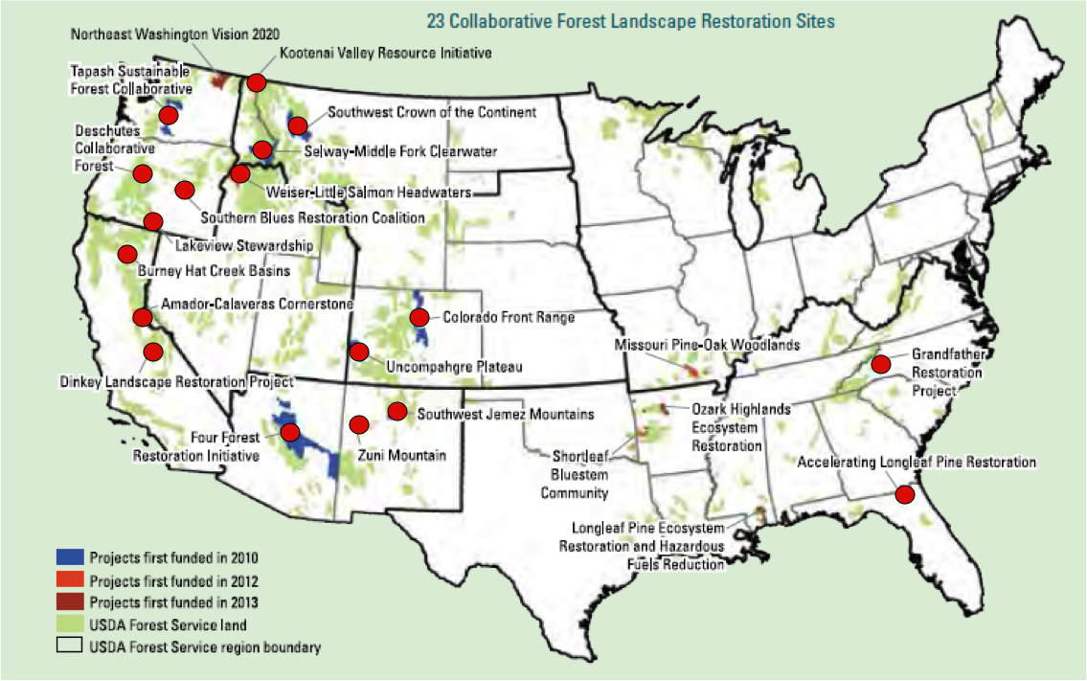
Notes:
SI recently did a study of CFLR SEM efforts nation wide
The case studies included in that report are marked by red dots
That study identified trends in several areas, which I will discuss on the next two slides.

Slide 4
Similarities & Differences
Area of Analysis
Status
Who?
As of Spring, 2015
Notes:
Don’t spend much time on this slide, the point here is to say that although no two CFLR had identical SEM programs, there were clear patterns of overlap regarding characteristics such as status, the party responsible for monitoring, and the area of analysis.
Remind folks that is what our most NFF webinar focused on and that recording, as well as the paper is available online.
For now you want to focus on is one particular indicator that groups across the country are monitoring and how monitoring it has impacted the CA Collaboratives (next slide)

Slide 5
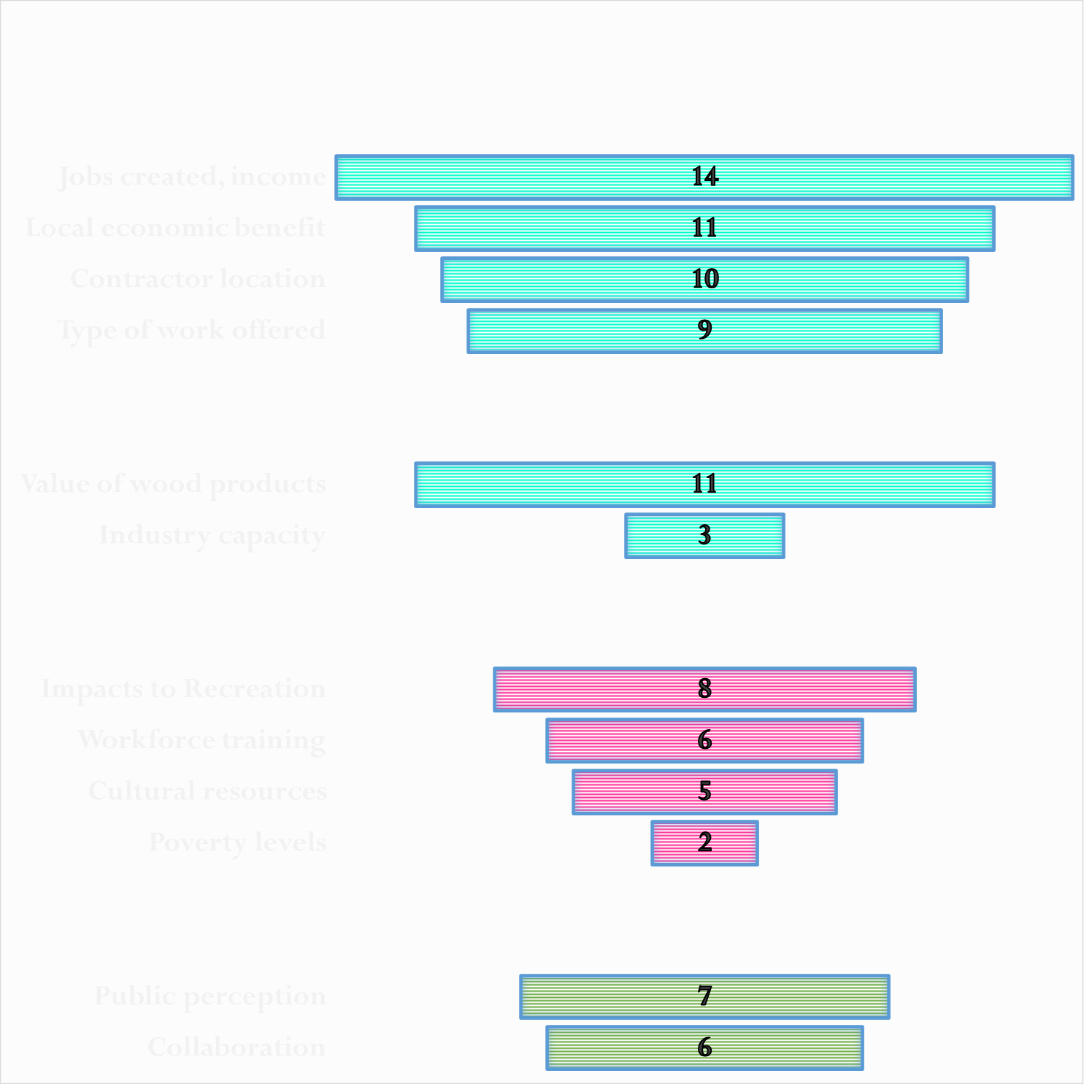
Notes:
This is a summary of the most frequently monitored indicators, according to our 2015 research.
Economic indicators are shown in teal, social well-being in pink, other types of indicators in green.
I’m going to focus on the pink and green for the remainder of this presentation.
First, I want to unpack how monitoring local contracting has influenced the focus of CA collaboratives

Slide 6
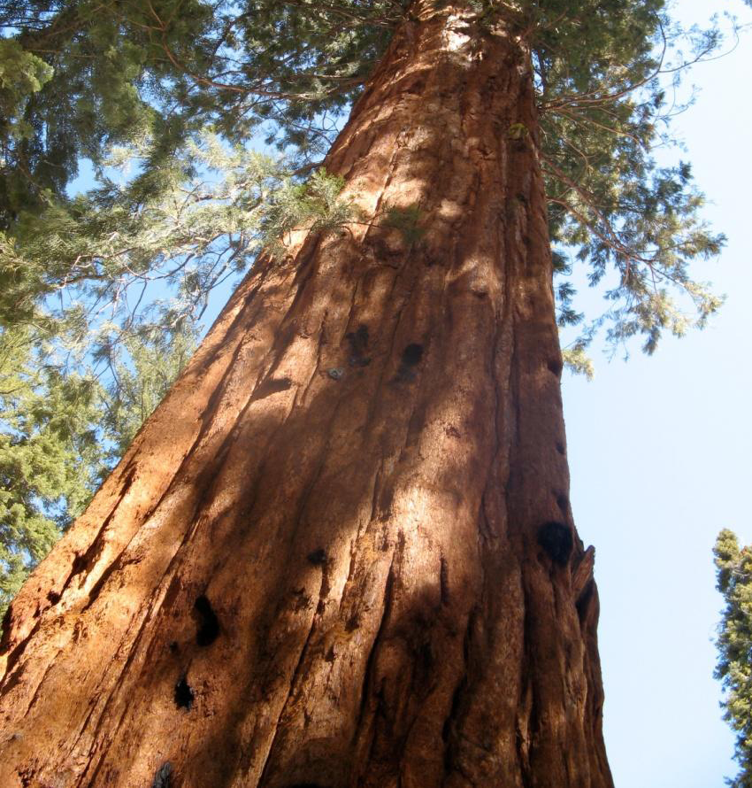
Launching an Adaptive Socioeconomic Monitoring Program
Dinkey CFLR

Slide 7
Stakeholder Assessment ID Conditions, Indicators, Measures Data Assessment and Analysis
Notes:
Sierra Institute has experience and perspectives on the topic of socioeconomic monitoring in several different contexts
I will be focusing on the first two during this presentation, addressing the objectives of this session:
· Discuss how to examine social attitudes toward restoration using surveys and other tools
· Demonstrate how collaborative economic monitoring augments Forest Service monitoring

Slide 8
Phase I
Project Tasks
Background research & indicator design
Stakeholder Assessment/Interview key informants
Establish advisory body
Background research/expert interviews
Develop a Stakeholder report
Workshop to further develop and select among proposed indicators
Final indicator and measures selection
Products: Stakeholder report; draft list of proposed indicators
Notes:
(more effective than a survey) – Key focus area: ID broad issues of concern

Slide 9
Social and Economic Conditions and Trends
Conditions
Indicators
Measures
Notes:
Condition is the state of the social, economic, or ecological system that affects the way in which people live and work, especially with regard to their safety and well-being.
Indicator is defined as the more specific categories that work to establish the state or condition of a particular aspect of a community.
A measure is the unit used to express the amount, size, or degree of areas of particular interest in the study.

Slide 10
Socioeconomic Health and Impoverishment
 | Indicators |  | Measures
 | Income & Poverty |  | Median household income
 |  |  | Personal wage and transfer income
 |  |  | % Households receiving public assn income
 |  |  | % of Student on Free and Reduced Lunch Programs
Notes:
What we’re doing
In essence this project is really two projects: 1) identifying important conditions and useable indicators and measures to evaluate those conditions 2) Data collection and reporting. Sometimes lost sight that this is not only an indicator and measures project for the county, communities and watersheds.
For this presentation, I’m going to add a bit more information from places elsewhere in the Sierra

Slide 11
Demographics
 | Indicators and Measures
 | Total population by age
 | Population by age groups
 | School enrollment by grade
Notes:
Other conditions:
Economic Vitality
Public health
Public Safety (& Crime)
Capacity

Slide 12
Phase II A
Project Task Data Assessment and Analysis
Populate data sets
Analyze data
Community/Partner workshop to share data and analysis;
Products: Socioeconomic report on measures and analysis of findings
Notes:
3-4 months
discuss findings and local implications

Slide 13
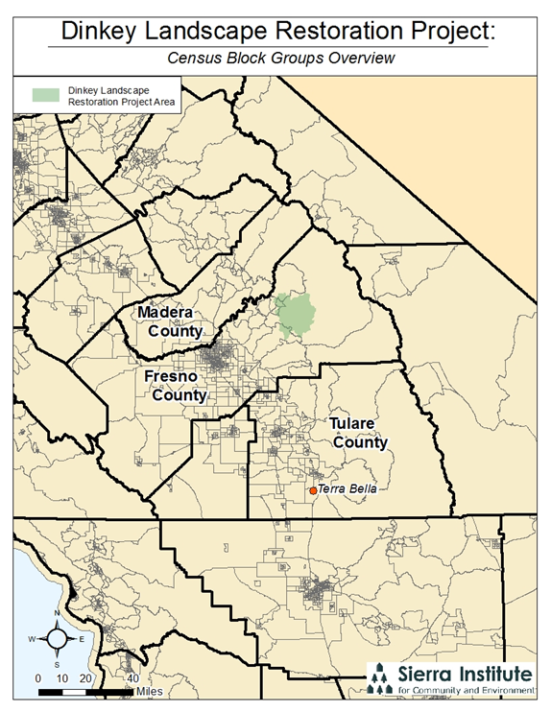

Slide 14
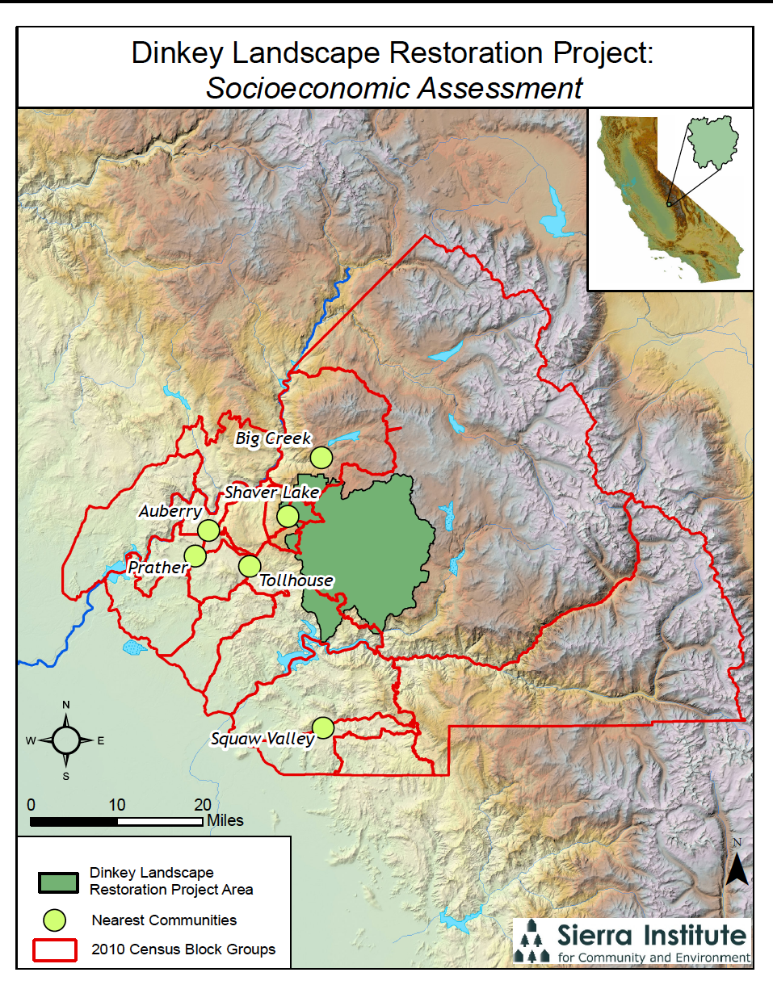

Slide 15
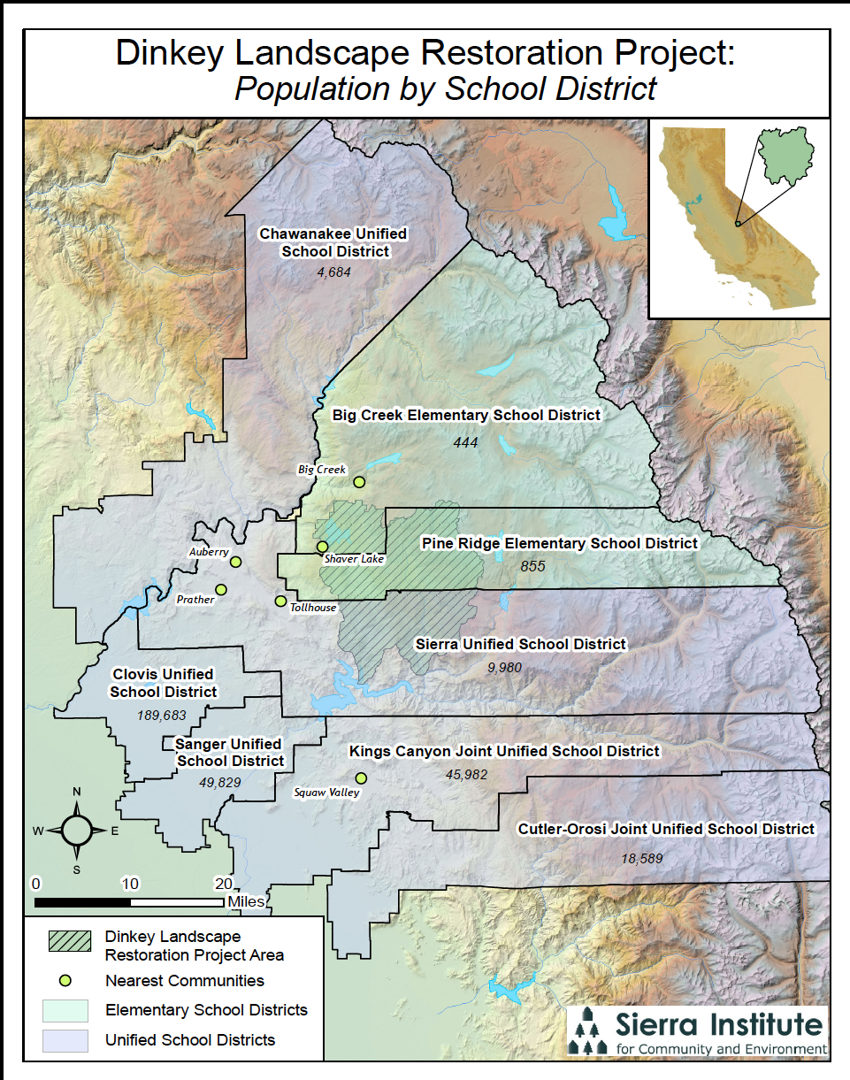

Slide 17
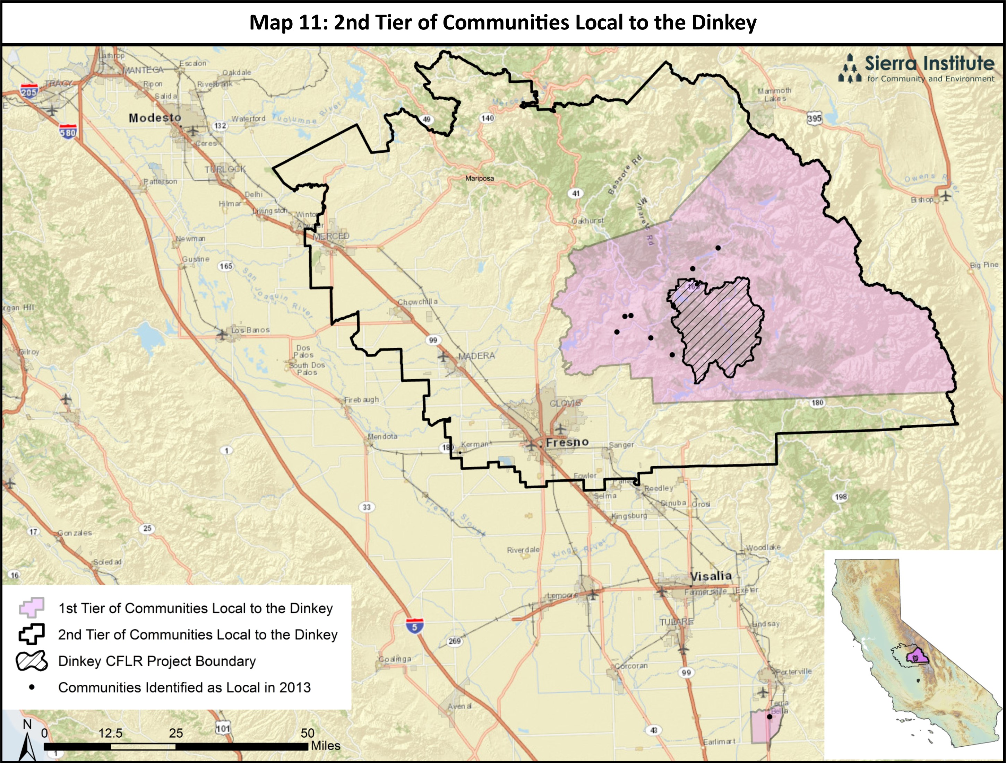
2. Defining Local
Notes:
And a second tier of communities outlined in black
BRIEF note of Terra Bella

Slide 18
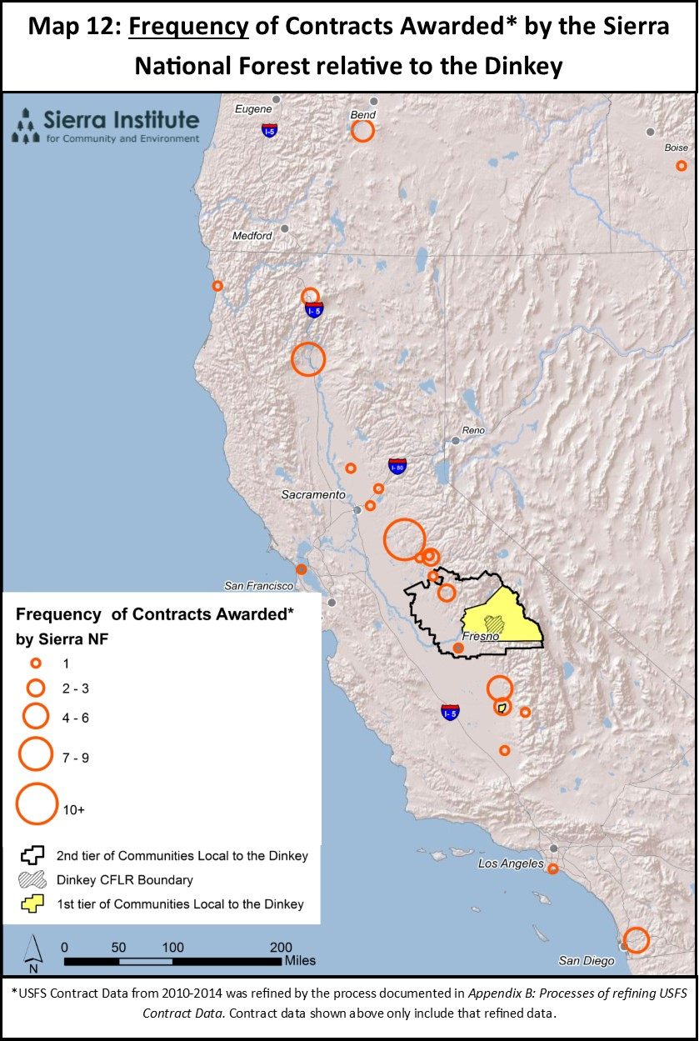
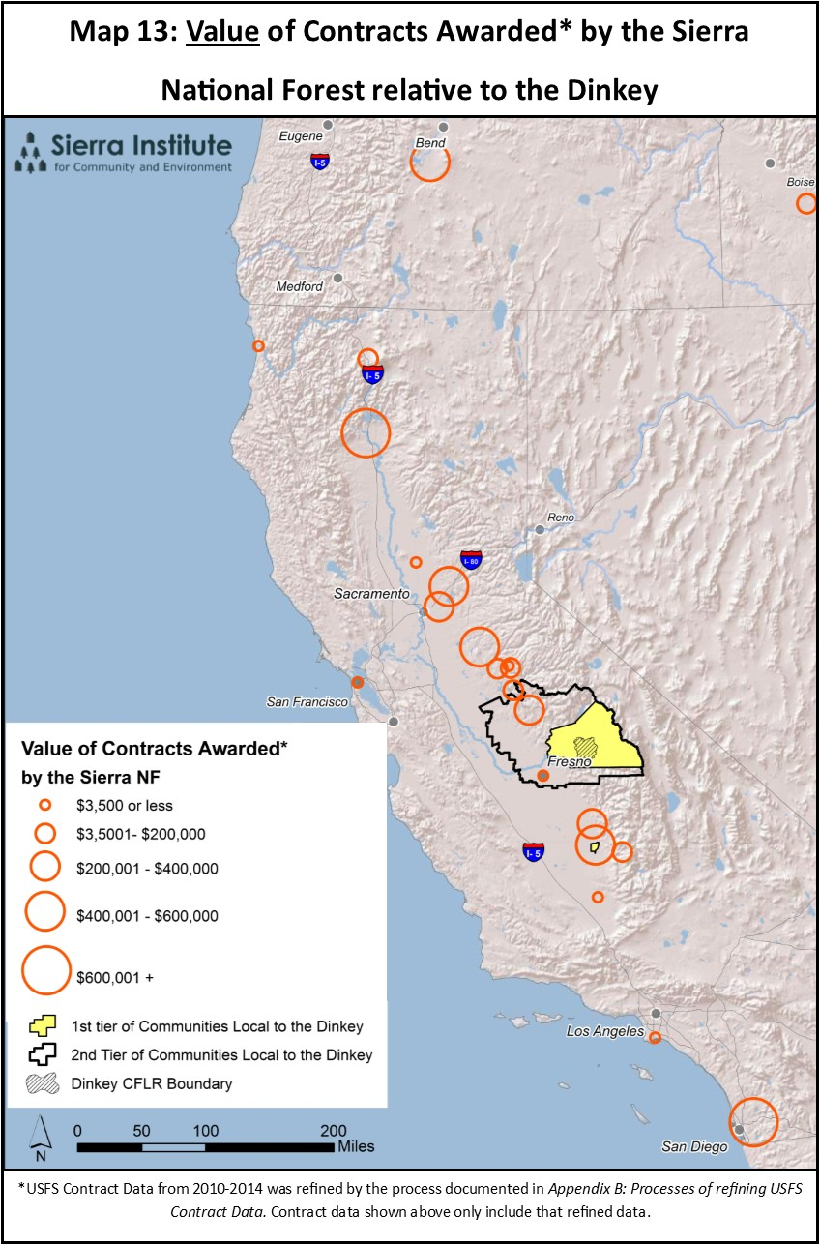
2. Defining Local
Notes:
These maps display the frequency and value of contracts most related to the Dinkey Creek Forest Collaborative
Although the discernment of tiers was at times a challenging process, this data shows that in within 4 years, no contractors within the first tier were awarded a job by the Sierra National Forest. This visually portrays how low current local capacity is.
Because our recommendation involves Stand Alone Service Contracts, rather than a “you’re in or you’re out” model, being included in Tier 1 v. Tier 2 v. none of the above, the process also allows for change over time as capacity increases

Slide 19
Phase II B
Project Task Data Assessment and Analysis
Discuss/Explore how Collaborative projects can affect/respond to socioeconomic issues of concern
Work with Forest Service and Partnership to develop responsive work or manner of work (e.g., local contracts)
Products: Development of a responsive CFLRP program of work
Notes:
3-4 months
discuss findings and local implications

Slide 20
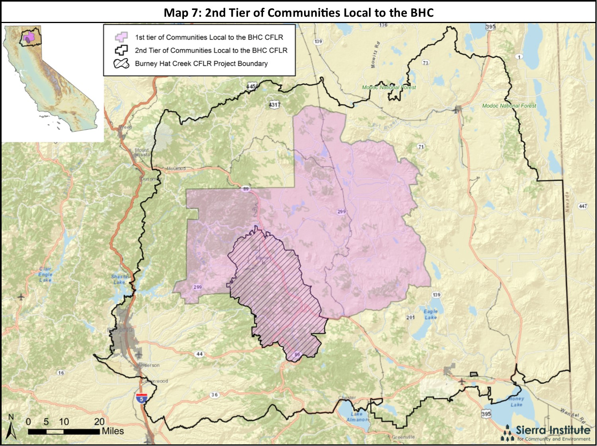
Notes:
To give you an idea of

Slide 21
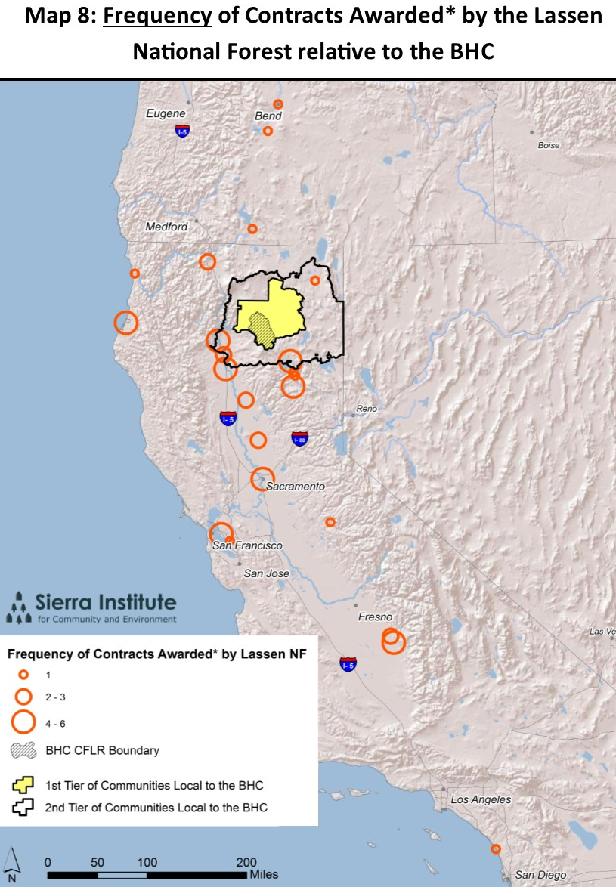
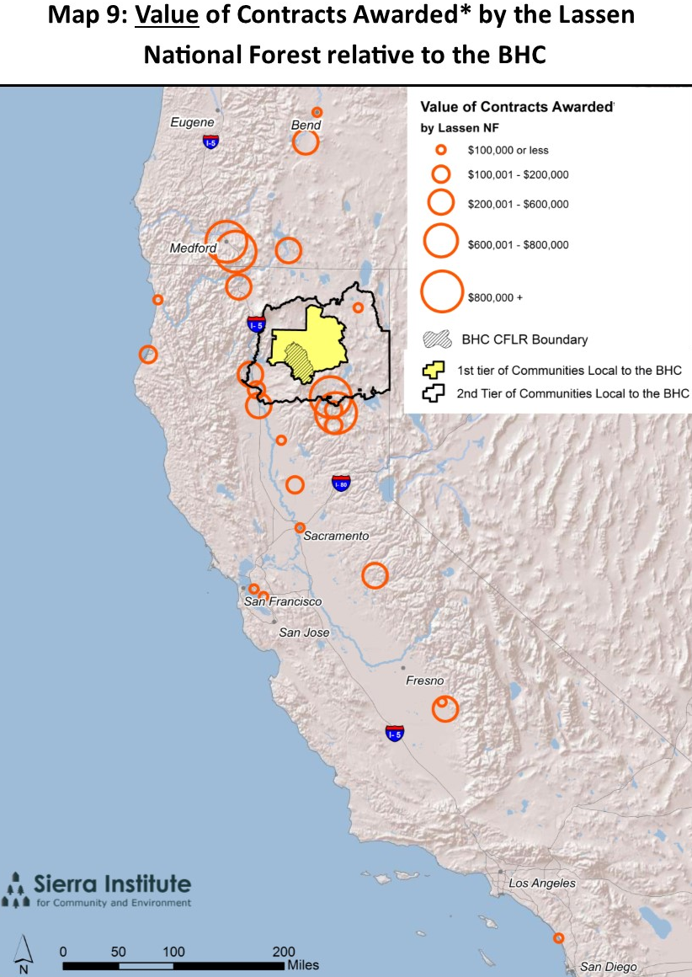
Notes:
Examining the location, frequency, and value of contracts (shown by the orange circles) – ie monitoring USFS contracts– has lead to significant conversations regarding the concept of defining local, as well as establishing a clearer, stronger pathway for the USFS to award preference to contractors within that defined local area.

Slide 22
“Although the agency has a number of authorities to support this [preference for local contractors], we have not been consistent, nor as assertive as we should be, to use them to support our local communities.” -Randy Moore Regional Forester Pacific Southwest Region
Notes:
I think allowing people time to read the quotes on this slide and the next would be great. Important enough to warrant it, I think.

Slide 23
Phase III
Project Task Continued Socioeconomic monitoring
Continued tracking and monitoring of data
Community/Partner workshops to discuss findings and local implications
Continued work with the Collaborative about how CFLRP work can more effectively respond to socioeconomic issues of concern

Slide 24
“The intent of the study and reports is to support collaborative discussions and decisions related to defining “local” and identifying acquisition methods and processes that can increase the potential of local contractors being selected.” -Randy Moore Regional Forester Pacific Southwest Region

Slide 25
Adaptive Planning & Adaptive Mgmt
USFS Policies, authorities, and support
Size of contracts
Weight and criteria of “local” preference
Collaborative processes
Communication
Decision making

Slide 26
Socioeconomic Monitoring and USFS Collaboratives
Jonathan Kusel, Ph.D.
jkusel@sierrainstitute.us
530.284.1022
Notes:
Q & A
Pierce Roll Out
Discussion on pilot

