Slide 1
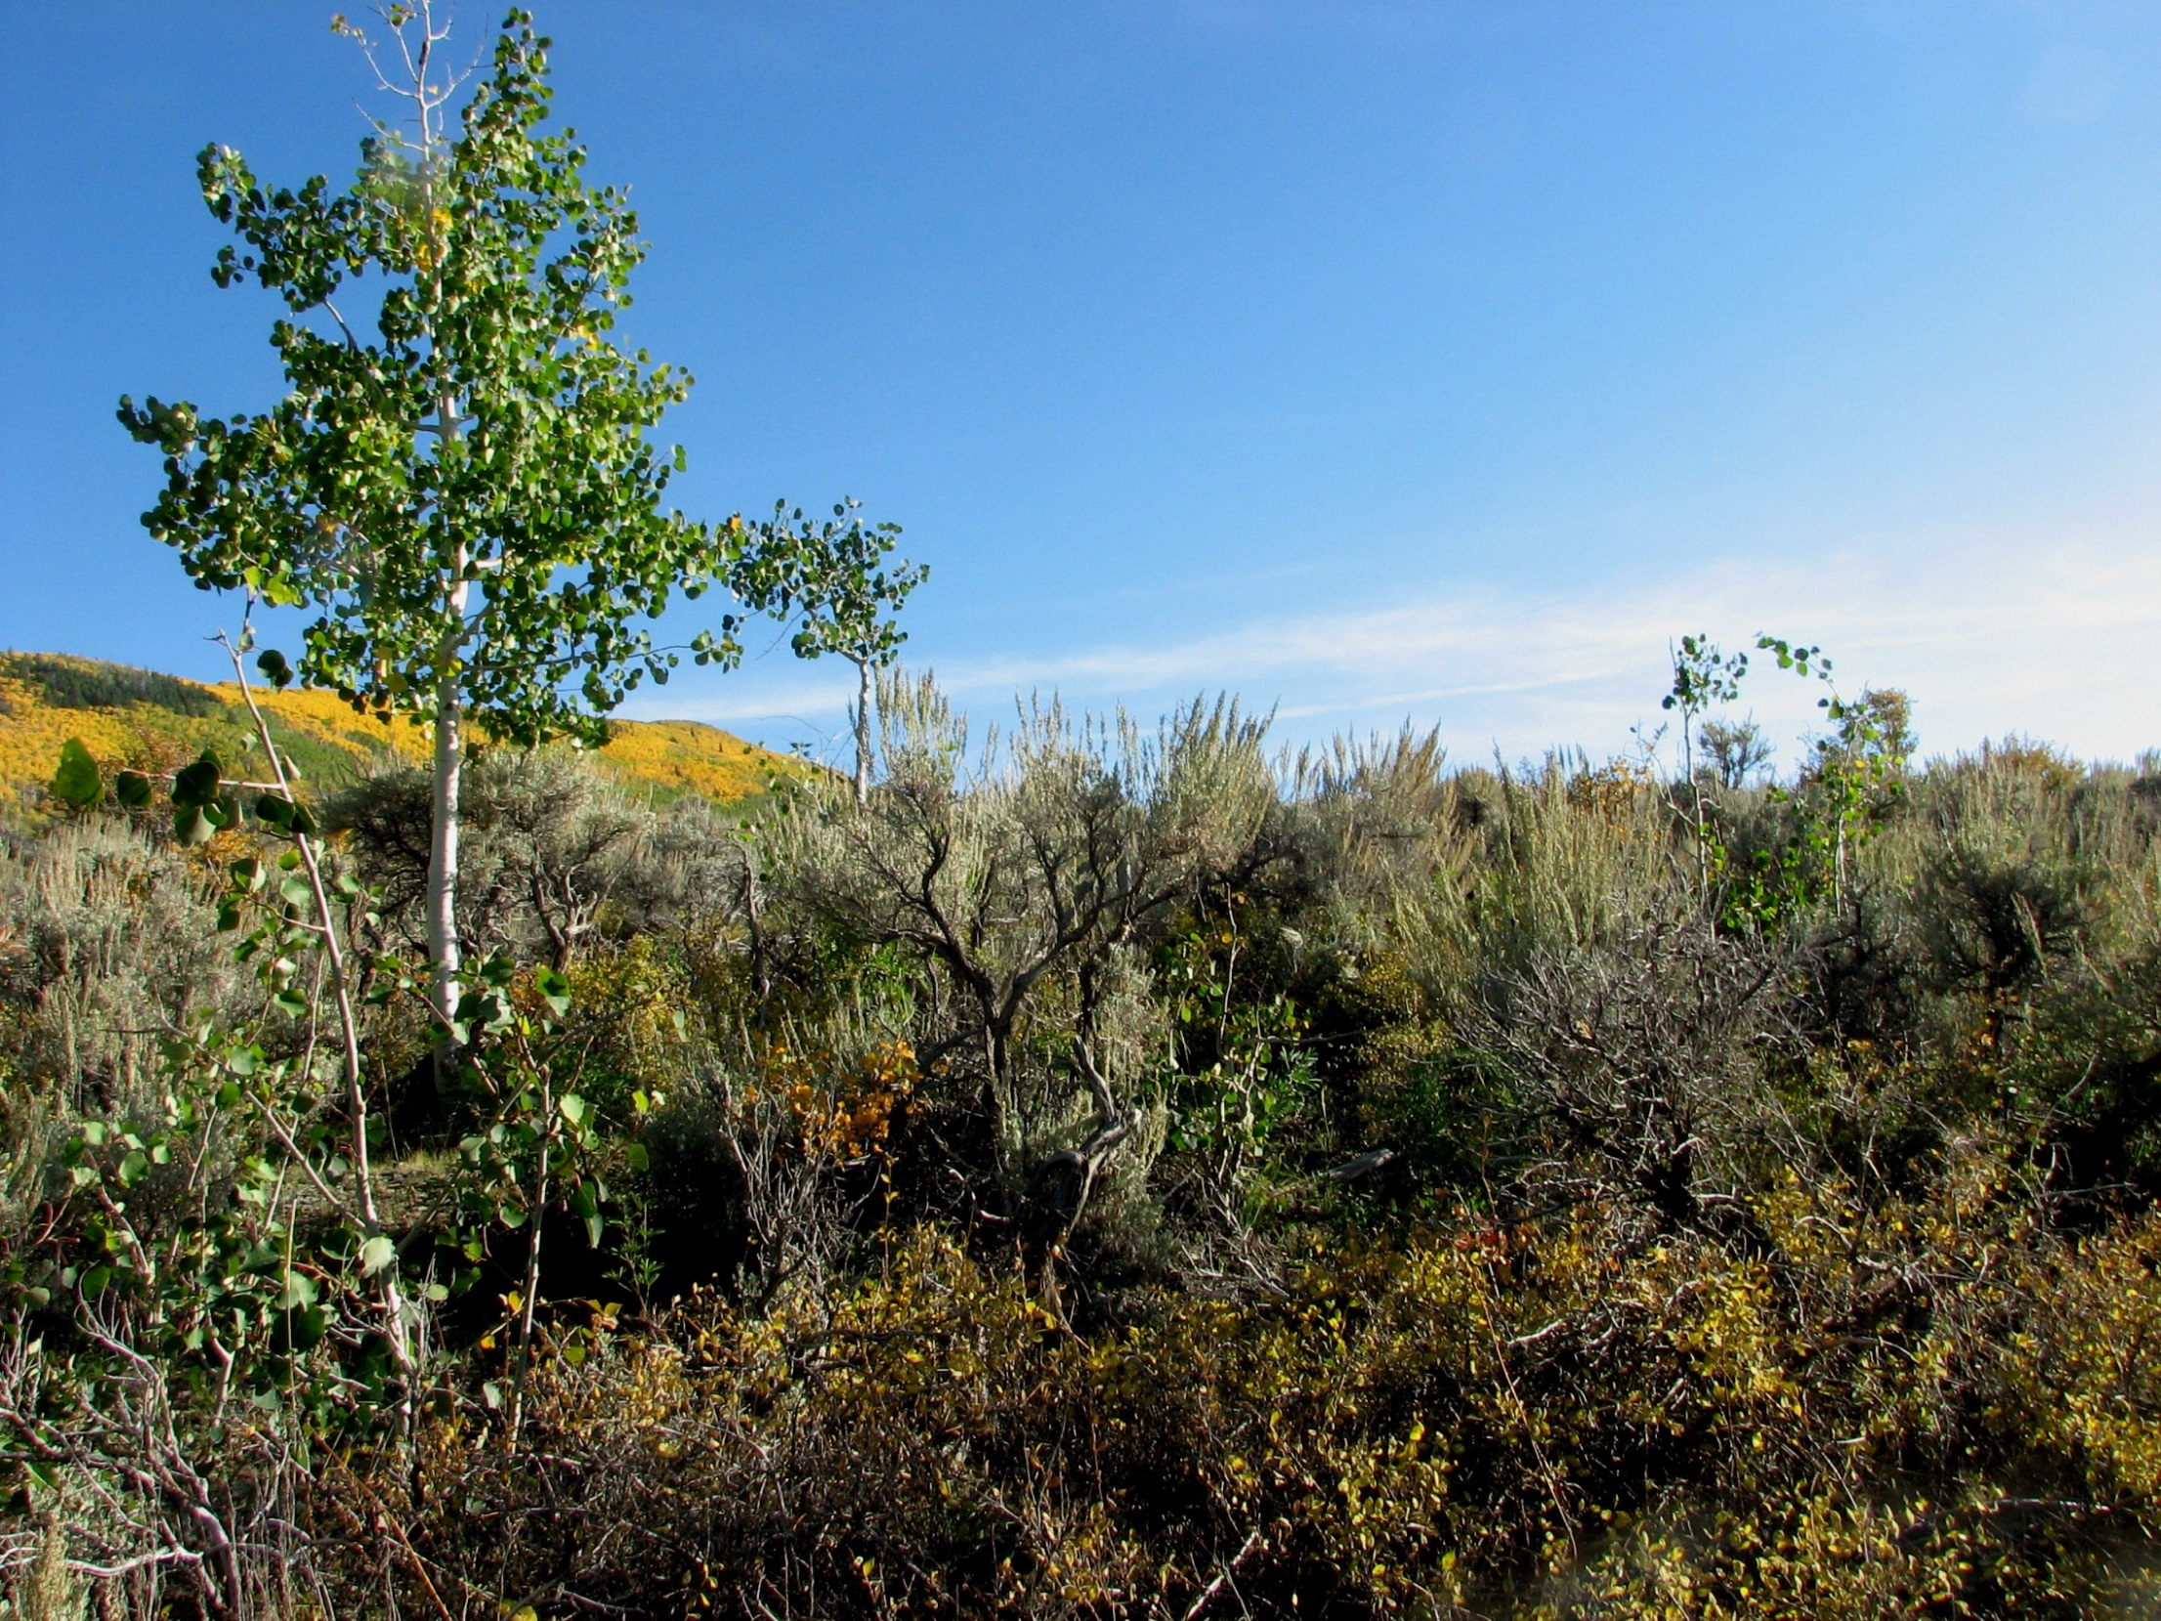
Monroe Mountain: A Utah Case of Partner and Collaborative Monitoring
Mary O’Brien
Grand Canyon Trust
Collaborative Restoration Workshop
Denver, CO
April 26-27, 2016
maryobrien10@gmail.com

Slide 2
The Mountain
Monroe Mountain
Richfield Ranger District
Fishlake NF

Slide 3
The Collaboration (2011- present): Monroe Mountain Working Group

Slide 4
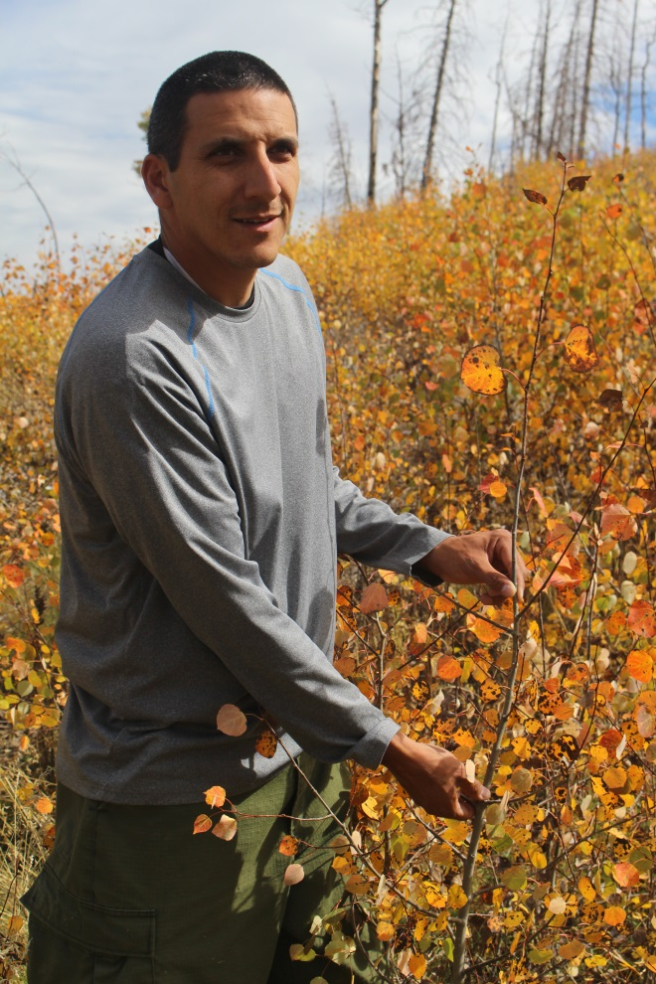
Collaboration Partners
Fishlake NF
Allen Rowley/Mel Bolling, Forest Supervisor
Jason Kling, Richfield District Ranger
Richfield Ranger District staff)
Brigham Young University
Sam St. Clair – Principal Investigator
Aaron Rhodes – Ph.D. student

Slide 5
The Aspen

Slide 6
The Desired Conditions
Persistent aspen communities
Multi-height aspen stems
Adequate recruitment to perpetuate the aspen communities
Biodiverse understories
Big sagebrush, if present, is a minor component
Fire regimes are adequate to perpetuate aspen in areas seral to conifer

Slide 7
The Challenges
Lack of stable aspen recruitment (excessive browse of persistent aspen sprouts);
Split management : State manages elk/deer; FS manages aspen
Overtopping of seral aspen by conifer (fire suppression)
Private inholdings (fire risk)
Boreal toads, goshawk, Bonneville cutthroat trout
Inventoried roadless areas

Slide 8
The Monitoring Questions
Selected by the Monroe Mountain Working Group
Monitoring by MMWG subgroups, members, volunteers and Brigham Young University doctoral student/crew
Funded by organizations/agencies of MMWG members, Forest Service, Utah Partners for Conservation and Development
Volunteers, college students have contributed

Slide 9
Who is eating all the aspen sprouts and when?
Four 100’ belt transects
Trail cams at each end
Read browse percent,
height 7 times in 2011
[Collaboration
self-selected subgroup]

Slide 10
When did persistent aspen stands last recruit?
Students cut down 5 “most recent” aspen in each of 100 stands
RMRS counted “cookies”
Cannot judge aspen age from diameter
Some stands last recruited130 years ago
[Whitman College,
Rocky Mountain Research Station, 2014]

Slide 11
What is happening to seral aspen stands (aspen-conifer) after a fire?
Four three-way post-fire exclosures:
all ungulates; deer only; cattle only; outside
Cameras, scat, browse, height
Everybody is eating
[BYU - 2012-2016]

Slide 12
How are persistent aspen stands doing?
60 belt transects
Measure height and browse of leaders
[BYU – 2012-2016]

Slide 13
What about the understory in persistent aspen stands?
Nested frequency transects beneath 60 BYU belt transects
15 transects/year
Dandelion and KY bluegrass most frequent plants
[Grand Canyon Trust 2012-2016; five years later]

Slide 14
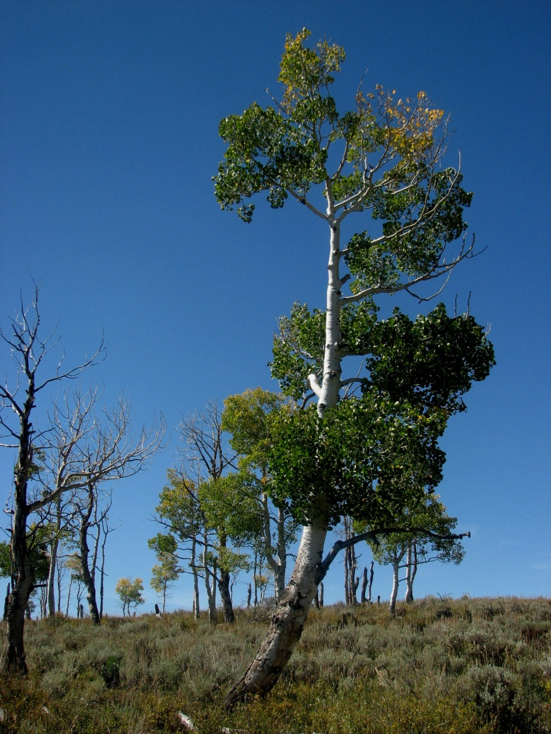
Are old, “decadent” aspen stands just waiting to die?
Five 8’ tall, ½ acre exclosures are being built around scattered old aspen
Recruitment will be monitored
[Trust, Collaboration members, 2016-?]

Slide 15
What are the population trends of cattle, sheep, elk, and deer?
?
[Grazing Improvement Program, UDWR, USU County Extension - 2013]

Slide 16
What is the contribution of elk/deer versus cattle/sheep browsing?
Six livestock-free areas will be estaboi9shed
in 2016
Two each in heavy, moderate, and light elk use areas
140 acres
Will be aspen height/browse belt transects
Collaboration – 2016 - ?]

Slide 17
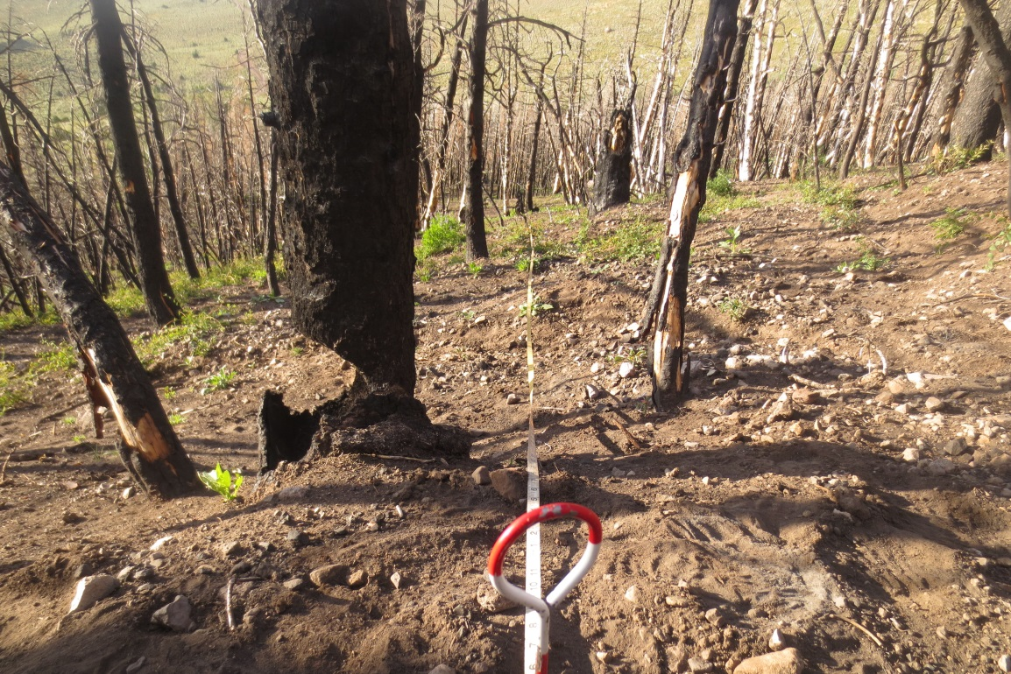
How many sprouts/acre are present after a fire?
Agreed-upon quantitative browse limits depend on post-fire sprouts/acre
Trust and BYU 2015monitoring after Twin Peaks fire differed in estimates of post-fire sprouts
2016 collaborative monitoring by several methods will recommend most efficient method for estimating post-fire sprouts to determine browse limits
[Collaboration members, volunteers]

Slide 18
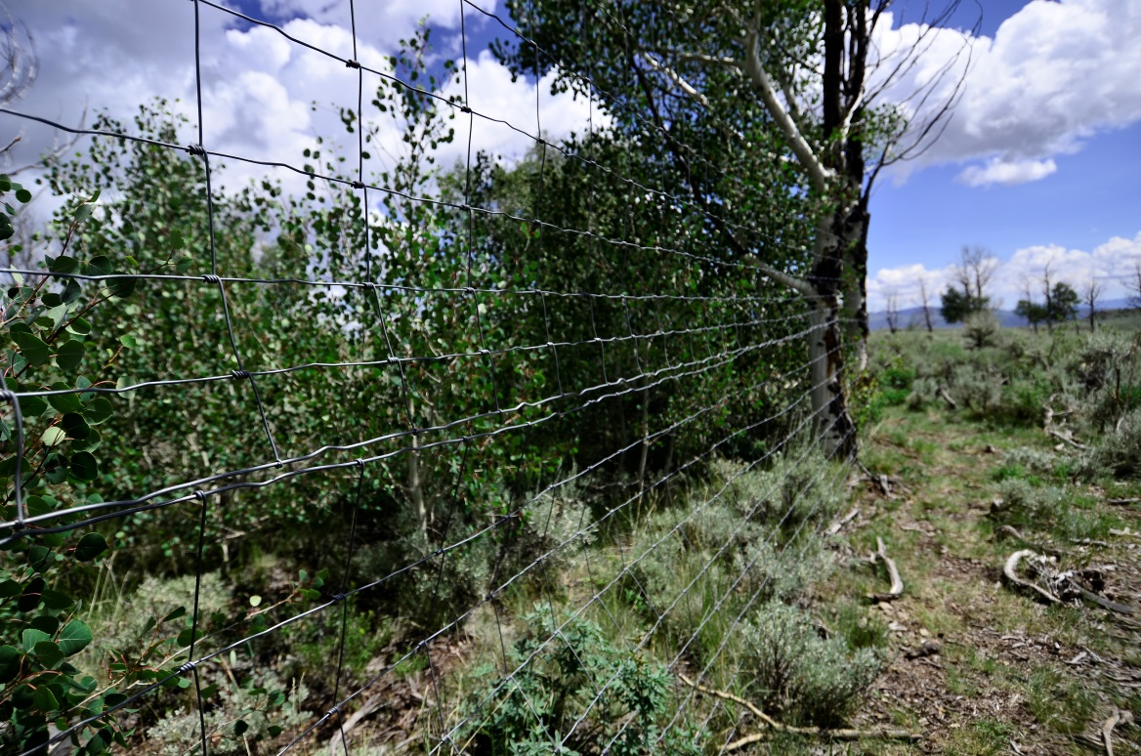
The value of it all
Shared understanding across diverse perspectives
Information replaces
assumptions
Broad buy-in to FS
management
Supplements what the
FS can do; allows for
research and not just monitoring
AND . . . aspen restoration – hopefully!

