Slide 1
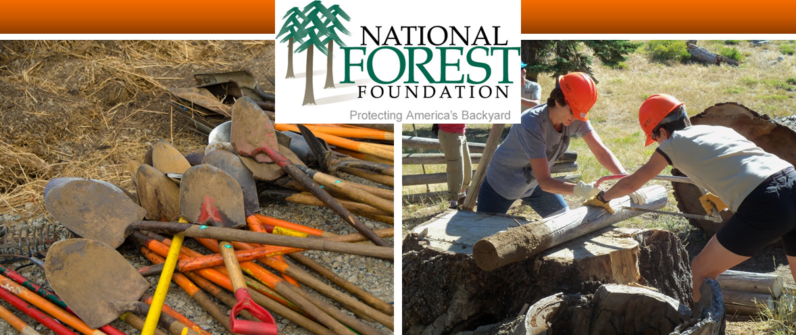
Collaboration Tools & Best Practices
Emily Olsen | April 26, 2016 | Collaborative Restoration Workshop

Slide 2
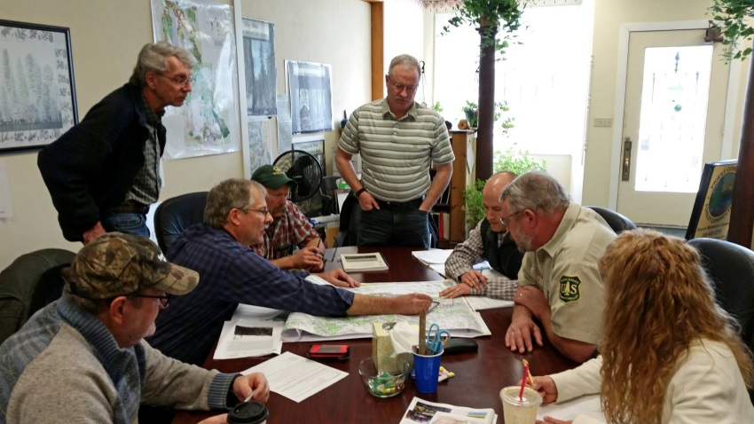
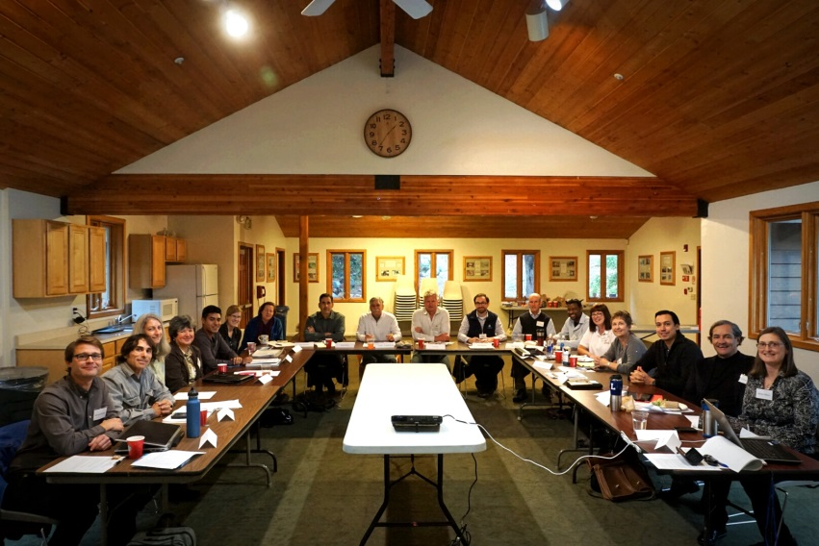
The NFF’s Values
Unite the power of diverse interests and communities in collaborative stewardship;
Restore ecosystems to their natural resiliency and functions through on-the-ground conservation;
Engage Americans, young and old, in recognizing the gifts of our National Forests and Grasslands and in caring for them;
Sustain the commitment and ability of communities to serve as stewards by building the capacity of collaborative organizations; and
Add value where action would not otherwise be taken.
Protecting America’s Backyard

Slide 3
The NFF’s Values
Unite the power of diverse interests and communities in collaborative stewardship;
Restore ecosystems to their natural resiliency and functions through on-the-ground conservation;
Engage Americans, young and old, in recognizing the gifts of our National Forests and Grasslands and in caring for them;
Sustain the commitment and ability of communities to serve as stewards by building the capacity of collaborative organizations; and
Add value where action would not otherwise be taken.
Protecting America’s Backyard

Slide 4
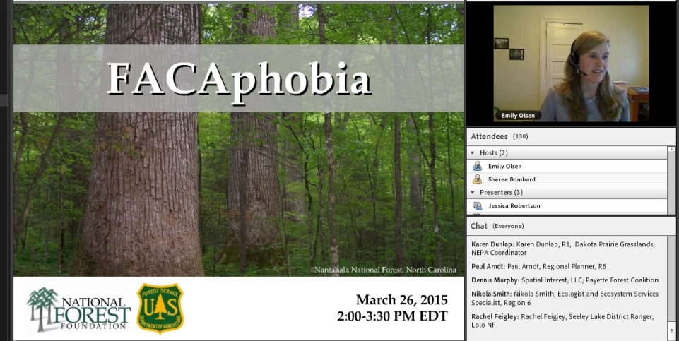
Assessments, collaborative process design, facilitation and coordination
Peer learning sessions
Fostering of peer-to-peer and community-to-agency connections
Development of best practices and tools
Partnering with research and academic institutions to support applied learning and advance the field
Convening of face-to-face workshops
Building the organizational capacity of collaborative groups
Protecting America’s Backyard

Slide 5
Direct work with collaborative groups
Proposals from the field
IDEAS FROM YOU!
Requests from collaborators, the Forest Service, others
NFF staff ideas
Protecting America’s Backyard

Slide 6
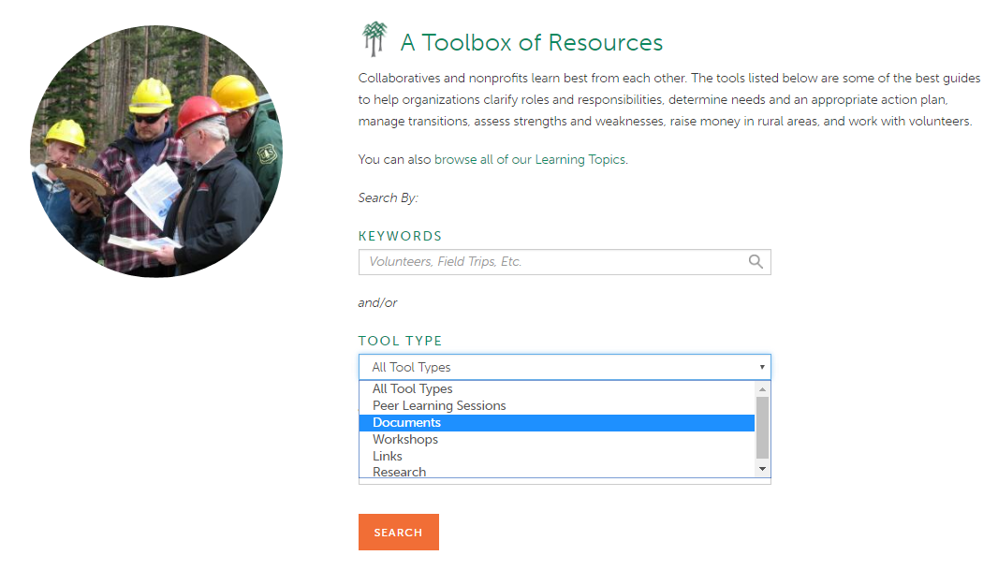
Website: Collaboration Tools Search
www.nationalforests.org
Protecting America’s Backyard

Slide 7
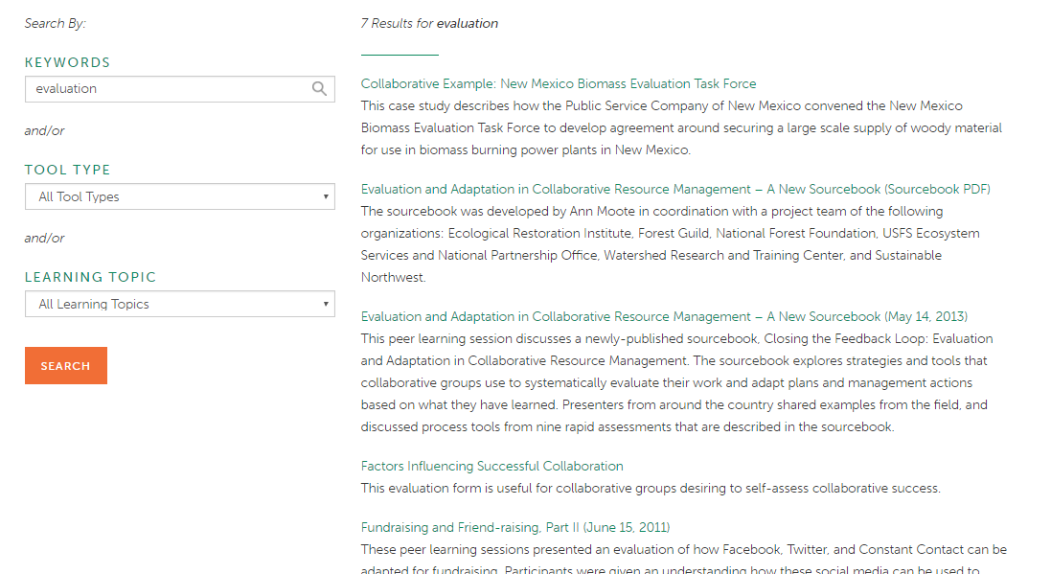
Website: Collaboration Tools Search
www.nationalforests.org
Protecting America’s Backyard

Slide 8
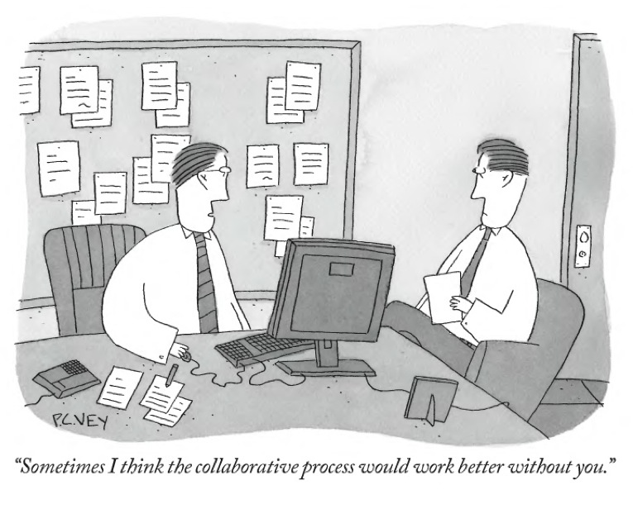
We’ve All Been There: Common Hurdles
Measuring Success (and identifying areas for improvement)
Dealing with Transitions
Building Credibility in Local Communities
Collaborating Before, During, and After the NEPA Process

Slide 9
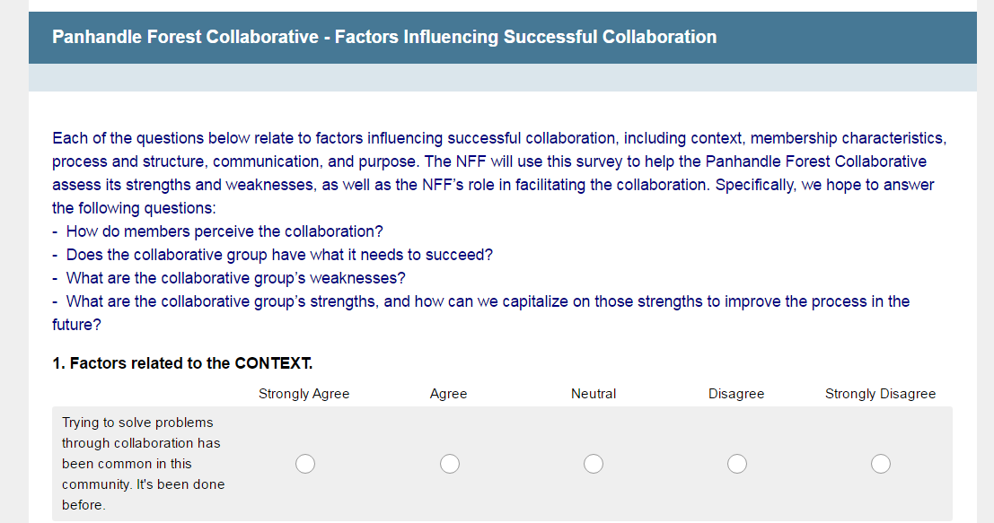
Measuring Success (and identifying areas for improvement)
Protecting America’s Backyard

Slide 10
Measuring Success (and identifying areas for improvement)
Protecting America’s Backyard

Slide 11
Measuring Success (and identifying areas for improvement)
Factors Related to CONTEXT.
Protecting America’s Backyard

Slide 12
Dealing with Transitions
Protecting America’s Backyard
Notes:
This fat cat is struggling to make it through a small door. Maybe he was stressing out so much after you told him about an upcoming change that it made him splurge on cake and ice-cream. But, now, after you’ve led him to the doorstep, let him examine the measurements of the door, assured him that he could make it through and cheered him on as he made his first attempt, he did it! The bottom line is that people are flexible (even fat cats) and no one wants to be left behind. If you prepare for and assume change, you’ll make sure that everyone’s behind you, no matter how hard it is to get through that small door.

Slide 13
Dealing with Transitions
Protecting America’s Backyard
Notes:
This fat cat is struggling to make it through a small door. Maybe he was stressing out so much after you told him about an upcoming change that it made him splurge on cake and ice-cream. But, now, after you’ve led him to the doorstep, let him examine the measurements of the door, assured him that he could make it through and cheered him on as he made his first attempt, he did it! The bottom line is that people are flexible (even fat cats) and no one wants to be left behind. If you prepare for and assume change, you’ll make sure that everyone’s behind you, no matter how hard it is to get through that small door.

Slide 14
Dealing with Transitions
EXAMPLE:
Protecting America’s Backyard
Notes:
This fat cat is struggling to make it through a small door. Maybe he was stressing out so much after you told him about an upcoming change that it made him splurge on cake and ice-cream. But, now, after you’ve led him to the doorstep, let him examine the measurements of the door, assured him that he could make it through and cheered him on as he made his first attempt, he did it! The bottom line is that people are flexible (even fat cats) and no one wants to be left behind. If you prepare for and assume change, you’ll make sure that everyone’s behind you, no matter how hard it is to get through that small door.

Slide 15
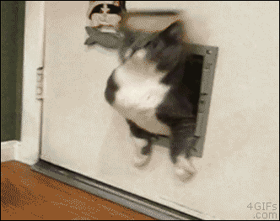
Dealing with Transitions
Protecting America’s Backyard
Notes:
This fat cat is struggling to make it through a small door. Maybe he was stressing out so much after you told him about an upcoming change that it made him splurge on cake and ice-cream. But, now, after you’ve led him to the doorstep, let him examine the measurements of the door, assured him that he could make it through and cheered him on as he made his first attempt, he did it! The bottom line is that people are flexible (even fat cats) and no one wants to be left behind. If you prepare for and assume change, you’ll make sure that everyone’s behind you, no matter how hard it is to get through that small door.

Slide 16
Building Credibility in Local Communities
Protecting America’s Backyard

Slide 17
Building Credibility in Local Communities
Protecting America’s Backyard

Slide 18
Collaborating Before, During, and After the NEPA Process
Protecting America’s Backyard

Slide 19
We can also help with technology, communications, and distance-based learning!
Has your group developed a resource, strategy, or tool that we could share?
What would most help you or your group?
Emily Olsen
Conservation Connect Associate
National Forest Foundation
Missoula, MT
406.830.3369
eolsen@nationalforests.org
Protecting America’s Backyard

