Slide 1
THE CASE FOR RECONSIDERATION OF INFORMATION FURNISHED
BY THE NANTAHALA/PISGAH STAKEHOLDERS FORUM
MAP COMMITTEE
Jim Gray
Ruffed Grouse Society
Notes:
This presentation differs from the draft that Michelle and Sheryl saw at the FWCC meeting earlier this week
The previous version did not fully convey my message
Do not misunderstand my requests in this presentation. I still fully support the counties who have passed resolutions
I ask the FS to fully consider the counties requests

Slide 2
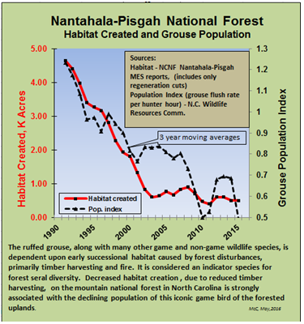
(Mac McConnell)
Notes:
Credit to Mac McConnell for these graphs
Red line is Habitat Created – drastic declines since 1990, leveling out in 2003
Grouse population declines in parallel with the decline in creation of habitat
Fractional increase in grouse population post 2010 happens with wildlife populations
Robust “WHAMA’s” are needed

Slide 3
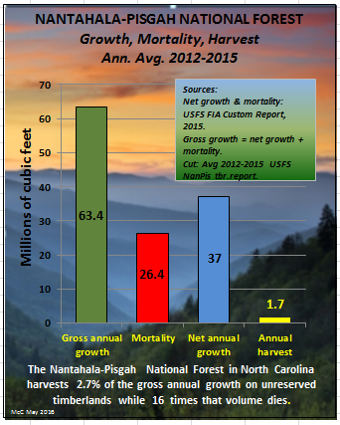
(Mac McConnell)
Notes:
Can the Nantahala/Pisgah support more timber harvest?
Trees are dying at a rate far in excess of what is being harvested
Dale Remington said basically the same thing as shown on this slide

Slide 4
WILDLIFE CONSIDERATIONS:
Managed Habitat is Low
Wildlife Abundance Declining For Many Years
Possible Results of Continued Grouse Decline:
  Reduction of Hunting Season/Bag Limit
  Listing by USFWS as Species of Concern
  (or other classification)
  Elimination as Game Bird
  Who Will Be Responsible?
Increasing “Natural Areas” Decreases Ideal Habitat
Are Increased “Natural Areas” Justified?
Notes:
Ruffed Grouse are at the Southern extreme of their range – with small populations in northern Georgia and South Carolina
USFWS is sensitive to species contracting from their historical range
Continued decline in grouse population could lead to elimination of grouse as a game bird
USFS will bear a great deal of responsibility if grouse are severely restricted due to population decline related to loss of habitat.

Slide 5
EXAMPLES OF AREAS INCLUDED IN “NAP” MAP LAYER
SILER BALD
TELLICO
CHUNKY GAL
COWEE MOUNTAIN/BIG LAUREL
Notes:
These are EXAMPLES of areas that are included in the NAP layer and 3 are on the list as potential Wilderness Areas
This is NOT my entire request at all – only examples of what is contained in the NAP layers across the entire forest
These are EXAMPLES of areas I know well. FSU example
I will show why these areas should be WHAMA not NAP

Slide 6
SILER BALD CHARACTERISTICS
23+ Miles Linear Wildlife Openings
12 Maintained Wildlife Plots
11 Timber Cuts < 20 Years Old
3 Approved Burn Units
3 Current Timber Sale Units (TBV)
Appalachian Trail Corridor
Prime Ruffed Grouse Habitat
Popular Grouse/Deer Hunting Area
Golden Winged Warbler Priority Area
Potential Bald Restoration Area
Audible Gunshots from Dirty John Gun Range (northern section)
Audible Traffic Noise from US 64
(southern section)

Slide 7
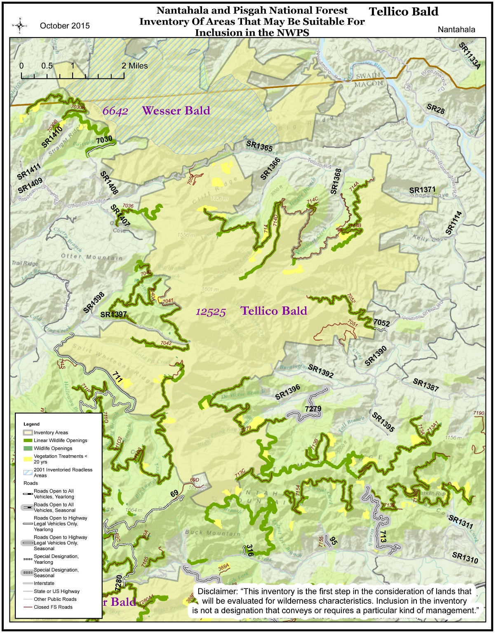
TELLICO BALD CHARACTERISTICS
10.7 (28.6) Miles Linear Wildlife Openings
3 Acres Maintained Wildlife Plots
14 Timber Cuts < 20 Years Old
5 Adjacent Timber Cuts < 20 Years Old
Appalachian Trail Corridor
Ruffed Grouse Research Project Area
Golden Winged Warbler Priority Area
Grouse/Deer Focal Area
Popular Ruffed Grouse Hunting Area
21 FS Roads Within/Bordering Area
Potential to Restore 5 Balds

Slide 8
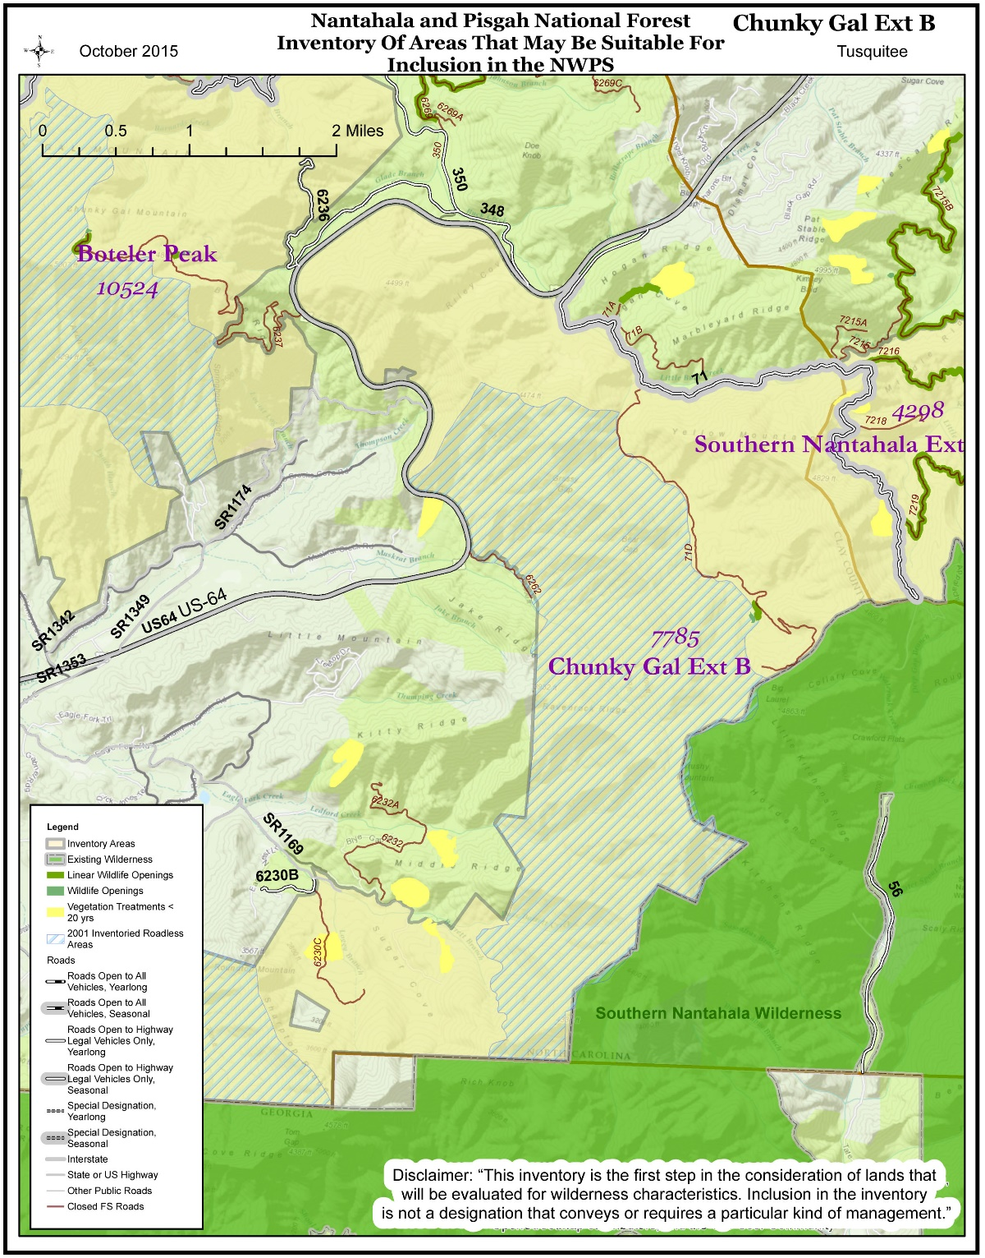
CHUNKY GAL CHARACTERISTICS
4.88 Miles Linear Wildlife Openings
2 Acres Maintained Wildlife Plots
Excellent High Elevation ESH Potential
Golden Winged Warbler Priority Area
Prime Ruffed Grouse Habitat
Popular Ruffed Grouse Hunting Area
Audible Traffic Noise from US 64
(NW section)

Slide 9
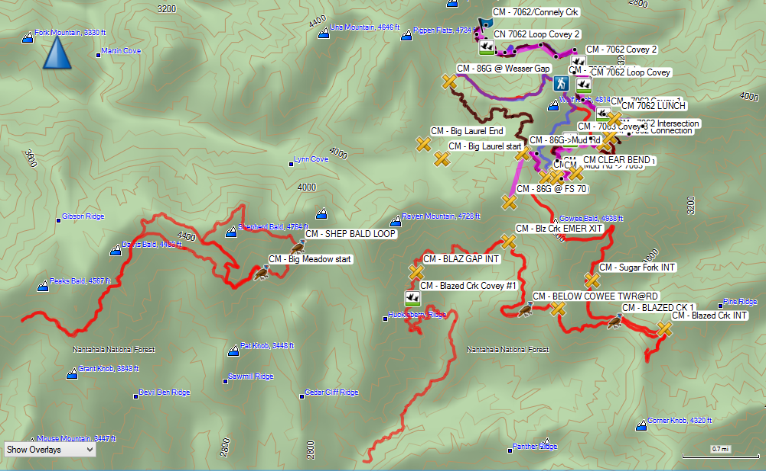
COWEE/BIG LAUREL CHARACTERISTICS
15+ Timber Cuts < 18 Years Old
41 Miles Linear Wildlife Openings
7.31 Acres Wildlife Plots
4 USFS Burn Units
Excellent High Elevation ESH Potential
Golden Winged Warbler Priority Area
Prime Ruffed Grouse Habitat & Potential
Popular Ruffed Grouse Hunting Area
Ruffed Grouse Layer Not Complete

Slide 10
CONSIDERATIONS & RECOMMENDATIONS
Reconsider “NAP” Map Layer:
  Map Committee Not Representative of Forum
  Forum Never Reviewed Details in Maps
  Forum Never Voted On or Approved Maps
  “NAP” Layer Not Scientifically Justified
  Treat “NAP” Layer as Organization Input Only
Recommended Next Steps:
  Get Detailed Map Input Across Entire Forest
  High Priority to Wildlife Habitat Creation (“WHAMA’s”, Front/Mid Country,
  Half Mile Border on Linear Wildlife Openings)
  Strong Consideration for Local Economies
  Listen to the Counties & Citizens
  Maintain Access – Habitat Management, Hunting, Hiking, Timber, Foraging!
Notes:
Map Committee: Hugh Irwin (TWS), Gordon Warburton (NCWRC), Greg Peters (NWTF – South Carolina), Josh Kelly (Mountain True)
With significant, highly skilled support from Carly Lewis
Did I miss anybody?
Where is anybody from Timber, Hunting, Hiking, Biking, Fishing, Horse Riding, etc?

